Slide 1
Probability

Slide 2
Basic Terminologies
Sample Space
The set of all possible outcomes of a statistical experiment is called the sample space and is represented by the symbol S.
Sample Point
Each outcome in a sample space is called an element or a member of the sample space, or simply a sample point.

Slide 3
Basic Terminologies
Example of Sample Space
The sample space S, of possible outcomes when a coin is flipped can be expressed as:
S = { H , T }
Where H and T correspond to heads and tails, respectively.

Slide 4
Basic Terminologies
Example 2.1 (Sample Space)
Consider the experiment of tossing a die. If we are interested in the number that shows on the top face, the sample space will be:
S1 = {1, 2, 3, 4, 5, 6}.
If we are interested only in whether the number is even or odd, the sample space will be:
S2 = {even, odd}.

Slide 5
Basic Terminologies
Tree diagram of events
In some experiments, it is helpful to list the elements of the sample space systematically by means of a tree diagram. Reference Example 2.2
Sets can be defined by
List down the all elements (if possible) or a series of elements that define pattern.
For example:
A={1 , 2 , 2 , 3 , 3 , 3 , … , 9} = duplication not allowed ={1,2,3,…9}
B={a, e, i, o, u}
Statement or rule method (Set formal method)
For example:
S = {(x, y) | x² + y² ≤ 4}
Q = {x | x is an odd number}

Slide 6
Basic Terminologies
Example 2.2
An experiment consists of flipping a coin and then flipping it a second time if a head occurs.
If a tail occurs on the first flip, then a die is tossed once.
To list the elements of the sample space providing the most information, we construct the tree diagram of Figure 2.1.
By proceeding along all paths, we see that the sample space is:
S = {HH, HT, T1, T2, T3, T4, T5, T6}

Slide 7
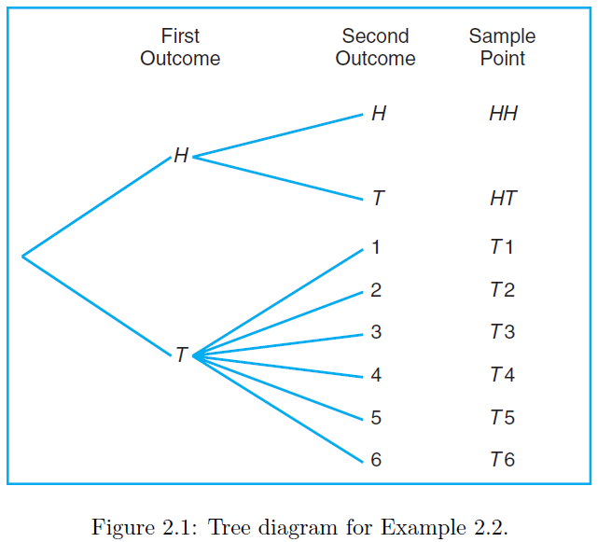
Basic Terminologies

Slide 8
Basic Terminologies
Example 2.3
Suppose that three items are selected at random from a manufacturing process.
Each item is inspected and classified defective, D, or non-defective, N.
To list the elements of the sample space providing the most information, we construct the tree diagram of Figure 2.2.
We see that the sample space is:
S = {DDD, DDN, DND, DNN, NDD, NDN, NND, NNN}.

Slide 9
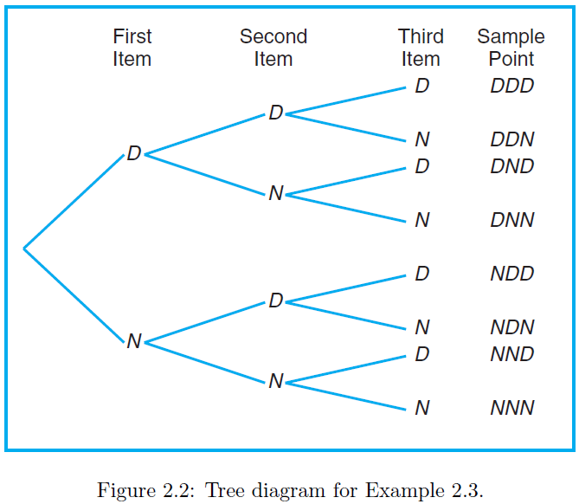
Basic Terminologies

Slide 10
Events and their types
Event
An event is a subset of a sample space.
Example 2.4:
Given the sample space S = {t | t ≥ 0}, where t is the life in years of a certain electronic component, then the event A that the component fails before the end of the fifth year is the subset A = {t | 0 ≤ t < 5}.

Slide 11
Events and their types
Simple Events
Composite / Compound Event
Sure Events
Impossible Event
Equally likely event
Complementary Events
Independent and Dependent Events
Exhausted Event
Mutually Exclusive Events
Compatible Event

Slide 12
Events and their types
Simple Events
Any event consisting of a single point of the sample space is known as a simple event in probability.
It is an event that consists of exactly one outcome.
For example, if S = {56 , 78 , 96 , 54 , 89} and E = {78} then E is a simple event.

Slide 13
Events and their types
Composite / Compound Events
If any event consists of more than one single point of the sample space then such an event is called a compound event.
It involves combining two or more events together and finding the probability of such a combination of events.
Example-1: Considering the same example again, if S = {56 ,78 ,96 ,54 ,89}, E1 = {56 ,54}, E2 = {78 ,56 ,89} then, E1 and E2 represent two compound events.
Example-2: When we throw a die, the possibility of an even number appearing is a compound event, as there is more than one possibility, there are three possibilities i.e. E = {2,4,6}.

Slide 14
Events and their types
Sure Events
If the probability of occurrence of an event is 1, it is called a sure event.
Sample space S is a sure event
Impossible Event
If the probability of occurrence of an event is 0, such an event is called an impossible event.
In other words, the empty set ϕ is an impossible event.

Slide 15
Events and their types
Equally Likely Event
Each outcome of an experiment occurs with equal probability.
For example, if you toss a fair, six-sided die, each face (1,2,3,4,5,6) is as likely to occur as any other face.
Also, if you toss a fair coin, a Head (H) and a Tail (T) are equally likely to occur.

Slide 16
Events and their types
Complementary Event
Two events are said to be complementary when one event occurs if and only if the other does not.
The probabilities of two complimentary events add up to 1.
For example, rolling a 5 or greater and rolling a 4 or less on a die are complementary events, because a roll is 5 or greater if and only if it is not 4 or less.
If A is an event, A’ will represent complement of A.

Slide 17
Events and their types
Independent Events
If the occurrence of any event is completely unaffected by the occurrence of any other event, such events are known as an independent event.
Example: For example, if we flip a coin in the air and get the outcome as Head, then again if we flip the coin but this time we get the outcome as Tail. In both cases, the occurrence of both events is independent of each other.

Slide 18
Events and their types
Dependent Events
The events which are affected by other events are known as dependent events.
Examples:
Robbing a bank and going to jail.
Not paying your power bill on time and having your power cut off.
Boarding a plane first and finding a good seat.
Parking illegally and getting a parking ticket.
Driving a car and getting in a traffic accident.

Slide 19
Events and their types
Mutually Exclusive
Two or more events that cannot happen simultaneously.
It is commonly used to describe a situation where the occurrence of one outcome supersedes the other.
Two events A and B are mutually exclusive, or disjoint, if A∩B=φ, that is, if A and B have no elements in common.
Examples:
You can't run backwards and forwards at the same time. The events “running forward” and “running backwards” are mutually exclusive.
Rolling a die or tossing a coin can also give you this type of event.

Slide 20
Example: Mutually Exclusive
A cable television company offers programs on eight different channels, three of which are affiliated with ABC, two with NBC, and one with CBS. The other two are an educational channel and the ESPN sports channel.
Suppose that a person subscribing to this service turns on a television set without first selecting the channel.
Let A be the event that the program belongs to the NBC network.
Let B the event that it belongs to the CBS network.
Since a television program cannot belong to more than one network, the events A and B have no programs in common.
Therefore, the intersection A ∩ B contains no programs, and consequently the events A and B are mutually exclusive.

Slide 21
Events and their types
Exhausted Event
When a sample space is distributed down into some mutually exclusive events such that their union forms the sample space itself, then such events are called exhaustive events.
-or-
When two or more events form the sample space collectively than it is known as collectively exhaustive events.

Slide 22
Events and their types
Compatible Event
Compatible events are events that can occur at the same time. Incompatible events cannot occur at the same time. ... If, however, event A is to roll an even number and event B is to roll a number larger than 3, then events A and B are compatible, because it is possible for both events to occur at the same time.

Slide 23
Intersection of two events
The intersection of two events A and B, denoted by the symbol A ∩ B, is the event containing all elements that are common to A and B.
Example:
Let E be the event that a person selected at random in a classroom is majoring in engineering.
Let F be the event that the person is female.
Then E∩F is the event of all female engineering students in the classroom.

Slide 24
Book Exercises
2.10 → 2.20
2.12 and 2.18 not included

Slide 25
Union of two events
The union of the two events A and B, denoted by the symbol A∪B, is the event containing all the elements that belong to A or B or both
Example:
Let P be the event that an employee selected at random from an oil drilling company smokes cigarettes.
Let Q be the event that the employee selected drinks alcoholic beverages.
Then the event P ∪ Q is the set of all employees who either drink or smoke or do both.

Slide 26
Union of two events
Example:
If M = {x | 3 < x < 9} and N = {y | 5 < y < 12}, then
Then M ∪ N = {z | 3 < z < 12}.

Slide 27
Counting Sample Points
Rule 2.1
If an operation can be performed in n₁ ways, and if for each of these ways a second operation can be performed in n₂ ways, then the two operations can be performed together in n₁n₂ ways.

Slide 28
Counting Sample Points
Example 2.13
How many sample points are there in the sample space when a pair of dice is thrown once?
Solution
The first die can land face-up in any one of n1 = 6 ways.
For each of these 6 ways, the second die can also land face-up in n2 = 6 ways.
Therefore, the pair of dice can land in n1n2 = (6)(6) = 36 possible ways.

Slide 29
Counting Sample Points
Example 2.15:
If a 22-member club needs to elect a chair and a treasurer, how many different ways can these two to be elected?
Solution
For the chair position, there are 22 total possibilities.
If one member has already been selected as chair then there are 21 possibilities left to elect the treasurer.
Using the multiplication rule, we obtain:
n1 × n2 = 22 × 21 = 462 different ways.

Slide 30
Counting Sample Points
Rule 2.2:
If an operation can be performed in n₁ ways, and if for each of these a second operation can be performed in n₂ ways, and for each of the first two a third operation can be performed in n₃ ways, and so forth, then the sequence of k operations can be performed in
n₁xn₂xn₃ · · · n_{k} ways.

Slide 31
Counting Sample Points
Example 2.16:
Sam is going to assemble a computer by himself. He has the choice of chips from two brands, a hard drive from four, memory from three, and an accessory bundle from five local stores. How many different ways can Sam order the parts?
Solution :
Since n₁ = 2, n₂ = 4, n₃ = 3, and n₄ = 5,
there are n₁ × n₂ × n₃ × n₄ = 2× 4 × 3 × 5 = 120 different ways to order the parts.

Slide 32
Counting Sample Points
Example:
Find the number of four digit even numbers that can be formed using the digits 1, 2, 3, 4, 5 if no digit is repeated how many of those will be even?
Solution:
We have total 5 numbers that can be used but unrepeated.
Let 4-digit even number is ABCD. Moving from right to left digit by digit.
For D we have two possibilities i.e. {2,4}
For C we have 4 possibilities as 1 digit is consumed by D.
For B we have 3 possibilities as 2 digits have been consumed by C and D.
For A we have 2 possibilities as 3 digits have been consumed by BCD.
4-digit even number = ABCD = (2)(3)(4)(2) = 48
Notes:
S={1, 2, 3, 4, 5}
a) Even/Odd Repeated
5x5x5x5
b) Even/Odd Not repeated
5x4x3x2
c) Even Repeated
5x5x5x2
d) Odd, repeated
(5)(5)(5)(3)
e) Odd non-repeated
(2)(3)(4)(3)

Slide 33
Counting Sample Points
Example:
Find the number of four digit even numbers that can be formed using the digits 1, 2, 3, 4, 5 if digits can be repeated. How many of those will be even?
Solution:
We have total 5 numbers that can be used with repetition.
Let 4-digit even number is ABCD. Moving from right to left digit by digit.
For D we have two possibilities i.e. {2,4}
For C we have 5 possibilities.
For B we have 5 possibilities.
For A we have 5 possibilities.
4-digit even number = ABCD = (5)(5)(5)(2) = 250

Slide 34
Permutation
Definition 2.7
A permutation is an arrangement of all or part of a set of objects.
Example:
Consider the three letters a, b, and c.
The possible permutations are abc, acb, bac, bca, cab, and cba.
Thus, we see that there are 6 distinct arrangements.
We could arrive at the answer 6 without actually listing the different orders.

Slide 35
Permutation
When the order matters.
There are n₁ = 3 choices for the first position.
No matter which letter is chosen, there are always n₂ = 2 choices for the second position.
No matter which two letters are chosen for the first two positions, there is only n₃ = 1 choice for the last position, giving a total of
n₁n₂n₃ = (3)(2)(1) = 6 permutations
In general, n distinct objects can be arranged in
n(n − 1)(n − 2) · · · (3)(2)(1) ways.

Slide 36
Factorial
Definition 2.8
For any non-negative integer n, n!, called “n factorial,” is defined as
n! = n(n − 1) · · · (2)(1)
with special case 0! = 1.
Theorem 2.1
The number of permutations of n objects is n!

Slide 37

Permutation
Theorem 2.2
The number of permutations of n distinct objects taken r at a time is:
_{n}$Pr=\frac{n!}{\left(n−r\right)!}$

Slide 38
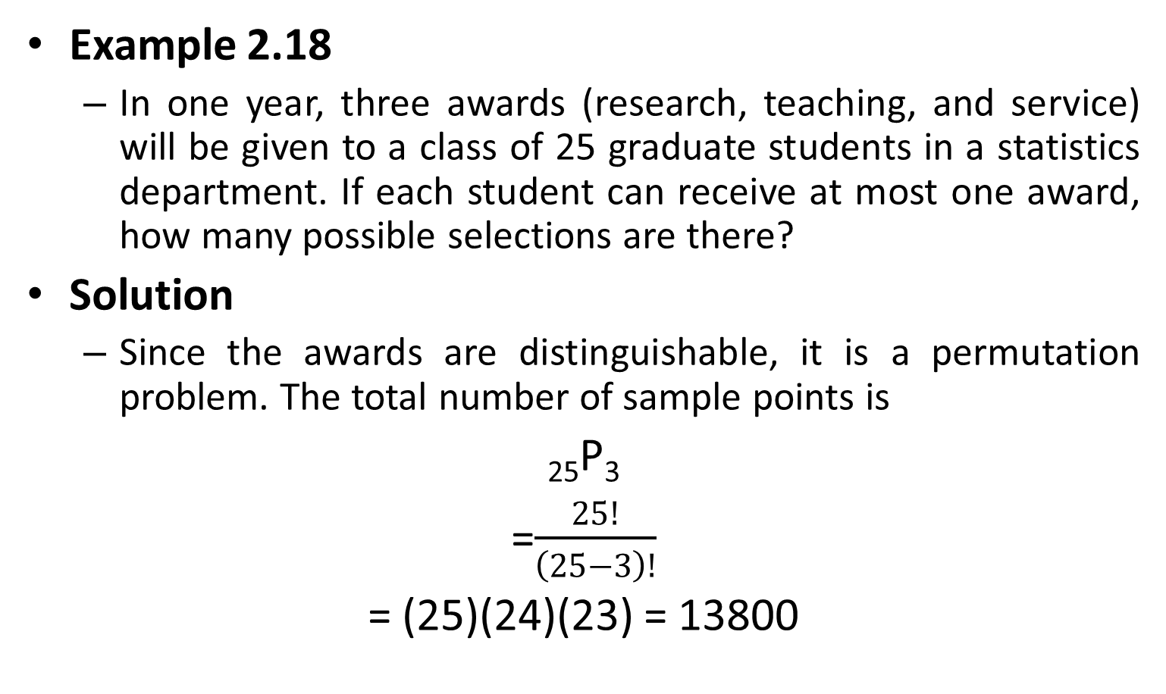
Permutation
Example 2.18
In one year, three awards (research, teaching, and service) will be given to a class of 25 graduate students in a statistics department. If each student can receive at most one award, how many possible selections are there?
Solution
Since the awards are distinguishable, it is a permutation problem. The total number of sample points is
₂₅P₃
=$\frac{25!}{\left(25−3\right)!}$
= (25)(24)(23) = 13800

