Slide 1
Probability

Slide 2
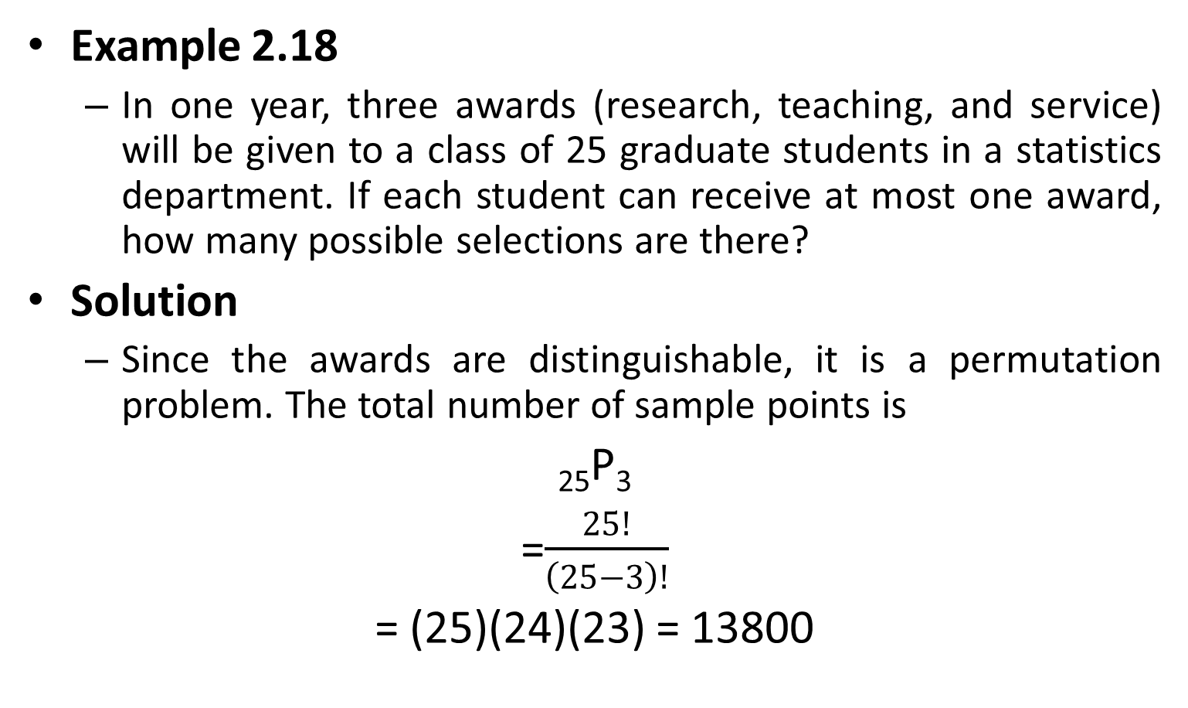
Permutation
Example 2.18
In one year, three awards (research, teaching, and service) will be given to a class of 25 graduate students in a statistics department. If each student can receive at most one award, how many possible selections are there?
Solution
Since the awards are distinguishable, it is a permutation problem. The total number of sample points is
₂₅P₃
=$\frac{25!}{\left(25−3\right)!}$
= (25)(24)(23) = 13800

Slide 3
Permutation
Example 2.19
A president and a treasurer are to be chosen from a student club consisting of 50 people. How many different choices of officers are possible if
There are no restrictions;
A will serve only if he is president;
B and C will serve together or not at all;
D and E will not serve together?

Slide 4
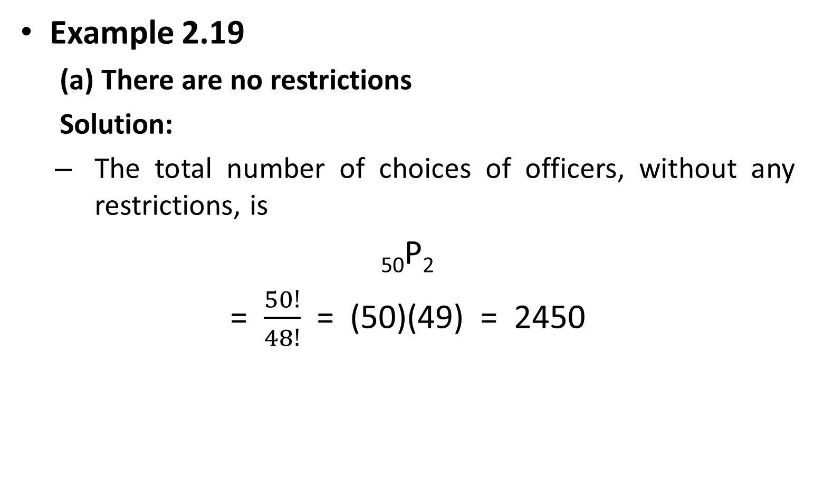
Permutation
Example 2.19
(a) There are no restrictions
Solution:
The total number of choices of officers, without any restrictions, is
₅₀P₂
= $\frac{50!}{48!}$ = (50)(49) = 2450

Slide 5
Permutation
Example 2.19
(b) A will serve only if he is president;
Solution:
Since A will serve only if he is president, we have two situations here:
A is selected as the president.
= (1)(49) = 49
(b) Officers are selected from the remaining 49 people without A.
= ₄₉P₂ = 2352
= 49 + 2352 = 2401

Slide 6
Permutation
Example 2.19
(c) B and C will serve together or not at all;
Solution:
The number of selections when B and C serve together is 2.
The number of selections when both B and C are not chosen is ₄₈P₂ = 2256
Therefore, the total number of choices in this situation is
2 + 2256 = 2258

Slide 7
Permutation
Example 2.19
(d) D and E will not serve together
Solution:
The number of selections when D serves as an officer but not E is (2)(48) = 96
where 2 is the number of positions D can take and 48 is the number of selections of the other officer from the remaining people in the club except E.
The number of selections when E serves as an officer but not D is also (2)(48) = 96
The number of selections when both D and E are not chosen is ₄₈P₂ = 2256
Therefore, the total number of choices is
(2)(96) + 2256 = 2448.

Slide 8
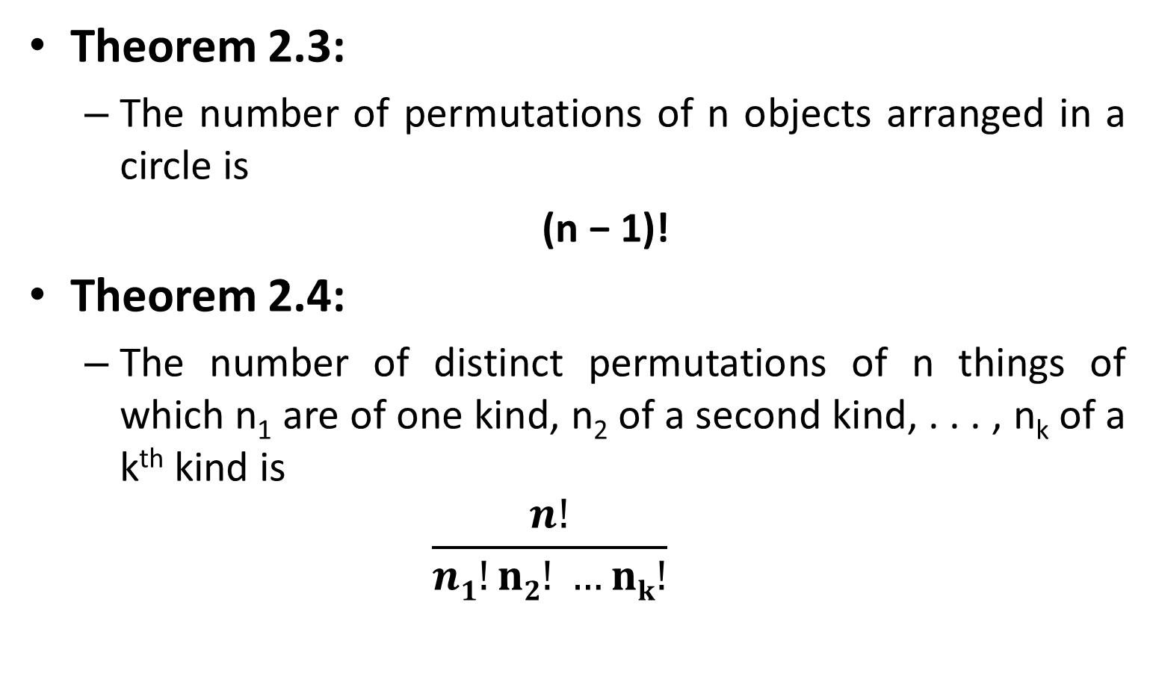
Permutation
Theorem 2.3:
The number of permutations of n objects arranged in a circle is
(n − 1)!
Theorem 2.4:
The number of distinct permutations of n things of which n₁ are of one kind, n₂ of a second kind, . . . , n_{k} of a k^{th} kind is
$$\frac{n!}{n1!n2! …nk!}$$

Slide 9
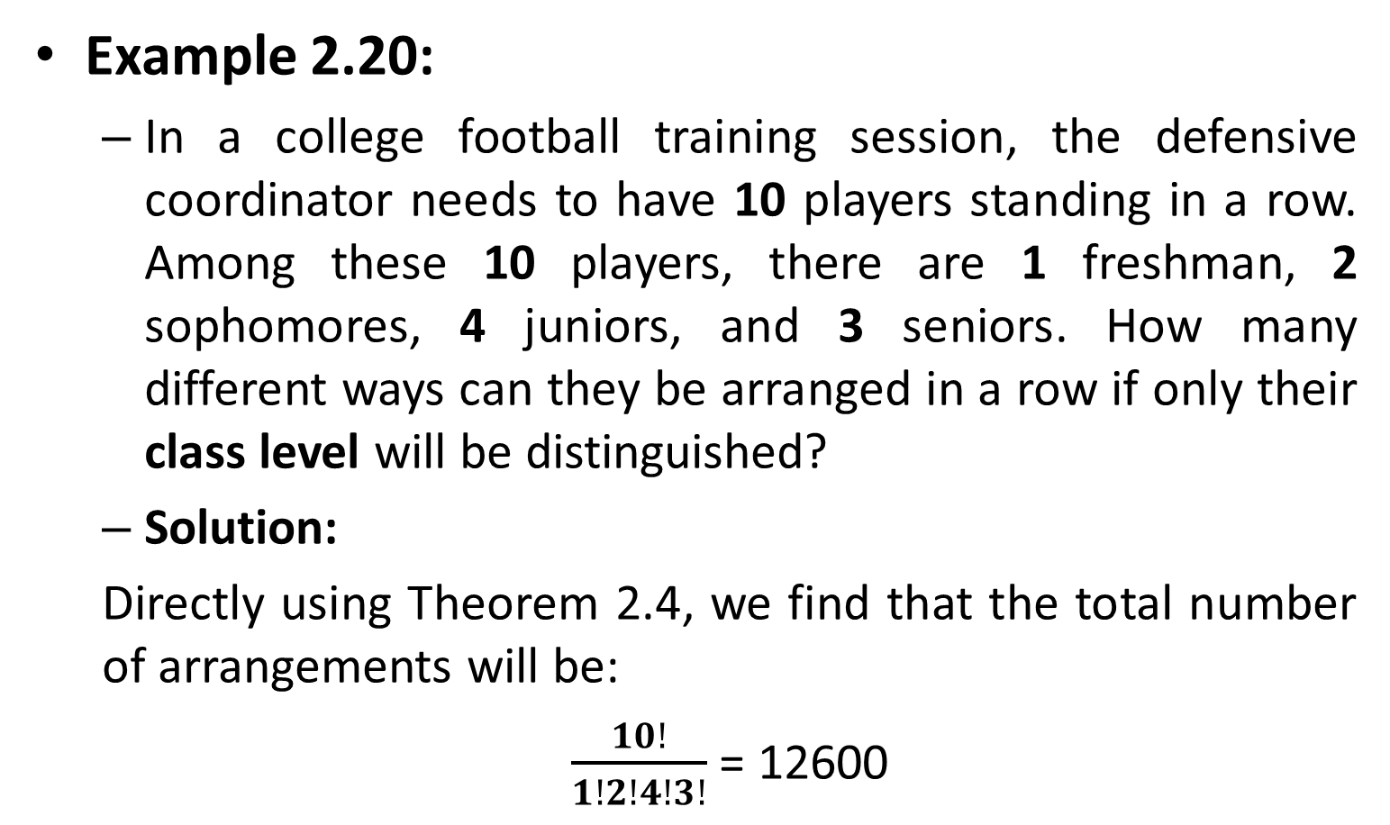
Permutation
Example 2.20:
In a college football training session, the defensive coordinator needs to have 10 players standing in a row. Among these 10 players, there are 1 freshman, 2 sophomores, 4 juniors, and 3 seniors. How many different ways can they be arranged in a row if only their class level will be distinguished?
Solution:
Directly using Theorem 2.4, we find that the total number of arrangements will be:
$\frac{10!}{1!2!4!3!}$ = 12600

Slide 10
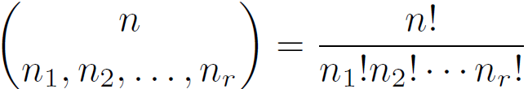
Permutation
Theorem 2.5:
The number of ways of partitioning a set of n objects into r cells with n₁ elements in the first cell, n₂ elements in the second, and so forth, is:
Where n₁+n₂…n_{r}=n

Slide 11
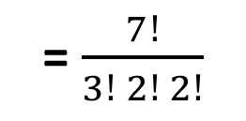

Permutation
Example 2.21:
In how many ways can 7 graduate students be assigned to 1 triple and 2 double hotel rooms during a conference?
Solution
= 210
=$\left(\begin{matrix}7 \\ 3, 2, 2\end{matrix}\right)$
= $\frac{7!}{3! 2! 2!}$

Slide 12
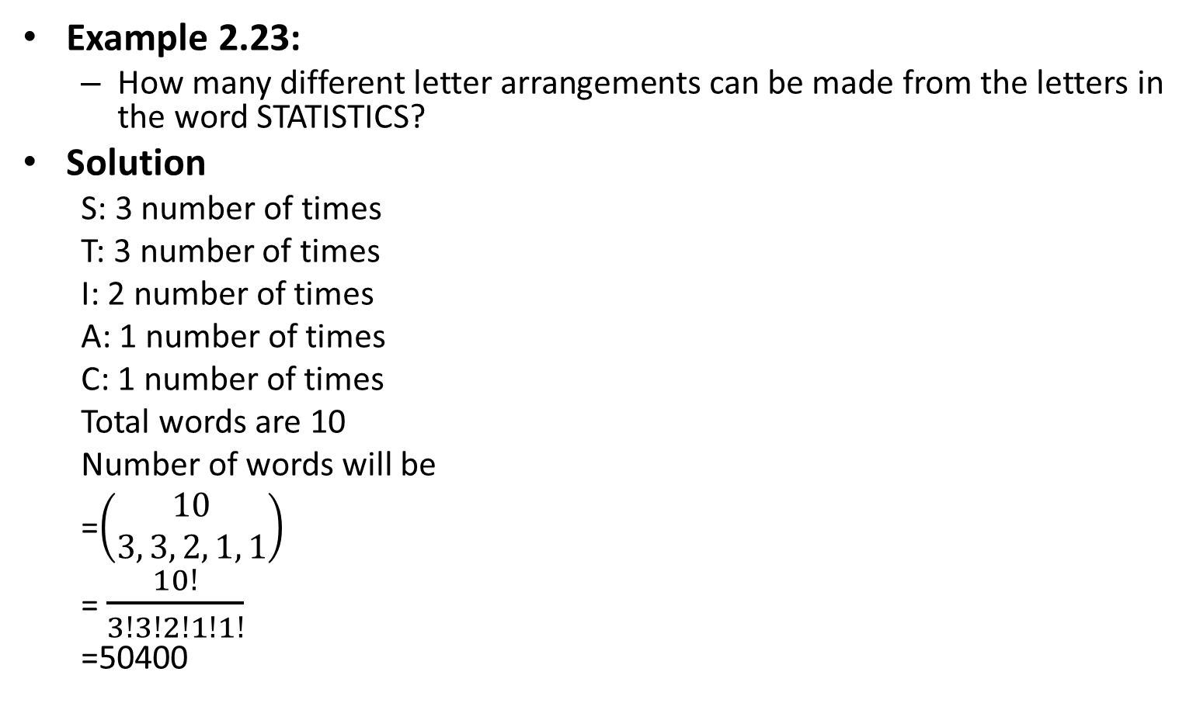
Permutation
Example 2.23:
How many different letter arrangements can be made from the letters in the word STATISTICS?
Solution
S: 3 number of times
T: 3 number of times
I: 2 number of times
A: 1 number of times
C: 1 number of times
Total words are 10
Number of words will be
=$\left(\begin{matrix}10 \\ 3, 3, 2, 1, 1\end{matrix}\right)$
= $\frac{10!}{3!3!2!1!1!}$
=50400

Slide 13
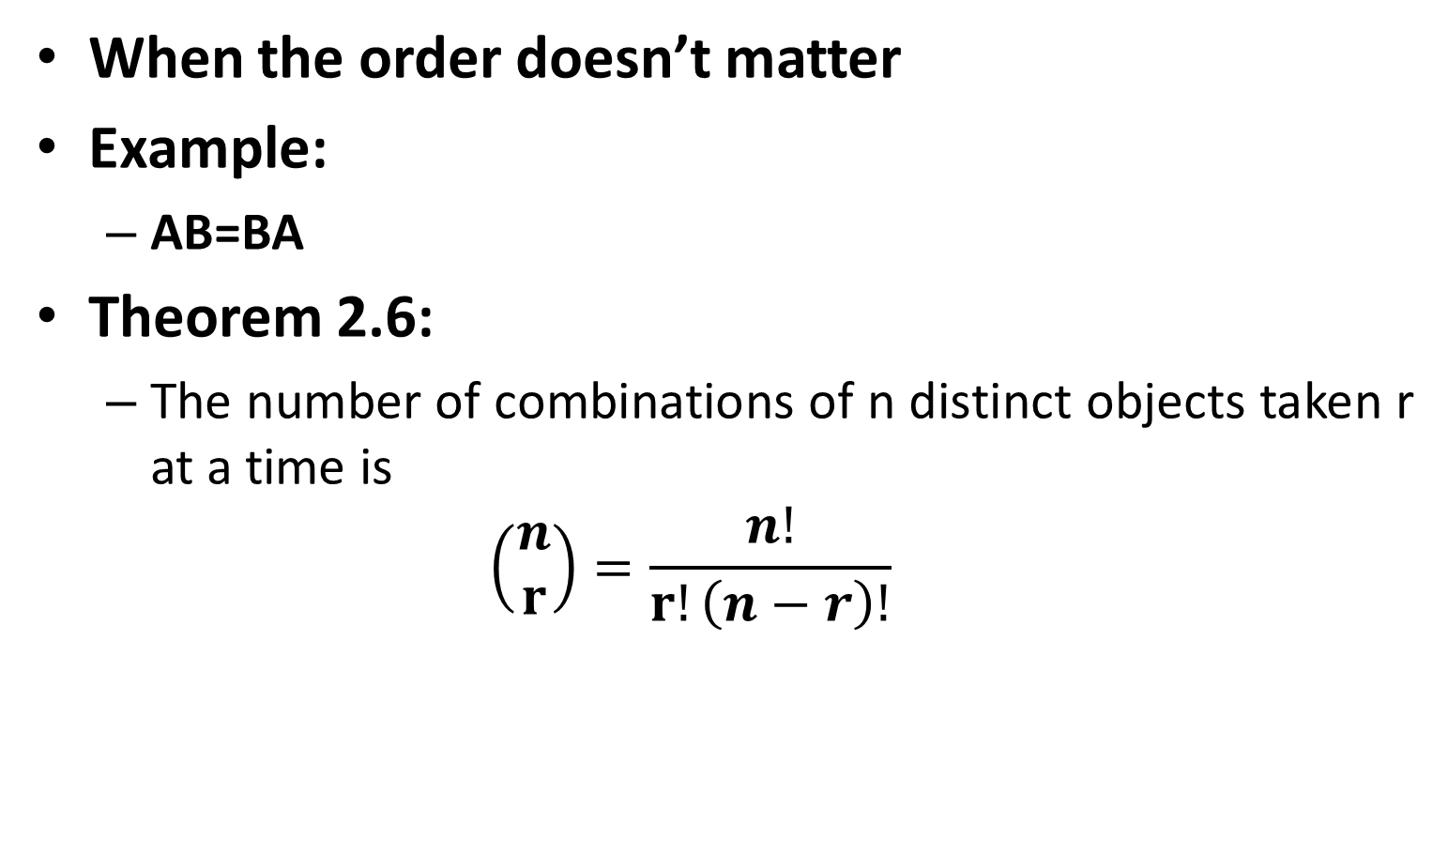
Combinations
When the order doesn’t matter
Example:
AB=BA
Theorem 2.6:
The number of combinations of n distinct objects taken r at a time is
$$\left(\begin{matrix}n \\ r\end{matrix}\right)=\frac{n!}{r!\left(n−r\right)!}$$

Slide 14
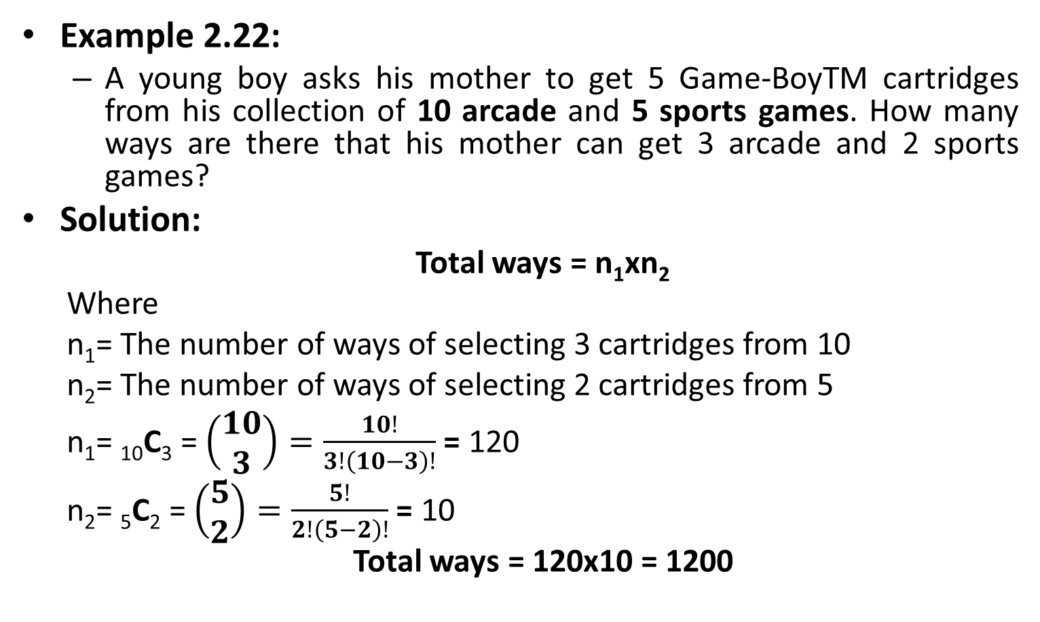
Combinations
Example 2.22:
A young boy asks his mother to get 5 Game-BoyTM cartridges from his collection of 10 arcade and 5 sports games. How many ways are there that his mother can get 3 arcade and 2 sports games?
Solution:
Total ways = n₁xn₂
Where
n₁= The number of ways of selecting 3 cartridges from 10
n₂= The number of ways of selecting 2 cartridges from 5
n₁= ₁₀C₃ = $\left(\begin{aligned}10 \\ 3\end{aligned}\right)=\frac{10!}{3!\left(10−3\right)!}$ = 120
n₂= ₅C₂ = $\left(\begin{aligned}5 \\ 2\end{aligned}\right)=\frac{5!}{2!\left(5−2\right)!}$ = 10
Total ways = 120x10 = 1200

Slide 15
Permutation vs. Combination
No. of different ways that 3 letters A, B, and C are put on 3 locations:
We will consider order as locations
= (3)(2)(1) = 6 permutations
No of ways that three different letters are put on 3 locations:
Order/location has no importance
= 1 combination
ABC | ACB | One combination, 06 permutations
BAC | BCA
CAB | CBA

Slide 16
Exercises
2.21 to 2.48

Slide 17
Probability of an Event
The probability of an event is the number of favorable outcomes divided by the total number of outcomes possible.
Ranges from 0 to 1 i.e. 0 ≤ P ≤ 1
Probability of sample space is 1. i.e. P(S)=1
Also P(φ)=0

Slide 18
Probability of an Event
Rule 2.3:
If an experiment can result in any one of N different equally likely outcomes, and if exactly n of these outcomes correspond to event A, then the probability of event A is
P(A) = n/N

Slide 19
Probability of an Event
if A1, A2, A3, . . . is a sequence of mutually exclusive events, then
P(A1 ∪ A2 ∪ A3 ∪ ·· ·) = P(A1) + P(A2) + P(A3) + · · ·

Slide 20
Probability of an Event
Example 2.24:
A coin is tossed twice. What is the probability that at least 1 head occurs?
Solution

Slide 21
Probability of an Event
Example 2.25:
A die is loaded in such a way that an even number is twice as likely to occur as an odd number. If E is the event that a number less than 4 occurs on a single toss of the die, find P(E).
Solution

Slide 22
Probability of an Event
Example 2.26:
In Example 2.25, let A be the event that an even number turns up and let B be the event that a number divisible by 3 occurs. Find P(A ∪ B) and P(A ∩ B).
Solution

Slide 23
Probability of an Event
Example 2.27:
A statistics class for engineers consists of 25 industrial, 10 mechanical, 10 electrical, and 8 civil engineering students. If a person is randomly selected by the instructor to answer a question, find the probability that the student chosen is:
(a) an industrial engineering major
(b) a civil engineering or an electrical engineering major.
Solution

Slide 24
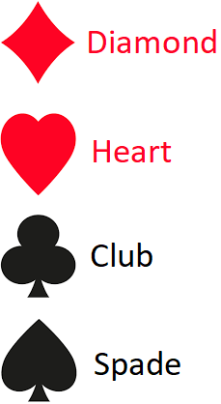
Playing Cards Intro
 | 2 | 3 | 4 | 5 | 6 | 7 | 8 | 9 | 10 | J | Q | K | A | Total
Diamond | 1 | 1 | 1 | 1 | 1 | 1 | 1 | 1 | 1 | 1 | 1 | 1 | 1 | 13
Heart | 1 | 1 | 1 | 1 | 1 | 1 | 1 | 1 | 1 | 1 | 1 | 1 | 1 | 13
Club | 1 | 1 | 1 | 1 | 1 | 1 | 1 | 1 | 1 | 1 | 1 | 1 | 1 | 13
Spade | 1 | 1 | 1 | 1 | 1 | 1 | 1 | 1 | 1 | 1 | 1 | 1 | 1 | 13
Total | 4 | 4 | 4 | 4 | 4 | 4 | 4 | 4 | 4 | 4 | 4 | 4 | 4 | 52

Slide 25
Probability of an Event
Example 2.28:
In a poker hand consisting of 5 cards, find the probability of holding 2 aces and 3 jacks.
Solution:

Slide 26
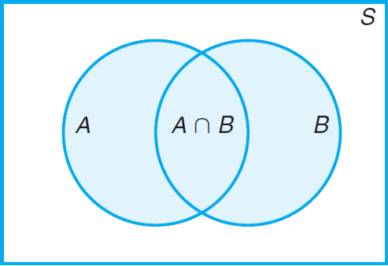
Probability of an Event
Theorem 2.7: Additive rule of probability
If A and B are two events (non-mutually exclusive) , then
P(A ∪ B) = P(A) + P(B) − P(A ∩ B).

Slide 27
Probability of an Event
Theorem 2.8:
For three events A, B, and C,
P(A ∪ B ∪ C)
=P(A)+P(B)+P(C)−P(A∩B)−P(A∩C)−P(B∩C)+P(A∩B∩C)

Slide 28
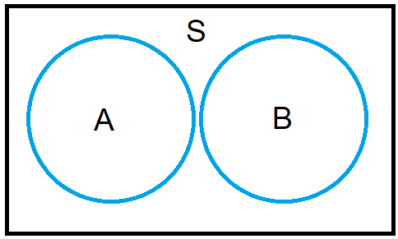
Probability of an Event
Corollary 2.1:
If A and B are mutually exclusive, then
P(A ∪ B) = P(A) + P(B)

Slide 29
Probability of an Event
Corollary 2.2:
If A1, A2, . . . , An are mutually exclusive, then
P(A₁ ∪ A₂ ∪ · · · ∪ A_{n}) = P(A₁) + P(A₂) + · · · + P(A_{n})
Corollary 2.3:
If A₁, A₂, . . . , A_{n} is a partition of sample space S then
P(A₁ ∪ A₂ ∪ · · · ∪ A_{n}) = P(A₁) + P(A₂) + · · · + P(A_{n})
= P(S)
= 1.

Slide 30
Probability of an Event
Example 2.29:
John is going to graduate from an industrial engineering department in a university by the end of the semester. After being interviewed at two companies he likes, he assesses that his probability of getting an offer from company A is 0.8, and his probability of getting an offer from company B is 0.6. If he believes that the probability that he will get offers from both companies is 0.5, what is the probability that he will get at least one offer from these two companies?

Slide 31
Probability of an Event
Example 2.30
What is the probability of getting a total of 7 or 11 when a pair of fair dice is tossed?

Slide 32
Probability of an Event
Example 2.31
If the probabilities are, respectively, 0.09, 0.15, 0.21, and 0.23 that a person purchasing a new automobile will choose the color green, white, red, or blue, what is the probability that a given buyer will purchase a new automobile that comes in one of those colors?

Slide 33
Probability of an Event
Theorem 2.9:
If A and A are complementary events, then
P(A) + P(A’) = 1

Slide 34
Probability of an Event
Example 2.32:
If the probabilities that an automobile mechanic will service 3, 4, 5, 6, 7, or 8 or more cars on any given workday are, respectively, 0.12, 0.19, 0.28, 0.24, 0.10, and 0.07, what is the probability that he will service at least 5 cars on his next day at work?

