Slide 1
Conditional Probability

Slide 2
Independent Events under Conditional Probability
Definition 2.11: Two events A and B are independent if and only if
P(B|A) = P(B)
or
P(A|B) = P(A)

Slide 3
Independent Events under Conditional Probability
Example:
Consider an experiment in which 2 cards are drawn in succession from an ordinary deck, with replacement.
Let A: the first card is an ace ;B: the second card is a spade.
P(B|A) = P(B∩A)/P(A) = (1/52)/(4/52) = 1/4
P(B) = 13/52 = 1/4
Hence the events A and B are said to be independent.

Slide 4
Product / Multiplicative Rule
Theorem 2.10:
If in an experiment the events A and B can both occur, then:
P(A ∩ B) = P(A) P(B|A)
provided P(A) > 0
As Logically, P(A ∩ B) = P(B ∩ A)
So, P(A ∩ B) = P(B ∩ A) = P(B) P(A|B).

Slide 5
Product / Multiplicative Rule
Example 2.36:
Suppose that we have a fuse box containing 20 fuses, of which 5 are defective. If 2 fuses are selected at random and removed from the box in succession without replacing the first, what is the probability that both fuses are defective?
SOLUTION:
Let A: First fuse is defective; B: Second fuse is defective
P(A) = 5/20 = 1/4
P(B|A) = 4/19 (as B→A)
So, P(A∩B) = P(B|A) P(A) = (4/19) (1/4) = (1/19)

Slide 6
Product / Multiplicative Rule
Example 2.37:
One bag contains 4 white balls and 3 black balls, and a second bag contains 3 white balls and 5 black balls. One ball is drawn from the first bag and placed unseen in the second bag. What is the probability that a ball now drawn from the second bag is black?

Slide 7
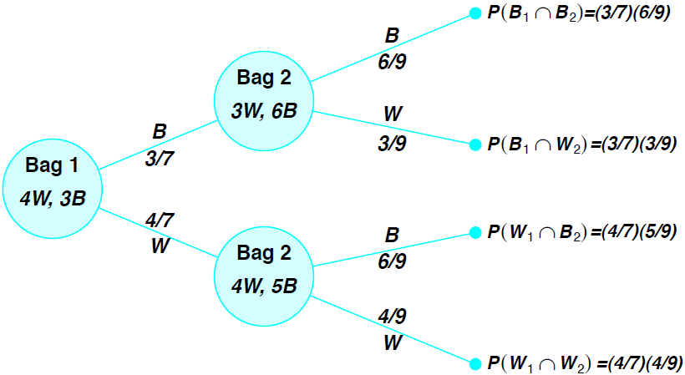
Product / Multiplicative Rule
Example 2.37:

Slide 8
Product / Multiplicative Rule
Theorem 2.11: Two events A and B are independent if and only if
P(A ∩ B) = P(A)P(B).
Therefore, to obtain the probability that two independent events will both occur, we simply find the product of their individual probabilities.

Slide 9
Product / Multiplicative Rule
Example 2.38:
A small town has one fire engine and one ambulance available for emergencies. The probability that the fire engine is available when needed is 0.98, and the probability that the ambulance is available when called is 0.92. In the event of an injury resulting from a burning building, find the probability that both the ambulance and the fire engine will be available, assuming they operate independently.

Slide 10
Product / Multiplicative Rule
Example 2.39:
An electrical system consists of four components as illustrated in Figure 2.9. The system works if components A and B work and either of the components C or D works. The reliability (probability of working) of each component is also shown in Figure 2.9. Find the probability that
(a) the entire system works
(b) the component C does not work, given that the entire system works. Assume that the four components work independently.

Slide 11
Product / Multiplicative Rule
Theorem 2.12:
If, in an experiment, the events A1,A2, . . . , Ak can occur, then:
P(A1 ∩ A2 ∩ ·· · ∩Ak) = P(A1)P(A2|A1)P(A3|A1 ∩ A2) … …P(Ak|A1 ∩ A2 ∩ · · · ∩ Ak−1).
If the events A1,A2, . . . , Ak are independent, then
P(A1 ∩ A2 ∩ ·· · ∩ Ak) = P(A1)P(A2) · · · P(Ak).

Slide 12
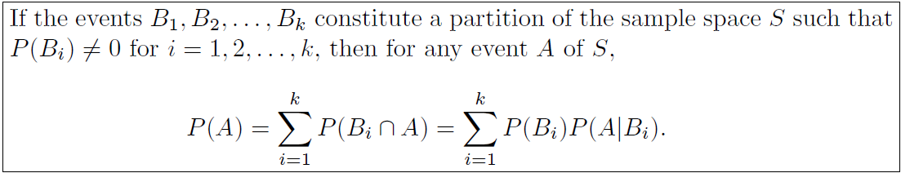
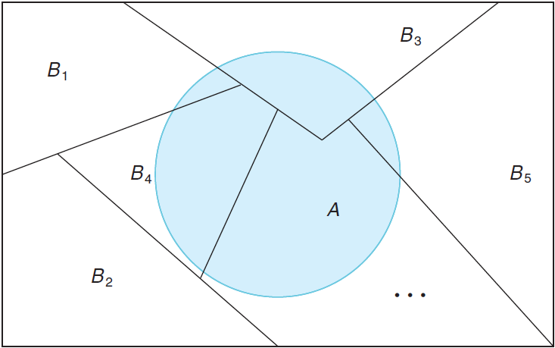
Total Probability
Theorem 2.13:

Slide 13
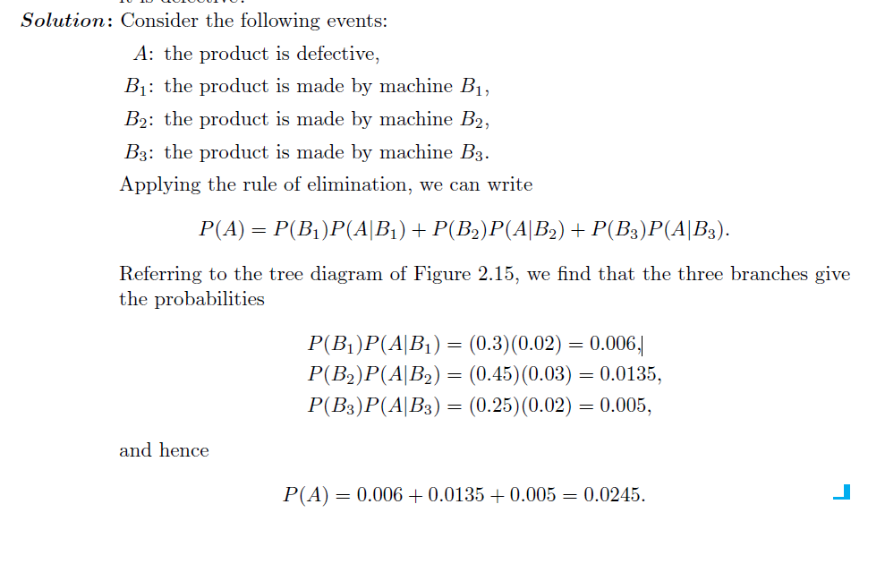
Total Probability
Example 2.41:
In a certain assembly plant, three machines, B₁, B₂, and B₃, make 30%, 45%, and 25%, respectively, of the products. It is known from past experience that 2%, 3%, and 2% of the products made by each machine, respectively, are defective. Now, suppose that a finished product is randomly selected. What is the probability that it is defective?

Slide 14
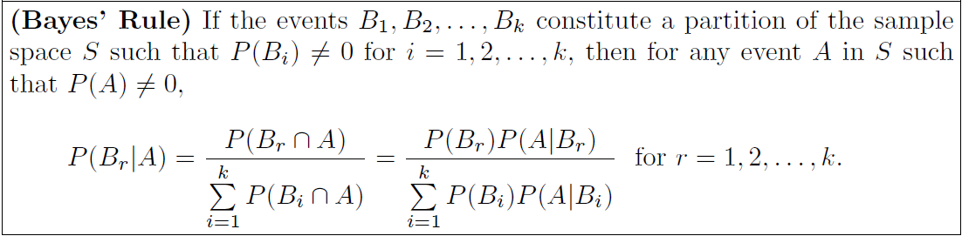
Bayes Rule
Theorem 2.14:

Slide 15
Bayes Rule
Example 2.41:
In a certain assembly plant, three machines, B₁, B₂, and B₃, make 30%, 45%, and 25%, respectively, of the products. It is known from past experience that 2%, 3%, and 2% of the products made by each machine, respectively, are defective. Now, suppose that a finished product is randomly selected. What is the probability that it is defective?
Example 2.42:
With reference to Example 2.41, if a product was chosen randomly and found to be defective, what is the probability that it was made by machine B3?

Slide 16
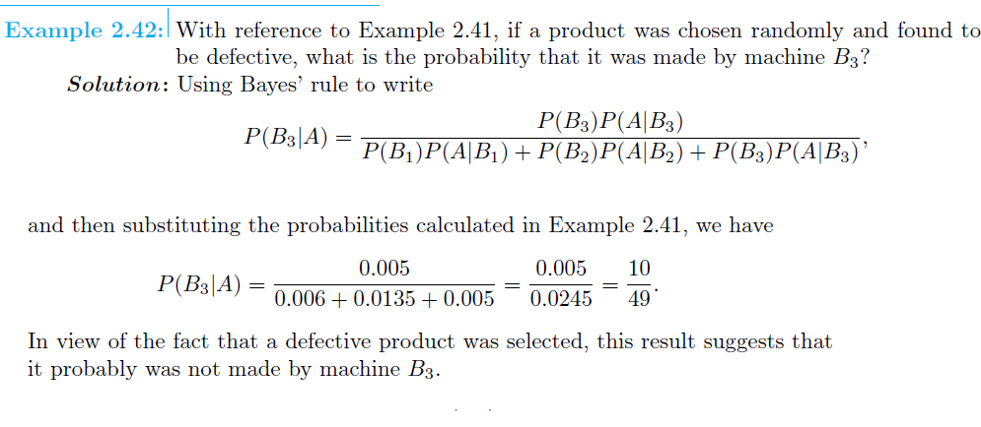

Slide 17
Bayes Rule
Example 2.43:
A manufacturing firm employs three analytical plans for the design and development of a particular product. For cost reasons, all three are used at varying times. In fact, plans 1, 2, and 3 are used for 30%, 20%, and 50% of the products, respectively. The defect rate is different for the three procedures as follows:
P(D|P₁) = 0.01, P(D|P₂) = 0.03, P(D|P₃) = 0.02,
where P(D|P_{j}) is the probability of a defective product, given plan j. If a random product was observed and found to be defective, which plan was most likely used and thus responsible?

