Slide 1
STRESS, HEALTH & COPING
SESSION 12

Slide 2
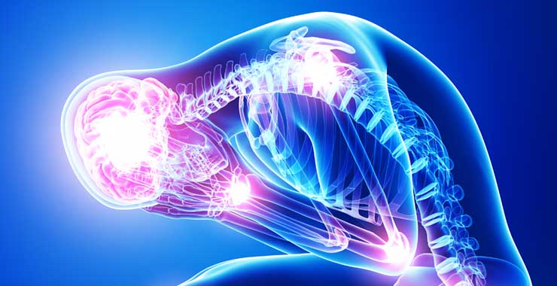

Slide 3
STRESS
Stress is a normal reaction to everyday pressures, but can become unhealthy when it upsets your day-to-day functioning.
Stress involves changes affecting nearly every system of the body, influencing how people feel and behave.
By causing mind–body changes, stress contributes directly to psychological and physiological disorder and disease and affects mental and physical health, reducing quality of life.

Slide 4
Imagine a conversation with a friend who is complaining about her current situation. She tells you, “I have four exams over the next two days, I have to work until midnight, and my car is broken down. I am under a lot of stress.”
When people use the word in everyday conversation, they tend to refer to the environment itself as the stress. For example, the exam is stress.
For psychologists, however, the events or situations are stressors, and our response to those events is stress.

Slide 5
Our bodies are well equipped to handle stress in small doses, but when that stress becomes long-term or chronic, it can have serious effects on your body.

Slide 6
STRESS VS ANXIETY
Stress is a response to an external cause, such as a tight deadline at work or having an argument with a friend, and subsides once the situation has been resolved.
If you’re experiencing prolonged, chronic stress, there are many ways to manage and reduce your symptoms, including physical activity, breathing exercises, adequate sleep and taking time connect with others.
Anxiety is a person’s specific reaction to stress; its origin is internal.
Anxiety is typically characterized by a “persistent feeling of apprehension or dread” in situations that are not actually threatening.
Unlike stress, anxiety persists even after a concern has passed.
In more severe cases, anxiety can escalate into an anxiety disorder, the most common mental health issue

Slide 7
fight-or flight response: the name given to the stress response that prepares the body to meet a physical danger by fighting or fleeing from it
tend-and-befriend response: the name given to the stress response that helps the individual cope by nurturing others and seeking social support

Slide 8
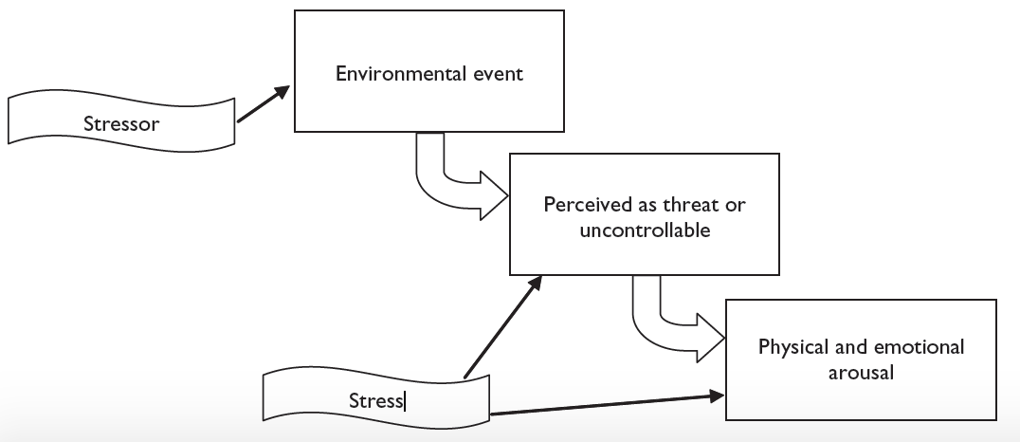

Slide 9
STRESS VS TENSION
Stress and tension are psychologically co-related to each-other, i.e. a stress is a response whereas the tension occurs after the stress.

Slide 10
Psychologist Martin Seligman (1990) has adapted techniques from cognitive therapy, which is an effective treatment for depression, and demonstrated how individuals can use them to change their style of thinking to cope better with stress.
He notes that many people have a tendency to blame themselves when they experience a negative event, and they believe that it will be permanent and affect many aspects of their lives.
For example, if you fail an important exam, you might think that it is all your fault, that you will never be able to pass this or any class, and that you will never be able to have a fulfilling career or social life because of your failure..

Slide 11
Importantly, researchers have discovered that stress reappraisal, reframing part of the stress response to change its meaning, it can have remarkable effects.
For example, Jamieson et al. (2016) taught students who were enrolled in developmental math courses that the stress arousal that they experienced with exams actually helps their performance. Compared to controls who were told to ignore stress feelings, the students who reappraised, reported less test anxiety and they actually did perform better on exams.

Slide 12
Stressors have a major influence upon mood, our sense of well-being, behavior, and health. Acute stress responses in young, healthy individuals may be adaptive and typically do not impose a health burden.
However, if the threat is unremitting, particularly in older or unhealthy individuals, the long-term effects of stressors can damage health.
The relationship between psychosocial stressors and disease is affected by the nature, number, and persistence of the stressors as well as by the individual’s biological vulnerability (i.e., genetics, constitutional factors), psychosocial resources, and learned patterns of coping.
Psychosocial interventions have proven useful for treating stress-related disorders and may influence the course of chronic diseases.

Slide 13
Acute stressors are observable stressful events that are time-limited such as an upcoming test or a family gathering. An acute stressor brings activation to our neuro-endocrine system and makes us ready to act (i.e., “fight or flight”).
Remember that pumped up feeling you got the last time you were getting ready to give a speech in front of the class?
Chronic stressors, in contrast, are persistent demands on you; they are typically open-ended, using up your resources in coping but not having any resolution.

Slide 14
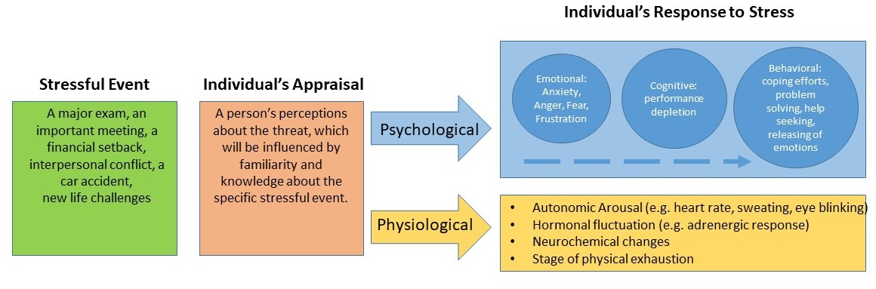

Slide 15
STRESS & HEALTH
Stress affects all systems of the body including the musculoskeletal, respiratory, cardiovascular, endocrine, gastrointestinal, nervous, and reproductive systems.

Slide 16
LIFESTYLE
Lifestyle is a way used by people, groups and nations and is formed in specific geographical, economic, political, cultural and religious text.
Lifestyle is referred to the characteristics of inhabitants of a region in special time and place. It includes day to day behaviors and functions of individuals in job, activities, fun and diet.

Slide 17
According to WHO, 60% of related factors to individual health and quality of life are correlated to lifestyle

Slide 18
LIFESTYLE THAT INFLUENCE HEALTH
Diet and Body Mass Index (BMI): Diet is the greatest factor in lifestyle and has a direct and positive relation with health. Poor diet and its consequences like obesity is the common healthy problem in urban societies. Unhealthy lifestyle can be measured by BMI. Urban lifestyle leads to the nutrition problems like using fast foods and poor foods, increasing problems like cardiovascular.
Exercise: For treating general health problems, the exercise is included in life style. The continuous exercise along with a healthy diet increases the health. Some studies stress on the relation of active life style with happiness.
Sleep: One of the bases of healthy life is the sleep. Sleep cannot be apart from life. Sleep disorders have several social, psychological, economical and healthy consequences. Lifestyle may effect on sleep and sleep has a clear influence on mental and physical health.

Slide 19
Medication abuse: It is a common form of using medication in Iran and it is considered as an unhealthy life style. Unhealthy behaviors in using medication are as followed: self-treatment, sharing medication, using medications without prescription, prescribing too many drugs, prescribing the large number of each drug, unnecessary drugs, bad handwriting in prescription, disregard to the contradictory drugs, disregard to harmful effects of drugs, not explaining the effects of drugs.
Application of modern technologies: Advanced technology facilitates the life of human beings. Misuse of technology may result in unpleasant consequences.
For example, using of computer and other devices up to midnight, may effect on the pattern of sleep and it may disturb sleep. Addiction to use mobile phone is related to depression symptoms.
Recreation: Leisure pass time is a sub factor of life style. Neglecting leisure can bring negative consequences. With disorganized planning and unhealthy leisure, people endanger their health.

Slide 20
Study: Study is the exercise of soul. Placing study as a factor in lifestyle may lead to more physical and mental health.
For example, prevalence of dementia, such as Alzheimer's disease is lower in educated people. Study could slow process of dementia.

Slide 21
Stress And Health
You probably know exactly what it’s like to feel stress, but what you may not know is that it can objectively influence your health. Answers to questions like, “How stressed do you feel?” or “How overwhelmed do you feel?” can predict your likelihood of developing both minor illnesses as well as serious problems like future heart attack (Cohen, Janicki-Deverts, & Miller, 2007). (Want to measure your own stress level? Check out the links at the end of the module.)
Imagine that you are a research subject for a moment. After you check into a hotel room as part of the study, the researchers ask you to report your general levels of stress. Not too surprising; however, what happens next is that you receive droplets of cold virus into your nose! The researchers intentionally try to make you sick by exposing you to an infectious illness. After they expose you to the virus, the researchers will then evaluate you for several days by asking you questions about your symptoms, monitoring how much mucus you are producing by weighing your used tissues, and taking body fluid samples—all to see if you are objectively ill with a cold. Now, the interesting thing is that not everyone who has drops of cold virus put in their nose develops the illness. Studies like this one find that people who are less stressed and those who are more positive at the beginning of the study are at a decreased risk of developing a cold (Cohen, Tyrrell, & Smith, 1991; Cohen, Alper, Doyle, Treanor, & Turner, 2006)

Slide 22
Our emotions, thoughts, and behaviors play an important role in our health.
Not only do they influence our day-to-day health practices, but they can also influence how our body functions.

Slide 23
The Importance Of Good Health Practices
In one study, researchers found that students taking exams were more stressed and, thus, smoked more, drank more caffeine, had less physical activity, and had worse sleep habits (Oaten & Chang, 2005), all of which could have detrimental effects on their health.
Positive health practices are especially important in times of stress when your immune system is compromised due to high stress and the elevated frequency of exposure to the illnesses of your fellow students in lecture halls, cafeterias, and dorms.

Slide 24
COPING
Coping is often classified into two categories: problem-focused coping or emotion-focused coping (Carver, Scheier, & Weintraub, 1989).
Problem-focused coping is thought of as actively addressing the event that is causing stress in an effort to solve the issue at hand. - For example, say you have an important exam coming up next week. A problem-focused strategy might be to spend additional time over the weekend studying to make sure you understand all of the material.
Emotion-focused coping, on the other hand, regulates the emotions that come with stress.
In the above examination example, this might mean watching a funny movie to take your mind off the anxiety you are feeling. In the short term, emotion-focused coping might reduce feelings of stress, but problem-focused coping seems to have the greatest impact on mental wellness (Billings & Moos, 1981; Herman-Stabl, Stemmler, & Petersen, 1995)..

Slide 25
Control and Self-Efficacy
Another factor tied to better health outcomes and an improved ability to cope with stress is having the belief that you have control over a situation.
For example, in one study where participants were forced to listen to unpleasant (stressful) noise, those who were led to believe that they had control over the noise performed much better on proofreading tasks afterwards (Glass & Singer, 1972). .
Believing that you have control over your own behaviors can also have a positive influence on important outcomes and weight management (Wallston & Wallston, 1978). When individuals do not believe they have control, they do not try to change.
Self-efficacy is closely related to control, in that people with high levels of this trait believe they can complete tasks and reach their goals. Just as feeling in control can reduce stress and improve health, higher self-efficacy can reduce stress and negative health behaviors, and is associated with better health (O’Leary, 1985).

Slide 26
COPING STRATEGIES
Identify what's causing stress and take action.
Build strong, positive relationships: Connect with supportive friends and family members when you're having a difficult time.
Get regular exercise, eat nourishing food and participate in activities you enjoy.
Stay focused on the positive and avoid negative energy.
Avoid drugs and alcohol.
Rest your mind: Sleep, do yoga, meditate and perform relaxation exercises that can help restore energy.
Get help from a psychologist when you're overwhelmed.

Slide 27
Research on coping has usually found five types of coping styles (Clarke, 2006; Skinner, et al., 2003; Folkman & Moskowitz, 2005).
These include the following:
problem-focused coping style involves addressing the problem situation by taking direct acting, planning or thinking of ways to solve the problem,
emotion-focused coping style involves expressing feelings or engaging in emotional release activities such as exercising or practicing meditation,
seeking-understanding coping style refers to finding understanding of the problem and looking for a meaning of the experience, and
seeking help involves using others as a resource to solve the problem. Finally, people might respond to stressors by
avoiding the problem and trying to stay away from the problem or potential solution to the problem.

Slide 28


