Slide 1
PERCEPTION & SENSATION
SESSION 8

Slide 2
What does it mean to sense something?

Slide 3
Sensation
When sensory information is detected by a sensory receptor, sensation has occurred.
For example, light that enters the eye causes chemical changes in cells that line the back of the eye

Slide 4
Sensory Adaptation
An adjustment in sensory capacity following prolonged exposure to stimuli.
People living near airports
Odor in a room
Reason being – sensory receptors are more responsive to changes in stimulation, constant stimulation does not produce a reaction.

Slide 5
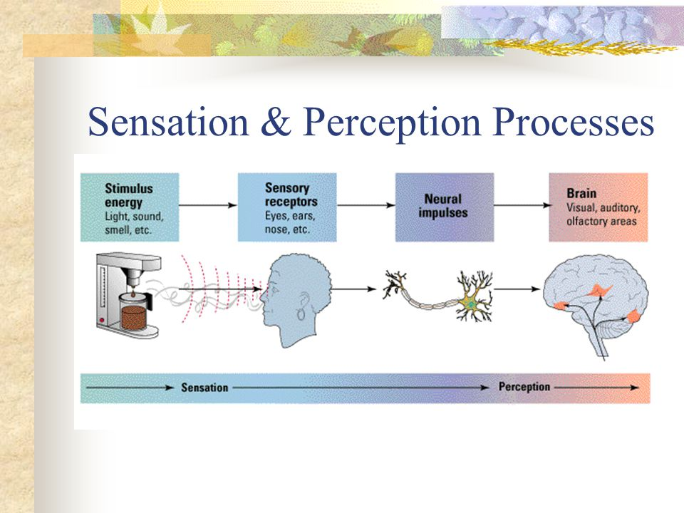

Slide 6
Perception
Organizing and making sense of what we experience as stimuli.
Perception is a constructive process by which we go beyond the stimuli that are presented to us and attempt to construct meaning out of it

Slide 7
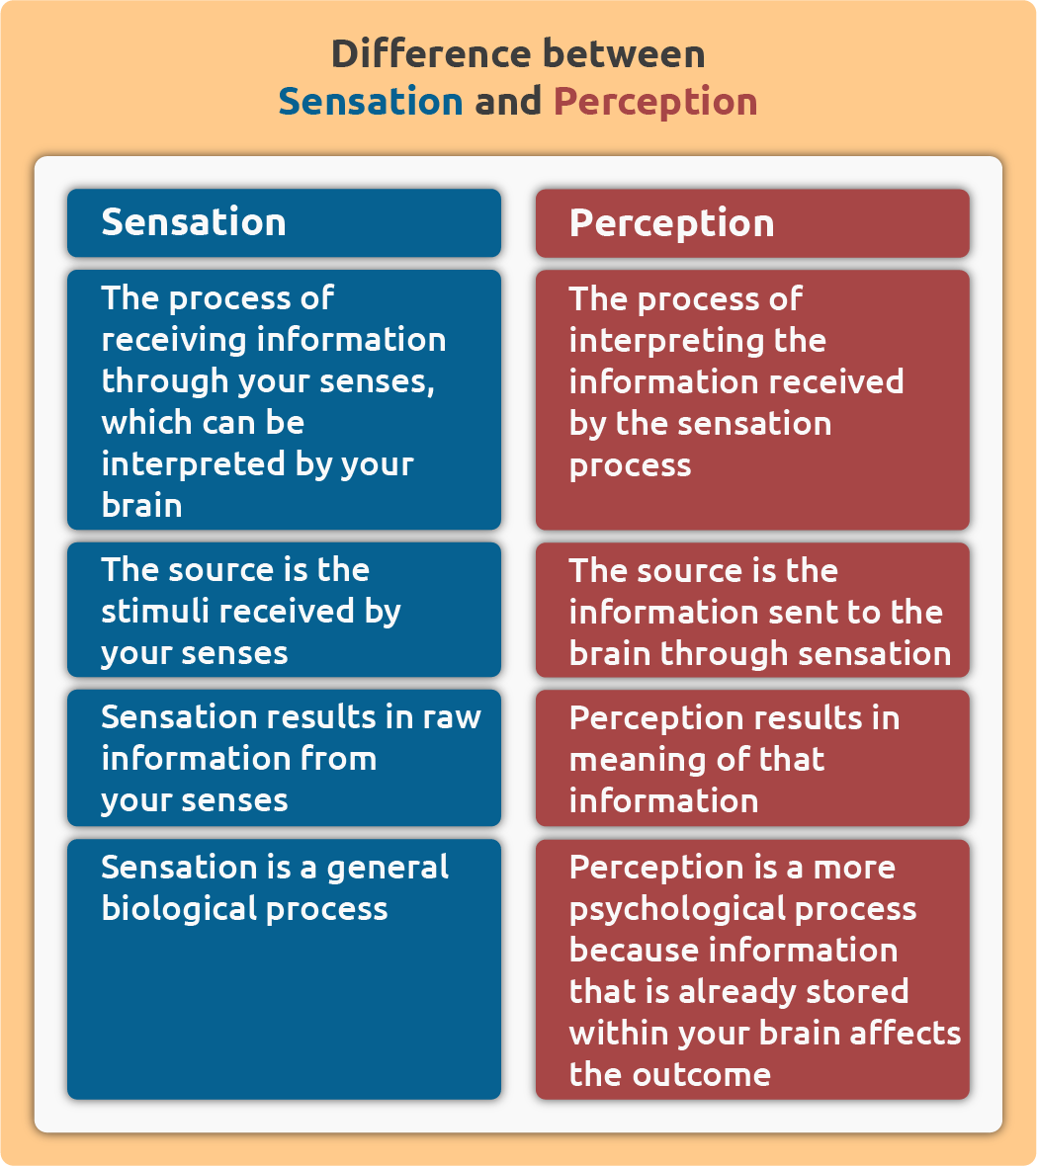

Slide 8
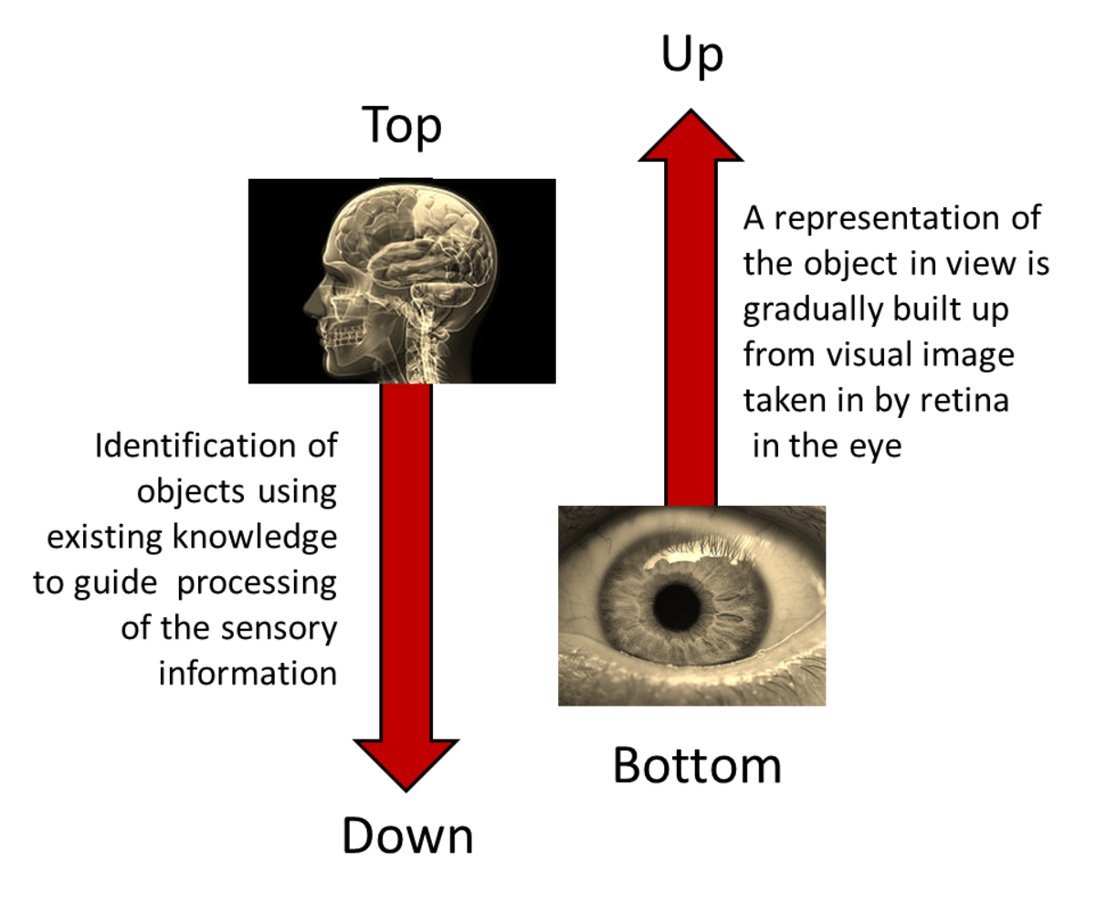

Slide 9
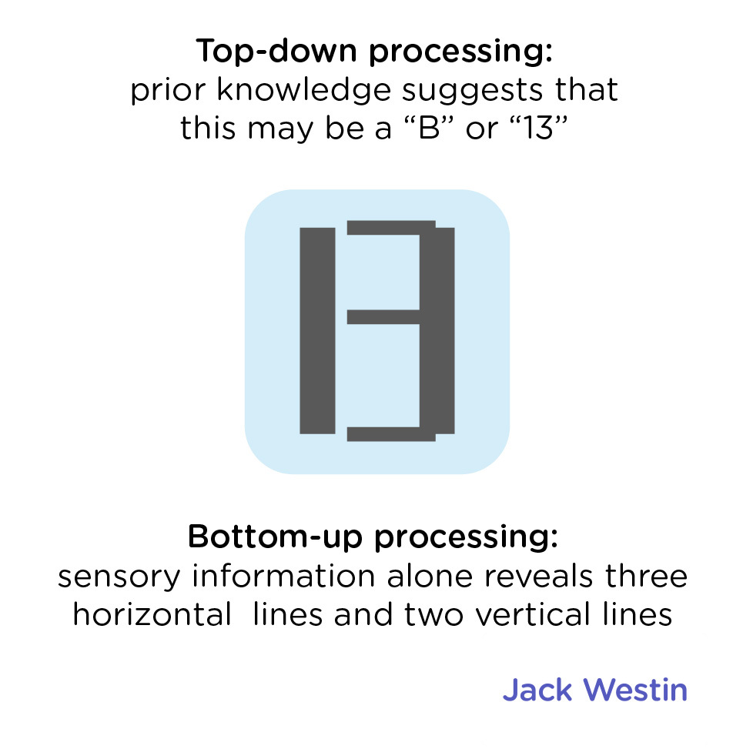

Slide 10
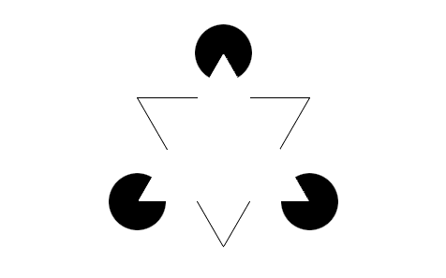
The Kanisza triangle as figure-ground illusory contours

Slide 11


Slide 12
Perception – gestalt laws
Gestalt means perceptual whole, which is something greater than the sum of the individual elements.
We impose visual organization on stimuli.

Slide 13
Gestalt Psychology
Gestalt psychology has influenced how we study perception and sensation.
It also increases our understanding of how our cognitive processes influence the way we behave socially.

Slide 14
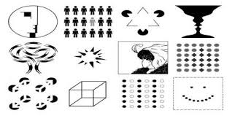

Slide 15
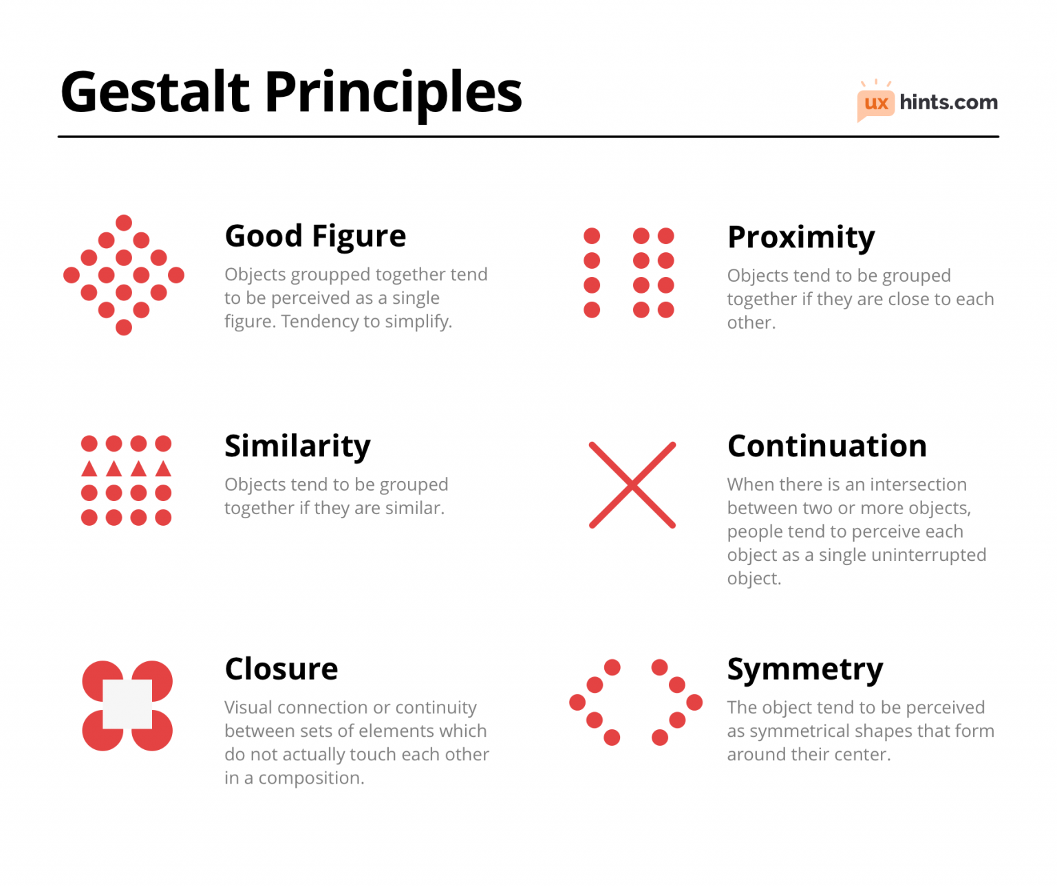

Slide 16
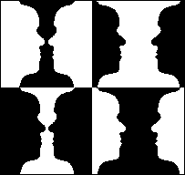
Gestalt Principles of Visual Perception
Reversible Figure/Ground
relationship
Can be affected by the principle of smallness:
Smaller areas tend to be seen as figures against a larger background.

Slide 17


Slide 18
Depth perception
The ability to view the world in three dimensions and to perceive distance.
It is generally because we have two eyes! And the distance between them cause a slightly different image on the retina.
That difference in images is known as Binocular disparity.
This disparity varies according to the distance of the objects.

Slide 19
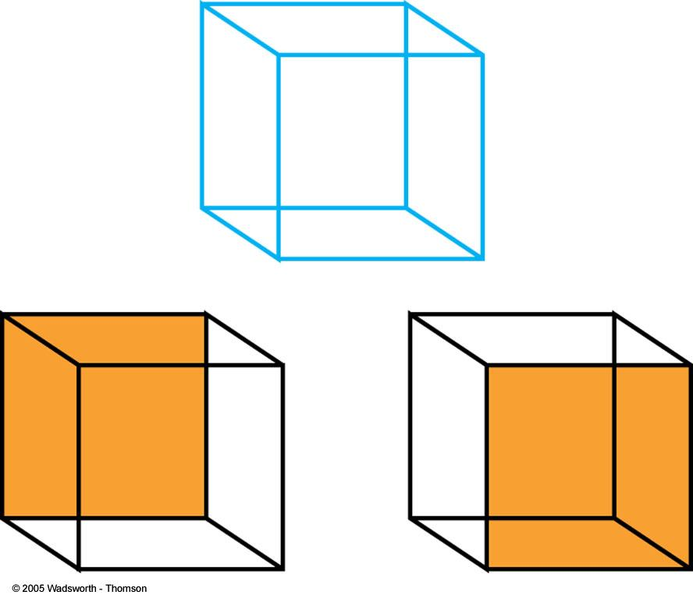

Slide 20
ILLUSION
Illusions are special perceptual experiences in which information arising from “real” external stimuli leads to an incorrect perception, or false impression, of the object or event from which the stimulation comes.

Slide 21
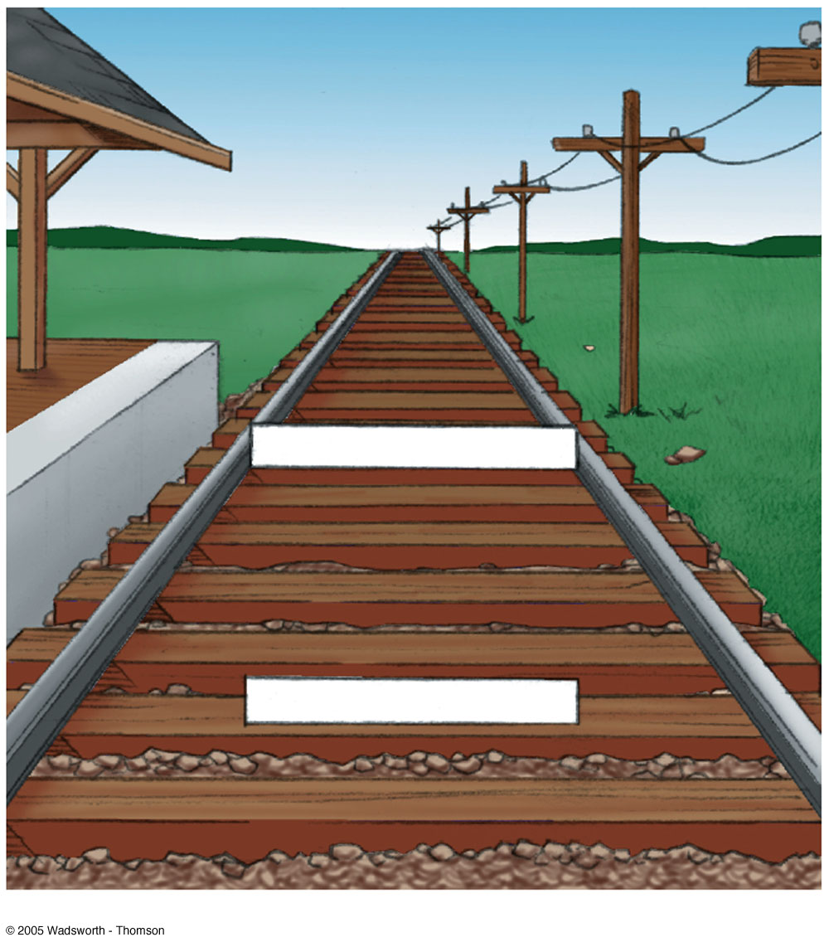
The Ponzo illusion may help you understand the moon illusion. Picture the two white bars as resting on the railroad tracks. In the drawing, the upper bar is the same length as the lower bar. However, because the upper bar appears to be farther away than the lower bar, we perceive it as longer. The same logic applies to the moon illusion.

Slide 22
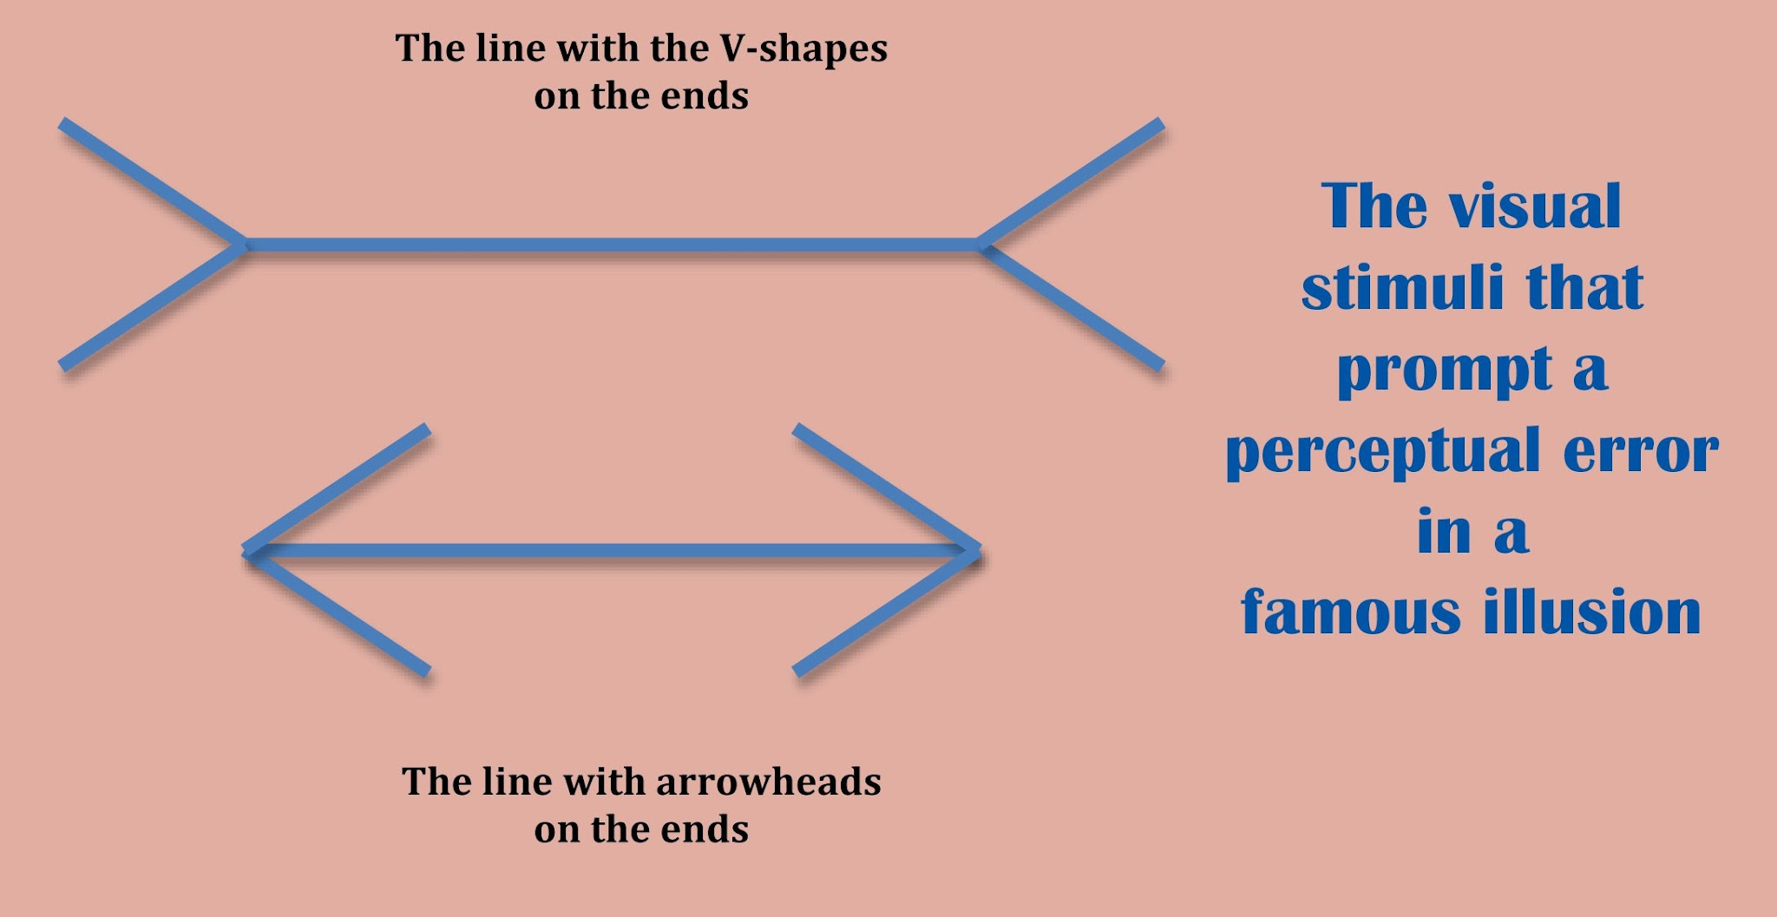

Slide 23
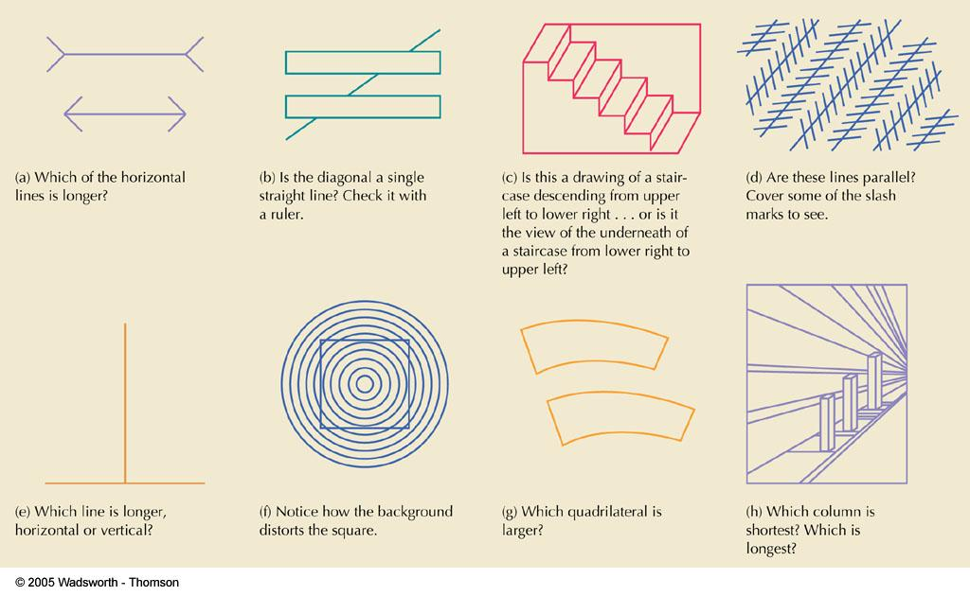

Slide 24
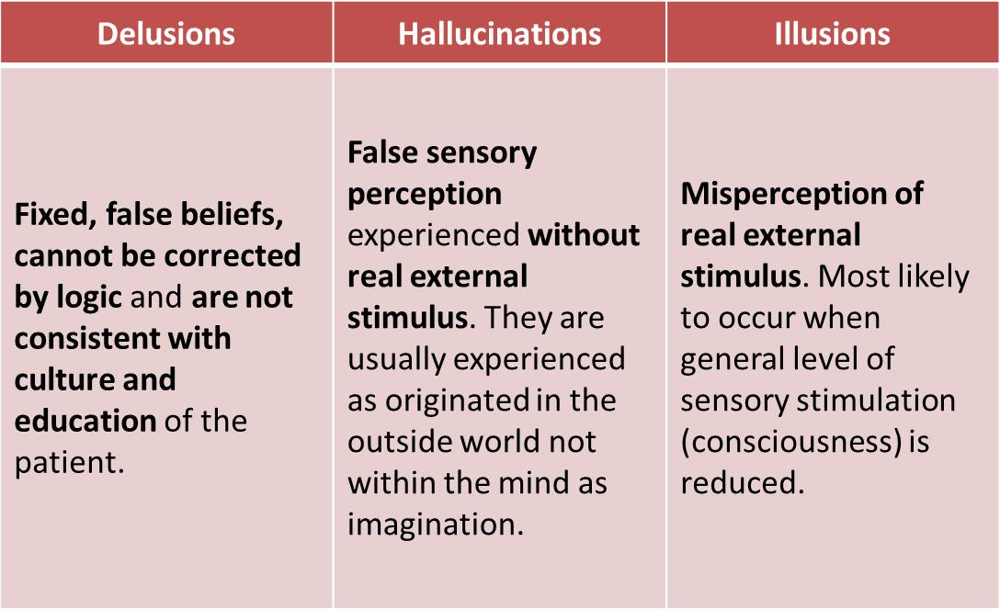

Slide 25
Social Perception
Social perception is concerned with how individuals perceive one another.

Slide 26
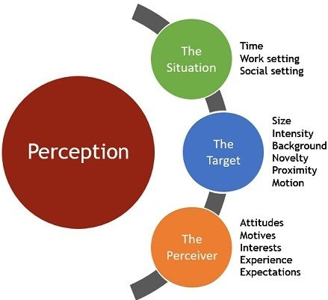

Slide 27
The primary factors that lead to social perception are the psychological processes:
Attribution,
Stereotyping

Slide 28
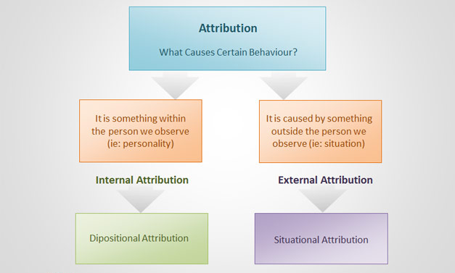
Attribution Theory

Slide 29
Attribution Theory
This causal determination depends upon three factors:
Distinctiveness – whether the individual displays different behavior in different situations
Consensus – whether the other people also responded in the same way
Consistency – does the person respond the same way again and again

Slide 30
Distorted attribution
Errors & biases distort attribution
Fundamental attribution error
Where we underestimate the influence of external factors and overestimate the influence of internal (personal) factors
Late coming / Low sales

Slide 31
Errors & biases distort attribution
Self-serving bias – attributing success to internal factors and failure to external factors (blame).
Judging own behavior
Lack of ability or effort = failure
Luck / fate

Slide 32
Stereotype
Stereotyping – judging someone on the basis of the perception of the group to which that person belong to.
Gender, age, race, ethnic background, physique etc.

Slide 33
Perception is tempered by point of view and experience. Because of this, no two people see things the same way if left to their own devices.
Our perception is governed by the information we have access to and the way we interpret it. That's why the area of perceptual organization is so important.

Slide 34
Organizational Processes In Perception
Perceptual organization is the process of grouping visual elements together (organization) so that one can more readily determine the meaning of the visual as a whole (perception).
For Example: the main screen of Microsoft Word, you have buttons along the top which represent commands or actions, text in the middle which is what you are writing, and messages along the bottom which indicate status.
Similar items are grouped together, making it easy to understand their basic purpose.

Slide 35
Recognition Processes In Perception.
Perception doesn't just involve becoming consciously aware of the stimuli.
It is also necessary for the brain to categorize and interpret what you are sensing.
The ability to interpret and give meaning to the object is the next step, known as recognition.

Slide 36
Activity
What communication skills do you think are key for a law enforcement officer to have in order to do their job effectively and why?
Describe an encounter that you have had with a law enforcement officer (if you haven’t had a direct experience you can use a hypothetical or fictional example).
What were your perceptions of the officer? What do you think his or her perceptions were of you?
What schemata do you think contributed to each of your interpretations?
What perceptual errors create potential ethical challenges in law enforcement? For example, how should the organizing principles of proximity, similarity, and difference be employed?

