Slide 1
SOCIAL PSYCHOLOGY (Applied Social Psychology)
SESSION 11

Slide 2
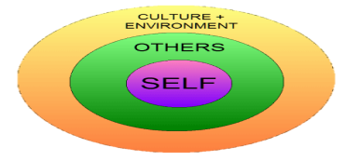
What is social psychology?
The study of how people think about, influence and relate to others, whether their presence is actual or implied - Gordon Allport
Baron, Byrne & Suls (1989) define social psychology as ....“the scientific field that seeks to understand the nature and causes of individual behavior in social situations”.
These influences are active when others are not present, we carry internal representations of others. How often have you considered carrying out an action when alone and thought “What would ______________ think?” (We imagine how someone might react to the actions we might perform)
An individuals surrounding/environment has an impact on them and the study of these influences comes under Social Psychology

Slide 3
What is social psychology NOT?
Anthropology
Cultural level of analysis
Sociology
Societal level of analysis
Personality psychology
Individual level of analysis
Social psychologists believe in “the power of the situation” and an interpersonal level of analysis. Social psychology truly does investigate the entire span of social existence

Slide 4
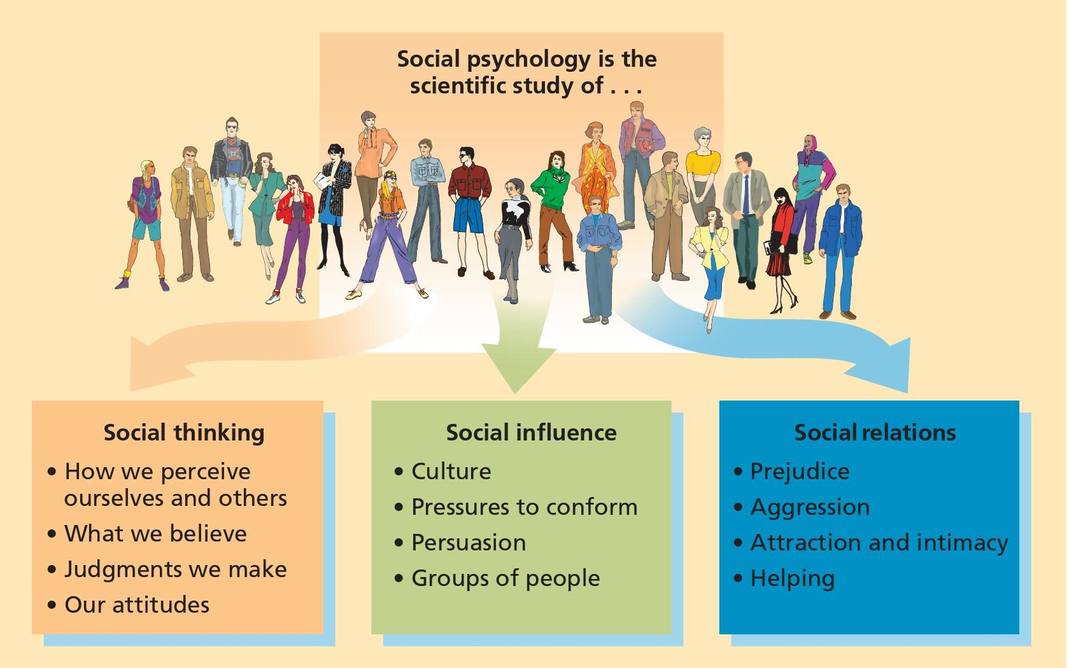
Themes in Social Psychology

Slide 5
Four major headings of Social Psychology (Baron (8-11))
Actions and Characteristics of Others: How our thoughts and behaviors are influenced by other people. E.g., someone attractive looks at you
Cognitive Processes: Perception dictates your thoughts and behaviors. E.g., someone takes your seat
Environmental Variables: Physical environment has an impact on us. E.g., summer heat and fasting
Biological Factors: Genetics play a role in behavior and thought. E.g., same situation, different reactions

Slide 6
Historical Roots of Social Psychology
First experiment in 1898 (p.4, 269) Perhaps the first social psychology laboratory experiment was undertaken in this area by Norman Triplett in 1898. In his research on the speed records of cyclists, he noticed that racing against each other rather than against the clock alone increased the cyclists' speeds. He attempted to duplicate this under laboratory conditions using children and fishing reels. There were two conditions: the child alone and children in pairs but working alone. Their task was to wind in a given amount of fishing line and Triplett reports that many children worked faster in the presence of co-actors (co-participants working individually on a noncompetitive activity) doing the same task. Triplett's experiments demonstrate social facilitation.

Slide 7
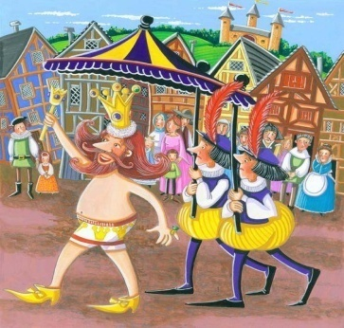
First Social psychology textbook published in 1908. Started to take form in 1930s.
Post WWII, Social Psychology emerged as a field. People started to turn to Social Psychology to understand what causes violence, prejudice, genocide, obedience, conformity and the like.
There are a few prominent figures that helped shape social psychology as a field
1) The Allport Brothers
Floyd Allport- 1930’s, gave the concept of ‘pluralistic ignorance.’ Does any know this story?
Pluralistic Ignorance- “no one believes, but everyone thinks that everyone believes.” In short, pluralistic ignorance is a bias about a social group, held by a social group.
Gordon Allport- Younger brother of Floyd Allport, conducted pioneering research on attitudes, prejudice, religion, personality etc. In 1954 he put forth the "intergroup contact hypothesis" – a theory that the more contact members of a majority group have with a minority group, the less prejudice they feel towards them.

Slide 8
‘I knew it all along’- The tendency to think that we could have predicted something that we probably would not have been able to predict, because its common sense
Major reason why we cannot rely on commonsense and have to study Social Psychology
Question:- If I am conducting a research on self-esteem and parenting, what do you think the results would look like?
Easy to predict because it is common sense knowledge?
Eg- When you miss someone, you tend to feel closer to them, realize that you have/had a special bond. This is because absence makes the heart grow fonder. Do you agree?
What about the phenomenon, out of sight out of mind?
The reason that research is needed was confirmed by a study by Karl Teigen (1986) where he did exactly the following, he gave students phrases to rate that were widely accepted alongside their opposites ->

Slide 9
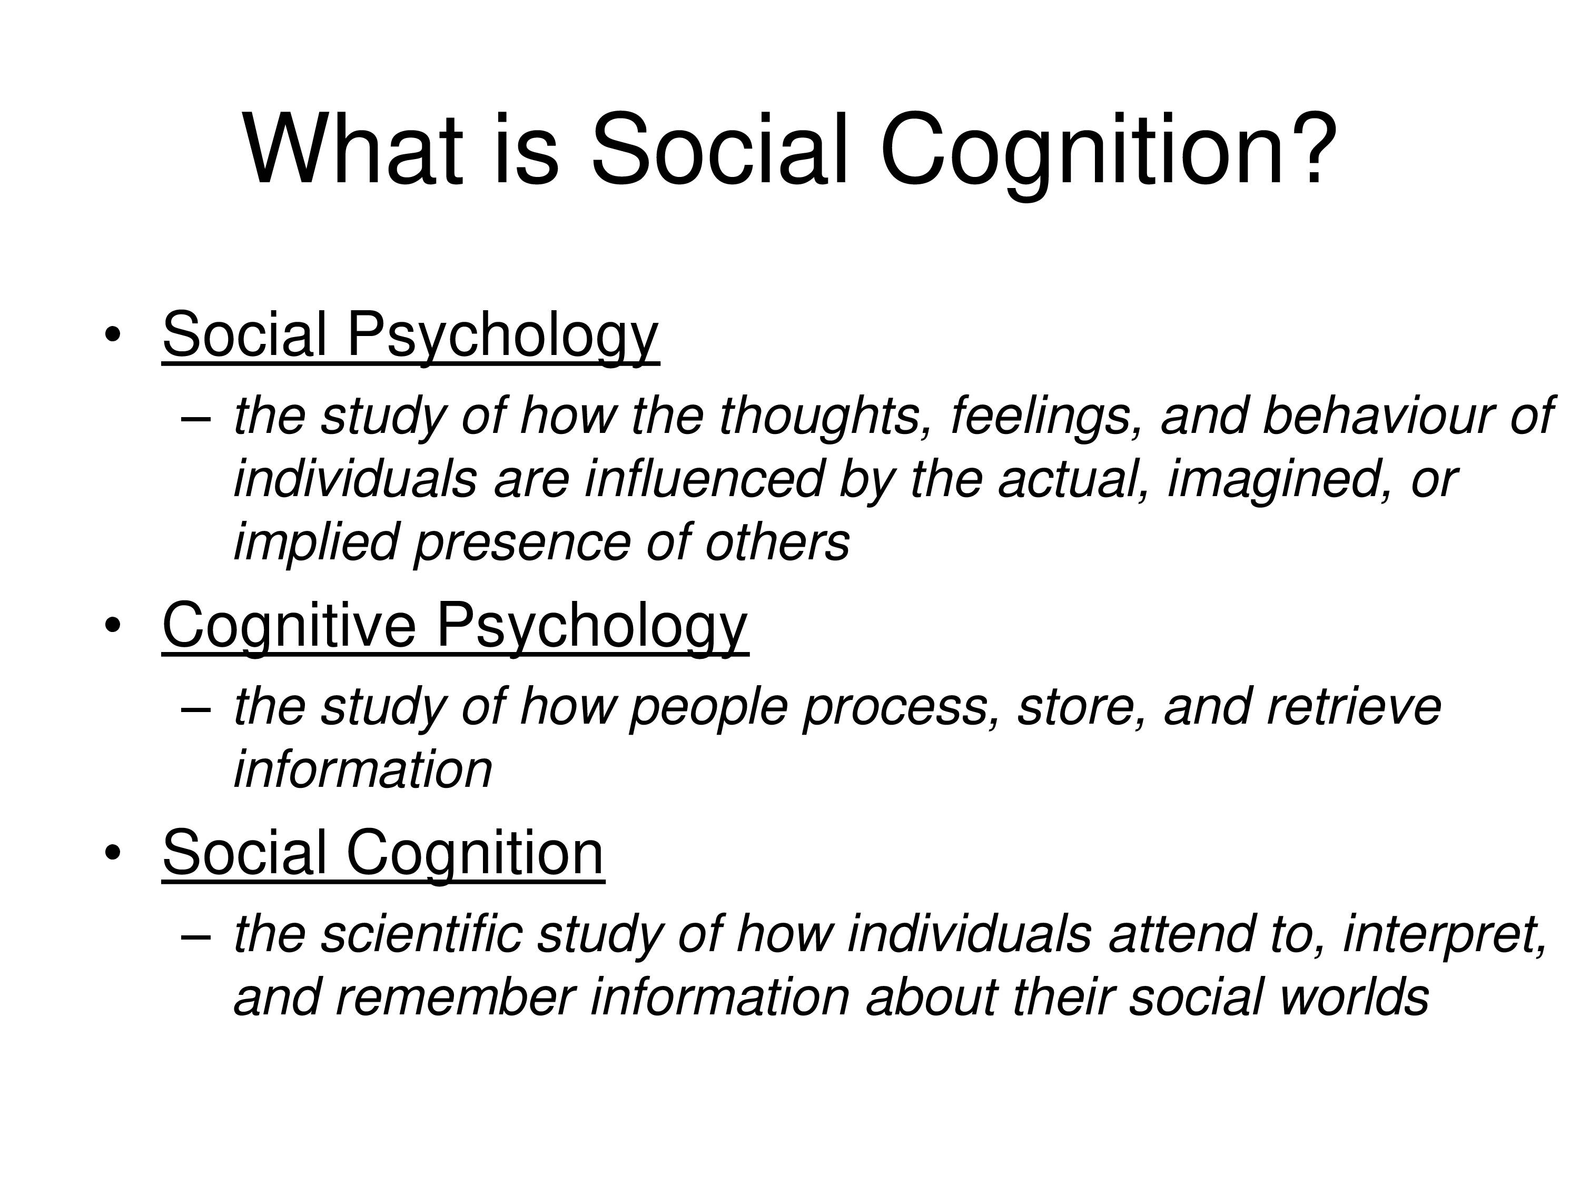

Slide 10
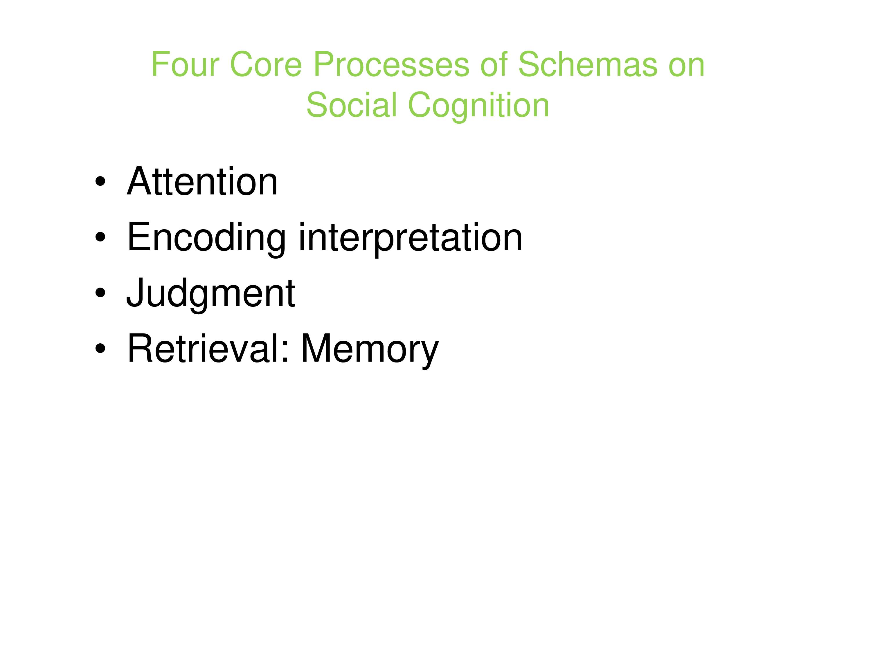

Slide 11
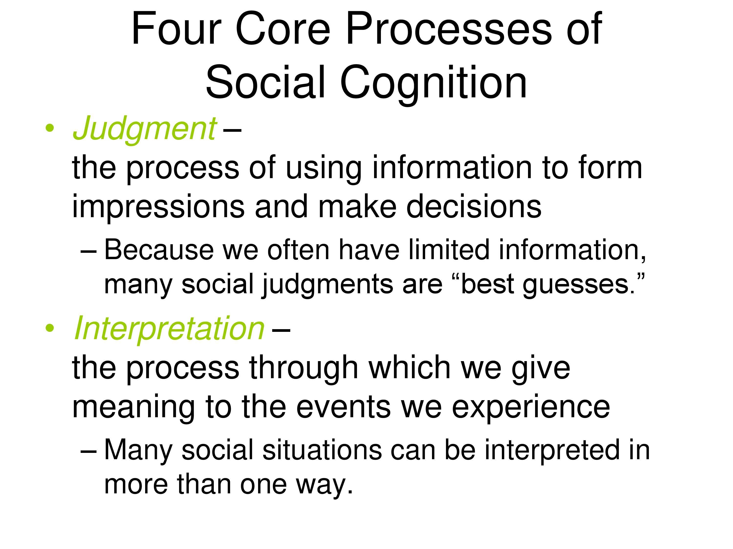

Slide 12
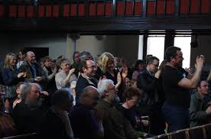
The Standing Ovation
When people on the front seats start rising, do others behind them follow suit?
Unless you really don’t like the speech made, would you also stand up?
What happens in a theatre when watching a movie, do you notice conformity there?

Slide 13
Differences in conformity, compliance, obedience, acceptance
Conformity-
A change in behavior or belief as the result of real or imagined group pressure.
When you come to school, are you conforming?
When you eat using a spoon, are you conforming?
Important pointer to answer the above questions- would your behavior or beliefs be the same if you were apart from the group?
Its an alone vs with group situation

Slide 14
Compliance-
Conformity that involves publicly acting in accord with an implied or explicit request while privately disagreeing
Acceptance-
Conformity that involves both acting and behaving in accord with social pressures. There is internal acceptance

Slide 15
Obedience-
Acting in accord with a direct order or command
If compliance is to an explicit command, it becomes obedience
Milgram's experiment

Slide 16
NORMATIVE INFLUENCE INOFRMATIONAL INFLUENCE
NORMATIVE INFLUENCE
Conformity based on a persons desire to fulfill others expectations, often to gain acceptance
INFORMATIONAL INFLUENCE
Conformity occurring when people accept evidence about reality provided by other people
The result of wanting to be liked and be part of a group
The result of wanting to be right and looking to others for the right answer when the situation is ambiguous

Slide 17
Define Attitude?
A favorable or unfavorable evaluative reaction toward something or someone (often rooted in ones belief, and exhibited in ones feelings and intended behavior)
The study of attitudes is a major topic within the field of social psychology.
They represent a very basic component of social cognition.
They often influence behavior, especially when they are strong, accessible, and long-standing.

Slide 18
How do attitudes form then?
So how do you think attitudes form?
-SOCIAL LEARNING—The process through which people acquire new information, forms of behavior, or attitudes from other persons (this is the major source)
Three learning processes are important to the development of attitudes
1)Classical Conditioning—learning in which one stimulus becomes a signal for the presentation of another stimulus (learning by association)
2)Instrumental/Operant Conditioning—learning in which responses (e.g., attitudes) that lead to positive outcomes or which avoid negative outcomes are strengthened
3) Observational Learning—learning in which individuals acquire new forms of behavior (e.g., attitudes) as a result of observing others
----Social Comparison to people that are liked also plays a role in learning attitudes from others and people learn attitudes from those they like and respect

Slide 19
Do we know ourselves well?
Do you think there might be times when what you say (Consciously) might be different from how things actually might be?
Our rational logical explanation may omit our unconscious attitudes
Eg, hermaphrodite

Slide 20
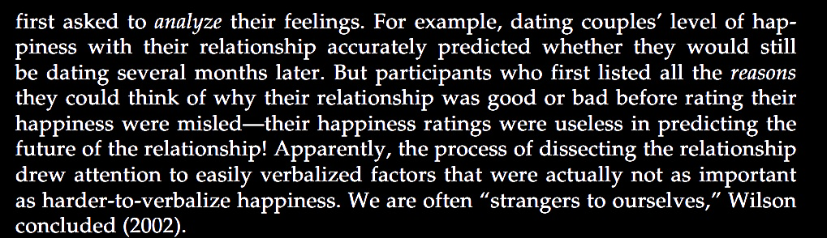
So does your attitude successfully predict behavior?
Not always actually. Read the following example

Slide 21
Link Between Attitudes and Behavior
Even though attitudes do not always successfully predict behaviors, nonetheless, there does exist a very strong relationship between the two
Role of the Social Context- Attitudes and behaviors diverge a lot of the times, because of the situation presented to us
LaPiere (1934) – travelled for 2 years in the US with a Chinese couple. Went to 184 restaurants and 66 hotels and motels and were treated nicely. When LaPiere wrote to them asking if they would serve Chinese visitors again, 92% restaurants and 91% hotels refused
Attitudes predicting behaviors is not linear. People often give into situational pressures

Slide 22
RECONSTRUCTING OUR PAST ATTITUDES
Up till now we have seen what attitudes are, cultural impact on attitudes, the implicit and explicit attitudes. But do our long held attitudes change?
People whose attitudes have changed often insist that they have always felt much as they now feel
Daryl Bem and Keith McConnell (1970) conducted a survey among Carnegie Mellon University students. Buried in it was a question concerning student control over the university curriculum
A week later, the students agreed to write an essay opposing student control. After doing so, their attitudes shifted toward greater opposition to student control. When asked to recall how they had answered the question before writing the essay, the students “remembered” holding the opinion that they now held and denied that the experiment had affected them

Slide 23
Rosy Retrospection
Besides the long held attitudes that we just spoke about, do we change the attitude towards memories?
Think about the last time you went out with your friends, to a big fun get together. How was it?
Terence Mitchell, Leigh Thompson, and colleagues (1994, 1997): recall mildly pleasant events more favorably than they experienced them
Likely to minimize the boring and unpleasant aspects and remember the high points
Its not that we are totally unaware of how we used to feel, just that when memories are hazy, current feelings guide our recall

Slide 24
Cathy McFarland and Michael Ross (1985) found that as our relationships change, we also revise our recollections of other people. They had university students rate their steady dating partners. Two months later, they rated them again.
Students who were more in love than ever had a tendency to overestimate their first impressions—it was “love at first sight.” Those who had broken up were more likely to underestimate their earlier liking—recalling the partner as somewhat selfish and bad-tempered.
What does this tell you about rosy retrospection?

