Slide 1
Social Psychology
Persuasion

Slide 2
PERSUASION
Persuasion, the process by which a person's attitudes or behavior are, without duress, influenced by communications from other people.
One's attitudes and behavior are also affected by other factors (for example, verbal threats, physical coercion, one's physiological states).

Slide 3
Central Route Persuasion
The central route is used when information is processed by the audience in a thorough way.
The researchers propose that the central route gets activated when there is a motivation to understand the information and there is the ability to process this information.
The central route to persuasion is thought to be a direct route that focuses on the quality of the information presented to the audience.

Slide 4
Peripheral Route Persuasion
The peripheral route to persuasion is an indirect route that uses peripheral cues to associative positivity with the message.
Peripheral route relies on association with positive characteristics such as positive emotions.
For instance, the peripheral route may use attractive speakers or celebrities to endorse a product.

Slide 5
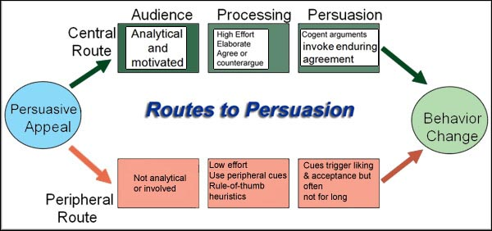

Slide 6
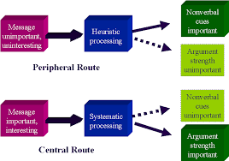

Slide 7
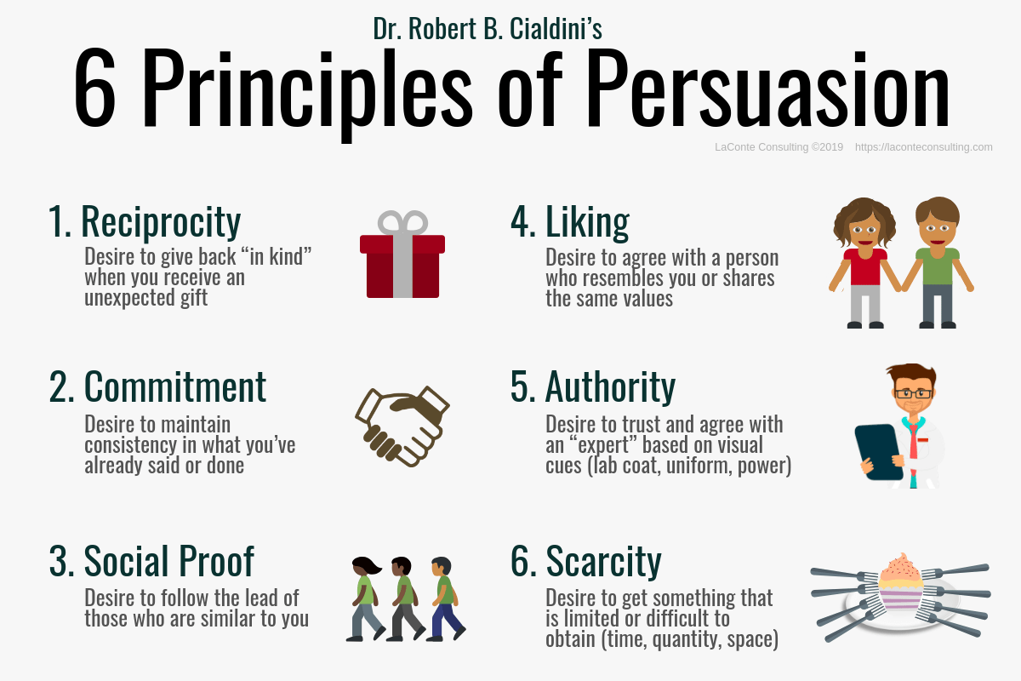

Slide 8


