Slide 1
HUMAN DEVELOPMENT
Marvi Makhdoom

Slide 2
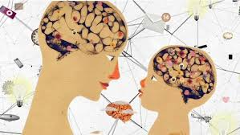

Slide 3

What is Development
Development is the sequence of age-related changes that occur as a person progresses from conception to death

Slide 4
Developmental Psychology
Developmental psychology is a scientific approach which aims to explain:
Growth, change and consistency through the lifespan.
It looks at how thinking, feeling, and behavior change throughout a person’s life.

Slide 5
Human & Development
Physical development, deal with the changes in the body;
Personal development, means the changes in an individual’s personality;
Social development refers to changes in the way an individual relates to others;
Cognitive development refers to changes in thinking.

Slide 6

Nurturing Nature

Slide 7
What is role of heredity vs. environment in determining psychological makeup?
Is your IQ inherited or determined by nutrition and early environment?
Is there a ‘criminal’ gene or does poverty lead to criminal behavior?
Is sexual orientation a choice or genetically determined?

Slide 8

Nature Vs Nurture

Slide 9
Nature is vulnerable to nurture,
During various phases of development, children need appropriate experiences that support their interest in exploration, experimentation, and self-direction.
Hence, modifying nurturing ways by adapting to the nature of a child will lead to desirable consequences both to the individual and society at large.

Slide 10
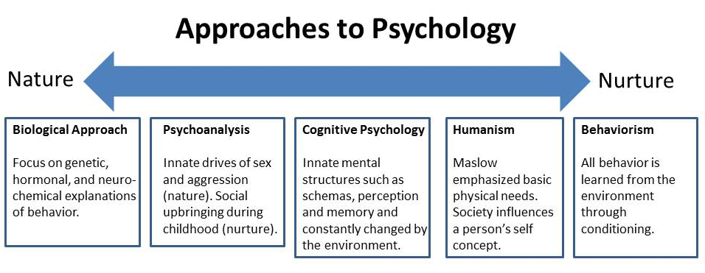

Slide 11
Developmental Theories
Piaget’s Stage Theory
Vygotschy’s Theory of Cognitive Development
Erickson’s Theory of Psychosocial Development
Kohlberg’s Theory of Moral Development

Slide 12
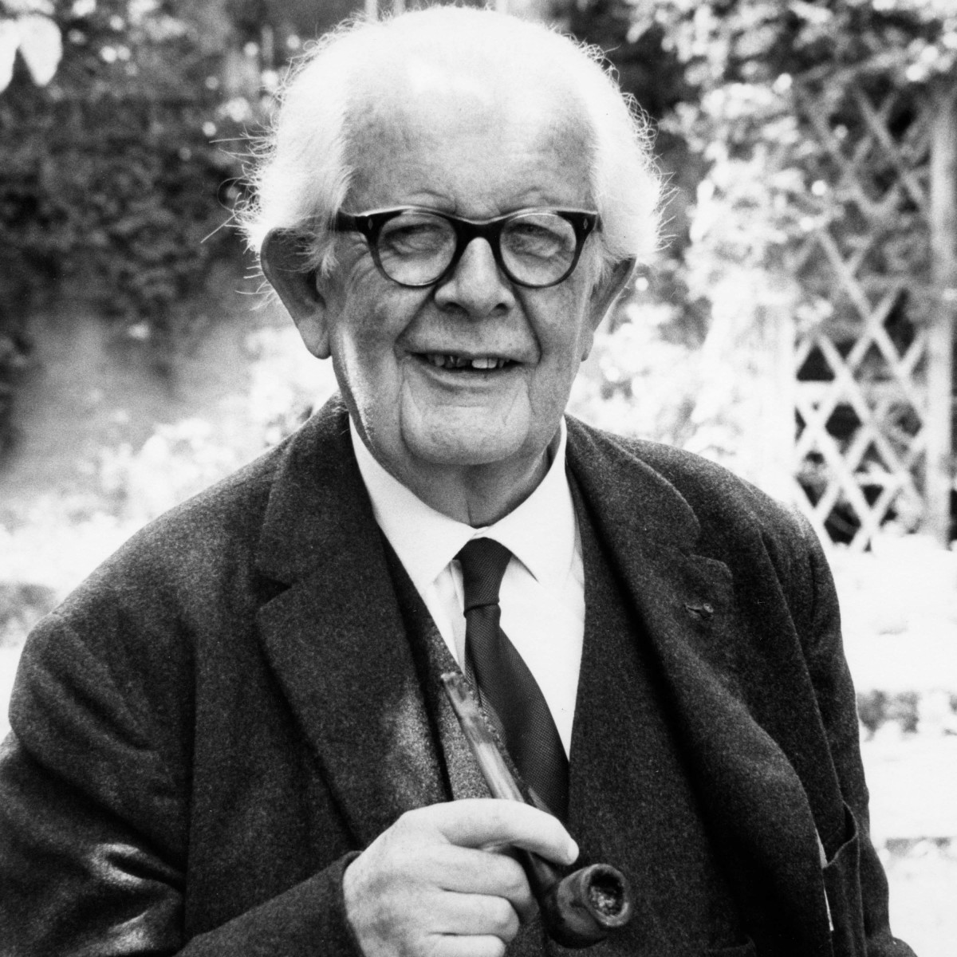
Piaget’s Stage Theory
Jean Piaget 1896-Born in Switzerland.
In 1919-Started to study language development in children.
Did an experiment and found out that children think differently than adult.

Slide 13
To make sense of the world, children develop schemas.
Schema:
A concept or framework that organizes and interprets information.
Conceptual models of how the world works
Schemas and stages build on one another through learning by:
Assimilation
Accommodation

Slide 14
Assimilation occurs when we modify or change new information to fit into our schemas (what we already know). It keeps the new information or experience and adds to what already exists in our minds.
Accommodation is when we restructure or modify what we already know so that new information can fit in better.

Slide 15
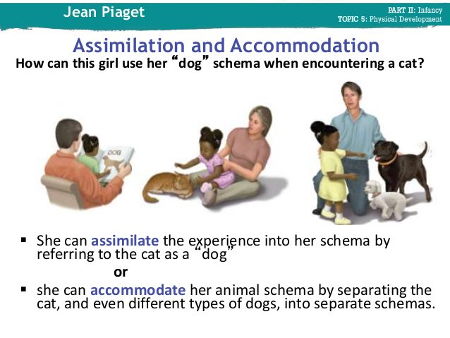

Slide 16
Development happens from one stage to another through interaction with the environment.
Changes from stage to stage may occur abruptly and kids will differ in how long they are in each stage.
Cognitive development can only happen after genetically controlled biological growth occurs.
Development leads to learning
Drive for development is internal
The child can only learn certain things when she is at the right developmental stage
Environmental factors can influence but not direct development
Development will happen naturally through regular interaction with social environment

Slide 17
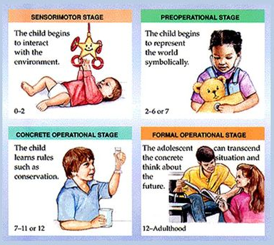
Four Stages
Sensorimotor Stage (Birth to 2 years)
Preoperational Stage (2 years to 7 years)
Concrete Operational Stage (7 to 11 years)
Formal Operational Stage (11 through adulthood)

Slide 18
Sensorimotor (Birth to 2 years)
Reflexes
Child becomes more aware of world around him and interacts with it.
The child will intentionally pick up a toy to put it in his mouth.
Actions are more intentional, child explores environment and imitates behaviors.
A child realizes that when you shake a rattle, it will make a sound.
Trial and error experimentation.
The child will repeat sounds and/or behaviors in order to get desired results.
Child develops symbols to represent events or objects in the world-moving toward mental understanding of the world.

Slide 19
Preoperational (2 years to 7 years)
Better speech communication
Can imagine the future & reflect on the past
Develop basic numerical abilities
Still pretty egocentric, but learning to be able to delay gratification
Can’t understand conservation of matter
Has difficulty distinguishing fantasy from reality (ex: cartoon characters are real people).

Slide 20
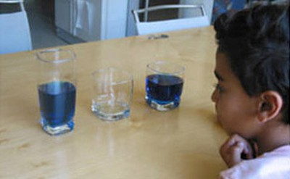
Conservation is the understanding that something stays the same in quantity even though its appearance changes.
Redistributing material does not affect its mass, number, volume or length.

Slide 21
Concrete Operational (7 to 11 years)
Better understanding of mental operations Logical thinking about concrete events
Difficulty with abstract or hypothetical concepts.
Inductive Logic- a specific experience to a general principal
NO DEDUCTIVE (general principal to an outcome)
Reversibility- actions can be reversed (reversing the order of relationships between mental categories)

Slide 22
Formal Operational Stage (11 through adulthood)
Abstract concepts-less concrete, not relying on experience alone,
consider possible outcomes and consequences of actions
Logical thought, deductive reasoning and systematic planning (hypothetical situations, predicting outcomes, science, math)
Problem solving- planned, logical, methodical, organized (as opposed to trial and error when younger)

Slide 23
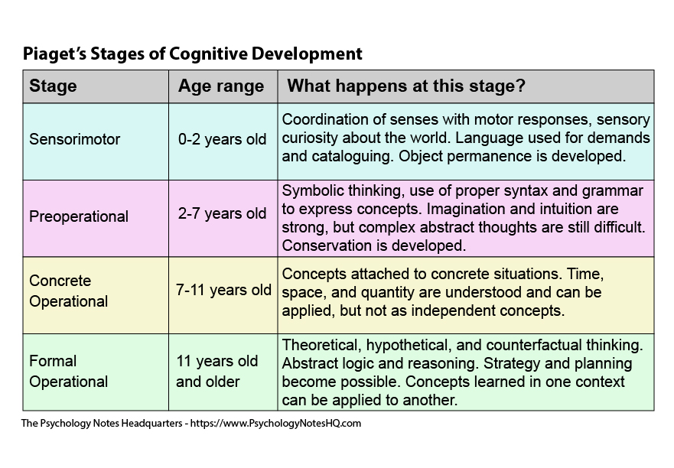

Slide 24
Video
https://www.youtube.com/watch?v=IhcgYgx7aAA

Slide 25
Criticisms
Piaget’s Research-much was based on observing his 3 children, others were from well educated parents and of higher socioeconomic status.
Research also showed that environmental factors play a role in child’s movement between the stages, not only age

Slide 26
Vygotsky’s Developmental Theory
Emphasis on the impact of society and culture on cognitive development.
Theory suggests that social interaction leads to continuous step by step changes in a child’s thought and behaviour that can vary greatly from culture to culture.
Vygotsky’s theory
Places emphasis on culture affecting/shaping cognitive development
Empahizes social factors that contribute to cognitive development
Places emphasis on the role of language in cognitive development

Slide 27
Principle’s of Vygotsky’s Theory
Language plays a central role in mental development
Development can not be separated from its social context
Learning leads development
Children construct their knowledge

Slide 28
Vygotsky saw cognitive development as depending more on interactions with people & tools in the child’s world.
Tools are real: pens, paper, computers;
or
Tools are symbols: language, math systems, signs
Play allows children to stretch themselves cognitively
Vygotsky believed that children will acquire ways of thinking and behaving that make up a culture by interacting with a More Knowledgeable Other (MKO).

Slide 29
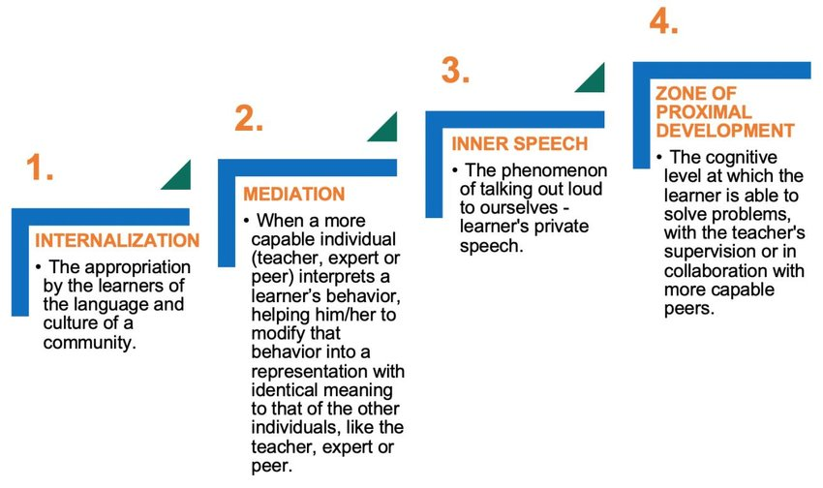

Slide 30
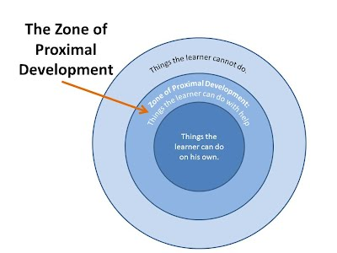
Zone of Proximal Development
This refers to the difference in a child’s performance when he or she attempts the problem on his or her own compared to when an adult or older child provides assistance.

Slide 31
APPLICATION
Encourage students to talk themselves through difficult tasks
Provide cognitive tools that students can use to make difficult tasks easier
Present some tasks that students can perform successfully only with assistance
Provide sufficient scaffolding (more knowledgeable person provides some structure) to enable students to attempt to perform challenging tasks
Have students work in small groups on complex tasks
Provide opportunities to engage in adult-like activities
Give young children time to practice adult roles and behaviors through play

Slide 32
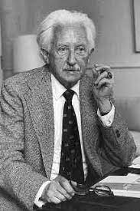
Erikson’s Theory of Psycho-social Development
Development proceeds in stages
Each stage is characterized by a psychosocial challenge or crisis
Stages reflect the motivation of the individual

Slide 33
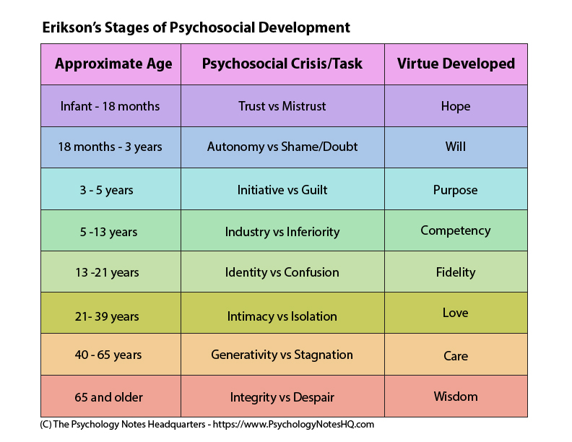

Slide 34
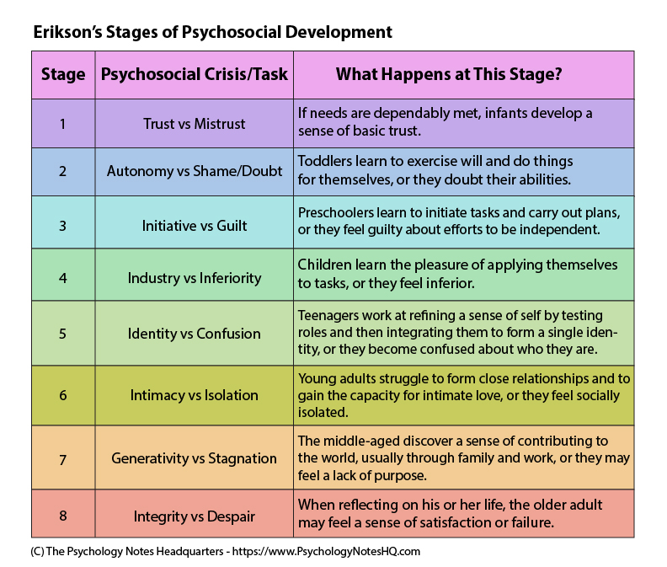

Slide 35
Strategies for Erikson’s Stages of Development
Initiative
Encourage social play
Have children assume responsibility
Structure assignments for success
Industry
Nourish motivation for mastery
Be tolerant of honest mistakes
Identity
Recognize that identity is multidimensional
Encourage independent thinking
Stimulate students to examine different perspectives

Slide 36
Video
https://www.youtube.com/watch?v=aYCBdZLCDBQ

Slide 37
Heinz's wife was near death, and her only hope was a drug that had been discovered by a pharmacist who was selling it for an exorbitant price. The drug cost $200 to make, and the pharmacist was selling it for $20,000. Heinz could only raise $5,000 and insurance wouldn't make up the difference. He offered what he had to the pharmacist, and when his offer was rejected, Heinz said he would pay the rest later. Still the pharmacist refused. In desperation, Heinz considered stealing the drug. Would it be wrong for him to do that?
Should Heinz have broken into the store to steal the drug for his wife? Why or why not?

Slide 38
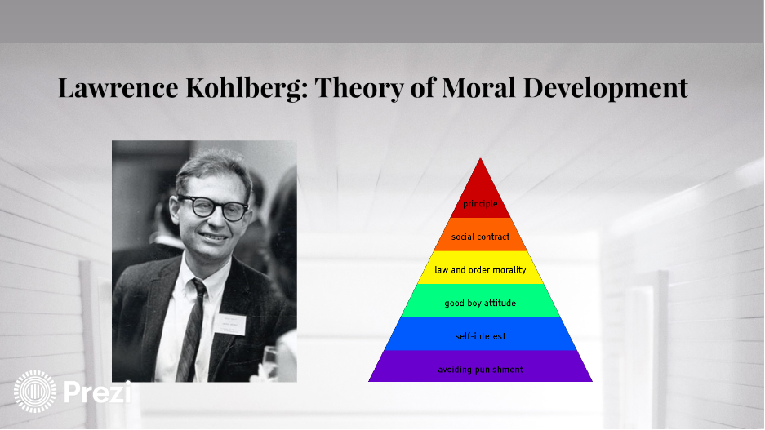

Slide 39
Kohlberg’s Theory of Moral Development
Lawrence Kohlberg's ideas of moral development are based on the premise that at birth, all humans are void of morals, ethics, and honesty.
Family as the first source of values and moral development for an individual. (nature vs nurture?)
As one's intelligence and ability to interact with others matures, so does one's patterns of moral behavior
Believed that people progressed in their moral reasoning (i.e., in their basis for ethical behavior) through a series of stages.

Slide 40
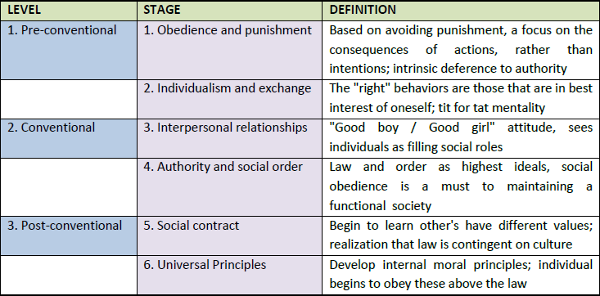

Slide 41
Level 1: Pre-conventional level
Morality is externally controlled.
Rules imposed by authority figures are conformed to in order to avoid punishment or receive rewards.
Involves the idea that what is right is what one can get away with or what is personally satisfying.
Level 1 has two stages.
Stage 1: Punishment/obedience orientation
Behaviour is determined by consequences.
Avoid punishment.
Stage 2: Instrumental purpose orientation
Behaviour is determined again by consequences.
Receiving rewards or satisfying personal needs.

Slide 42
Level 2: Conventional level
Conformity to social rules.
Emphasis shifts from self-interest to relationships with other people and social systems.
Strive to support rules in order to win elders approval or to maintain social order.
Stage 3: Good Boy/Nice Girl orientation
Behaviour is determined by social approval.
The individual wants to maintain or win the affection and approval of others by being a “good person.”
Stage 4: Law and order orientation
Social rules and laws determine behaviour.
Moral decision making becomes more than consideration of close ties to others.
Believes that rules and laws maintain social order that is worth preserving.

Slide 43
Level 3: Post-conventional or principled level
The individual moves beyond the perspective of his or her own society. Morality is defined in terms of abstract principles and values that apply to all situations and societies.
The individual attempts to take the perspective of all individuals.
Stage 5: Social contract orientation
Individual rights determine behaviour.
The individual views laws and rules as flexible tools for improving human purposes.
That is, given the right situation, there are exceptions to rules.
Stage 6: Universal ethical principle orientation
According to Kohlberg, this is the highest stage of functioning.
The appropriate action is determined by one’s self-chosen ethical principles of conscience.
These principles are abstract and universal in application. This type of reasoning involves taking the perspective of every person or group that could potentially be affected by the decision.

Slide 44
Video regarding Kohlberg’s Moral Development.
https://www.youtube.com/watch?v=bounwXLkme4

Slide 45
Imagine you are a doctor and you have five patients who all need transplants in order to live. Two each require one lung, another two each require a kidney and the fifth needs a heart.
In the next ward is another individual recovering from a broken leg. But other than that, he is perfectly healthy. So, would you kill the healthy patient and harvest his organs to save five others?

Slide 46
Criticism
Kohlberg's theory is concerned with moral thinking, but there is a big difference between knowing what we ought to do versus our actual actions.
Is justice the only aspect of moral reasoning we should consider? Critics have pointed out that Kohlberg's theory of moral development overemphasizes the concept as justice when making moral choices.
Other factors such as compassion, caring, and other interpersonal feelings may play an important part in moral reasoning.
Does Kohlberg's theory overemphasize Western philosophy? Individualistic cultures emphasize personal rights while collectivist cultures stress the importance of society and community.
Eastern cultures may have different moral outlooks that Kohlberg's theory does not account for.

