Slide 1
TRAITS & ITS THEORIES
Marvi Makhdoom

Slide 2
Trait theory
A trait is basically a relatively stable characteristic that causes an individual to behave in certain ways.
Trait personality theories suggest that a person can be described on the basis of some number of personality traits
Allport identified some 4,500 traits
Cattel used factor analysis to identify 30-35 basic traits
Eysenck argued there are 3 distinct traits in personality
Extraversion/introversion
Neuroticism
Psychoticism – e.g., lacking in empathy, cruel, a loner, aggressive and troublesome.

Slide 3
Allport trait theory
Allport (1937) believes that personality is biologically determined at birth, and shaped by a person's environmental experience.
Allport's theory of personality emphasizes the uniqueness of the individual and the internal cognitive and motivational processes that influence behavior. For example, intelligence, temperament, habits, skills, attitudes, and traits.
Three basic categories of traits
Cardinal trait – single characteristic which directs most of the person’s activities.
Central traits – set of characteristics (5-10) which dominates
Secondary traits – affect in fewer situations and are less influential than above two.

Slide 4
Eysenck’s Personality Theory
Eysenck (1952, 1967, 1982) proposed a theory of personality based on biological factors, arguing that individuals inherit a type of nervous system that affects their ability to learn and adapt to the environment.
Introduced Big 5 personality factors:
OCEAN (openness, conscientious, extraversion, agreeableness, neuroticism)

Slide 5
Big five personality traits
Five broad trait factors:
Openness to experience – novelty, imaginative, intelligent, simple, artistically sensitive etc
Conscientiousness – reliability, careful, organized, plan-ful
Extroversion – sociable, active, quiet, shy, talkative, energetic etc
Agreeableness – cooperative, kind, affectionate, unfriendly, sympathetic etc
Neuroticism (emotional stability) – withstand stress, calm, anxious, tense, nervous etc

Slide 6
Humanistic Perspective
Embraces human freedom, and forces of self-actualization
Given the right environmental conditions, we will develop to our full potentials
Carl Rogers was influenced by strong religious experiences (both in America and in China) and his early clinical career in a children’s hospital.
Rogers also focused on the unique characteristics and viewpoint of individuals.

Slide 7
His theory is structured around the concept of self
The Self
The perceptions individuals have of themselves & of their relationships to other people & to various aspects of life
The self concept is how people see their own behavior & internal characteristics
People actively seek higher development & engage in process of fulfilling their potential

Slide 8
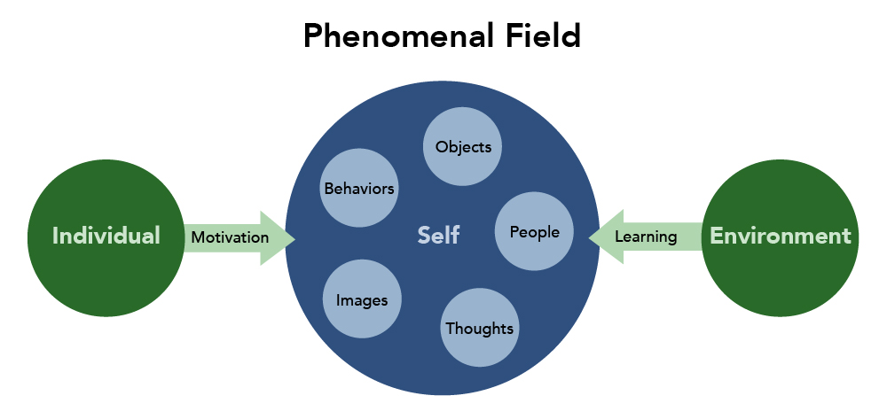

Slide 9
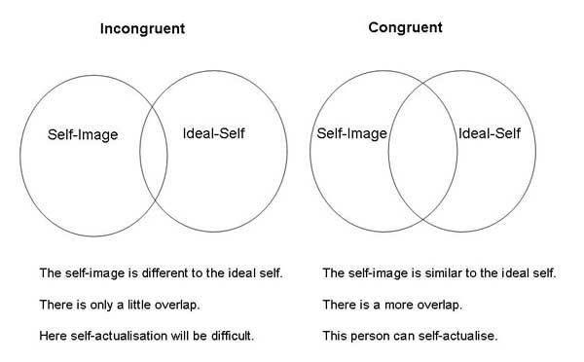

Slide 10
Need for positive regard by others
Unconditional positive regard
Conditional positive regard
Positive self regard
Positive development leads to a fully-functioning person

Slide 11
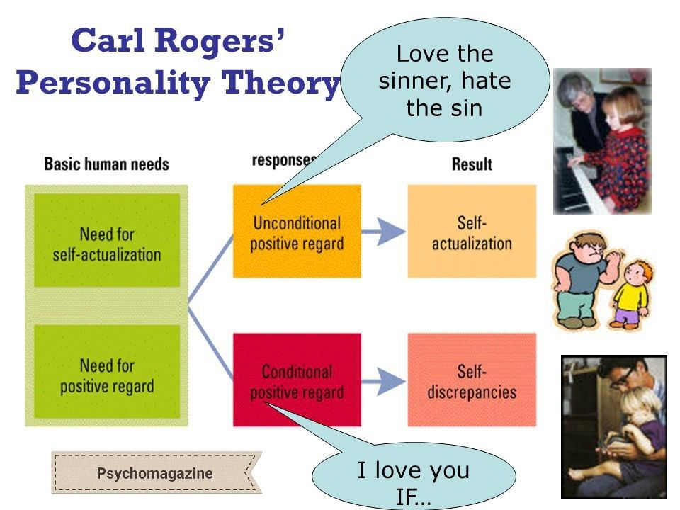

Slide 12
Social-Cognitive Perspective
Most of behavior is learned from the society – family, friends & culture.
A person develops adequate personality if they are provided adequate stimuli, reinforced appropriately, and exposed to good models.
Our capacity to process language and images and other sensory stimuli in our minds have an effect on how we behave, how we develop our personality traits, and thus, how we affect our environment.

Slide 13
Behavior learned through conditioning & observation
What we think about our situation affects our behavior
Interaction of Environment & Intellect

Slide 14
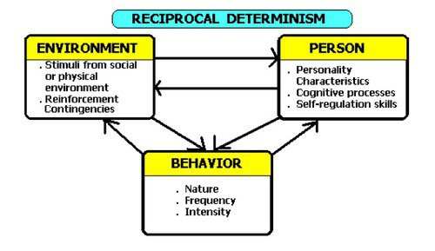
Reciprocal determinism
Individual’s behavior & the social learning environment continually influence one another
Internal World + External World = Us

Slide 15
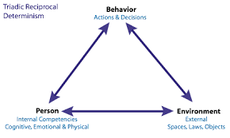

Slide 16
Personality Assessment
Personality assessment can be done through:
Psychological tests (self report measures)
Projective methods (ambiguous pictures/stimuli)
Behavioral assessment (observational)

Slide 17
Psychological Tests
These are Self-report measures – ask people about a small sample of behavior and on their response inferences are drawn about the personality characteristics they possess.
MMPI – 567 items, responses are taken ‘true’, ‘false’ & ‘cannot say’
No correct or incorrect answers
Most widely used personality test

Slide 18
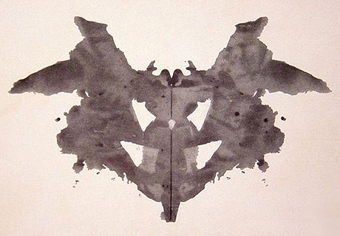
Projective tests
Rorscharch Inkblot Test

Slide 19
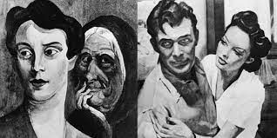
Projective tests
Thematic Apperception Test

Slide 20
Projective tests
Vague stimulus and response to such an ambiguous stimulus provide valuable clues to the state of unconscious and general personality characteristics
Interpretation requires much care and expertise.
Reports high reliability and validity

Slide 21
Behavioral Assessment
Based on observations of responses to a given situation
Under controlled conditions
Used in curing Specific behavioral difficulties like shyness
Based on learning theories

