Slide 1
RESEARCH METHOD IN PSYCHOLOGY
Marvi Makhdoom

Slide 2
Scientific Method
The scientific method is the standardized process by which scientists gather data to test whether their hypothesis aligns with existing scientific knowledge.
i.e., Milgram followed all the steps of the scientific method to produce one of the most notable psychological experiments.

Slide 3
Steps in Scientific Method
Make an Observation and Ask a question.
Background Research/ Literature & Hypothesis Formation.
Conduct an Experiment.
Collect & Analyze Data.
Draw Conclusions & Report Implications.

Slide 4
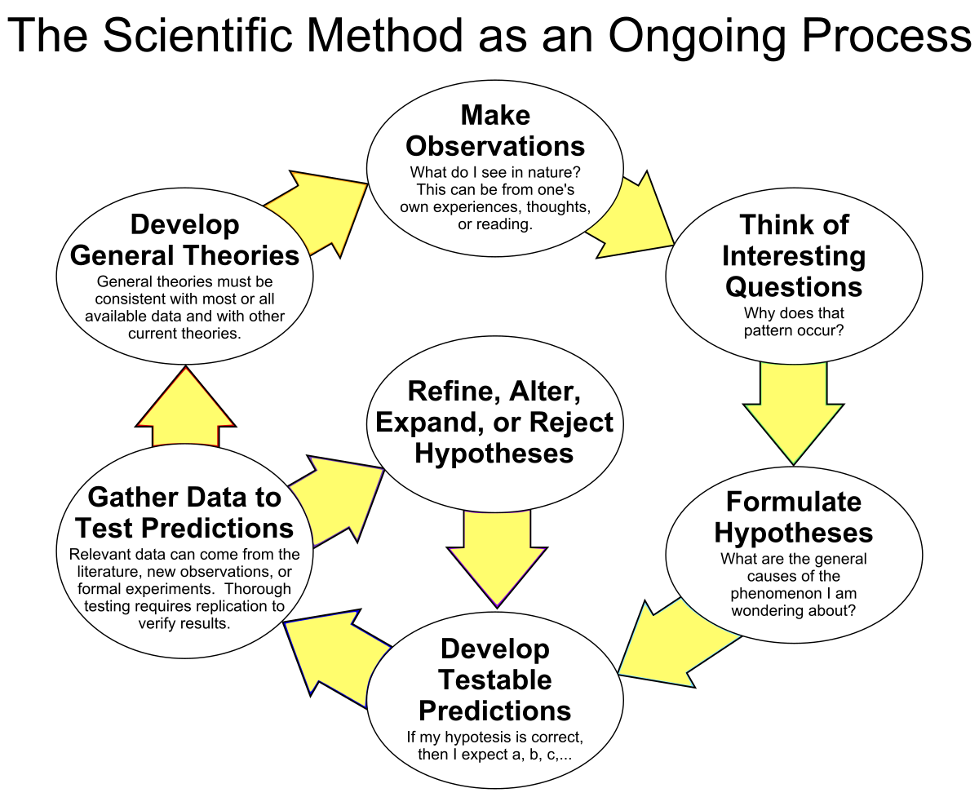

Slide 5
Terms in Psychological Research
Variable: A variable is something that can be changed or varied, such as a characteristic or value. Variables are generally used in psychology experiments to determine if changes to one thing result in changes to another.
Independent Variable The variable/s the experimenter manipulates (i.e. Changes).
Dependent Variable A DV is the variable which is measured by the experimenter after they have manipulated the IV.
Extraneous Variables are other variables (not the IV) which could affect the results of the experiment e.g. the weather

Slide 6
Important terms in Research
Aim identifies the purpose/reason behind the investigation.
Hypothesis (plural hypotheses) is a precise, testable statement of what the researchers predict/s will be the outcome of the study.
The alternative hypothesis states that there is a relationship between the IV and the DV.
The null hypothesis states that there is no relationship between the IV and DV.

Slide 7
Basic Elements of Scientific Method
Observation
Defining a problem
Proposing a hypothesis (an educated guess that can be tested)
Gathering evidence/testing the hypothesis
Publishing results
Building a theory

Slide 8
Sample & Population
Small number of people which represent the characteristics of the population.

Slide 9

RESEARCH METHODS

Slide 10
Qualitative & Quantitative Research
Quantitative research is expressed in numbers and graphs. It is used to test or confirm theories and assumptions.
This type of research can be used to establish generalizable facts about a topic.
Common quantitative methods include experiments, observations recorded as numbers, and surveys with closed-ended questions.
Qualitative research is expressed in words. It is used to understand concepts, thoughts or experiences. This type of research enables you to gather in-depth insights on topics that are not well understood.
Common qualitative methods include interviews with open-ended questions, observations described in words, and literature reviews that explore concepts and theories.

Slide 11
Qualitative Primarily inductive process used to formulate theory or hypotheses More subjective. More in-depth information on a few cases Text-based , no statistical tests Unstructured or semi-structured response options Can be valid and reliable: largely depends on skill and rigor of the researcher Time expenditure lighter on the planning end and heavier during the analysis phase Less generalizable | Quantitative Primarily deductive process used to test pre-specified concepts/hypotheses that make up a theory More objective: provides observed effects (interpreted by researchers) on a problem or condition Number-based, statistical tests are used. Fixed response options Can be valid and reliable: largely depends on the measurement /instrument used Time expenditure heavier on the planning phase and lighter on the analysis phase More generalizable

Slide 12
Research in Psychology
Meta Analysis/ Archival Research
Naturalistic Observation
Experimental Research
Survey and interview Research
The Case Study and focus group
Correlational Research

Slide 13
Meta Analysis/Archival Research
A meta-analysis is essentially a study of past studies. It is used to get an integrated result. A researcher reviews previously published studies on a topic, then analyzes the various results to find general trends across the studies.
It can be used in psychology, general medical practice, or other fields.
Advantages:
It is an inexpensive means of testing a hypothesis.
Faster way
Disadvantages:
The data may not be in the form which can be used to test the hypothesis fully.
The information could be incomplete or haphazard.

Slide 14
Naturalistic Research
Research in which investigator simply observes some naturally occurring behavior and does not make a change in the situation.
Advantage:
We get the first hand knowledge of what people do in their natural situations but lack of control is the biggest drawback.
Disadvantages:
Furthermore, if people realize that they are being observed, they may change their natural response.
Researcher is passive & simply records whatever is happening

Slide 15
Survey Research Method
The first commonly used research method in psychology is called a survey. A survey gathers data by asking a group of people their thoughts, reactions or opinions to fixed questions. This data is then collected and analyzed by a psychologist to provide insight on human behavior as related to a particular subject.
Benefits: Standardized surveys provide data with little to no errors.
Cost effective and efficient as a large group of people can be surveyed in a short period of time.
Disadvantages include the validity based upon honest answers, answer choices could not reflect true opinions and one particular response may be understood differently by the subjects of the study, thus providing less than accurate results.

Slide 16
Case Study Research
Case study closely studies one individual as opposed to a group of people.
The purpose of a case study is to learn as much as possible about an individual or group so that the information can be generalized to many others.
The benefits of performing a case study include getting an in-depth view into a subjects behavior and can also help a psychologist determine research questions to study for a larger group.
A disadvantage to doing a case study is that a psychologist may start off only looking for certain data and accidentally overlook important behaviors while only focusing on desired data, or data may be purposely overlooked if it does not coincide with an original hypothesis. (Introduction to Psychology)

Slide 17
Case Study Example: Anna O. was a pseudonym of a woman named Bertha Pappenheim, a patient of a physician named Josef Breuer. While she was never a patient of Freud's, Freud and Breuer discussed her case extensively. The woman was experiencing symptoms of a condition that was then known as hysteria (overwhelming and unmanageable fear) and found that talking about her problems helped relieve her symptoms. Her case played an important part in the development of talk therapy as an approach to mental health treatment.

Slide 18
Interviews
An interview is a qualitative research method that relies on asking questions in order to collect data. Interviews involve two or more people, one of whom is the interviewer asking the questions.
Structured interviews have predetermined questions asked in a predetermined order. Unstructured interviews are more free-flowing, and semi-structured interviews fall in between.
Interviews are commonly used in market research, social science, and ethnographic research.
Allow you to gather rich information and draw more detailed conclusions than other research methods, taking into consideration nonverbal cues, off-the-cuff reactions, and emotional responses.
However, they can also be time-consuming and deceptively challenging to conduct properly. Smaller sample sizes can cause their validity and reliability to suffer, and there is an inherent risk of interviewer effect arising from accidentally leading questions.

Slide 19
Focus Group
A focus group brings together a group of participants to answer questions on a topic of interest in a moderated setting.
Focus groups are qualitative in nature and often study the group’s dynamic and body language in addition to their answers.
Responses can guide future research on consumer products and services, human behavior, or controversial topics.
Focus groups can provide more nuanced and unfiltered feedback than individual interviews and are easier to organize than experiments or large surveys.
However, their small size leads to low external validity and the temptation as a researcher to “cherry-pick” responses that fit your hypotheses.

Slide 20
Correlational Research
A type of research design that looks at the relationships between two or more variables. Correlational studies are non-experimental, which means that the experimenter does not manipulate or control any of the variables.
A correlation refers to a relationship between two variables. Correlations can be strong or weak and positive or negative. Sometimes, there is no correlation.
Positive correlations: Both variables increase or decrease at the same time. A correlation coefficient close to +1.00 indicates a strong positive correlation.
For instance, the number of cars a person owns is positively correlated with their income. More the income, more the number of cars.
Negative correlations: As the amount of one variable increases, the other decreases (and vice versa). A correlation coefficient close to -1.00 indicates a strong negative correlation.

Slide 21
Correlational Research
For example, there is a negative relationship between levels of stress and life satisfaction. This indicates that as stress levels increase, life satisfaction decreases.
No correlation: There is no relationship between the two variables. A correlation coefficient of 0 indicates no correlation.
Example: the relationship between intelligence and height. An increase in height does not lead to any changes in the intelligence of an individual
Types: naturalistic observation, the survey method, and archival research.

Slide 22
Experimental Research
The experimental method involves the manipulation of variables to establish cause and effect relationships.
The key features are controlled methods and the random allocation of participants into controlled and experimental groups.
An experiment is an investigation in which a hypothesis is scientifically tested. In an experiment, an independent variable (the cause) is manipulated and the dependent variable (the effect) is measured; any extraneous variables are controlled.
An advantage is that experiments should be objective. This is good as it makes the data more valid, and less biased.

Slide 23
Important Terms
Key features of an experiment:
Independent variable (factor that is manipulated) versus dependent variable (factor that is measured)
Experimental group (receives treatment) versus control group (receives no treatment)

Slide 24
Important Terms
The manipulation implemented by the experimenter is called treatment
Random assignment of participants – participants characteristics have equal chance to be distributed across the various groups
Significant Outcome – meaningful results (statistical procedures)
Replication – the repetition of research using different procedures, settings, people in order to increase confidence in prior findings.

Slide 25
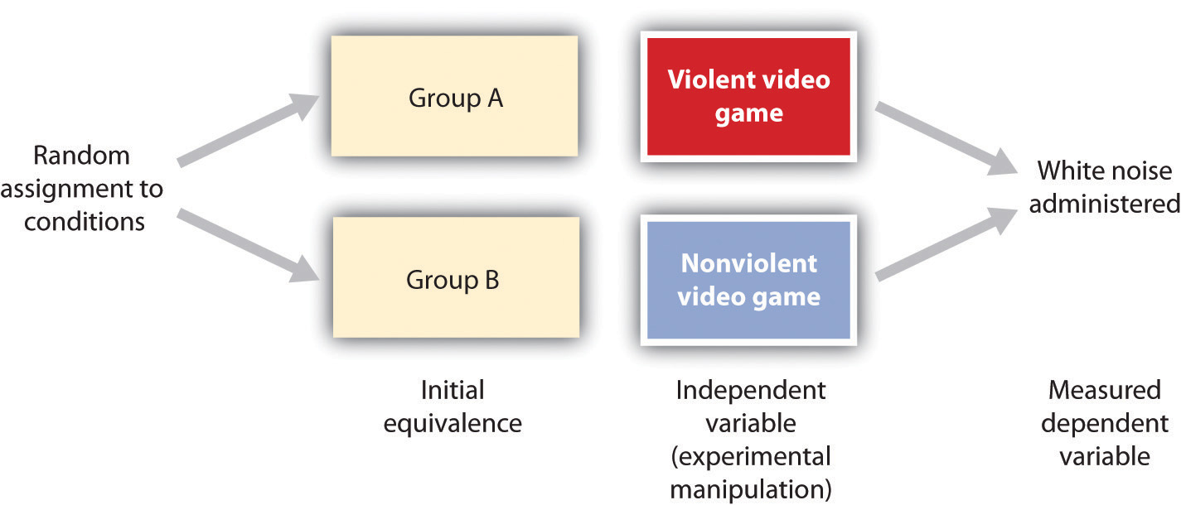

Slide 26
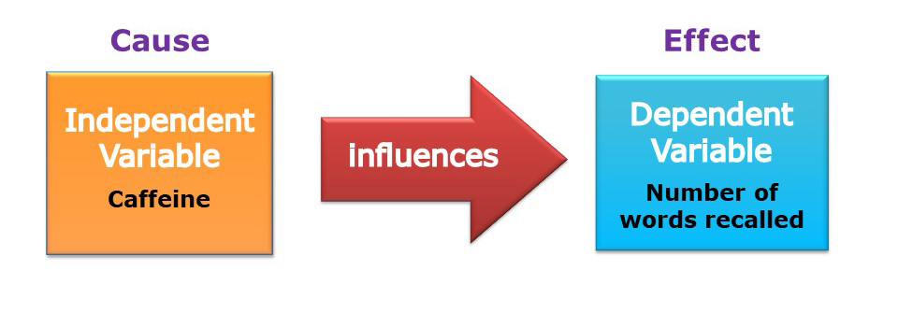
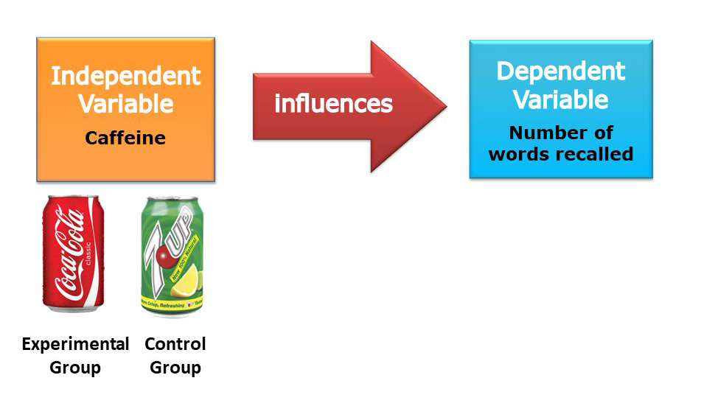

Slide 27
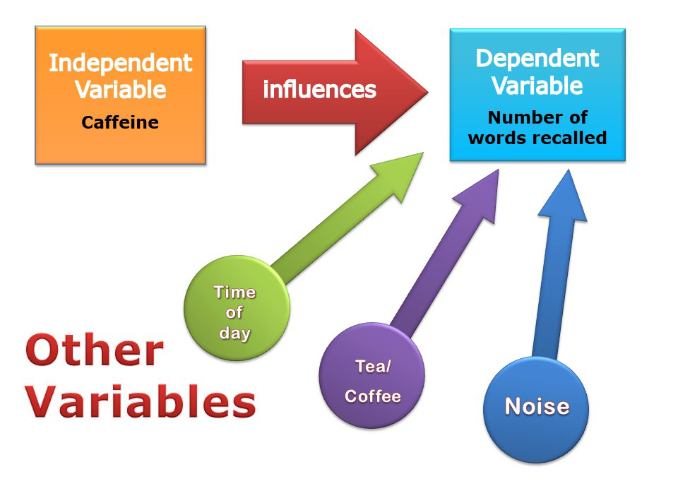
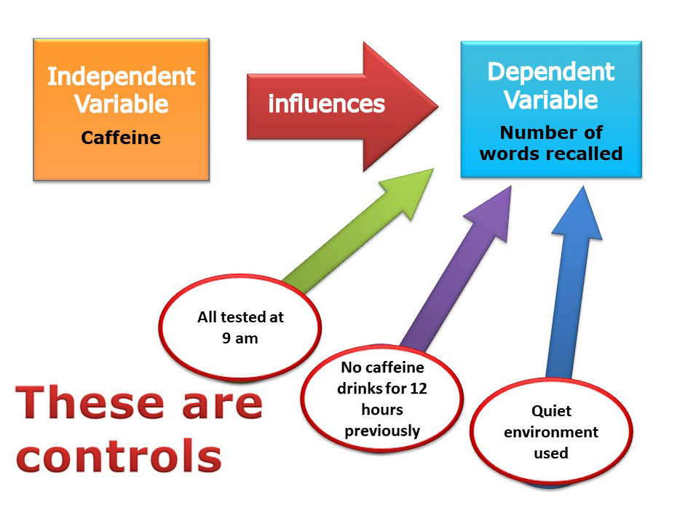

Slide 28
Barnum Effect:
Barnum effect: Tendency to consider personal descriptions accurate if stated in general terms
Always have a little something for everyone. Make sure all palm readings, horoscopes, etc. are so general that something in them will always apply to any one person!

Slide 29
General Ethical Guidelines
Ethical Guidelines for Human Research Participants:
Informed consent
Voluntary participation
Restricted use of deception
Debriefing
Confidentiality
Alternative activities
No Deception

