Slide 1
LEARNING & BEHAVIOR
Session 5

Slide 2
What is Learning?
Learning can be defined as the process leading to relatively permanent behavioral change or potential behavioral change.
we learn, we alter the way we perceive our environment,
the way we interpret the incoming stimuli,
and therefore, the way we interact, or behave.
Not due to biological factors, drugs, etc.

Slide 3
CONDITIONING
Conditioning is a form of learning in which either
A given stimulus (or signal) becomes increasingly effective in evoking a response
A response occurs with increasing regularity in a well-specified and stable environment.
The type of reinforcement used will determine the outcome.

Slide 4
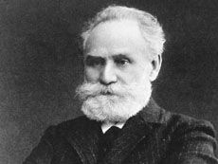
Classical Conditioning
It is a form of associative learning that was first demonstrated by Ivan Pavlov.
The study of classical conditioning began in the 20th century, when Ivan Pavlov, a Russian psychologist turned his attention to learning.

Slide 5
Pavlov’s Dog Experiment
https://www.youtube.com/watch?v=asmXyJaXBC8

Slide 6
CLASSICAL CONDITIONING
A learning process in which a previously neutral stimulus becomes associated with another stimulus through repeated pairing with that stimulus.
Classical conditioning theory involves learning a new behavior via the process of association.
In simple terms two stimuli are linked together to produce a new learned response in a person or animal.

Slide 7
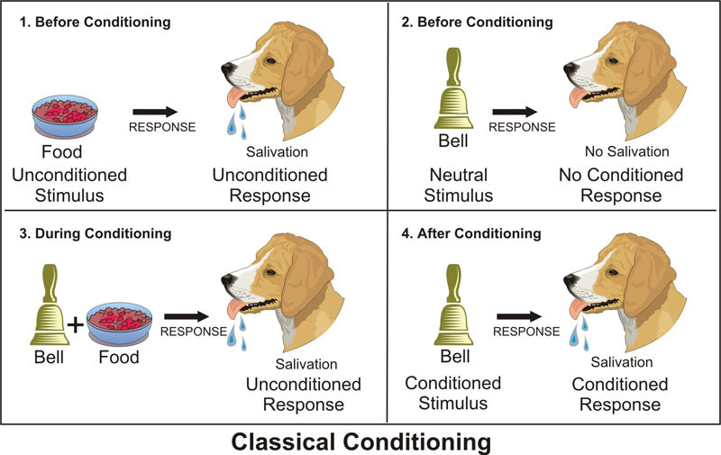

Slide 8
STIMULUS & FEAR CONDITIONING
Stimulus Generalization – when a new stimulus that is similar to the conditioned stimulus can evoke the same conditioned response without the need to condition.
Stimulus Discrimination – is the opposite of generalization. It’s the ability to discern between two similar stimuli.

Slide 9
EXTINCTION
EXTINCTION – stopping previously conditioned responses. In Pavlov’s experiment, if he stops giving his dogs food when he rings the bell, the dogs will eventually stop salivating at the sound.
Spontaneous Recovery – the sudden return of the previously extinct behavior. After the learned behavior is extinct, it may return suddenly and this phenomenon is called spontaneous recovery.
Extinction Burst – a temporary increase in frequency, duration, or magnitude of the extinct behavior. Sometimes, during the extinction process, conditioned behavior may temporarily increase instead of decrease because the individual is trying to bring back the unconditioned stimulus.

Slide 10
https://www.youtube.com/watch?v=jd7Jdug5SRc

Slide 11
Important Terms
Unconditioned Stimulus: one that unconditionally, naturally and automatically triggers a response.
Unconditioned Response: the unlearned response that occurs naturally in response to the unconditioned stimulus
Unconditioned Relationship: an existing stimulus response connection
Neutral Stimulus: a stimulus that does not produce the targeted response
Conditioned Stimulus: previously neutral stimulus that, after becoming associated with the unconditioned stimulus, eventually comes to trigger a conditioned response.
Conditioned Response: the learned response to the previously neutral stimulus.

Slide 12
Examples of Classical Conditioning
A WARM AND NURTURING TEACHER MOTIVATES STUDENTS
A warm and nurturing teacher (US) makes students feel connected (UR). Students associate going to school (CS) with the teacher. Therefore, students learn to enjoy going to school (CR)​​.
ADVERTISING
Most children love playing with other kids (US). It is fun and makes them feel happy (UR). When a child sees a group of children playing with a toy in a commercial, they associate the toy (CS) with happy feelings (CR) and want to play with it, too.

Slide 13
Examples of Classical Conditioning
FEAR OF DOGS
A child sees a dog attack a person. It’s a very frightening experience (UR). Dogs are generally neutral stimuli (US) that many people find adorable. But to this child, after this incident, he’s scared (CR) whenever he sees a dog (CS).
FOOD AVERSION
Food poisoning can lead to a phobia of a specific food. The first time someone eats a certain food (US) and gets sick from it, they may associate the food with feeling awful (UR). The food’s appearance, smell, or taste (CS) can evoke an intense dislike or even fear in the person (CR).
STAGE FRIGHT
A child is laughed at (US) when he gave a presentation in class and he felt ashamed (UR). Now every time he has to speak up in front of people (CS), he feels nervous and fearful (CR).

Slide 14
Operant Conditioning
Operant conditioning is a method of learning that occurs through rewards and punishments for behavior.
Through operant conditioning, an association is made between a behavior and a consequence for that behavior.
Sometimes referred to as instrumental conditioning

Slide 15
OPERANT CONDITIONING
Skinner is regarded as the father of Operant Conditioning, but his work was based on Thorndike’s (1898) law of effect.
According to this principle, behavior that is followed by pleasant consequences is likely to be repeated, and behavior followed by unpleasant consequences is less likely to be repeated.

Slide 16
Thorndike’s Experiment
https://www.youtube.com/watch?v=hhNxeYYyCSQ

Slide 17
Skinner’s Experiment
https://www.youtube.com/watch?v=NeK8GNLylkc

Slide 18
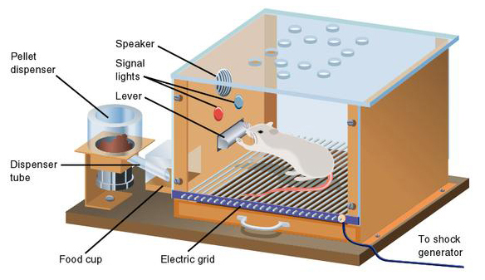
A Skinner box, also known as an operant conditioning chamber, is a device used to objectively record an animal's behavior in a compressed time frame.
An animal can be rewarded or punished for engaging in certain behaviors, such as lever pressing (for rats) or key pecking (for pigeons).

Slide 19
Skinner & Operant Conditioning
“The behavior is followed by a consequence, and the nature of the consequence modifies the organism’s tendency to repeat the behavior in the future.”
(Skinner)
“All we need to know in order to describe and explain behavior is this: actions followed by good outcomes are likely to recur , and actions followed by bad outcomes are less likely to recur.”
(Skinner, 1953)

Slide 20
Operant Conditioning
Skinner used the term operant to refer to any "active behavior that operates upon the environment to generate consequences" (1953).
Operant behavior: occurs without an observable external stimulus
Operates on the organism’s environment
The behavior is instrumental in securing a stimulus more representative of everyday learning

Slide 21
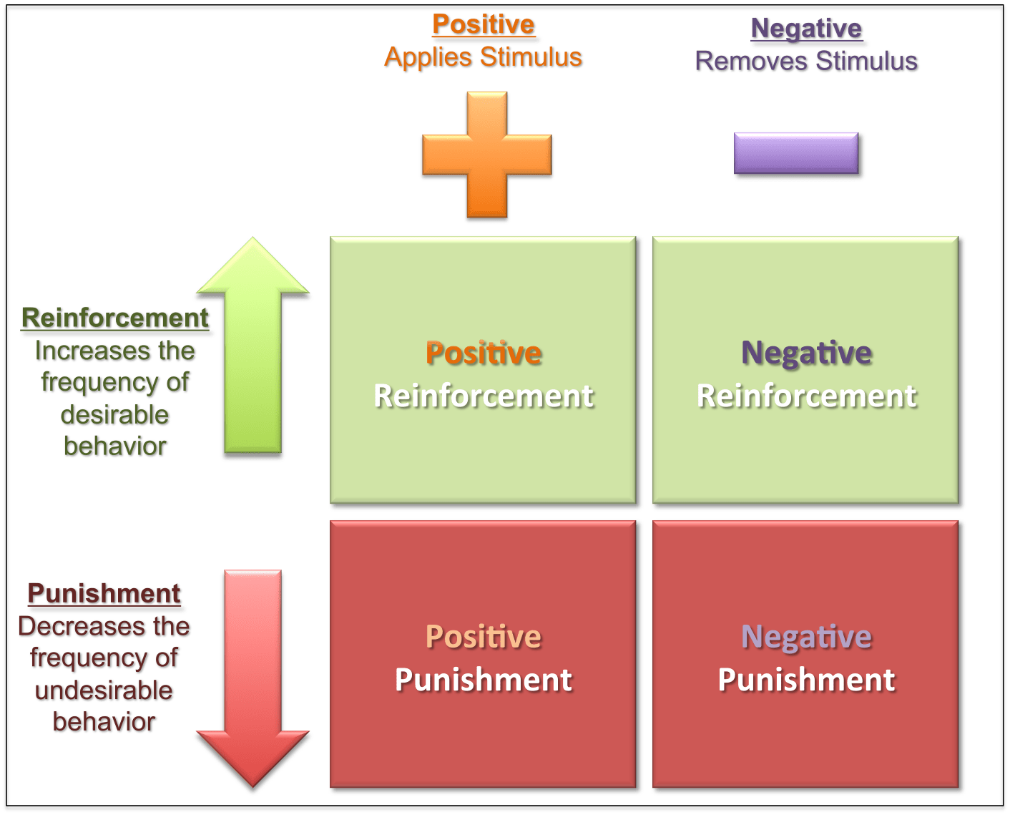

Slide 22
REINFORCEMENT
“REINFORCEMENT" refers to anything that increases the likelihood that a response will occur. For example, reinforcement might involve presenting praise (a reinforcer) immediately after a child puts away their toys (the response).
POSITIVE REINFORCEMENT adds a rewarding consequence as a positive reinforcer to behavior, therefore strengthening or increasing the likelihood that the desired behavior will appear again.
Examples: A parent gives their child an extra allowance (reinforcer) for doing the dishes (desired behavior.)
NEGATIVE REINFORCEMENT removes an unpleasant stimulus to increase the desired behavior in the future.
Examples: Workers won’t get yelled at (unpleasant stimulus) when they arrive at work on time (wanted behavior.)

Slide 23
PUNISHMENT
Punishment is the opposite of reinforcement. It aims to reduce bad behavior.
Like reinforcement, punishment also comes in two forms: positive punishment and negative punishment.
POSITIVE PUNISHMENT adds an unpleasant stimulus to weaken or eliminate a behavior. Positive punishment is usually what we refer to as “punishment” in our everyday lives.
Examples: The teacher gives a student extra homework (aversive stimulus) for making noise in class (undesired behavior.)
NEGATIVE PUNISHMENT removes a pleasant stimulus to stop undesired behavior.
Examples: A parent takes away their child’s phone (pleasant stimulus) for watching too many videos (bad behavior.)
The police revoke the driver’s license (pleasant stimulus) for reckless driving (unwanted behavior.)

Slide 24
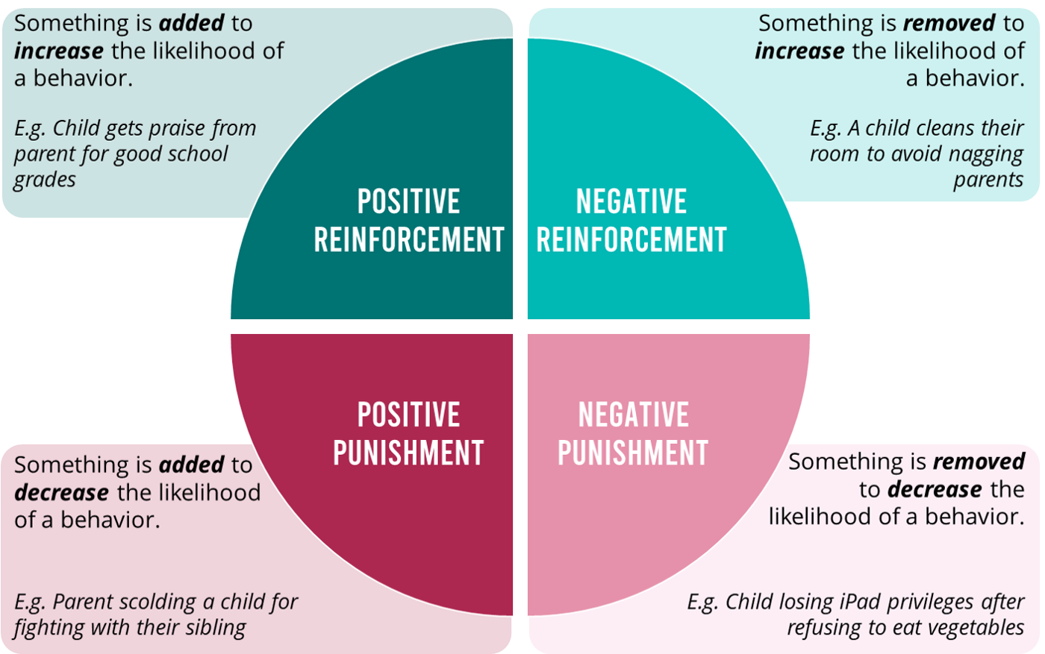

Slide 25
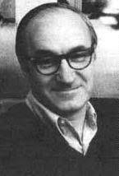
Albert Bandura
Social Learning theory was proposed by Albert Bandura’
The theory focused on both modeling and cognition, and their role in understanding behavior.

Slide 26
Bandura’s Views
Humans learn by watching others.
You don’t have to produce a behavior yourself, to learn the consequences of producing such behavior.
E.g., Dia learns not to jump on the coffee table, because she watched her brother get into trouble for doing so last week.
He argued that we acquire behaviors & are influenced by observing others.

Slide 27
Bandura’s Experiment
https://www.youtube.com/watch?v=dmBqwWlJg8U

Slide 28
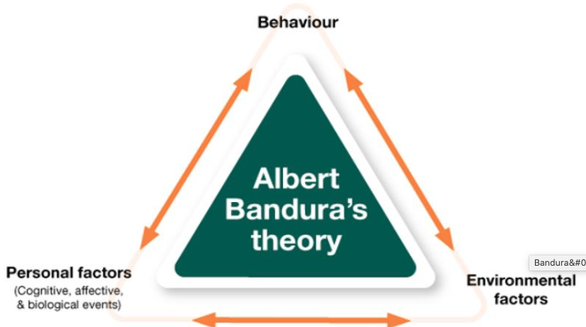

Slide 29
Key Elements of Observational Learning
Attention
Motor skills
Motivation
In order for observational learning to be successful, you have to be motivated to imitate the behavior that has been modeled.
Reinforcement and punishment play an important role in motivation.
Memory
Retention of the observed behavior

Slide 30


