Slide 1
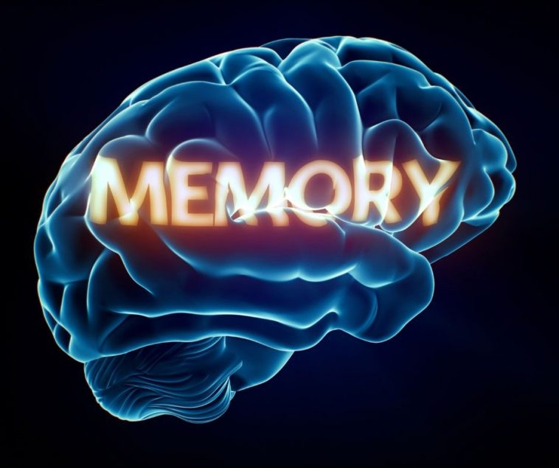

Slide 2
WHAT IS MEMORY?
Any system – human, animal, or machine – that encodes, stores, and retrieves information
Memory is the process of maintaining information over time.

Slide 3
HUMAN MEMORY IS GOOD AT
Information on which attention is focused
Information in which we are interested
Information that arouses us emotionally
Information that fits with our previous experiences
Information that we rehearse

Slide 4
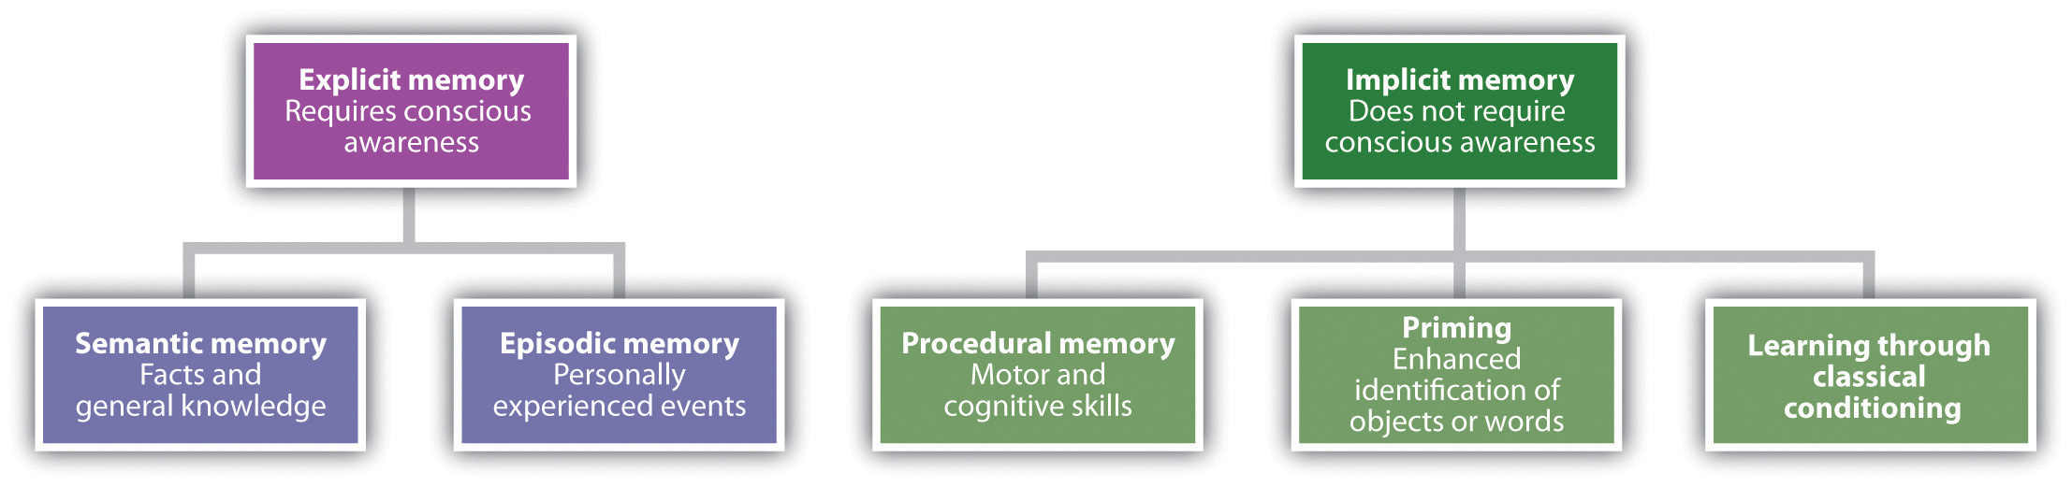

Slide 5
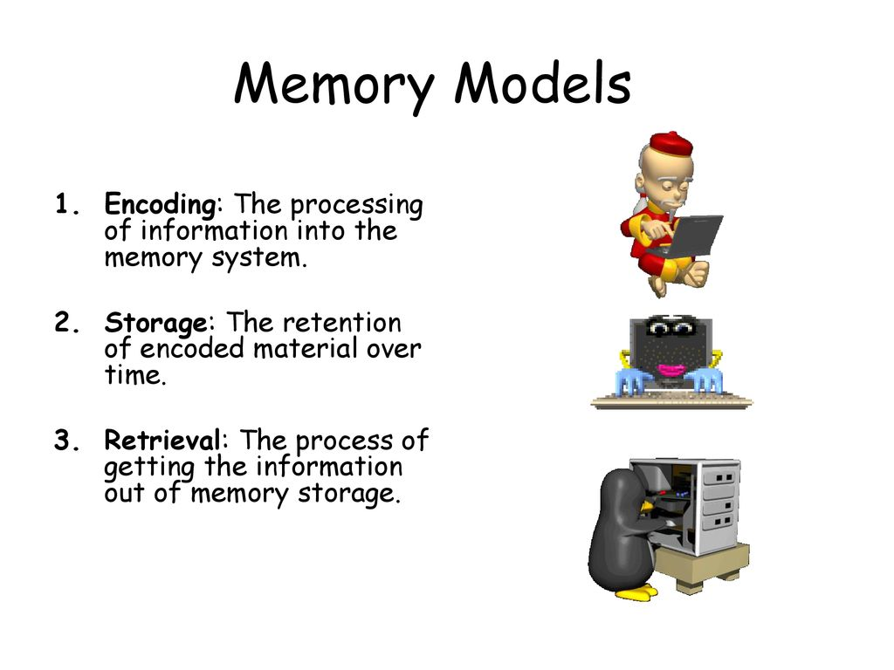

Slide 6
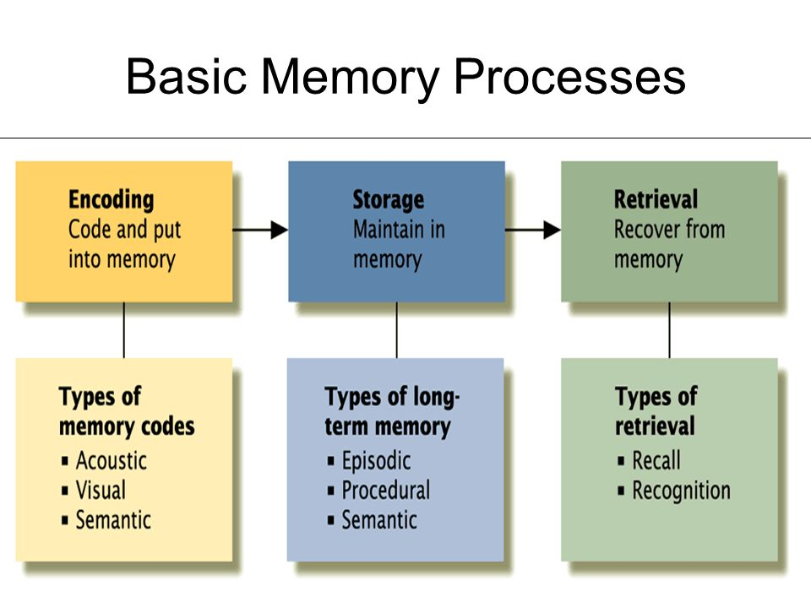

Slide 7
Stages of Memory
Sensory, Short-Term, and Long-Term Memory
Information begins in sensory memory, moves to short-term memory, and eventually moves to long-term memory.
But not all information makes it through all three stages; most of it is forgotten..

Slide 8
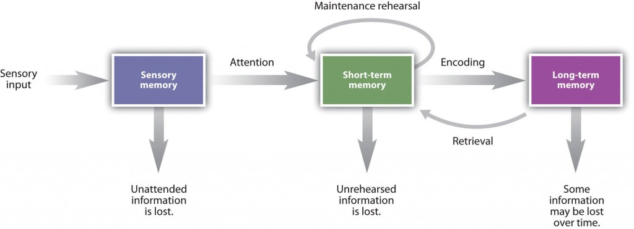

Slide 9
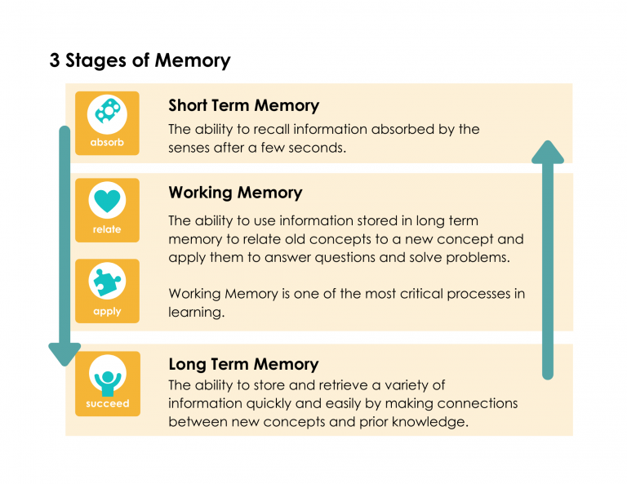

Slide 10
Sensory Memory
Sensory memory refers to the brief storage of sensory information.
Sensory memory is a memory buffer that lasts only very briefly and then, unless it is attended to and passed on for more processing, is forgotten.

Slide 11
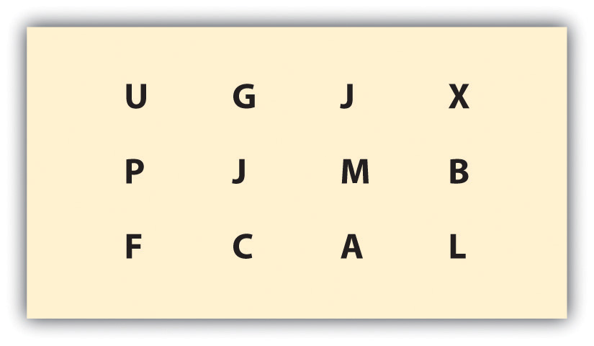

Slide 12
Short Term Memory
Information that we turn our attention to, with the goal of remembering it, may pass into short-term memory.
Short-term memory (STM) is the place where small amounts of information can be temporarily kept for more than a few seconds but usually for less than one minute.

Slide 13
Working Memory
The processes that we use to make sense of, modify, interpret, and store information in STM are known as working memory.
Working memory is not a store of memory like STM but rather a set of memory procedures or operations.

Slide 14
Exercise
Write down as many of the numbers as you can remember.
019
3586
10295
861059
1029384
75674834
657874104
6550423897

Slide 15
The digit span of most adults is between five and nine digits, with an average of about seven.
The cognitive psychologist George Miller (1956) referred to “seven plus or minus two” pieces of information as the magic number in short-term memory.

Slide 16
ENCODING & STORAGE IN WORKING MEMORY
Chunking is the process of organizing information into smaller groupings (chunks), thereby increasing the number of items that can be held in STM.
For instance, try to remember this string of 12 letters:
XOFCBANNCVTM

Slide 17
Storage of Memory
Maintenance rehearsal
Process in which information is repeated or reviewed to keep it from fading while in working memory

Slide 18
Elaborative rehearsal
Process in which information is actively reviewed and related to information already in LTM
For e.g. remembering name
Acoustic encoding
Conversion of information to sound patterns in working memory
Rhyming words in poems

Slide 19
LONG-TERM MEMORY
If information makes it past short term-memory it may enter long-term memory (LTM), memory storage that can hold information for days, months, and years.
Capacity: Unlimited

Slide 20
Types of Long Term Memory
Procedural memory
Division of LTM that stores memories for how things are done for e.g. driving, operating IOS
Declarative memory
Division of LTM that stores explicit information (also known as fact memory)
Dates (birth, anniversary), numbers , frequencies

Slide 21
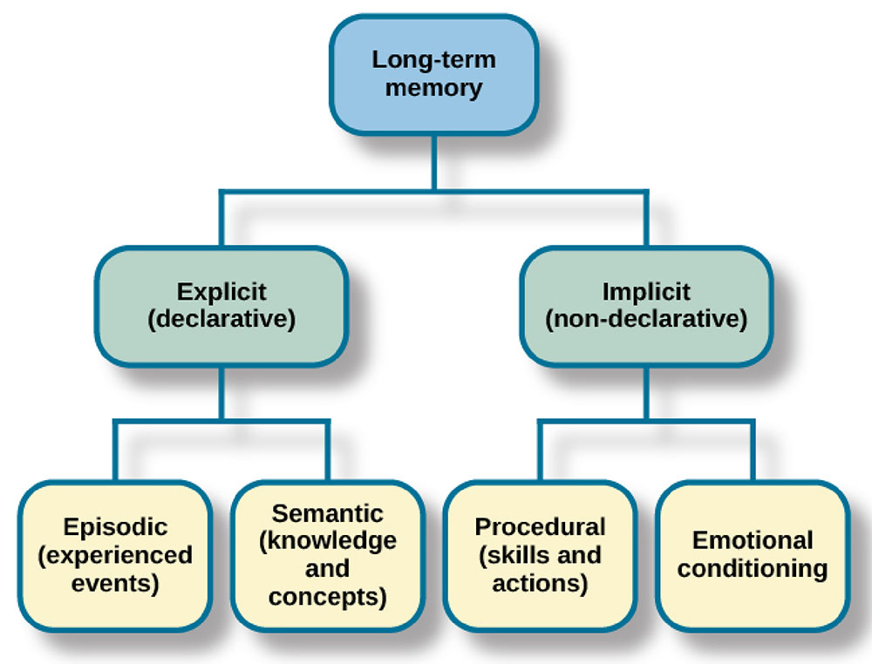

Slide 22
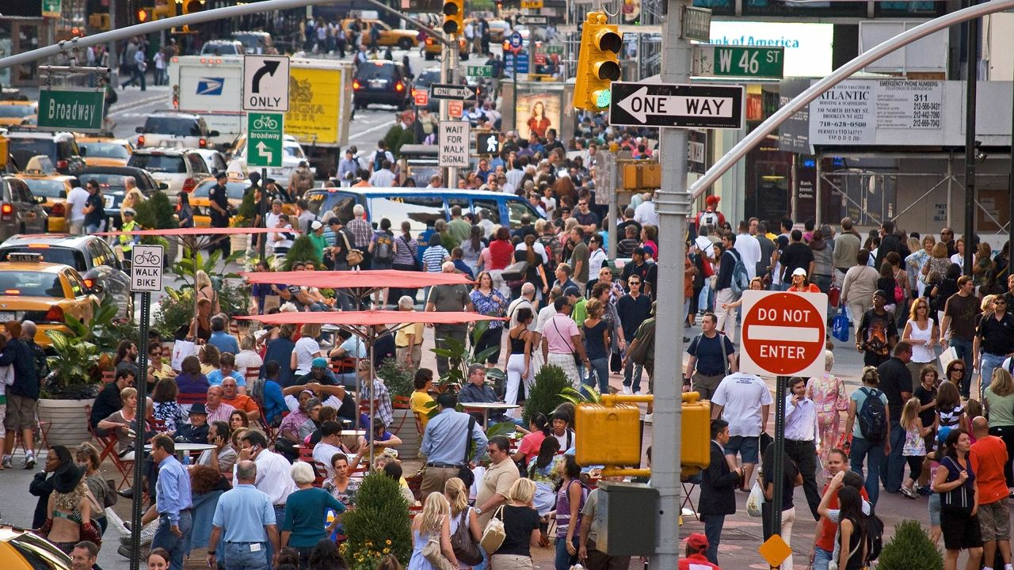

Slide 23
Whether memories are implicit or explicit, successful retrieval depends on how they were encoded and how they are cued
Implicit memory
Memory that was not deliberately learned or of which you have no conscious awareness
Explicit memory
Memory that has been processed with attention and can be consciously recalled

Slide 24
RETRIEVING IMPLICIT MEMORY
PRIMING
Technique for retrieving implicit memories by providing cues that stimulate a memory without awareness of the connection between the cue and the retrieved memory

Slide 25
PRIMING
If you are presented with the following words:
assassin, octopus, avocado, mystery, sheriff, climate

Slide 26
PRIMING
An hour later, you would easily be able to identify which of the following words you had previously seen
twilight, assassin, dinosaur, mystery

Slide 27
PRIMING
However, an hour later, you would also have a
much easier time filling in the blanks of some of
these words than others:
ch_ _ _ _ nk
o _ t _ _ _ us
_ og _ y _ _ _
_ l _ m _ te

Slide 28
While you did not actively try to remember
“octopus” and “climate” from the first list, they were primed in the reading, which made them easier to identify in this task
chipmunk
octopus
bogeyman
climate

Slide 29
RETRIEVING EXPLICIT MEMORIES
Anything stored in LTM must be filed according to its pattern or meaning
Recall
Technique for retrieving explicit memories in which one must reproduce previously presented information
Example: essay test
Recognition
Technique for retrieving explicit memories in which one must identify present stimuli as having been previously presented
Example: multiple-choice test

Slide 30
OTHER FACTORS AFFECTING RETRIEVAL
Encoding specificity principle
The more closely the retrieval clues match the form in which the information was encoded, the better the information will be remembered
Shows how memories are linked to the context where they are created
State/mood congruent memory
Formed during a particular physiological or psychological state will be easier to recall while in similar state

Slide 31
WHY WE FORGET?
Repression
Suppression
Brain tumor
Diseases of the nervous system
Old age
Accidental injuries
Organic Decay
Those traces which do not get reinforced by training and practice, will fade away with time.
Retroactive Inhibition (Interference)
Proactive Inhibition (Interference)

Slide 32
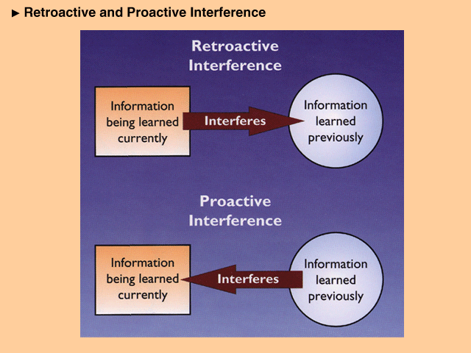

Slide 33
How Can We Improve Memory?
Organize material
Think and be sure that you understand the meaning of the material to be memorized
Establish memory cues (imagery can be useful)
PQRST
P= Preview
Q= Question
R= Read
S= Self recitation
T= Test

Slide 34
EYEWITNESS TESTIMONY… IS IT RELIABLE?
Witnesses reconstruct memory
Time gap
Focus of eyewitness
Can form false memories

