Slide 1
Intelligence and the Assessment of Intelligence

Slide 2
Intelligence
Based on the definitions, it is:
Rational thought and reasoning
The ability
to act purposefully in an environment.
to deal with situations, in an effective manner, within an environment.
to learn from experience
to live and cope with the demands of daily life

Slide 3
Defining Intelligence
Mental activity directed towards purposive adaptation to, and selection and shaping of, real-world environments relevant to ones life”
(Sternberg, 1985)
“the aggregate or global capacity of the individual to act purposefully, to think rationally, and to deal effectively with the environment”
(Wechsler, 1958)

Slide 4
What Factors Determine Intelligence?
Both genetics and the environment play a role in determining intelligence.
It is important to note that genetics and the environment interact to determine exactly how inherited genes are expressed.

Slide 5
Genetics
Heritability estimates for IQ is about .50 in a population
Environment
Like other traits, IQ is changeable (height for example).
Educational experiences affect IQ
IQ scores have increased over the years (nutritional factors, increasing access to information)

Slide 6
Theories of Intelligence
Charles Spearman: General Intelligence
General intelligence, also known as ‘g’ factor, refers to the existence of a general intelligence that influences performance on mental ability measures
Those who hold this view believe that intelligence can be measured and expressed by a single number, such as an IQ score.
The idea is that this underlying general intelligence influences performance on all cognitive tasks.
Notes:
Mental Ability: the power to learn or retain knowledge; in law, the ability to understand the facts and significance of your behavior;
possession of the qualities (especially mental qualities) required to do something or get something done

Slide 7
Mental Ability: the power to learn or retain knowledge; in law,
the ability to understand the facts and significance of your behavior;
possession of the qualities (especially mental qualities) required to do something or get something done

Slide 8
Raymond Cattell: Two-Factor Theory
Raymond Cattell (1963) believed that ‘g’ is composed of fluid and crystallized intelligence.
Fluid Intelligence & Crystallized Intelligence:
Crystallized intelligence is the ability to use knowledge and experience.
Fluid intelligence is the ability to solve new problems independently of knowledge or experience.

Slide 9
Howard Gardner: Multiple Intelligences
His theory describes eight distinct intelligences that are based on skills and abilities that are valued within different cultures.

Slide 10
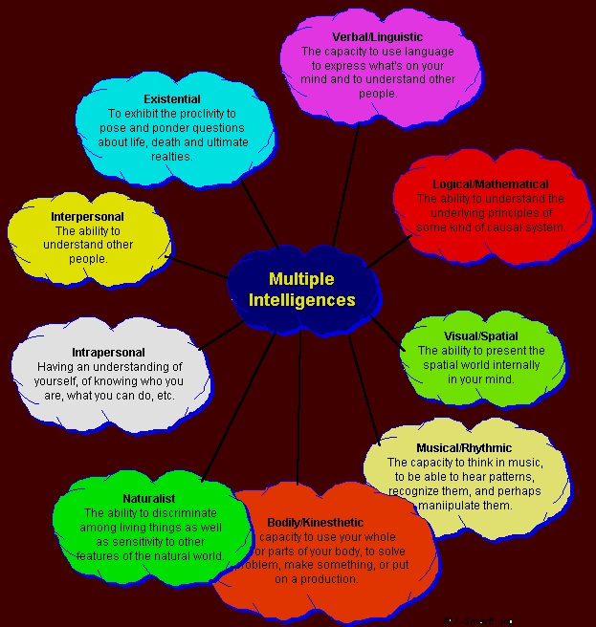

Slide 11
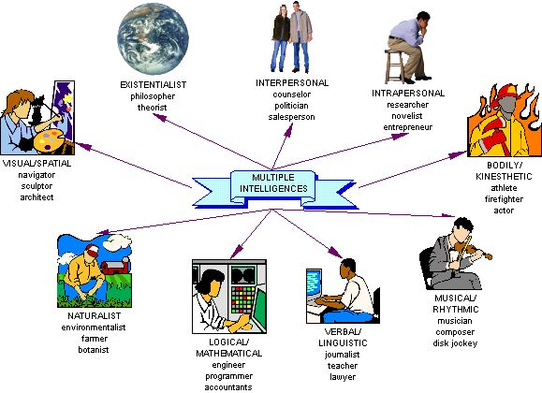

Slide 12
Purposes of Intellectual Assessment
Psycho-educational Assessment
Identification & placement of special-needs students.
Predict academic and work performance.
Evaluate for Mental Retardation & Learning Disabilities.
Evaluate for neurological impairment.
Career Counseling.
Research.

Slide 13
History of Intelligence Testing
Charles Darwin’s theory of evolution sparked interest in the study of differences in mental abilities.
Francis Galton, cousin of Charles Darwin, studied family trees to try to demonstrate a hereditary basis for intelligence.
Early intelligence tests measured sensory-motor functions, such as reaction time.
1905: Alfred Binet & Theodore Simon developed a test to identify mentally retarded students in Paris, France.
1916: Lewis Terman published the first version of the Stanford-Binet Intelligence Scale.
1939: David Wechsler published the Wechsler-Bellevue Scale.

Slide 14
Intelligence Quotient (IQ)
It is a mathematical formula that is supposed to be a measure of a person's intelligence.
The term "intelligence quotient," or IQ, was first coined in the early twentieth century by a German psychologist named William Stern.
Since that time, intelligence testing has emerged as a widely used tool that has led to the development of many other tests of skill and aptitude.

Slide 15
Intelligence Quotient
IQ= Mental age/Chronological Age X 100
IQ ratio enables direct comparison of children of different ages

Slide 16
Group Intelligence Tests
Paper-and-Pencil examinations frequently used to screen applicants & identify those in need of more thorough evaluations.
WWI: Army Alpha & Beta Tests.
Wonderlic Personnel Test: 50-item instrument that provides a quick estimate of cognitive ability. Popular in organizational settings to screen job applicants or make placement decisions.
Examples of items: analogies, definitions, logical reasoning, math, spatial reasoning,

Slide 17
The Wechsler Scales
Wechsler Intelligence Scale for Children (WISC-R)
Wechsler Adult Intelligence Scale (WAIS)
Wechsler Preschool and Primary Scale of Intelligence (WPPSI)

Slide 18
The Wechsler Scales
Verbal Subtests
Information: culturally acquired information
Vocabulary: general verbal intelligence
Arithmetic: numerical reasoning
Similarities: abstract reasoning
Comprehension: social norms
Digit Span: short term memory

Slide 19
The Wechsler Scales
Performance Subtests
Picture Completion: visual concentration and nonverbal general information
Picture Arrangement: ability to plan, interpret and anticipate in social context
Block Design: perceptual organization, spatial visualization and abstract concentration
Object Assembly: visual motor organ., synthesis
Digit Symbol: visual memory

Slide 20
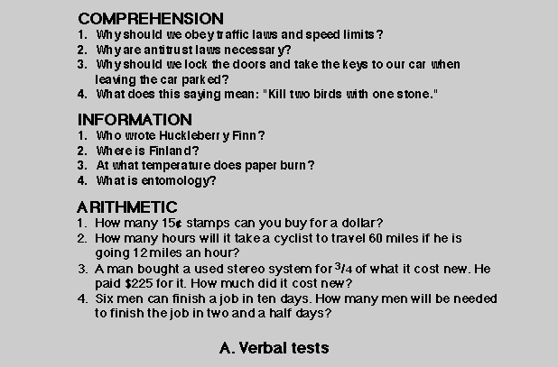

Slide 21
Similarities
In what way are an orange and a banana alike?
How are whales and lions similar?
How are anger and delight similar?
"In what way are RED and BLUE alike?

Slide 22
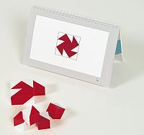
Block DEsign

Slide 23
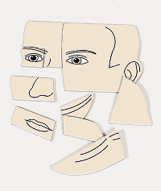
Object Assembling

Slide 24
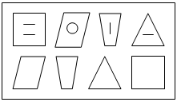
Digit symbol coding

Slide 25
Emotional intelligence
Emotional intelligence (EI) is the area of cognitive ability that facilitates interpersonal behavior.
The term emotional intelligence was popularized in 1995 by psychologist and behavioral science journalist Dr. Daniel Goleman in his book, Emotional Intelligence.
Dr. Goleman described emotional intelligence as a person's ability to manage his feelings so that those feelings are expressed appropriately and effectively.
According to Goleman, emotional intelligence is the largest single predictor of success in the workplace.

Slide 26
Five components of emotional intelligence
Self-awareness. A person has a healthy sense of emotional intelligence self-awareness if they understand their own strengths and weaknesses, as well as how their actions affect others.
Self-regulation. A person with a high emotional intelligence has the ability to exercise restraint and control when expressing their emotions.
Motivation. People with high emotional intelligence are self-motivated, resilient and driven by an inner ambition rather than being influenced by outside forces, such as money or prestige.
Empathy. An empathetic person has compassion and is able to connect with other people on an emotional level, helping them respond genuinely to other people's concerns.
Social skills. People who are emotionally intelligent are able to build trust with other people, and are able to quickly gain respect from the people they meet.

Slide 27


