Slide 1
UML Modeling

Slide 2
UML (Unified Modeling Language)
UML (Unified Modeling Language) is a standard language for specifying, visualizing, constructing, and documenting the artifacts of software systems.
UML is a pictorial language used to make software blueprints.
UML diagrams are not only made for developers but also for business users, common people, and anybody interested to understand the system. The system can be a software or non-software system.

Slide 3
UML MODEL
It is very important to distinguish between the UML model. Different diagrams are used for different types of UML modeling. There are three important types of UML modeling.

Slide 4
What is UML and Why we use UML?
Year Version
2003: UML 2.0
2001: UML 1.4
1999: UML 1.3
1997: UML 1.0, 1.1
1996: UML 0.9 & 0.91
1995: Unified Method 0.8
Booch ‘93
OMT - 2
Other methods
Booch ‘91
OMT - 1

Slide 5
UML MODEL
Structural Modeling
Structural modeling captures the static features of a system. They consist of the following −
Classes diagrams
Objects diagrams
Deployment diagrams
Component diagram

Slide 6
UML MODEL
Behavioral Modeling
Behavioral model describes the interaction in the system. It represents the interaction among the structural diagrams. Behavioral modeling shows the dynamic nature of the system. They consist of the following
Activity diagrams
Interaction diagrams
Use case diagrams

Slide 7
UML MODEL
Architectural Modeling
Architectural model represents the overall framework of the system. It contains both structural and behavioral elements of the system. Architectural model can be defined as the blueprint of the entire system. Package diagram comes under architectural modeling.

Slide 8
Basic Notations
Structural Things
Structural things define the static part of the model. They represent the physical and conceptual elements. Following are the brief descriptions of the structural things.

Slide 9
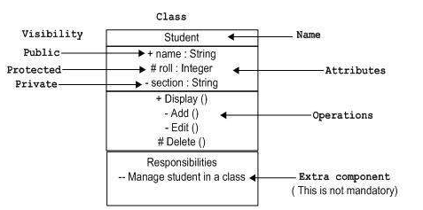
Basic Notations
Class Notation
UML class is represented by the following figure. Class represents a set of objects having similar responsibilities.

Slide 10
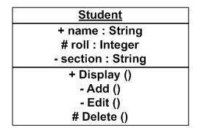
Basic Notations
Object Notation
The object is represented in the same way as the class. The only difference is the name which is underlined as shown in the following figure.

Slide 11
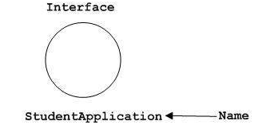
Basic Notations
Interface Notation
Interface is represented by a circle as shown in the following figure. It has a name which is generally written below the circle.

Slide 12
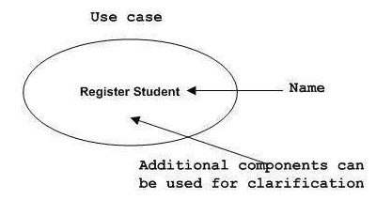
Basic Notations
Use Case Notation
Use case is represented as an eclipse with a name inside it. It may contain additional responsibilities.

Slide 13
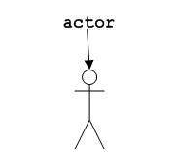
Basic Notations
Actor Notation
An actor can be defined as some internal or external entity that interacts with the system.

Slide 14

Basic Notations
Initial State Notation
Initial state is defined to show the start of a process. This notation is used in almost all diagrams.

Slide 15

Basic Notations
Final State Notation
Final state is used to show the end of a process. This notation is also used in almost all diagrams to describe the end.

Slide 16
Basic Notations
Relationships
A model is not complete unless the relationships between elements are described properly. The Relationship gives a proper meaning to a UML model. Following are the different types of relationships available in UML.

Slide 17
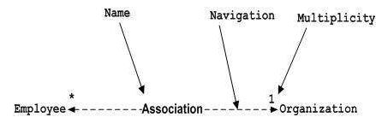
Basic Notations
Association Notation
Association describes how the elements in a UML diagram are associated. In simple words, it describes how many elements are taking part in an interaction.

Slide 18

Basic Notations
Generalization Notation
Generalization describes the inheritance relationship of the object-oriented world. It is a parent and child relationship.

Slide 19
Class Diagram
Class diagram is a static diagram. It represents the static view of an application. Class diagram is not only used for visualizing, describing, and documenting different aspects of a system but also for constructing executable code of the software application.

Slide 20
Class Diagram
Purpose of Class Diagrams
Analysis and design of the static view of an application.
Describe responsibilities of a system.
Base for component and deployment diagrams.

Slide 21
Class Diagram
Class Name
Following rules must be taken care of while representing a class:
A class name should always start with a capital letter.
A class name should always be in the center of the first compartment.
A class name should always be written in bold format.
An abstract class name should be written in italics format.

Slide 22
Class Diagram
Attributes characteristics
The attributes are generally written along with the visibility factor.
Public, private, protected and package are the four visibilities which are denoted by +, -, #, or ~ signs respectively.
Visibility describes the accessibility of an attribute of a class.
Attributes must have a meaningful name that describes the use of it in a class.

Slide 23
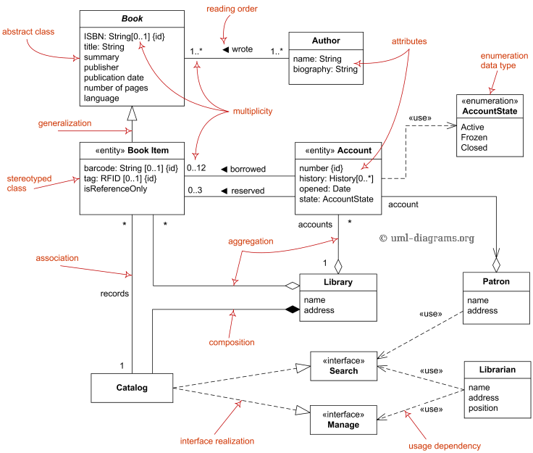
Class Diagrams

Slide 24
Use Case Diagrams
Only static behavior is not sufficient to model a system rather dynamic behavior is more important than static behavior. case diagram is dynamic in nature, there should be some internal or external factors for making the interaction.
The diagram is used to model the system/subsystem of an application. A single use case diagram captures a particular functionality of a system.
Hence to model the entire system, a number of use case diagrams are used.

Slide 25
Use Case Diagrams
Components of use case diagrams
Actors
System
Relationships
Use cases
Notes:
We can say that use cases are nothing but the system functionalities written in an organized manner. The second thing which is relevant to use cases are the actors. Actors can be defined as something that interacts with the system.
Actors can be a human user, some internal applications, or may be some external applications.

Slide 26
Use Case Diagrams
Used during requirements elicitation to represent external behavior
Actors represent roles, that is, a type of user of the system
Use cases represent a sequence of interaction for a type of functionality
The use case model is the set of all use cases. It is a complete description of the functionality of the system and its environment
Passenger
PurchaseTicket

Slide 27
Actors
An actor models an external entity which communicates with the system:
  User
  External system
  Physical environment
An actor has a unique name and an optional description.
Examples:
  Passenger: A person in the train
  GPS satellite: Provides the system with GPS coordinates
Passenger

Slide 28
Use Case
A use case represents a class of functionality provided by the system as an event flow.
A use case consists of:
Unique name
Participating actors
Entry conditions
Flow of events
Exit conditions
Special requirements
PurchaseTicket

Slide 29
Use Case Diagram: Example
Name: Purchase ticket
Participating actor: Passenger
Entry condition:
Passenger standing in front of ticket distributor.
Passenger has sufficient money to purchase ticket.
Exit condition:
Passenger has ticket.
Event flow:
1. Passenger selects the number of zones to be traveled.
2. Distributor displays the amount due.
3. Passenger inserts money, of at least the amount due.
4. Distributor returns change.
5. Distributor issues ticket.
Anything missing?
Exceptional cases!

Slide 30
The <<extends>> Relationship
<<extends>> relationships represent exceptional or seldom invoked cases.
The exceptional event flows are factored out of the main event flow for clarity.
Use cases representing exceptional flows can extend more than one use case.
The direction of a <<extends>> relationship is to the extended use case
Passenger
PurchaseTicket
<<extends>>
<<extends>>
<<extends>>
OutOfOrder
<<extends>>
TimeOut
Cancel
NoChange

Slide 31
The <<includes>> Relationship
<<includes>> relationship represents behavior that is factored out of the use case.
<<includes>> behavior is factored out for reuse, not because it is an exception.
The direction of a <<includes>> relationship is to the using use case (unlike <<extends>> relationships).
Passenger
PurchaseMultiCard
PurchaseSingleTicket
<<includes>>
<<includes>>
<<extends>>
CollectMoney
<<extends>>
NoChange
Cancel

Slide 32

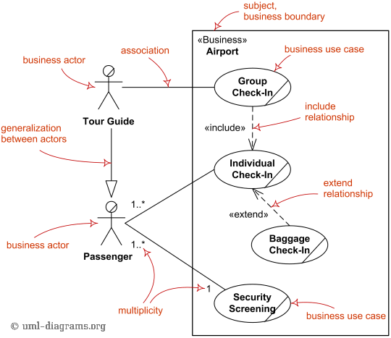
Use Case Diagram

Slide 33
The Sequence Diagram
The sequence diagram captures the time sequence of the message flow from one object to another.
Show how objects and classes interact with each other.
They show the sequence of events.

Slide 34
The Sequence Diagram
Actors
Objects
Lifeline
Message
  Call message
  return message
  self message
  create message
  destroy message
Activation boxes

Slide 35
UML sequence diagrams
Used during requirements analysis
  To refine use case descriptions
  to find additional objects (“participating objects”)
Used during system design
  to refine subsystem interfaces
Classes are represented by columns
Messages are represented by arrows
Activations are represented by narrow rectangles
Lifelines are represented by dashed lines
Passenger
TicketMachine
selectZone()
insertCoins()
pickupChange()
pickUpTicket()

Slide 36
Nested messages
Passenger
ZoneButton
TarifSchedule
Display
selectZone()
lookupPrice(selection)
price
Dataflow
displayPrice(price)
…to be continued...
The source of an arrow indicates the activation which sent the message
An activation is as long as all nested activations
Horizontal dashed arrows indicate data flow
Vertical dashed lines indicate lifelines

Slide 37
Iteration & condition
…continued from previous slide...
Passenger
ChangeProcessor
CoinIdentifier
Display
CoinDrop
*
insertChange(coin)
lookupCoin(coin)
Iteration
price
displayPrice(owedAmount)
Condition
[owedAmount<0] returnChange(-owedAmount)
…to be continued...
Iteration is denoted by a * preceding the message name
Condition is denoted by boolean expression in [ ] before the message name

Slide 38
Creation and destruction
…continued from previous slide...
Passenger
ChangeProcessor
Creation
createTicket(selection)
Ticket
print()
free()
Destruction
Creation is denoted by a message arrow pointing to the object.
Destruction is denoted by an X mark at the end of the destruction activation.
In garbage collection environments, destruction can be used to denote the end of the useful life of an object.

Slide 39
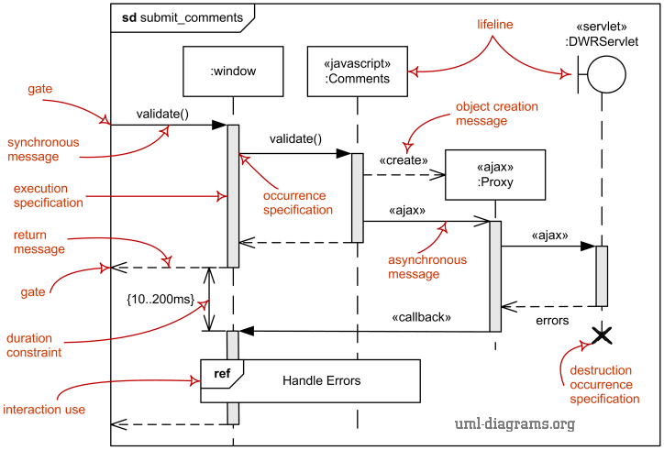
Sequence Diagram

Slide 40
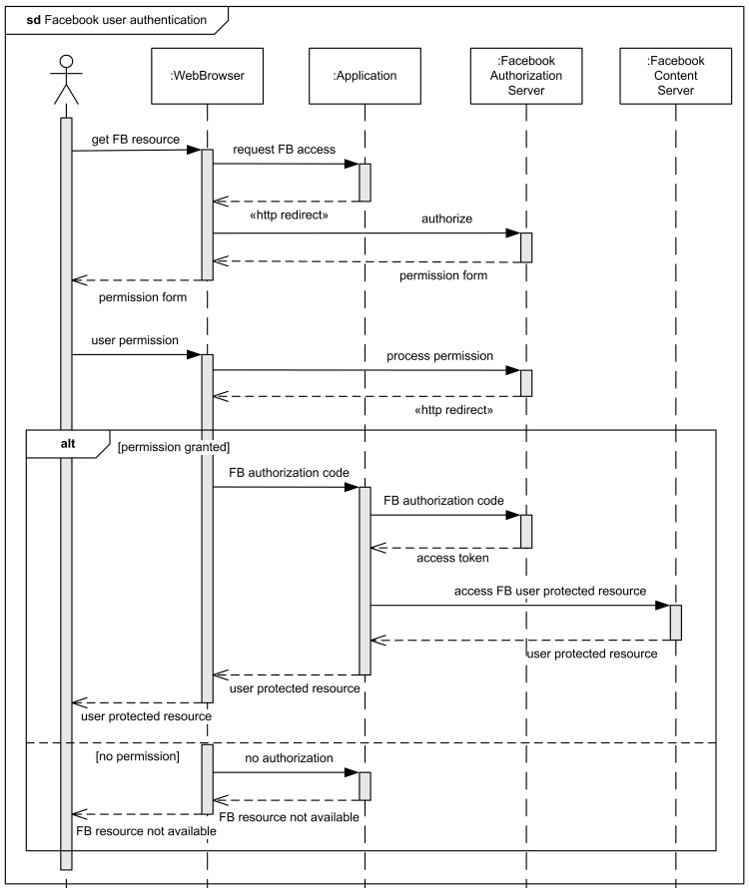

Slide 41
State Machine Diagrams
A state machine diagram models the behavior of a single object, specifying the sequence of events that an object goes through during its lifetime in response to events.
State machine diagrams can also be used to express the usage protocol of part of a system. Two kinds of state machines defined in UML 2.4 are
  Behavioral state machine
  Protocol state machine

Slide 42
  Protocol State Machine
UML protocol state machine diagrams display a sequence of events without specific behaviors.
UML Protocol state machine diagrams are a subset of state machine diagrams that display a sequence of events an object responds to, without having to show the specific behavior. Protocol state machines are most often used to describe complex protocols, such as database access through a specific interface, or communication protocols such as TCP/IP.

Slide 43
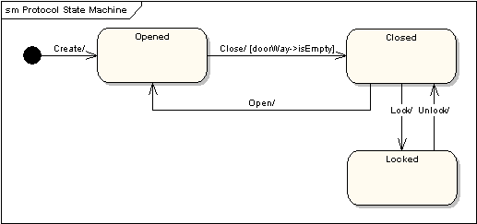
State Machine Diagrams
As an example, the following state machine diagram shows the states that a door goes through during its lifetime.
The door can be in one of three states: "Opened", "Closed" or "Locked". It can respond to the events Open, Close, Lock and Unlock. Notice that not all events are valid in all states; for example, if a door is opened, you cannot lock it until you close it. Also notice that a state transition can have a guard condition attached: if the door is Opened, it can only respond to the Close event if the condition doorWay->isEmpty is fulfilled. The syntax and conventions used in state machine diagrams will be discussed in full in the following sections.

Slide 44
State Transition Diagram
It describes different states of a component in a system. The states are specific to a component/object of a system.
A Statechart diagram describes a state machine. State machine can be defined as a machine which defines different states of an object and these states are controlled by external or internal events.

Slide 45
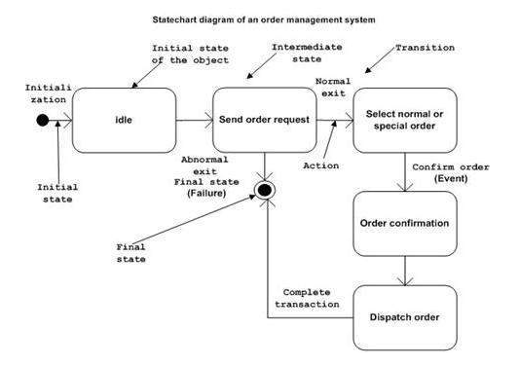
State Transition Diagram

Slide 46
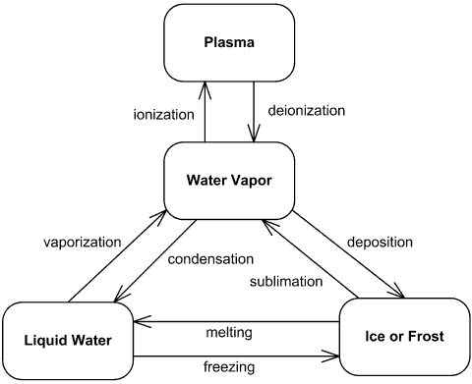
State Diagram

Slide 47
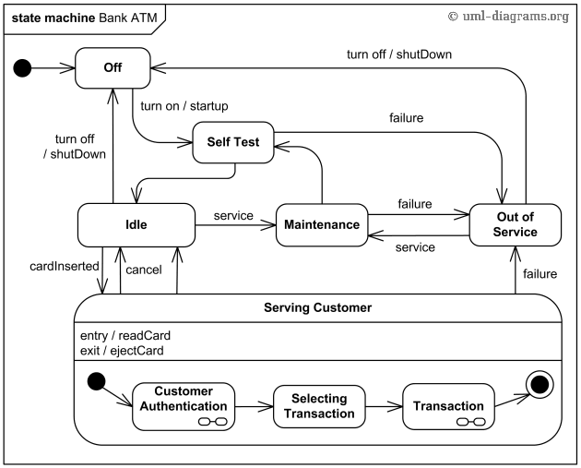

Slide 48
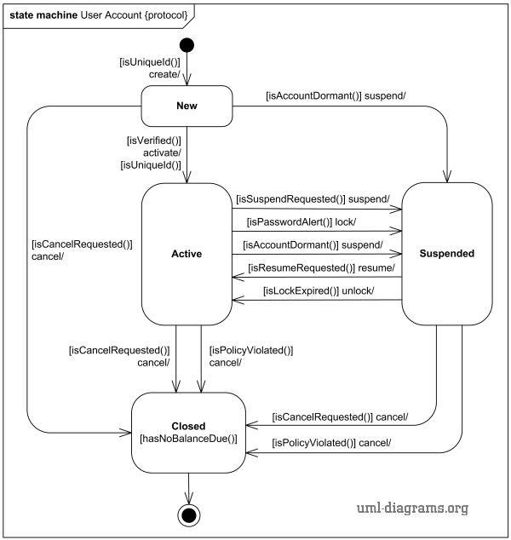

Slide 49
Activity Diagram
Activity diagram is basically a flowchart to represent the flow from one activity to another activity. The activity can be described as an operation of the system.

Slide 50
Activity Diagrams
An activity diagram shows flow control within a system
An activity diagram is a special case of a state chart diagram in which states are activities (“functions”)
Two types of states:
  Action state:
    Cannot be decomposed any further
    Happens “instantaneously” with respect to the level of abstraction used in the model
  Activity state:
    Can be decomposed further
    The activity is modeled by another activity diagram

Slide 51
Statechart Diagram vs. Activity Diagram
Statechart Diagram for Incident (similar to Mealy Automaton)
(State: Attribute or Collection of Attributes of object of type Incident)
Event causes
State transition
Active
Inactive
Closed
Archived
Incident-
Handled
Incident-
Documented
Incident-
Archived
Activity Diagram for Incident (similar to Moore
(State: Operation or Collection of Operations)
Completion of activity
causes state transition
Triggerless
Transition

Slide 52
Activity Diagram: Modeling Decisions

Slide 53
Activity Diagrams: Modeling Concurrency
Synchronization of multiple activities
Splitting the flow of control into multiple threads
Splitting
Synchronization

Slide 54
Activity Diagrams: Swimlanes
Actions may be grouped into swimlanes to denote the object or subsystem that implements the actions.
Allocate
Dispatcher
Resources
Open
Coordinate
Archive
Incident
Resources
Incident
FieldOfficer
Document
Incident

Slide 55
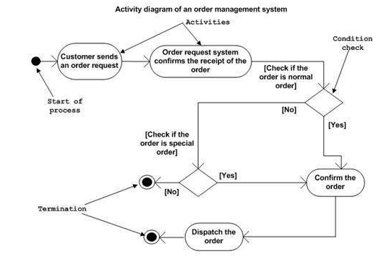
Activity Diagram

Slide 56
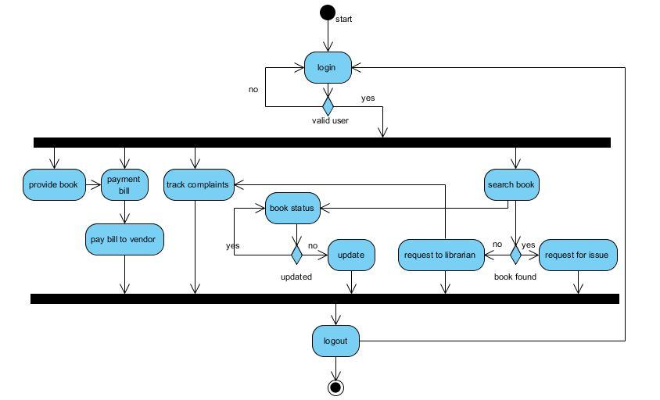
Activity Diagram

Slide 57
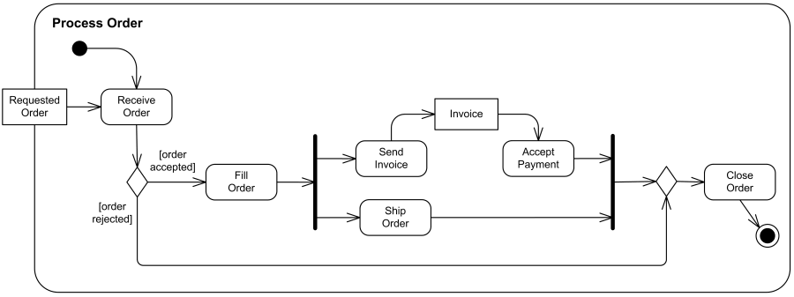
Activity Diagram

Slide 58
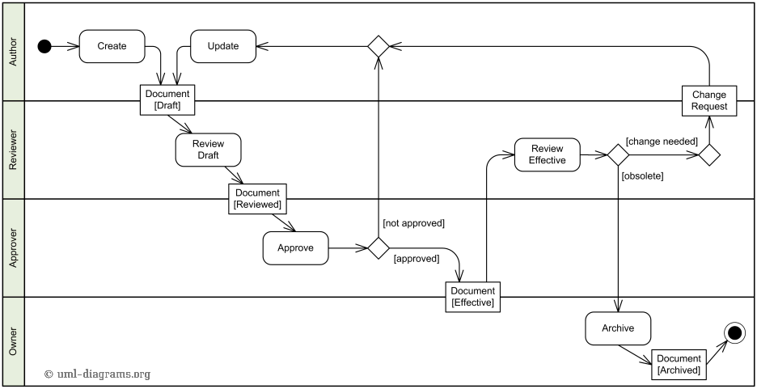

Slide 59
Package Diagram
Package diagrams organize the elements of a system into related groups to minimize dependencies among them.
Package diagrams are used to reflect the organization of packages and their elements.
When used to represent class elements, package diagrams provide a visualization of the namespaces.
The most common use for package diagrams is to organize use case diagrams and class diagrams, although the use of package diagrams is not limited to these UML elements.
Notes:
In general, a namespace is a container for a set of identifiers (also known as symbols, names).^{[1][2]} Namespaces provide a level of direction to specific identifiers, thus making it possible to distinguish between identifiers with the same exact name. For example, a surname could be thought of as a namespace that makes it possible to distinguish people who have the same given name. In computer programming, namespaces are typically employed for the purpose of grouping symbols and identifiers around a particular functionality.

Slide 60
Packages
A package is a UML mechanism for organizing elements into groups (usually not an application domain concept)
Packages are the basic grouping construct with which you may organize UML models to increase their readability.
A complex system can be decomposed into subsystems, where each subsystem is modeled as a package
DispatcherInterface
Notification
IncidentManagement

Slide 61
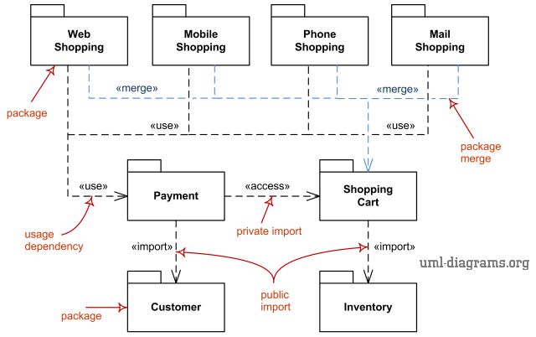
Package Diagram

Slide 62
Basic Package Diagram Symbols and Notations
Package:
A package is used to group elements, and provides a namespace for the grouped elements. A package is a namespace for its members, and may contain other packages.
Owned members of a package should all be package elements.
Package can also be merge with other package, thus provide the hierarchical organization of the package.
The members of the package may be shown within the boundaries of the package.
The elements that can be referred to within a package using non-qualified names are: Owned Element, Imported Element, and elements enclosing namespaces.
Owned and imported elements may have a visibility that determines whether they are available outside the package.

Slide 63
Component Diagram
Basics
The different high-level reusable parts of a system are represented in a Component diagram. A component is one such constituent part of a system. In addition to representing the high-level parts, the Component diagram also captures the inter-relationships between these parts.
The primary difference is that Component diagrams represent the implementation perspective of a system. Hence, components in a Component diagram reflect grouping of the different design elements of a system, for example, classes of the system.

Slide 64
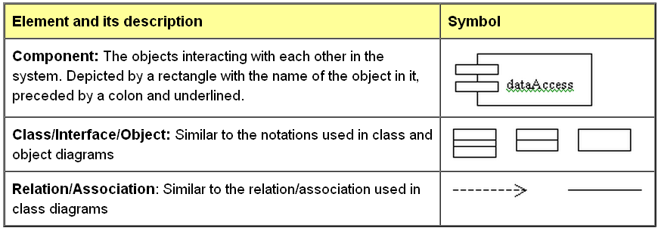
Component Diagram
Elements of a Component Diagram
A Component diagram consists of the following elements:

Slide 65
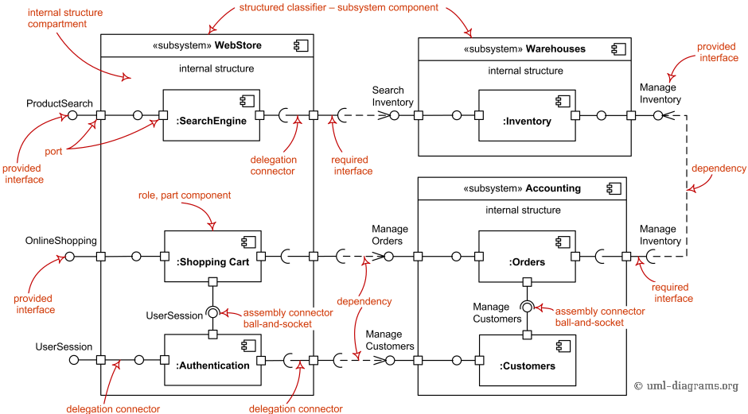
Component Diagram

Slide 66
Deployment Diagram
The deployment diagram provides a different perspective of the application. The deployment diagram captures the configuration of the runtime elements of the application.
This diagram is by far more useful when a system is built and ready to be deployed. But, this does not mean that you should start on your deployment diagram after your system is built.
On the contrary, your deployment diagram should start from the time your static design is being formalized using, say, class diagrams. This deployment diagram then evolves and is revised until the system is built.

Slide 67
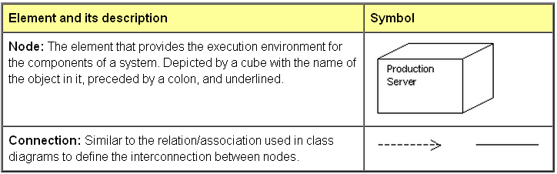
Deployment Diagram
Elements of a Deployment Diagram
A deployment diagram consists of the following elements:

Slide 68
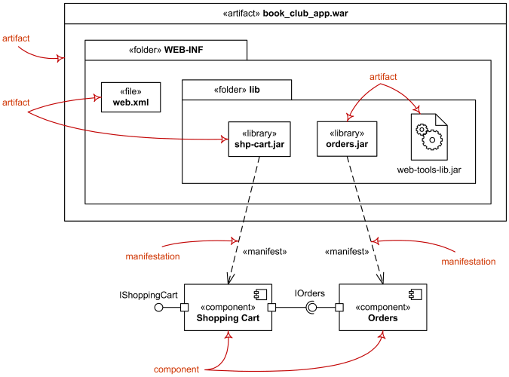
Deployment Diagram

Slide 69
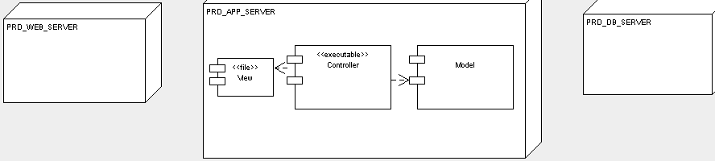
Deployment Diagram

