Slide 1
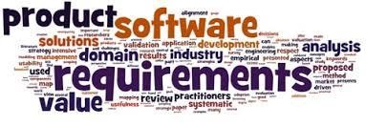
Software Requirement Engineering
Risk Reduction Through
Prototyping
Week # 14

Slide 2
Reading
“Sharon, today I’d like to talk with you about the requirements that the buyers in the Purchasing Department have for the new Chemical Tracking System,” began Lori, the requirements analyst. “Can you tell me what you want the system to do?” “Wow, I’m not sure how to do this,” replied Sharon with a puzzled expression. “I don’t know how to describe what I need, but I’ll know it when I see it.”

Slide 3
Discussion for Reading
IKIWISI—“I’ll know it when I see it”—is a phrase that chills the blood of requirements analysts.
Many people have difficulty describing their needs without having something tangible in front of them for reviewing is much easier than creating.
Software prototyping makes the requirements more real, brings use cases to life, and closes gaps in your understanding of the requirements.
Early feedback on prototypes helps the stakeholders arrive at a shared understanding of the system’s requirements, which reduces the risk of customer dissatisfaction.
Notes:
It conjures an image of the development team having to make their best guess at the right software to build, only to have users tell them, “Nope, that’s not right; try again.”
Prototyping puts a mock-up or an initial slice of a new system in front of users to stimulate their thinking and catalyze the requirements dialog

Slide 4
Prototyping: What and Why
A software prototype is a partial or possible implementation of a proposed new product. Prototypes serve three major purposes:
Clarify and complete the requirements. Used as a requirements tool, the prototype is a preliminary implementation of a part of the system that’s not well understood. User evaluation of the prototype points out problems with the requirements, which you can correct at low cost before you construct the actual product.
Explore design alternatives. Used as a design tool, a prototype lets stakeholders explore different user interaction techniques, optimize system usability, and evaluate potential technical approaches. Prototypes can demonstrate requirements feasibility through working designs.
Grow into the ultimate product. Used as a construction tool, a prototype is a functional implementation of an initial subset of the product, which can be elaborated into the complete product through a sequence of small-scale development cycles.
The primary reason for creating a prototype is to resolve uncertainties early in the development process. Use these uncertainties to decide which parts of the system to prototype and what you hope to learn from the prototype evaluations.
A prototype is useful for revealing and resolving ambiguity and incompleteness in the requirements.
Notes:
Users, managers, and other nontechnical stakeholders find that prototypes give them something concrete to contemplate
while the product is being specified and designed. Prototypes, especially visual ones, are easier to understand than the technical jargon that
developers sometimes use.

Slide 5
Types of Prototypes
Horizontal Prototypes
When people say “software prototype,” they are usually thinking about a horizontal prototype of a possible user interface. A horizontal prototype is also called a behavioral prototype or a mock-up. It is called horizontal because it doesn’t dive into all the layers of an architecture or into system details but rather primarily depicts a portion of the user interface.
This type of prototype lets you explore some specific behaviors of the intended system, with the goal of refining the requirements. The prototype helps users judge whether a system based on the prototype will let them get the job done.

Slide 6
Types of Prototypes
Horizontal Prototypes
Horizontal prototypes can demonstrate
the functional options the user will have available,
the look and feel of the user interface (colors, layout, graphics, controls), and
the information architecture (navigation structure). The navigations might work, but at some points the user might see only a message that describes what would really be displayed.
The information that appears in response to a database query could be faked or constant, and report contents are hardcoded. Try to use actual data in sample reports, charts, and tables to enhance the validity of the prototype as a model of the real system.

Slide 7
Types of Prototypes
Vertical Prototypes
A vertical prototype, also known as a structural prototype or proof of concept, implements a slice of application functionality from the user interface through the technical services layers.
A vertical prototype works like the real system is supposed to work because it touches on all levels of the system implementation.
Develop a vertical prototype when you’re uncertain whether a proposed architectural approach is feasible and sound, or when you want to optimize algorithms, evaluate a proposed database schema, or test critical timing requirements.
Notes:
To make the results meaningful, vertical prototypes are constructed using production tools in a production-like operating environment. Vertical prototypes are used to explore critical interface and timing requirements and to reduce risk during design.

Slide 8
Types of Prototypes
Throwaway Prototypes
Before constructing a prototype, make an explicit and well-communicated decision as to whether the prototype will be discarded after evaluation or become part of the delivered product.
Because you’ll discard the prototype after it has served its purpose, build it as quickly and cheaply as you can. The more effort you invest in the prototype, the more reluctant the project participants are to discard it.
When developers build a throwaway prototype, they ignore much of what they know about solid software construction techniques. A throwaway prototype emphasizes quick implementation and modification over robustness, reliability, performance, and long-term maintainability.
For this reason, don’t allow low-quality code from a throwaway prototype to migrate into a production system. Otherwise, the users and the maintainers will suffer the consequences for the life of the product.
The throwaway prototype is most appropriate when the team faces uncertainty, ambiguity, incompleteness, or vagueness in the requirements. Resolving these issues reduces the risk of proceeding with construction
Notes:
Build a throwaway prototype (or exploratory prototype) to answer questions, resolve uncertainties, and improve requirements
quality (Davis 1993).
. A prototype that helps users and developers visualize how the requirements might be implemented can reveal gaps in the requirements. It also lets users judge whether the requirements will enable the necessary business processes.

Slide 9
Types of Prototypes
Throwaway Prototypes
Figure 13-1 shows a sequence of development activities that move from use cases to detailed user interface design with the help of a throwaway prototype.
Notes:
Each use-case description includes a sequence of actor actions and system
responses, which you can model using a dialog map to depict a possible user
interface architecture. A throwaway prototype elaborates the dialog elements
into specific screens, menus, and dialog boxes. When users evaluate the prototype,
their feedback might lead to changes in the use-case descriptions (if, say,
an alternative course is discovered) or to changes in the dialog map. Once the
requirements are refined and the screens sketched out, each user interface element
can be optimized for usability. This progressive refinement approach is
cheaper than leaping directly from use-case descriptions to a complete user
interface implementation and then discovering major problems with the
requirements that necessitate extensive rework.

Slide 10
Types of Prototypes
Evolutionary Prototypes
In contrast to a throwaway prototype, an evolutionary prototype provides a solid architectural foundation for building the product incrementally as the requirements become clear over time.
Evolutionary prototyping is a component of the spiral software development life cycle model (Boehm 1988) and of some object-oriented software development processes (Kruchten 1996).
In contrast to he quick-and-dirty nature of throwaway prototyping, an evolutionary prototype must be built with robust, production-quality code from the outset. Therefore, an evolutionary prototype takes longer to create than a throwaway prototype that simulates the same system capabilities. An evolutionary prototype must be designed for easy growth and frequent enhancement, so developers must emphasize software architecture and solid design principles.

Slide 11
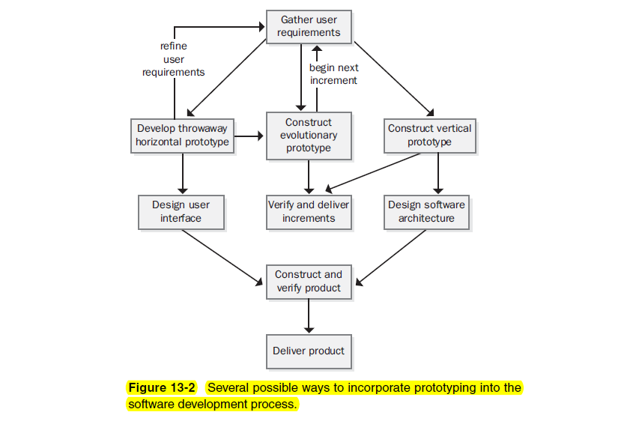
Types of Prototypes
Notes:
Figure 13-2 illustrates several ways to combine the various types of prototyping.
For example, you can use the knowledge gained from a series of throwaway
prototypes to refine the requirements, which you might then implement
incrementally through an evolutionary prototyping sequence. An alternative
path through Figure 13-2 uses a throwaway horizontal prototype to clarify the
requirements prior to finalizing the user interface design, while a concurrent
vertical prototyping effort validates the architecture, application components,
and core algorithms. What you cannot do successfully is turn the intentional
low quality of a throwaway prototype into the maintainable robustness that a
production system demands. In addition, working prototypes that appear to get
the job done for a handful of concurrent users likely won’t scale up to handle
thousands of users without major architectural changes. Table 13-1 summarizes
some typical applications of throwaway, evolutionary, horizontal, and vertical
prototypes.

Slide 13
Paper and Electronic Prototypes
You don’t always need an executable prototype to resolve requirements uncertainties. A paper prototype (sometimes called a lo-fi prototype) is a cheap, fast, and low-tech way to explore what a portion of an implemented system might look like (Rettig 1994; Hohmann 1997).
Paper prototypes help you test whether users and developers hold a shared understanding of the requirements. They let you take a tentative and low-risk step into a possible solution space prior to developing production code.
A similar technique is called a storyboard (Leffingwell and Widrig 2000). Storyboards often illustrate the proposed user interface without engaging the user in interacting with it.
Notes:
No matter how efficient your prototyping tools are, sketching displays on
paper is faster. Paper prototyping facilitates rapid iteration, and iteration is a key
success factor in requirements development. Paper prototyping is an excellent
technique for refining the requirements prior to designing detailed user interfaces,
constructing an evolutionary prototype, or undertaking traditional design
and construction activities. It also helps the development team manage customer
expectations.

Slide 14
Paper and Electronic Prototypes
If you decide to build an electronic throwaway prototype, several appropriate tools are available (Andriole 1996). These include the following:
Programming languages such as Microsoft Visual Basic, IBM
VisualAge Smalltalk, and Inprise Delphi
Scripting languages such as Perl, Python, and Rexx
Commercial prototyping tool kits, screen painters, and graphical user interface builders
Drawing tools such as Microsoft Visio and Microsoft PowerPoint

Slide 15
The Risks of Prototyping
Although prototyping reduces the risk of software project failure, it introduces its own risks. The biggest risk is that a stakeholder will see a running prototype and conclude that the product is nearly completed.
“Wow, it looks like you’re almost done!” says the enthusiastic prototype evaluator. “It looks great. Can you just finish this up and give it to me?”

Slide 16
The Risks of Prototyping
Another risk of prototyping is that users become fixated on the how aspects of the system, focusing on how the user interface will look and how it will operate.
A third risk is that users will infer the expected performance of the final product from the prototype’s performance. You won’t be evaluating a horizontal prototype in the intended production environment. You might have built it using tools that differ in efficiency from the production development tools, such as interpreted scripts versus compiled code. A vertical prototype might not use tuned algorithms, or it might lack security layers that will compromise the ultimate performance. If evaluators see the prototype respond instantaneously to a simulated database query using hard-coded query results, they might expect the same fabulous performance in the production software with an enormous distributed database.

Slide 17
Prototyping Success Factors
To make prototyping an effective part of your requirements process, follow these guidelines:
Include prototyping tasks in your project plan. Schedule time and resources to develop, evaluate, and modify the prototypes.
State the purpose of each prototype before you build it.
Plan to develop multiple prototypes. You’ll rarely get them right on the first try (which is the whole point of prototyping!).
Create throwaway prototypes as quickly and cheaply as possible. Invest the minimum effort in developing prototypes that will answer questions or resolve requirements uncertainties. Don’t try to perfect a throwaway prototype.
Don’t include extensive input data validations, defensive coding techniques, error-handling code, or code documentation in a throwaway prototype.

Slide 18
Prototyping Success Factors
Don’t prototype requirements that you already understand, except to explore design alternatives.
Use plausible data in prototype screen displays and reports. Evaluators can be distracted by unrealistic data and fail to focus on the prototype as a model of how the real system might look and behave.
Don’t expect a prototype to fully replace an SRS. A lot of behind-thescenes functionality is only implied by the prototype and should be documented in an SRS to make it complete, specific, and traceable. The visible part of an application is the proverbial tip of the iceberg. Screen images don’t give the details of data field definitions and validation criteria, relationships between fields (such as UI controls that appear only if the user makes certain selections in other controls), exception handling, business rules, and other essential bits of information.

