Slide 1

Software Requirement Engineering
Validating the Requirements
Week # 14

Slide 2
Discussion regarding Reading
Most software developers have experienced the frustration of being asked to implement requirements that were ambiguous or incomplete. If they can’t get the information they need, the developers have to make their own interpretations, which aren’t always correct. Substantial effort is needed to fix requirement errors after work based on those requirements has already been completed.
Another study found that it took an average of 30 minutes to fix an error discovered during the requirements phase. In contrast, 5 to 17 hours were needed to correct a defect identified during system testing (Kelly, Sherif, and Hops 1992).
On many projects, testing is a late-stage activity. Requirements-related problems linger in the product until they’re finally revealed through time consuming system testing or by the customer. If you start your test planning and test-case development early, you’ll detect many errors shortly after they’re introduced. This prevents them from doing further damage and reduces your testing and maintenance costs.

Slide 3
Requirements Validation
Requirements validation activities attempt to ensure that
The SRS correctly describes the intended system capabilities and characteristics that will satisfy the various stakeholders’ needs.
The software requirements were correctly derived from the system requirements, business rules, or other sources.
The requirements are complete and of high quality.
All requirements representations are consistent with each other.
The requirements provide an adequate basis to proceed with design and construction.
Notes:
Validation ensures that the requirements exhibit the desirable characteristics of
excellent requirement statements (complete, correct, feasible, necessary, prioritized,
unambiguous, and verifiable) and of excellent requirements specifications
(complete, consistent, modifiable, and traceable).
Of course, you can validate only requirements that have been documented, not implicit requirements
that exist only in someone’s mind.
Validation isn’t a single discrete phase that you perform after gathering
and documenting all the requirements. Some validation activities, such as incremental
reviews of the growing SRS, are threaded throughout the iterative elicitation,
analysis, and specification processes.
Project participants sometimes are reluctant to invest time in reviewing
and testing an SRS. Intuitively, it seems that inserting time into the schedule to
improve requirements quality would delay the planned ship date by that same
duration. However, this expectation assumes a zero return on your investment
in requirements validation. In reality, that investment can actually shorten the
delivery schedule by reducing the rework required and by accelerating system
integration and testing (Blackburn, Scudder, and Van Wassenhove 1996).

Slide 5
Validation and verification
Precisely speaking, validation and verification are two different activities in software development.
Verification determines whether the product of some development activity meets its requirements (doing the thing right).
Validation assesses whether a product satisfies customer needs (doing the right thing).

Slide 6
Validation and verification
Validating requirements allows teams to build a correct solution that meets the stated business objectives. Requirements validation activities attempt to ensure that:
■ The software requirements accurately describe the intended system capabilities and properties that will satisfy the various stakeholders’ needs.
■ The software requirements are correctly derived from the business requirements, system requirements, business rules, and other sources.
■ The requirements are complete, feasible, and verifiable.
■ All requirements are necessary, and the entire set is sufficient to meet the business objectives.
■ All requirements representations are consistent with each other.
■ The requirements provide an adequate basis to proceed with design and construction.

Slide 7
Reviewing Requirements
Any time someone other than the author of a software work product examines the product for problems, a peer review is taking place. Reviewing requirements documents is a powerful technique for identifying ambiguous or unverifiable requirements, requirements that aren’t defined clearly enough for design to begin, and other problems.
Different kinds of peer reviews go by a variety of names (Wiegers 2002a). Informal reviews are useful for educating other people about the product and collecting unstructured feedback. However, they are not systematic, thorough, or performed in a consistent way.

Slide 8
Informal Review
Informal review approaches include:
A peer deskcheck, in which you ask one colleague to look over your work product
A passaround, in which you invite several colleagues to examine a deliverable concurrently
A walkthrough, during which the author describes a deliverable and solicits comments on it

Slide 9
Formal Review
In contrast to the ad hoc nature of informal reviews, formal peer reviews follow a well-defined process. A formal review produces a report that identifies the material, the reviewers, and the review team’s judgment as to whether the product is acceptable.
The best-established type of formal peer review is called an inspection (Gilb and Graham 1993; Radice 2002).
Notes:
The principal deliverable is a summary of the defects found and the issues raised. The members of a formal review team share responsibility for the quality of the review, although authors are ultimately responsible for the quality of the products they create (Freedman and Weinberg 1990).
If you’re serious about maximizing the quality of your software, your team
will inspect every requirements document it creates. Detailed inspection of
large requirements documents is tedious and time consuming. Nonetheless, the
people I know who have adopted requirements inspections agree that every
minute they spent was worthwhile.
If you don’t have time to inspect everything, use risk analysis to differentiate
those requirements that demand inspection from less critical material for which
an informal review will suffice. Begin holding SRS inspections when the
requirements are perhaps only 10 percent complete.
Detecting major defects early and spotting systemic problems in the way
the requirements are being written is a powerful way to prevent—not just
find—defects.

Slide 10

The Closer You Look, the More You See
On the Chemical Tracking System, the user representatives informally reviewed their latest contribution to the growing SRS after each elicitation workshop. These quick reviews uncovered many errors. After elicitation was complete, one analyst combined the input from all user classes into a single SRS of about 50 pages plus several appendices. Two analysts, one developer, three product champions, the project manager, and one tester then inspected this full SRS in three two-hour inspection meetings held over the course of a week. The inspectors found 223 additional errors, including dozens of major defects. All the inspectors agreed that the time they spent grinding through the SRS, one requirement at a time, saved the project team countless more hours in the long run.

Slide 11
The Inspection Process
Inspection is a well-defined multistage process. It involves a small team of trained participants who carefully examine a work product for defects and improvement opportunities.
Try to limit the team to six or fewer inspectors.
Participants
The participants in an inspection should represent four perspectives (Wiegers 2002a):
The author of the work product and perhaps peers of the author
The author of any predecessor work product or specification for the item being inspected
People who will do work based on the item being inspected
People who are responsible for work products that interface with the item being inspected
Notes:
This means that some perspectives
won’t be represented in every inspection. Large teams easily get
bogged down in side discussions, problem solving, and debates over whether
something is really an error. This reduces the rate at which they cover the material
during the inspection and increases the cost of finding each defect.
■ The author of the work product and perhaps peers of the author
The analyst who wrote the requirements document provides this perspective.
■ The author of any predecessor work product or specification
for the item being inspected
This might be a system engineer or an architect who can ensure
that the SRS properly details the system
specification. In the absence of a higher-level specification, the
inspection must include customer representatives to ensure that the
SRS describes their requirements correctly and completely.
■ People who will do work based on the item being inspected
For an SRS, you might include a developer, a tester, a project manager,
and a user documentation writer. These inspectors will detect
different kinds of problems. A tester is most likely to catch an unverifiable
requirement; a developer can spot requirements that are technically
infeasible.
■ People who are responsible for work products that interface
with the item being inspected
These inspectors will look for
problems with the external interface requirements. They can also
spot ripple effects, in which changing a requirement in the SRS being
inspected affects other systems.

Slide 12
The Inspection Process
Inspection Roles
All participants in an inspection, including the author, look for defects and improvement opportunities. Some of the inspection team members perform the following specific roles during the inspection.
Author
Moderator
Reader
Recorder
Notes:
Author
The author created or maintains the work product being inspected. The author of an SRS is usually the analyst who gathered customer requirements and wrote the specification. During informal reviews such as walkthroughs, the author often leads the discussion. However, the author takes a more passive role during an inspection. The author may not assume any of the other assigned roles—moderator, reader, or recorder. By not having an active role and by parking his ego at the door, the author can listen to the comments from other inspectors, respond to—but not debate—their questions, and think. The author will often spot errors that other inspectors don’t see.
Moderator
The moderator, or inspection leader, plans the inspection with the author, coordinates the activities, and facilitates the inspection meeting. The moderator distributes the materials to be inspected to the participants several days before the inspection meeting. Moderator responsibilities include starting the meeting on time, encouraging contributions from all participants, and keeping the meeting focused on finding defects rather than resolving problems. Reporting the inspection results to management or to someone who collects data from multiple inspections is another moderator activity. The moderator follows up on proposed changes with the author to ensure that the defects and issues that came out of the inspection were addressed properly.
Reader
One inspector is assigned the role of reader. During the inspection meeting, the reader paraphrases the SRS one requirement at a time. The other participants then point out potential defects and issues. By stating a requirement in her own words, the reader provides an interpretation that might differ from that held by other inspectors. This is a good way to reveal an ambiguity, a possible defect, or an assumption. It also underscores the value of having someone other than the author serve as the reader.
Recorder
The recorder, or scribe, uses standard forms to document the issues raised and the defects found during the inspection meeting. The recorder should review aloud what he wrote to confirm the record’s accuracy. The other inspectors should help the recorder capture the essence of each issue in a way that clearly communicates to the author the location and nature of the issue.

Slide 13
The Inspection Process
Entry Criteria
You’re ready to inspect a requirements document when it satisfies specific prerequisites.
Following are some suggested inspection entry criteria for requirements documents:
❏ The document conforms to the standard template.
❏ The document has been spell-checked.
❏ The author has visually examined the document for any layout errors.
❏ Any predecessor or reference documents that the inspectors will require to examine the document are available.
❏ Line numbers are printed on the document to facilitate referring to specific locations during the inspection meeting.
❏ All open issues are marked as TBD (to be determined).
❏ The moderator didn’t find more than three major defects in a ten-minute examination of a representative sample of the document.
Notes:
These entry criteria set some clear expectations for authors to follow while preparing for an inspection. They also keep the inspection team from spending time on issues that should be resolved prior to the inspection. The moderator uses the entry criteria as a checklist before deciding to proceed with the inspection.

Slide 14
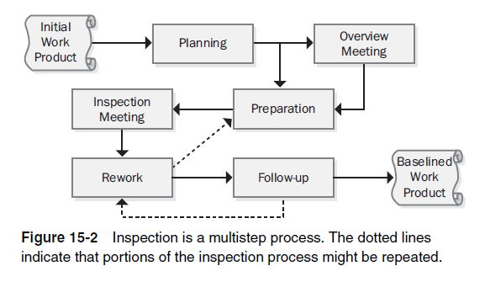
The Inspection Process
Inspection Stages
An inspection is a multistep process, as illustrated in Figure 15-2.
Notes:
As Figure 15-3 shows, proceeding through the SRS slowly reveals the most defects. (An alternative interpretation of this frequently reported relationship is that the inspection slows down if you encounter a lot of defects.) Because no team has infinite time available for requirements inspections, select an appropriate rate based on the risk of overlooking major defects. Two to four pages per hour is a practical guideline, although the optimum inspection rate for maximum defect-detection effectiveness is about half that rate (Gilb and Graham 1993).
Adjust this rate based on the following factors:
The team’s previous inspection data
The amount of text on each page
The specification’s complexity
The risk of having errors remain undetected
How critical the material being inspected is to project success
The experience level of the person who wrote the SRS

Slide 15
Inspection Stages
Planning
The author and moderator plan the inspection together. They determine who should participate, what materials the inspectors should receive prior to the inspection meeting, and how many inspection meetings will be needed to cover the material.
The inspection rate has a large impact on how many defects are found (Gilb and Graham 1993).
Overview meeting
During the overview meeting, the author describes the background of the material the team will be inspecting, any assumptions he made, and his specific inspection objectives. You can omit this stage if all inspectors are already familiar with the items being inspected.

Slide 16
Inspection Stages
Preparation
Prior to the inspection meeting, each inspector examines the product to identify possible defects and issues to be raised, using the checklists of typical defects described later in this chapter or other analysis techniques (Wiegers 2002a). Up to 75 percent of the defects found by an inspection are discovered during preparation (Humphrey 1989), so don’t omit this step.
Notes:
The techniques for finding missing requirements described
in Chapter 7, “Hearing the Voice of the Customer,” can be helpful during
inspection preparation.
Don’t proceed with an inspection meeting if the participants
haven’t already examined the work product on their own. Ineffective
meetings can lead to the erroneous conclusion that inspections are a
waste of time.

Slide 17
Inspection Stages
Inspection meeting
During the inspection meeting, the reader leads the other inspectors through the SRS, describing one requirement at a time in his or her own words. As inspectors bring up possible defects and other issues, the recorder captures them on a form that becomes the action item list for the requirements author. The purpose of the meeting is to identify as many major defects in the requirements document as possible.
The inspection meeting shouldn’t last more than about two hours because tired people aren’t effective inspectors. If you need more time to cover all the material, schedule another meeting.
At the meeting’s conclusion, the team decides whether to accept the requirements document as is, accept it with minor revisions, or indicate that major revision is needed. An outcome of major revision needed indicates problems with the requirements development process. Consider holding a retrospective to explore how the process can be improved prior to the next specification activity (Kerth 2001).

Slide 18
Inspection Stages
Rework
Nearly every quality control activity reveals some defects. The author should plan to spend some time reworking the requirements following the inspection meeting. Uncorrected requirement defects will be expensive to fix down the road, so this is the time to resolve the ambiguities, eliminate the fuzziness, and lay the foundation for a successful development project. There’s little point in holding an inspection if you don’t intend to correct the defects it reveals.
Follow-up
In this final inspection step, the moderator or a designated individual works with the author to ensure that all open issues were resolved and that errors were corrected properly. Follow-up brings closure to the inspection process and enables the moderator to determine whether the inspection’s exit criteria have been satisfied.

Slide 19
The Inspection Process
Exit Criteria
Your inspection process should define the exit criteria that must be satisfied before the moderator declares the inspection complete.
Here are some possible exit criteria for requirements document inspections:
❏ All issues raised during the inspection have been addressed.
❏ Any changes made in the document and related work products were made correctly.
❏ The revised document has been spell-checked.
❏ All TBDs have been resolved, or each TBD’s resolution process, target
date, and owner has been documented.
❏ The document has been checked into the project’s configuration
management system.

Slide 20
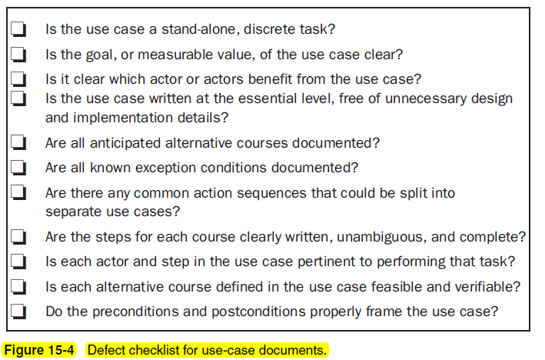
Defect Checklists
To help inspectors look for typical kinds of errors in the products they inspect, develop a defect checklist for each type of requirements document your organization creates. Such checklists call the inspectors’ attention to historically frequent requirement problems.

Slide 21
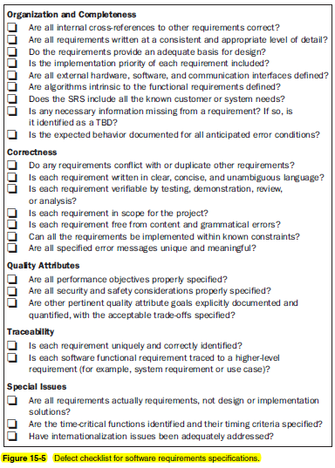
Defect Checklists

Slide 22
Requirements Review Challenges
Large requirements documents
Large inspection teams
Geographical separation of inspectors

Slide 23
Requirements review tips
Plan the examination
Start early
Allocate sufficient time
Provide context
Set review scope
Limit re-reviews
Prioritize review areas

Slide 24
Requirements review challenges
Large requirements documents
Large inspection teams
Geographically separated reviewers
Unprepared reviewers

Slide 25
Testing the Requirements
It’s hard to visualize how a system will function under specific circumstances just by reading the SRS. Test cases that are based on the functional requirements or derived from user requirements help make the expected system behaviors tangible to the project participants.
If you begin to develop test cases as soon as portions of the requirements stabilize, you can find problems while it’s still possible to correct them inexpensively.
Writing black box (functional) test cases crystallizes your vision of how the system should behave under certain conditions. Vague and ambiguous requirements will jump out at you because you won’t be able to describe the expected system response. When analysts, developers, and customers walk through the test cases together, they’ll achieve a shared vision of how the product will work.

Slide 26
Making Charlie Happy
I once asked my group’s UNIX scripting guru, Charlie, to build a simple e-mail interface extension for a commercial defect-tracking system we were using. I wrote a dozen functional requirements that described how the e-mail interface should work. Charlie was thrilled. He’d written many scripts for people, but he’d never seen written requirements before. Unfortunately, I waited a couple of weeks before I wrote the test cases for this e-mail function. Sure enough, I had made an error in one of the requirements. I found the mistake because my mental image of how I expected the function to work, represented in about 20 test cases, was inconsistent with one requirement. Chagrined, I corrected the defective requirement before Charlie had completed his implementation, and when he delivered the script, it was defect free. It was a small victory, but small victories add up.

Slide 28
Test Cases
You can begin deriving conceptual test cases from use cases or other user requirements representations very early in the development process (Ambler 1995; Collard 1999; Armour and Miller 2001).
You can then use the test cases to evaluate textual requirements, analysis models, and prototypes.
The test cases should cover the normal course of the use case, alternative courses, and the exceptions you identified during elicitation and analysis.
For example, consider a use case called “View Order” for the Chemical Tracking System. Some conceptual test cases would be the following:
User enters order number to view, order exists, user placed the order. Expected result: show order details.
User enters order number to view, order doesn’t exist. Expected result: Display message “Sorry, I can’t find that order.”
User enters order number to view, order exists, user didn’t place the order. Expected result: Display message “Sorry, that’s not your order.”

Slide 29
Test Cases
As developers translate the requirements into user interface and technical designs, testers can elaborate the conceptual tests into detailed test procedures for formal system testing (Hsia, Kung, and Sell 1997).

Slide 30
Defining Acceptance Criteria
Software developers might believe that they’ve built the perfect product, but the customer is the final arbiter. Customers perform acceptance testing to determine whether a system satisfies its acceptance criteria (IEEE 1990).
Acceptance criteria—and hence acceptance testing—should evaluate whether the product satisfies its documented requirements and whether it is fit for use in the intended operating environment (Hsia, Kung, and Sell 1997).
Notes:
Key users should consider the
most commonly used and most important use cases when deciding how to
evaluate the software’s acceptability. Acceptance tests focus on the normal
courses of the use cases, not on the less common alternative courses or whether
the system handles every exception condition properly.
Having customers develop acceptance criteria thus provides another
opportunity to validate the most important requirements. It’s a shift in perspective
from the requirements-elicitation question of “What do you need to do with
the system?” to “How would you judge whether the system satisfies your
needs?” If the customer can’t express how she would evaluate the system’s satisfaction
of a particular requirement, that requirement is not stated sufficiently
clearly.

Slide 31
Acceptance criteria
Acceptance tests constitute just a subset of acceptance criteria. Acceptance criteria could also encompass dimensions such as the following:
■ Specific high-priority functionality that must be present and operating properly before the product could be accepted and used. (Other planned functionality could perhaps be delivered later, or capabilities that aren’t working quite right could be fixed without delaying an initial release.)
■ Essential nonfunctional criteria or quality metrics that must be satisfied. (Certain quality attributes must be at least minimally satisfied, although usability improvements, cosmetics, and performance tuning could be deferred. The product might have to meet quality metrics such as a certain minimum duration of operational usage without experiencing a failure.)
■ Remaining open issues and defects. (You might stipulate that no defects exceeding a particular severity level remain open against high-priority requirements, although minor bugs could still be present.)
■ Specific legal, regulatory, or contractual conditions. (These must be fully satisfied before the product is considered acceptable.)
■ Supporting transition, infrastructure , or other project (not product) requirements. (Perhaps training materials must be available and data conversions completed before the solution can be released.)

Slide 32
Acceptance criteria Agile projects
Agile projects create acceptance criteria based on user stories. As Dean Leffingwell (2011) put it,
Acceptance criteria are not functional or unit tests; rather, they are the conditions of satisfaction being placed on the system. Functional and unit tests go much deeper in testing all functional flows, exception flows, boundary conditions, and related functionality associated with the story.

