Slide 1

Software Requirement Engineering
Requirements Management
Week # 15

Slide 2

• Requirements Management Practices

Slide 3
Content
• Requirements Management Practices
• Requirement Management Process
• The requirements baseline
• Requirements version control
• Requirement attributes
• Tracking requirements status

Slide 5
Requirements management process
• Requirements management includes all activities that maintain the integrity, accuracy, and currency of requirements agreements throughout the project.
• Figure 27-1 shows the core activities of requirements management in four major categories: version control, change control, requirements status tracking, and requirements tracing.

Slide 6
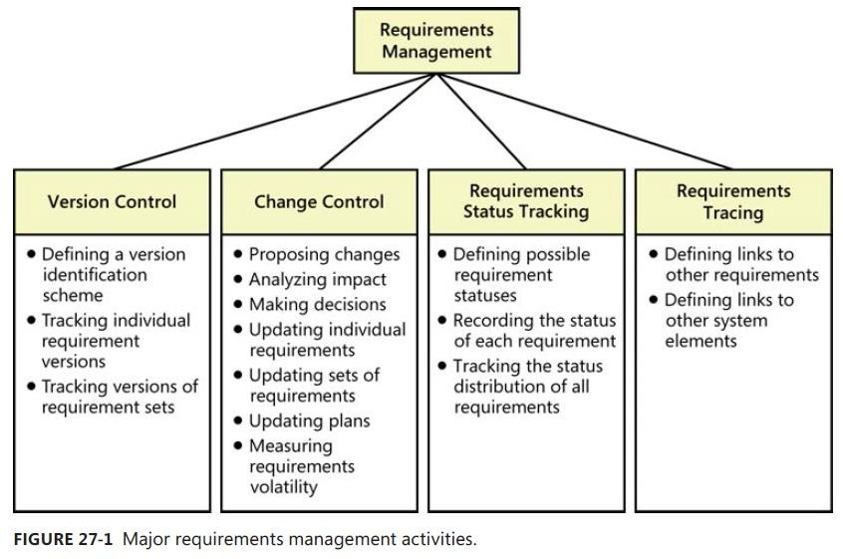
Requirements management process

Slide 8
The requirements baseline
• Requirements baseline is a set of requirements that stakeholders have agreed to, often defining the contents of a specific planned release or development iteration.
• The project might have additional agreements regarding deliverables, constraints, schedules, budgets, transition requirements, and contracts.

Slide 9
The requirements baseline
• Requirements development involves activities to elicit, analyze, specify, and validate a software project’s requirements.
• Requirements development deliverables include business requirements, user requirements, functional and nonfunctional requirements, a data dictionary, and various analysis models.
• After they are reviewed and approved, any defined subset of these items constitutes a requirements baseline.

Slide 10
The requirements baseline
• At the time a set of requirements is baselined—typically following review and approval—the requirements are placed under configuration (or change) management.
• Subsequent changes can be made only through the project’s defined change control procedure.

Slide 11
The requirements baseline
• A baseline could consist of some or all the requirements in a particular SRS (whether for an entire product or a single release), or a designated set of requirements stored in an RM tool, or an agreed-on set of user stories for a single iteration on an agile project.
• A development team that accepts proposed requirement changes or additions might not be able to fulfill its existing schedule and quality commitments.

Slide 12
The requirements baseline
• The project manager must negotiate changes to those commitments with affected managers, customers, and other stakeholders. The project can accommodate new or changed requirements in various ways:
▫ By deferring lower-priority requirements to later iterations or cutting them completely
▫ By obtaining additional staff or outsourcing some of the work
▫ By extending the delivery schedule or adding iterations to an agile project
▫ By sacrificing quality to ship by the original date

Slide 14
Requirements version control
• Version control—uniquely identifying different versions of an item— applies at the level of both individual requirements and requirements sets, most commonly represented in the form of documents.
• Every version of the requirements must be uniquely identified.
• Every team member must be able to access the current version of the requirements.

Slide 15
Requirements version control
• Changes must be clearly documented and communicated to everyone affected.
• To minimize confusion and miscommunication, permit only designated individuals to update the requirements, and make sure that the version identifier changes whenever an update is made.

Slide 17
Requirement attributes
• Think of each requirement as an object with properties that distinguish it from other requirements.
• In addition to its textual description, each requirement should have supporting pieces of information or attributes associated with it.
• These attributes establish a context and background for each requirement.
• You can store attribute values in a document, a spreadsheet, a database, or— most effectively—a requirements management tool.

Slide 18
Requirement attributes
• Following is requirement using RM Tool:
a list attributes
of potential to consider
▫ Origin or source of the requirement
▫ Rationale behind the requirement
▫ Release number or iteration to
which the requirement is allocated
▫ Date the requirement was created
▫ Current version number of the requirement
▫ Author who wrote the requirement
▫ Priority
▫ Status
▫ Stakeholder questions or
to contact with to make decisions
about proposed changes
▫ Validation method to be used or acceptance criteria

Slide 20
Tracking Requirements Status
• Tracking the status of each functional requirement throughout development provides a more precise gauge of project progress.
• Classifying requirements into several status categories is more meaningful than trying to monitor the percent completion of each requirement or of the complete release baseline.
• Update a requirement’s status only when specified transition conditions are satisfied.

Slide 21
Tracking Requirements Status
Table: Suggested requirement statuses
Status | Description
Proposed | The requirement has been requested by an authorized source.
In Progress | A business analyst is actively working on crafting the requirement.
Drafted | The initial version of the requirement has been written.
Approved | The requirement has been analyzed, its impact on the project has been estimated, and it has been allocated to the baseline for a specific release. The key stakeholders have agreed to incorporate the requirement, and the software development group has committed to implement it.

Slide 22
Tracking Requirements Status
Table: Suggested requirement statuses
Status | Description
Implemented | The code that implements the requirement has been designed, written, and unit tested. The requirement has been traced to the pertinent design and code elements. The software that implemented the requirement is now ready for testing, review, or other verification.
Verified | The requirement has satisfied its acceptance criteria, meaning that the correct functioning of the implemented requirement has been confirmed. The requirement has been traced to pertinent tests. It is now considered complete.

Slide 23
Tracking Requirements Status
Table: Suggested requirement statuses
Status | Description
Deferred | An approved requirement is now planned for implementation in a later release.
Deleted | An approved requirement has been removed from the baseline. Include an explanation of why and by whom the decision was made to delete it.
Rejected | The requirement was proposed but was never approved and is not planned for implementation in any upcoming release. Include an explanation of why and by whom the decision was made to reject it.

Slide 24
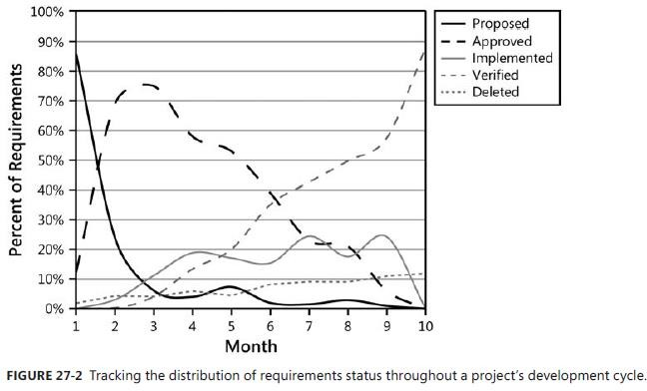
Tracking Requirements Status

Slide 25
Summary
• Requirements Management Practices
• Requirement Management Process
• The requirements baseline
• Requirements version control
• Requirement attributes
• Tracking requirements status

