Slide 1

Software Requirement Engineering
Change Management
Week # 15

Slide 2
Change happens

Slide 3
Content
• Change happens
• Why manage changes?
• Change Control Policy?
• A change control process description

Slide 5
Why Manage Changes?
• The world changes as development progresses: new market opportunities arise, regulations and policies change, and business needs evolve.
• An effective software team can nimbly respond to necessary changes so that the product they build provides timely customer value.

Slide 6
Why Manage Changes?
• An organization that’s serious about managing its software projects must ensure that:
▫ Proposed requirements changes are thoughtfully evaluated before being committed to.
▫ Appropriate individuals make informed business decisions about requested changes.
▫ Change activity is made visible to affected stakeholders.
▫ Approved changes are communicated to all affected participants.
▫ The project incorporates requirements changes in a consistent and effective fashion.

Slide 7



Slide 8
Change Control Policy
• Management should communicate a policy that states its expectations of how project teams will handle proposed changes in requirements and all other significant project artifacts.
• Policies are meaningful only if they are realistic, add value, and are enforced.

Slide 9
Change Control Policy
• The following change control policy statements can be helpful:
▫ All changes must follow the process. If a change request is not submitted in accordance with this process, it will not be considered.
▫ No design or implementation work other than feasibility exploration will be performed on unapproved changes.
▫ Simply requesting a change does not guarantee that it will be made. The project’s change control board (CCB) will decide which changes to implement.

Slide 10
Change Control Policy
• The following change control policy statements can be helpful:
▫ The contents of the change database must be visible to all project stakeholders.
▫ Impact analysis must be performed for every change.
▫ Every incorporated change must be traceable to an approved change request.
▫ The rationale behind every approval or rejection of a change request must be recorded.

Slide 12
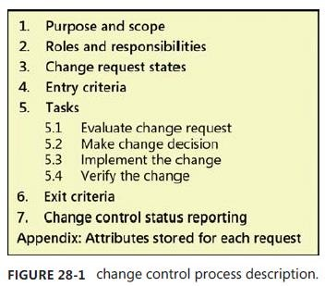
A change control process description
• Figure 28-1 illustrates a template for a change control process description to handle requirements modifications.
1. Purpose and scope
▫ Describe the purpose of this process and the organizational scope to which it applies. Indicate whether any specific kinds of changes are exempted, such as changes in interim work products.

Slide 13
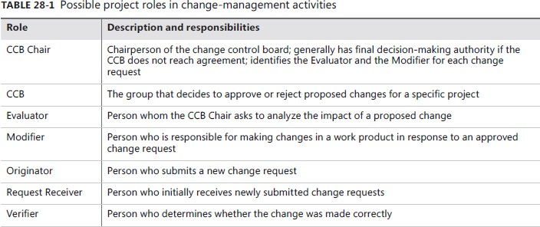
A change control process description
2. Roles and responsibilities

Slide 14
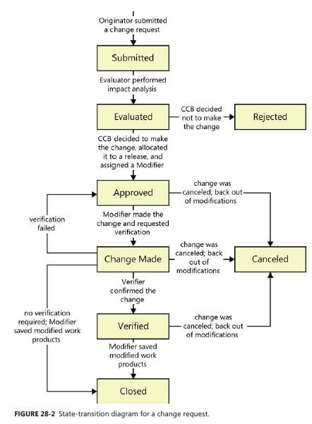
A change control process description
3. Change request status
▫ A change request passes through a defined life cycle of states. You can
represent these states by using a state-transition diagram, as
illustrated in Figure 28-2.

Slide 15
A change control process description
4. Entry criteria
• The basic entry criterion for your change control process is that a change request with all the necessary information has been received through an approved channel.
• All potential originators should know how to submit a change request.
• Change tool should assign a unique identifier to each request and route all changes to the Request Receiver.

Slide 16
A change control process description
5. Tasks
▪ Evaluate change request
🞄 Begin by evaluating the request for technical feasibility, cost, and alignment with the project’s business requirements and resource constraints.
🞄 The CCB Chair might assign an Evaluator to perform impact analysis, risk and
hazard analysis, or other assessments.

Slide 17
A change control process description
5. Tasks
▪ Make change decision
▪ The appropriate decision makers, chartered as the CCB, then decide whether to approve or reject the change.
▪ The CCB gives each approved change a priority or target implementation
date, or it allocates the change to a specific iteration or release.

Slide 18
A change control process description
5. Tasks
▪ Implement the change
▪ The assigned Modifier (or Modifiers) updates the affected work products as necessary to fully implement the change.
▪ Use requirements trace information to find all the parts of the system that the change touches, and revise the trace information if necessary to reflect the changes made.

Slide 19
A change control process description
5. Tasks
▪ Verify the change
▪ Requirements changes typically are verified through a peer review to ensure that modified deliverables correctly address all aspects of the change.
▪ Multiple team members might verify the changes made in various
downstream work products through testing or review.

Slide 20
A change control process description
6. Exit criteria
▫ Satisfying the following exit criteria indicates that an execution of your change control process was properly completed:
🞄 The status of the request is Rejected, Closed, or Canceled.
🞄 All modified work products are updated and stored in the correct locations.
🞄 The relevant stakeholders have been notified of the change details and the status of the change request.

Slide 21
A change control process description
7. Change control status reporting
▫ Identify the charts and reports you’ll use to summarize the contents of the change database.
▫ These charts might show the number of change requests in each state as a function of time, or trends in the average time that a change request is unresolved.
▫ Describe the procedures for producing the charts and reports. The project manager uses these reports when tracking the project’s status.

Slide 22
Summary
• Change happens
• Why manage changes?
• Change Control Policy?
• A change control process description

