Slide 1
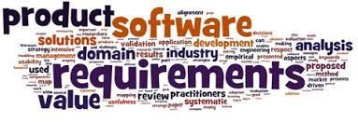
Software Requirement Engineering
Lecture # 2

Slide 2



The essential software requirement
Requirements from the customer’s perspective
Good practices for requirements engineering
The business analyst

Slide 4
Content
The Essential Software Requirement
▫ Software requirements
🞄 Some interpretations of ”requirement”
🞄 Levels and types of requirements
🞄 Working with the three levels

Slide 5
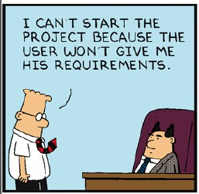
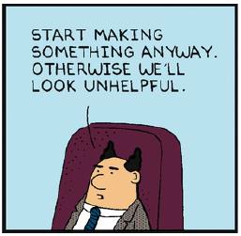
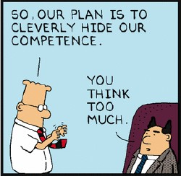
Where are the requirements?

Slide 6

Perceptions, communication patterns and interests…

Slide 7
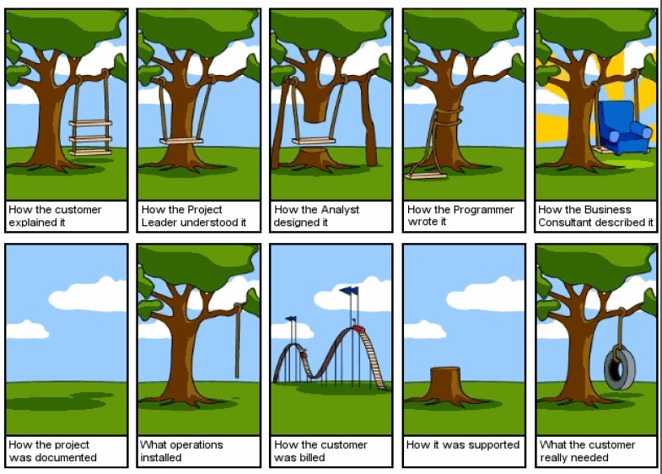

Slide 8
Why is RE important
Errors made during the requirements stage account for 40 to 60 percent of all defects found in a software project (Davis 1993; Leffingwell 1997).

Slide 9
Why do we care?
The most common reasons for project failures are not technical.
Reasons for project failure
*1. Lack of User Input 12.8%
*2. Incomplete Requirements & Specifications 12.3%
*3. Changing Requirements & Specifications 11.8%
4. Lack of Executive Support 7.5%
5. Technology Incompetence 7.0%
6. Lack of Resources 6.4%
*7. Unrealistic Expectations 5.9%
8. Unclear Objectives 5.3%
9. Unrealistic Time Frames 4.3%
10. New Technology 3.7%
Other 23.0%
Those marked with an asterisk are directly related to requirements.
Standish Group’s Chaos Report (1995)
Notes:
The data is drawn from surveys conducted by the Standish Group in 1995 and 1996, and shows the percentage of projects that
stated various reasons for project failure. Those marked with an asterisk are directly related to requirements.

Slide 10
Why do we care?
Project Success Factors % of Responses
1. User Involvement 15.9%
2. Executive Management Support 13.9%
3. Clear Statement of Requirements 13.0%
4. Proper Planning 9.6%
5. Realistic Expectations 8.2%
6. Smaller Project Milestones 7.7%
7. Competent Staff 7.2%
8. Ownership 5.3%
9. Clear Vision & Objectives 2.9%
10. Hard-Working, Focused Staff 2.4%
Other 13.9%
Standish Group’s Chaos Report (1995)

Slide 11
Some key questions
What are requirements?
How do stakeholders define requirements?
How are requirements documented?
Is there a process we can follow?

Slide 12
–Definitions –

Slide 13
IEEE-Standard 610.12 (1990)
A requirement is:
“A condition or capability needed by a user(be it person or system) to solve a problem or achieve an objective.”
“A condition or capability that must be met or possessed by a system or system component to satisfy a contract, standard, specification, or other formally imposed document.”
A documented representation of a condition or capability as in (1) or (2).

Slide 14
Requirement: A definition
According to Ian Sommerville and Pete Sawyer (1997): :
▫ “Requirements are a specification of what should be implemented. They are descriptions of how the system should behave, or of a system property or attribute. They may be a constraint on the development process of the system.”

Slide 15
Requirement: A definition
According to Wiegers & Beatty (2013):
▫ “[A requirement is a] statement of a customer need or objective, or of a condition or capability that a product must possess to satisfy such a need or objective. A property that a product must have to provide value to a stakeholder.”

Slide 17
Types of Requirements Information
Term | Definition
Business requirement | A high-level business objective of the organization that builds a product or of a customer who procures it.
Business rule | A policy, guideline, standard, or regulation that defines or constrains some aspect of the business. Not a software requirement in itself, but the origin of several types of software requirements.
Constraint | A restriction that is imposed on the choices available to the developer for the design and construction of a product.
External interface requirement | A description of a connection between a software system and a user, another software system, or a hardware device.

Slide 18
Types of Requirements Information
Term | Definition
Feature | A high-level business objective of the organization that builds a product or of a customer who procures it.
Functional Requirement | A description of a behavior that a system will exhibit under specific conditions.
Nonfunctional Requirement | A description of a property or characteristic that a system must exhibit or a constraint that it must respect.
Quality attribute | A kind of nonfunctional requirement that describes a service or performance characteristic of a product.

Slide 19
Types of Requirements Information
Term | Definition
System requirement | A top-level requirement for a product that contains multiple subsystems, which could be all software or software and hardware.
User requirement | A goal or task that specific classes of users must be able to perform with a system, or a desired product attribute.

Slide 20
Levels of software requirements
It comprises of three main parts:
▫ Business Requirements
▫ User Requirements
▫ Functional Requirements

Slide 21
Levels of Software Requirements
Business Requirements
▫ “A set of information that describes a business need that leads to one or more projects to deliver a solution and the desired ultimate business
outcomes. The business requirements include business opportunities, business objectives, success metrics, a vision statement, and scope and
limitations.”

Slide 22
Levels of Software Requirements
User Requirements
▫ “A goal or task that specific classes of users must be able to perform with a system, or a desired product attribute. Use cases, user stories, and scenarios are common ways to represent user requirements.”
▫ The domain of user requirements also includes descriptions of product attributes or characteristics that are important to user satisfaction.

Slide 23
Levels of Software Requirements
Functional Requirements
▫ “A description of a behavior that a software system will exhibit under specific conditions.”
▫ They describe what the developers must implement to enable users to accomplish their tasks (user requirements), thereby satisfying the business requirements.
▫ This alignment among the three levels of requirements is essential for project success.

Slide 24
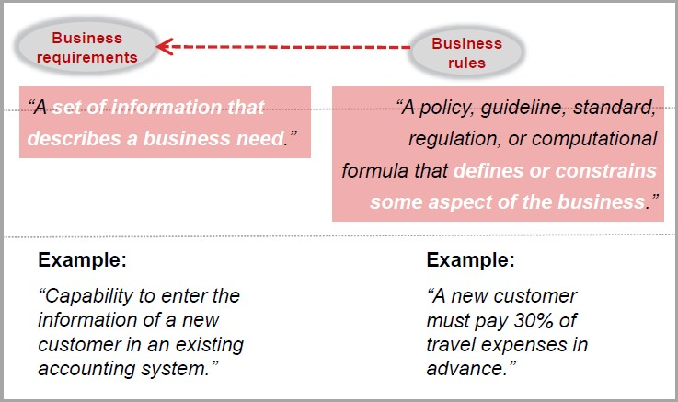
Origins of / influences from…

Slide 25
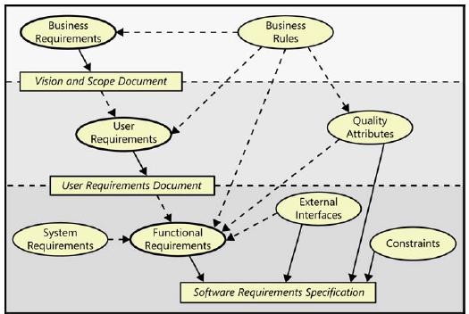
Origins of / influences from…
FIGURE shows Relationships among several types of requirements information.
Solid arrows mean “are stored in”; dotted arrows mean “are the origin of” or “influence.”

Slide 26
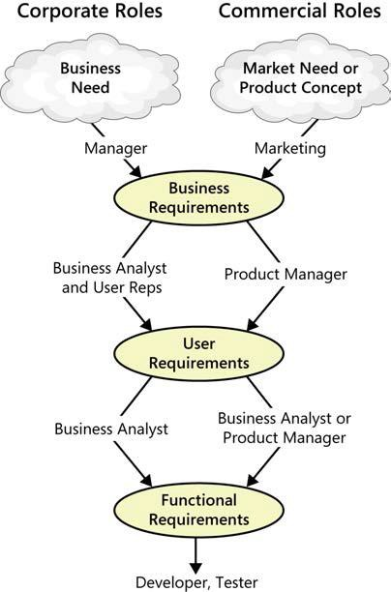
Working with the three levels
Figure illustrates how various stakeholders might participate in eliciting the three levels of requirements.
Based on an identified business need, a market
need, or
an
or marketing define the
exciting new product concept,
business
managers
requirements for software that will help their company operate more efficiently (for information systems) or compete successfully in the marketplace (for commercial products).

Slide 27
Working with the three levels
In the corporate environment, a business analyst then typically works with user representatives to identify user requirements.
Companies developing commercial products often identify a product manager to determine what features to include in the new product.
Each user requirement and feature must align with accomplishing the business requirements.
From the user requirements, the BA or product manager derives the functionality that will let users achieve their goals.

Slide 28
Working with the three levels
Developers use the functional and nonfunctional requirements to design solutions that implement the necessary functionality, within the limits that the constraints impose.
Testers determine how to verify whether the
requirements were correctly implemented.

Slide 29
Requirements development and management

Slide 30
Summary
The Essential Software Requirement
▫ Software requirements
🞄 Some interpretations of ”requirement”
🞄 Levels and types of requirements
🞄 Working with the three levels

