Slide 1

Software Requirement Engineering
Traceability
Week # 15

Slide 2
Requirements Tracing
Requirements tracing is a medium to trace requirements from the start of development process till the software is delivered to the user.
The objective of requirements tracing is to ensure that all the requirements are well understood and included in test plans and test cases. Various advantages of requirements tracing are listed below.
It verifies whether user requirements are implemented and adequately tested.
It enables user understanding of impact of changing requirements.

Slide 3
Traceability
Requirements traceability is concerned with documenting the life of a requirement.
It should be possible to trace back to the origin of each requirement and every change made to the requirement should therefore be documented in order to achieve traceability.
Even the use of the requirement after the implemented features have been deployed and used should be traceable.

Slide 4
Traceability
Requirements come from different sources, like the business person ordering the product, the marketing manager and the actual user. These people all have different requirements for the product.
Using requirements traceability, an implemented feature can be traced back to the person or group that wanted it during the requirements elicitation.
This can, for example, be used during the development process to prioritize the requirement, determining how valuable the requirement is to a specific user.
It can also be used after the deployment when user studies show that a feature is not used, to see why it was required in the first place.

Slide 5
Traceability
Traceability information is information which helps you assess the impact of requirements change. It links related requirements and the requirements and other system representations
Types of traceability information
Backward-from traceability Links requirements to their sources in other documents or people
Forward-from traceability Links requirements to the design and implementation components
Backward-to traceability Links design and implementation components backs to requirements
Forward-to traceability Links other documents (which may have preceded the requirements document) to relevant requirements.

Slide 6
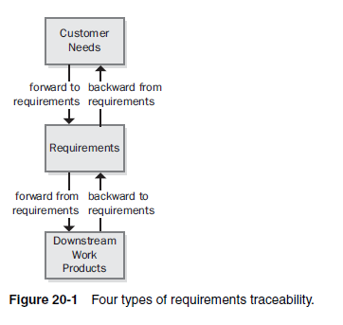
Four types of requirements traceability
Notes:
Figure 20-1 illustrates four types of requirements traceability links (Jarke
1998). Customer needs are traced forward to requirements, so you can tell
which requirements will be affected if those needs change during or after
development. This also gives you confidence that the requirements specification
has addressed all stated customer needs. Conversely, you can trace backward
from requirements to customer needs to identify the origin of each
software requirement. If you represented customer needs in the form of use
cases, the top half of Figure 20-1 illustrates tracing between use cases and functional
requirements.
The bottom half of Figure 20-1 indicates that, as requirements flow into
downstream deliverables during development, you can trace forward from
requirements by defining links between individual requirements and specific
product elements. This type of link assures that you’ve satisfied every requirement
because you know which components address each one. The fourth type
of link traces specific product elements backward to requirements so that you
know why each item was created. Most applications include code that doesn’t
relate directly to user-specified requirements, but you should know why someone
wrote every line of code.

Slide 7
Types of Traceability
Requirements-sources traceability
Links the requirement and the people or documents which specified the requirement
Requirements-rationale traceability
Links the requirement with a description of why that requirement has been specified.
Requirements-requirements traceability
Links requirements with other requirements which are, in some way, dependent on them. This should be a two-way link (dependants and is-dependent on).

Slide 8
Types of Traceability
Requirements-architecture traceability
Links requirements with the sub-systems where these requirements are implemented. This is particularly important where sub-systems are being developed by different sub-contractors
Requirements-design traceability
Links requirements with specific hardware or software components in the system which are used to implement the requirement
Requirements-interface traceability
Links requirements with the interfaces of external systems which are used in the provision of the requirements

Slide 9
Traceability Tables
Traceability tables show the relationships between requirements or between requirements and design components
Requirements are listed along the horizontal and vertical axes and relationships between requirements are marked in the table cells
Traceability tables for showing requirements dependencies should be defined with requirement numbers used to label the rows and columns of the table
A traceability matrix is an 'at-a-glance' way of seeing the dependencies between requirements.

Slide 10
Traceability Lists
If a relatively small number of requirements have to be managed (up to 250, say), traceability tables can be implemented using a spreadsheet
Traceability tables become more of a problem when there are hundreds or thousands of requirements as the tables become large and sparsely populated
A simplified form of traceability table may be used where, along with each requirement description, one or more lists of the identifiers of related requirements are maintained.
Traceability lists are simple lists of relationships which can be implemented as text or as simple tables

Slide 11
A Traceability List
Like all other test artifacts, RTM too varies between organizations.
It is necessary to update the RTM whenever there is a change in requirement.

Slide 12
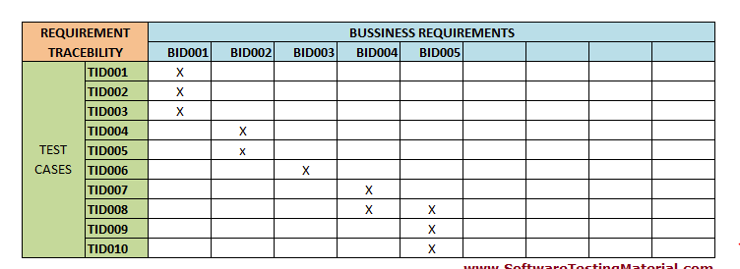
Traceability Matrix
This is traceability matrix between requirements and test cases. Most of the organizations use just the Requirement Id’s and Test Case Id’s in the RTM. It is possible to make some other fields such as Requirement Description, Test Phase, Test case result, Document Owner etc.,

Slide 13
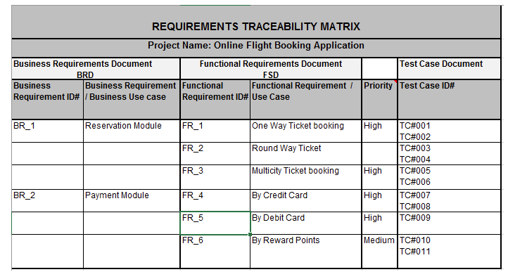
Traceability Matrix

Slide 14
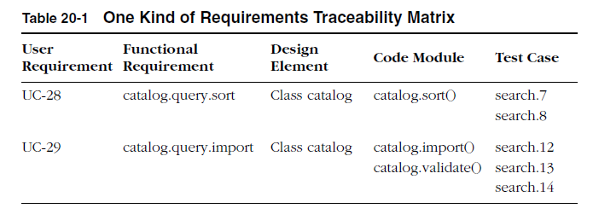
The Requirements Traceability Matrix
Notes:
Table 20-1 shows how each functional requirement is linked backward to
a specific use case and forward to one or more design, code, and test elements.
Design elements can be objects in analysis models such as data flow
diagrams, tables in a relational data model, or object classes.
references can be class methods, stored procedures, source code filenames, or procedures
or functions within the source file.
You can add more columns to extend the links to other work products, such as online help documentation.
Including more traceability detail takes more work, but it gives you the precise locations
of the related software elements, which can save time during change
impact analysis and maintenance.

Slide 15
Traceability Policies
Traceability policies may include
The traceability information which should be maintained.
Techniques, such as traceability matrices, which should be used for maintaining traceability.
A description of when the traceability information should be collected during the requirements engineering and system development processes.
The roles of the people, such as the traceability manager, who are responsible for maintaining the traceability information should also be defined.
A description of how to handle and document policy exceptions
The process of managing traceability information

Slide 16
Factors Influencing Traceability Policies
⊗ Number of requirements
The greater the number of requirements, the more the need for formal traceability policies.
⊗ Estimated system lifetime
More comprehensive traceability policies should be defined for systems which have a long lifetime.
⊗ Level of organizational maturity
Detailed traceability policies are most likely to be cost-effective in organizations which have a higher level of process maturity

Slide 17
Factors Influencing Traceability Policies
⊗ Project team size and composition
With a small team, it may be possible to assess the impact of proposed informally without structured traceability information. With larger teams, however, you need more formal traceability policies.
⊗ Type of system
Critical systems such as hard real-time control systems or safety- critical systems need more comprehensive traceability policies than non-critical systems.
⊗ Specific customer requirements
Some customers may specify that specific traceability information should be delivered as part of the system documentation.

Slide 18
Benefits Of Requirements Traceability
Good traceability of requirements offers us the following benefits:
1. Management of the solution scope
Since traceability allows each requirement to be associated with the appropriate business objectives, we can evaluate the value of each requirement. This allows us to effectively prioritize and avoid scope creep (the frustrating sensation of there being never-ending requirements for this project).
2. Quick evaluation of potential changes
Good traceability allows us to evaluate the impact of a potential change quickly and easily. For a given requirement, we can identify the related business objectives and other affected components. In addition, traceability allows easy identification of requirements associated with a failed test case, which supports accelerated resolution of problems.

Slide 19
Benefits Of Requirements Traceability
3. Reduced project risk
Traceability allows for identification of critical dependencies between requirements, supporting better visibility and control of these relationships.
4. Promotes consistency between requirements
Identifying relationships between requirements and related items helps us to be more consistent and coherent. We can detect and correct inconsistencies quickly and use the same terminology. For example, if we use two different terms to refer to the same entity, such as Client and Registered Customer, connecting related requirements may help us see the inconsistency more easily.
5. Allows monitoring and control across the lifecycle of requirements
The traceability matrix can be used to help manage which requirements are validated, which are pending, and which have been rejected. It also helps in identifying which requirements correspond to a specific release.

