Slide 1


Air Quality Monitoring through CO2 and VOC
Brief Introduction of the Problem Area
2. Purpose of the Project
3. Services,Tools and Libraries Used
4. Implementation
5. Applications
Serverless Computing 2021
Prof. Vittorio Scarano

Slide 2
Brief Introduction of the Problem Area
1.
One of the greatest problem in the current era is air pollution, not only of its impact on climate change but also its impact on public and individual health due to the increasing mortality rate. There are many pollutants in the environment that might cause serious diseases in humans. Among them, Volatile Organic Compound and Carbon dioxide are two major air pollutants that can,penetrate the respiratory system via inhalation and the long term effects of getting exposed to these pollutants can cause respiratory diseases such as Chronic Obstructive Pulmonary Disease (COPD) and Asthma.
2.
3.
4.
5.

Slide 3
Purpose of the Project
1.
So the best way to address the previously mentioned problem is to detect and monitor those environmental factors which triggers these diseases , therefore the purpose of this project is to detect and sense carbondioxide and Volatile Organic Compound Values from the environment and monitor those values on an independent platform since such a system will allow doctors and clinicians to correlate potential asthma symptoms and exacerbation reports from patients with environmental factors without having to personally be present
2.
3.
4.
5.

Slide 4
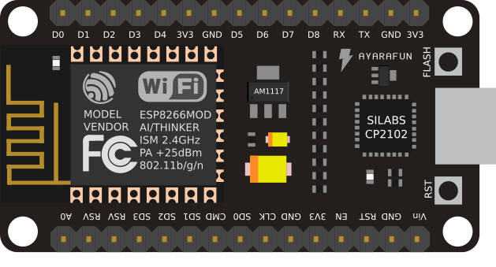
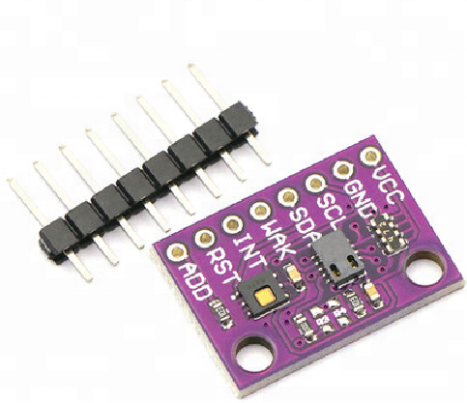
NodeMCU EPS8266
is a low-cost open source IoT device included with the firmware which runs on the ESP8266 Wi-Fi microchip, and hardware which was based on the ESP-12 module.NodeMCU has 128 KB RAM and 4MB of Flash memory to store data and programs.The device consists of 13 GPIO pins.
Services and Tools Used
1.
2.
3.
4.
CCS811 Sensor
The CCS811 Air Quality is a digital gas sensor solution that senses a wide range of Total Volatile Organic Compounds (TVOCs), including equivalent carbon dioxide (eCO2)This sensor is intended for indoor air quality monitoring in personal devices such as smartwatches and phones.
5.

Slide 5


Docker
Docker is a set of platform as a service (PaaS) product that is used to deliver software in packages called containers.
Services and Tools Used
1.
2.
3.
4.
Nuclio
Nuclio is an open source and managed serverless platform used to minimize development and maintenance overhead and automate the deployment of data-science based application
5.

Slide 6


RabbitMQ
RabbitMQ is an open-source message-broker software which implements AMQP and has since been extended with a plug-in architecture to support MQTT and other protocols
Services and Tools Used
1.
2.
3.
4.
Arduino IDE
The Arduino Integrated Development Environment is a cross-platform application that is written in functions from C and C++. It is used to write and upload programs to Arduino compatible boards such as NodeMCU.
5.

Slide 7


MQtizer
MQTIZER is a mobile MQTT client that can connect to any broker which shares the network with your phone, and to any broker on the cloud as well. So to view the on the mobile platform we use MQtizer
Services and Tools Used
1.
2.
3.
4.
MQTTlens
MQTT Lens is an web app for the chrome browser that lets you publish messages to an MQTT broker, subscribe to MQTT topics, and receive messages using the chrome web browser.
5.

Slide 8
ESP8266
ESP8266 is the library support for the ESP8266 chip to the Arduino environment. It lets us write sketches, using familiar Arduino functions and libraries, and run them directly on NODEMCU
Libraries Used
1.
2.
Pubsubclient
Is a client library for MQTT messaging, MQTT is a lightweight messaging protocol ideal for small devices. This library allows you to send and receive MQTT messages.
3.
4.
CCS811 Library
This is an Arduino library. It implements a driver for the CCS811. This chip is a indoor air quality sensor module with an I2C interface.
5.

Slide 9
Implementation
Ubuntu
Docker
Nuclio
RabbitMQ
Arduino IDE
The first step was to install UBUNTU 18.04 on a Virtual Machine
Then we have to install Docker and Docker Compose on the Ubuntu
After Installing docker then we have to install Nuclio serverless platform by using the docker command.
Then we moved to install RabbitMQ via using the given Docker command
Downloading the Arduino IDE to upload the code to NODEMCU.

Slide 10
Implementation
Installing the libraries and connecting the Sensor
Uploading the Code
Deploying the function on Nuclio
RabbitMQ
MQTIZER
Installing the CCS811 library for connecting the sensor
Before Uploading the Code we have to install mqtt library PUBSUBCLIENT and then we install ESP8266 library for NODEMCU and finally we upload the Code
To generate the queues on RabbitMQ first we have to deploy the given function on Nuclio by setting IP and triggers.
The deployed function on Nuclio will generate queues on RabbitMQ of the data sensed from the sensor
To display the data on SmartPhone we will set the RabbitMQ IP on the app and then it will generate the notifications of the CO2 AND VOC values on the SmartPhone.

Slide 11
Implementation
MQTTLENS
For the MQTT web app we will set the hostname which is our IP and then will generate the CO2 and VOC values notifications on the Web App as well.

Slide 12
Applications
Air Quality Monitoring for Asthma and COVID Patient
Since we Asthma gets triggered through getting exposed to these pollutants continuously so the primary application of this project is to detect Air pollutants that trigger Asthma attacks.
According to the Given situation of COVID19 this project can be used to Monitor the Environment of a COVID Patient, since the Patient will be in isolation so its necessary to Monitor its environment remotely.

Slide 13
Thank you!
SLIDESMANIA.COM

