Slide 1
Mapping Poverty: Reasons and Indicators of Poverty in US Web mapping 2017 | Final Project
Shoaib Mahmud |Submission Date:4/30/2017

Slide 2
goals AND Objectives
GOAL
Create a series of thematic maps based on the state-wise data of the reasons of poverty (amount of the gross domestic product, cost burden of housing, percentage of illicit drug use) and the indicators of poverty (percentage of people below poverty line, racial distribution, number of homeless people and so on).
OBJECTIVES
To prepare a map which will illustrate the status of poverty of US.
To show the reasons of the poverty
To show the indicators of the poverty

Slide 3
DATA COLLLECTIONS
Data Sources
Data was collected from the webpage of the following sources :
Data | Sources
State wise gross domestic product | Bureau of Economic Analysis
Percentage of people poverty line | National Institute of Drug Abuse
Cost burden of Affordable Housing | HUD
Percentage of people below poverty line | povertyusa.org
US population distribution | US factfinder

Slide 4
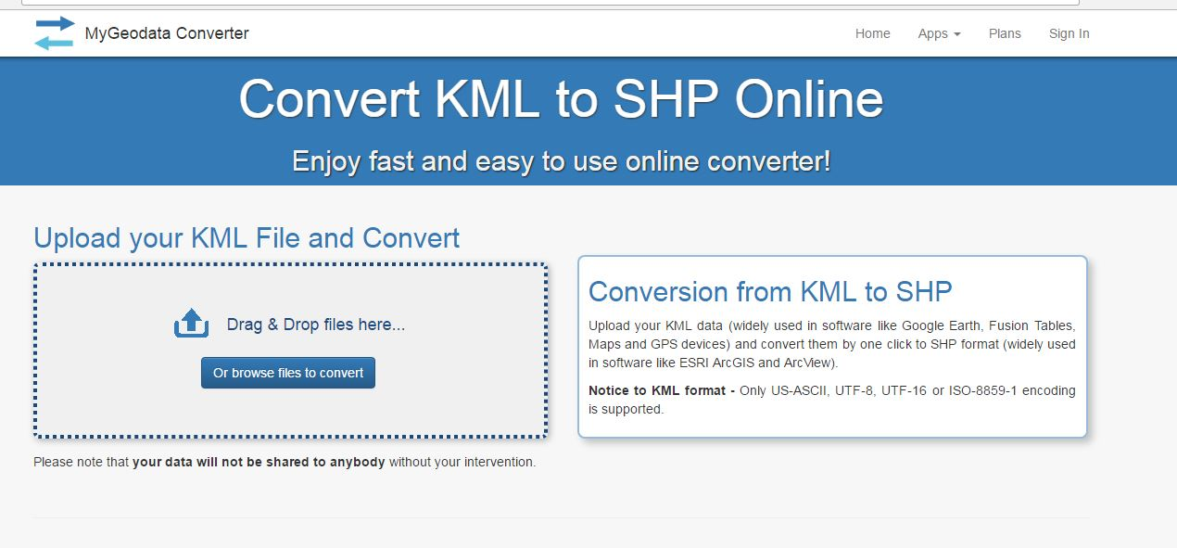
OPERATIONS: DATA CONVERSION
DATA CONVERSION
Data was retrieved from different sources and most of them were in CSV or Shapefile format. At first , data was collected from all the sources. Then it was converted to JSON format by using Mygeodata converter.

Slide 5
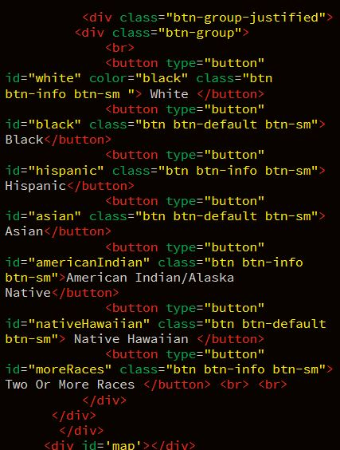
OPERATIONS:USE OF BOOTSRAP
BOOTSRAP
Bootsrap is mainly used to make the presentation beautiful. It is mainly used to make the button beautiful.

Slide 6
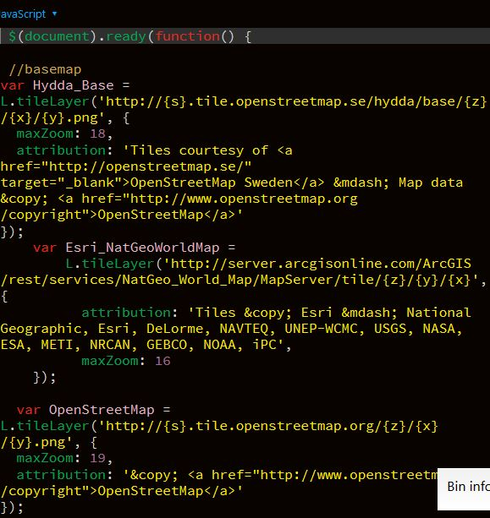
OPERATIONS:USE OF lEAFlet and OVERLAYS
LEAFLET
LEAFLET MAPS ARE MAINLY USED IN THIS PROJECT. THEY ARE USED TO :
SHOW BASSE MAPS
CREATE LEGENDS
SHOW OVERLAYS

Slide 7
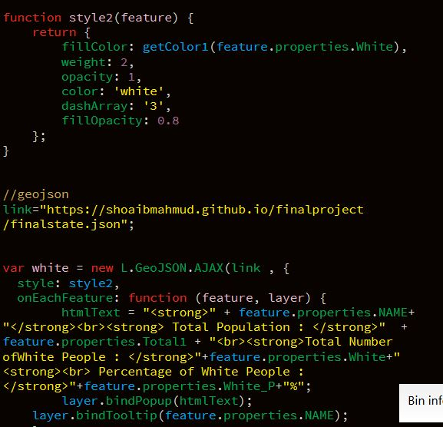
OPERATIONS:USE OF GEOJSON/JSON
Data was pulled from a single geojson file which was created by me compiling the data from different sources. HERE, AJAX is mainly used to receive information from the geojson file.

Slide 8
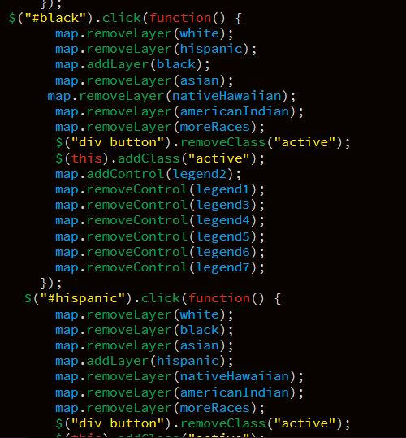
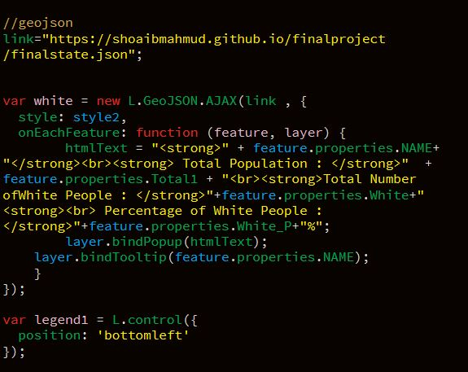
OPERATIONS: DATA FILTERING and use of Jquery
THEMATIC MAPS WERE MAINLY CREATED BYUSING JQUERY AND FILTERING THE DATA RETRIVED FROM THE GEOJSON FILE. IN THIS WAY MAPS FOR POVERTY,WHITE- BLACK POPULATION, GDP, COST BURBEN ARE CREATED

Slide 9
OPERATIONS: DATA FILTERING and use of Jquery
THEMATIC MAPS WERE MAINLY CREATED BYUSING JQUERY AND FILTERING THE DATA RETRIVED FROM THE GEOJSON FILE. IN THIS WAY MAPS FOR POVERTY,WHITE- BLACK POPULATION, GDP, COST BURBEN ARE CREATED

Slide 10
challenges NEEDED TO OVERCOME
Few challenges I faced while doing the projected
1.Data management : Data Management was a challenging task I was working with a huge amount of data from different sources. Therefore, I mainly copied the data to my own Geojson file.
2. Bringing the maps in one page : It was important to show different maps in one page so that people can compare different aspects of poverty at the same time which was very challenging
2. Data Filtering : In My Geojson File contains a huge number of parameters embedded with multi-polygon. Therefore, accurate data filtering was very challenging.

Slide 11
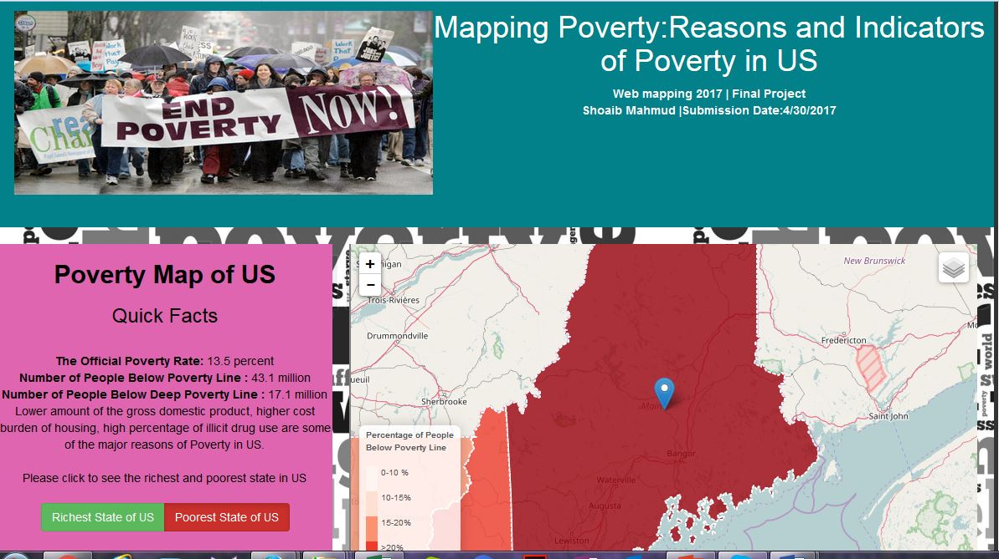
FINAL PRODUCT

Slide 12
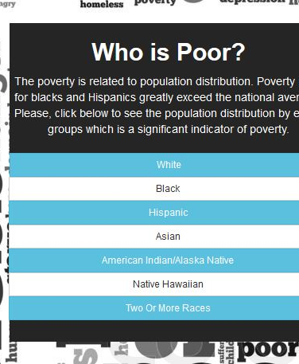
FINAL PRODUCT
The final output of the project is A webpage which consists interactive maps. The maps illustrates :
Status of Poverty
The first map shows the percentage of people below poverty line in each state and associated ranking
2. Indicators of Poverty
The second map shows population distribution of each states
3. Reasons of Poverty
The third map shows two significant reasons (GDP and excessive cost burden) of poverty

