Slide 1

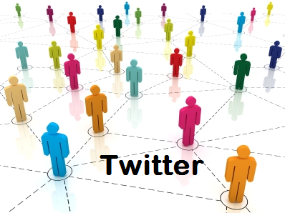


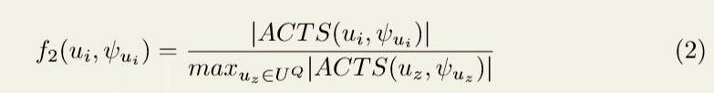
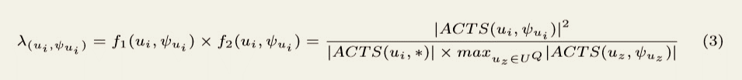
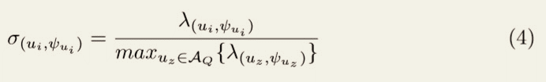
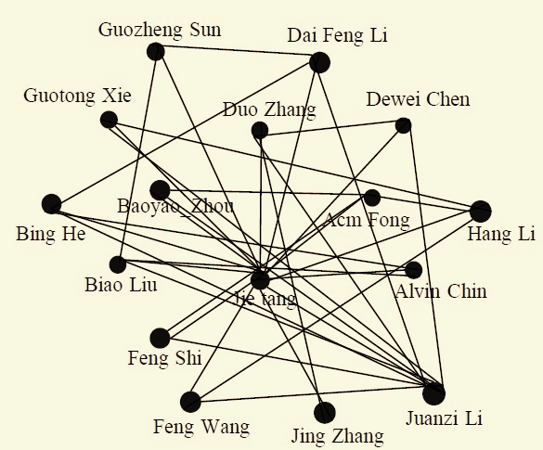
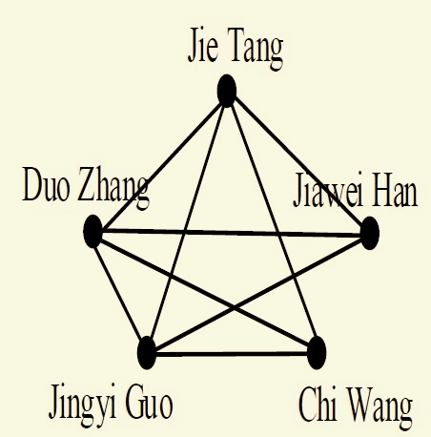
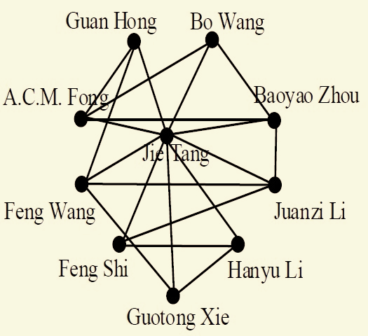
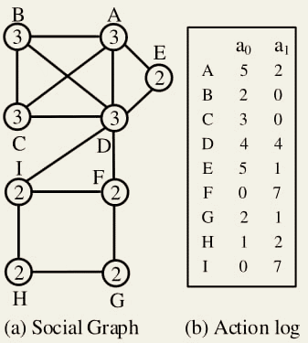
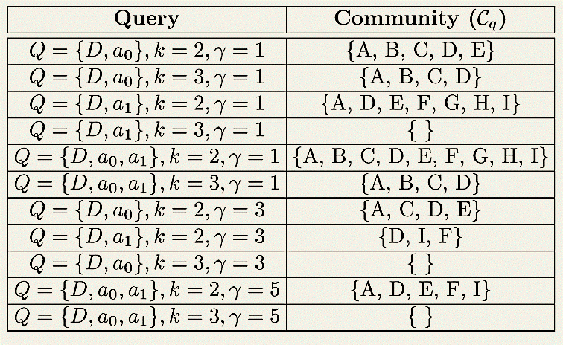
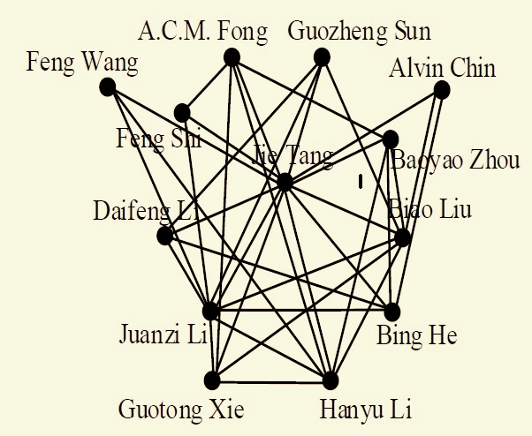
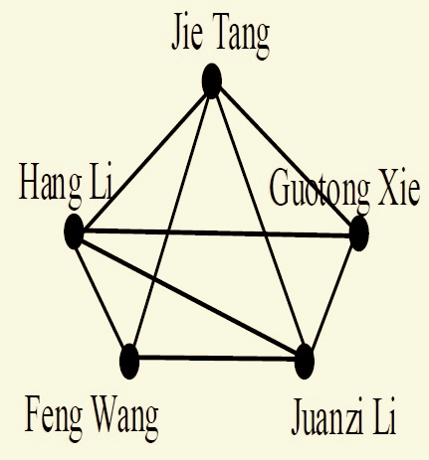
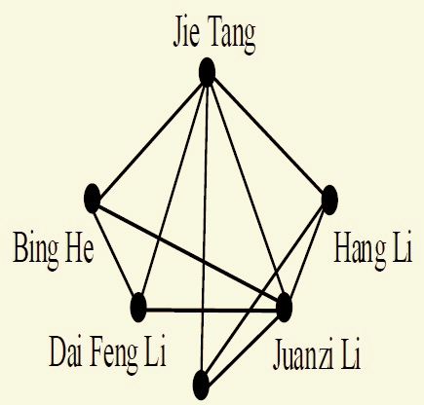
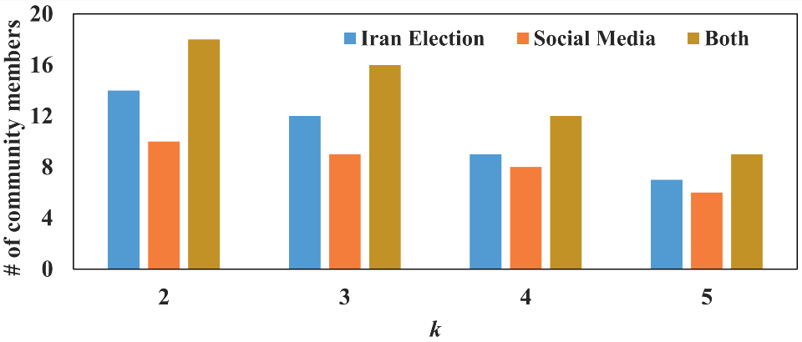
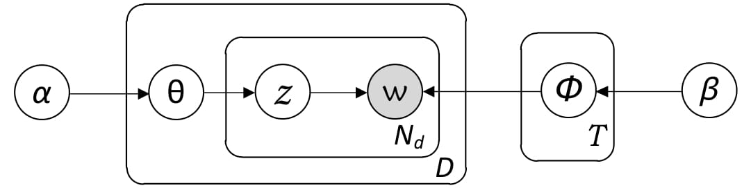
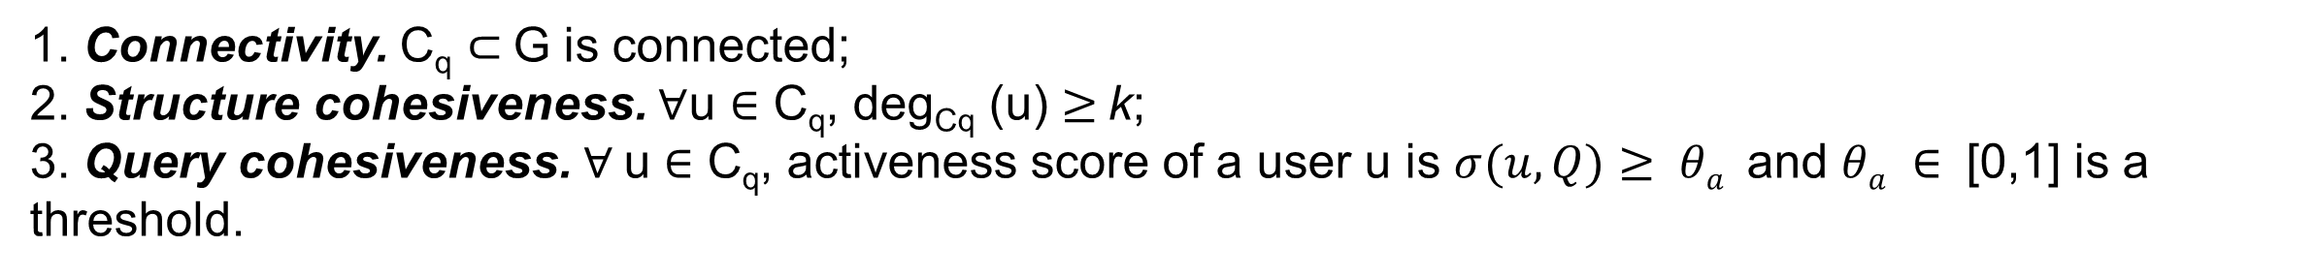
Attribute Driven Active Community Search
Md Shoaib Ahmed, Badhan Chandra Das and Md Musfique Anwar
Jahangirnagar University
Email: shoaibmehrab011@gmail.com, badhan0951@gmail.com, manwar@juniv.edu
Background
Experimentation and Finding
Community
A group of users who are closely connected to each other.
Interact with each other more than with those outside the group.
Activeness Score
The ﬁrst factor f₁ is the likelihood that a user u_{i} performs an activity in query Q.
The second factor f₂ is the participation of user u_{i} related to Q in comparison to the most active participant user related to Q in the network.
Attributed Graph
Rich attributed nodes with properties.
Classification of Online Community
Community Detection : identify all communities in a network by optimizing some pre-defined criterions.
Community Search : find the most likely community that contains the query node
ML, AI
ML, DM
DM, AI
ML, AI, DM
AI, DM. AI
ML
Then, the activeness (denoted as σ) of u related to Q is,
DM, AI
ML, DM
Motivation and Problem Formulation
Date Sets
Motivation
Previous approaches
paid less attention to the user interests and activities on different attributes.
ii. Failed to search active communities.
Our approaches
i. Our observation is that users’ have different degree of activeness for different attributes.
ii. Model and quantify users' activeness with regards to the attributes of a query.
Dataset | # of Nodes | # of Nodes | # of activities
SNAP | 40M | 535M | 58M
Co-Author | 327 | 1,180 | 807
Problem Formulation
Results
Given an attributed graph G = (U, E, A), an input query Q ={u$q$,a_{q}}, two positive integer h and k, an attributed active community C_{q} is an induced subgraph that meets the following constraints.
1. Connectivity. C_{q} $⊂$G is connected;
2. Structure cohesiveness. $∀$u $∈$ C_{q}, deg_{Cq} (u) $≥$k;
3. Query cohesiveness. $∀$u $∈$ C_{q}, activeness score of a user u is $σ(u,Q)$ $≥ θa$and $θa ∈$ [0,1] is a threshold.
k=3, Q={ }
k=3, Q={AI}, ɤ=1
k=3, Q={AI,DM}, ɤ=1
Proposed Methodology
Stage 1
k=3, Q={AI, ML,DM}, ɤ=1
k=3, Q={AI, ML}, ɤ=2
k=3, Q={AI, ML, DM}, ɤ=3
Social Stream
Data
Pre-processing
Normalization
Lexicon
Community evolution(Co-Author Dataset)
Stage 2
LDA Model
Cleaned Social
Stream
Stage 3
Community evolution(SNAP Dataset)
Conclusion and Future Work
Social Network
Processed Social
Streams
Identify
Future Work
-Apply time-based forgetting factor to the users’ past activities in order to emphasize the freshness of users’ recent activities in dynamic social network.
Community
Search
Algorithm
Apply
This Work
-Propose an approach to detect active attributed local community where
community members actively participate about their common attributes.
-Model and quantify users' activeness with regards to the attributes of a query.
References
Huang, X., Lakshmanan, L. VS.: Attribute-driven community search. In: VLDB,pp. 949–960 (2017)
Zhou, Y., Cheng, H., Yu, J. X.: Graph clustering based on structural/attribute similarities. In: VLDB, pp. 718–729(2009).
Anwar, M. M., Liu, C., Li, J..: Discovering and tracking query oriented activeonline social groups in dynamic information network. In: WWWJ, pp. 1–36 (2018)
Fang, Y., Cheng, R., Luo, S., Hu, J.: Effective Community Search for Large Attributed Graphs. In: VLDB, pp. 1233–1244 (2016
NSysS 2018, Dec 18-20, 2018, Dhaka, Bangladesh

