Slide 1
APPTHON
PARKING ASSISTANCE USING MOBILE GRID
TEAM MJ1
MUFFAKHAM JAH COLLEGE

Slide 2
Requirements:
Help the employees to park the car in shortest time possible.
Track the number of cars going in/out of each parking bay or floor.
Suggest the employees about the closest available parking space.
Scenarios considered:
Single entry Single exit
Single entry 2 exits
2 entry 2 exits
Use of proximity sensors to make the assistance completely automated.

Slide 3
PROBLEMS WE SOLVED

Slide 4
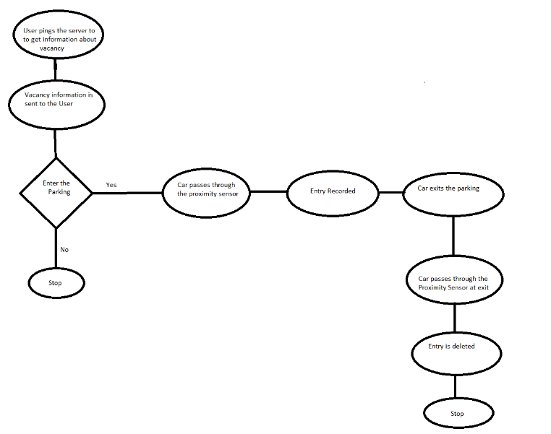

Slide 5
K SRINIVAS
 | COMPONENT
Name of the component I implemented | CLIENT APK
Application Functionality | ENABLES CLIENT TO GET NEAREST PARKING
Interfacing Components | WIFI (TCP/IP)
Components I used for implementation | NETWORKING
Code size of my components | 106
Most difficult technical problem and how I solved it | WASN’T ABLE TO DETECT IP ADDRESS OF THE PRIMARY SENSOR AUTOMATICALLY

Slide 6
S MOHAMMED
 | COMPONENT
Name of the component I implemented | PRIMARY ENTRY SENSOR
Application Functionality | SENSES THE ENTRY OF A VEHICLE, NEAREST PARKING
Interfacing Components | WIFI HOTSPOT , SQLite
Components I used for implementation | DATABASE,NETWORKING,PROXIMITY SENSOR.
Code size of my components | 400
Most difficult technical problem and how I solved it | I WAS UNABLE TO SEND DATA BACK TO THE CLIENT IN A SINGLE THREAD.

Slide 7
MOMIN SHOAIB
 | COMPONENT
Name of the component I implemented | SECONDRY ENTRY SENSOR
Application Functionality | SENSES THE ENRTY OF THE VEHICLE AND COMMUNICATES WITH THE PRIMARY SENSOR
Interfacing Components | WIFI(TCP/IP)
Components I used for implementation | PROXIMITY SENSOR,NETWORKING
Code size of my components | 154
Most difficult technical problem and how I solved it | INSERTION WAS HAPPENING AT THE START OF THE APPLICATION

Slide 8
ABDUL ALEEM
 | COMPONENT
Name of the component I implemented | FLOOR LEVEL EXIT SENSOR
Application Functionality | SENSES THE VEHICLE WHEN IT EXITS THE FLOOR COMMUNICATES WITH THE DATABASE
Interfacing Components | WIFI (TCP/IP)
Components I used for implementation | PROXIMITY SENSOR,NETWORKING
Code size of my components | 143
Most difficult technical problem and how I solved it | WAS NEW TO PROXIMITY SENSORS.

