Slide 1


Slide 2
Chapter 12
Practical Database Design Methodology and Use of UML Diagrams

Slide 3
Chapter Outline
Information System Life Cycle
Phases of Database Design
UML Diagrams
  Rational Rose
  Other tools
Design Tools

Slide 4
Organizational Context for using Database Systems
Consolidation and integration of data across organization
Maintenance of complex data
Simplicity of developing new applications
Data independence
  Protecting application programs from changes in the underlying logical organization and in the physical access paths and storage structures
External Schemas
  Allow the same data to be used for multiple applications with each application having its own view of the data

Slide 5
Information System
Information System includes all resources involved in the collection, management, use and dissemination of the information resources of the organization
We consider two systems life cycles:
  Macro Life Cycle
    Information System Life Cycle
  Micro Life Cycle
    Database System Life Cycle

Slide 6
Phases of Information System Life Cycle
Feasibility Analysis
  Analyzing potential application areas
  Identifying the economics of information gathering and dissemination
  Performing cost benefit studies
  Setting up priorities among applications
Requirement Collection and Analysis
  Detailed Requirements Collection
  Interaction with Users
Design
  Design of Database System
  Design of programs that use and process the database

Slide 7
Phases of Information System Life Cycle (contd.)
Implementation
  Information system is implemented
  Database is loaded & its transactions are implemented and tested
Validation and Acceptance Testing
  Testing against user’s requirements
  Testing against performance criteria
Deployment, Operation and Maintenance
  Data conversion
  Training
  System maintenance
  Performance monitoring
  Database tuning

Slide 8
Database System Life Cycle
System definition
  Defining scope of database system, its users and applications
Database Design
  Logical and physical design of the database system on the chosen DBMS
Database implementation
  Specifying conceptual, external and internal database definitions
  Creating empty database files
  Implementing software applications

Slide 9
Database System Life Cycle (contd.)
Loading or data conversion
  Populating the database
Application conversion
  Converting applications to the new system
Testing and validation
Operation
  Running the new system
Monitoring and maintenance
  System maintenance
  Performance monitoring

Slide 10
Database Design Process
Problem
  Design the logical and physical structure of one or more databases to accommodate the information needs of the users in an organization for a defined set of applications.
Goals
  Satisfy the content requirements
  Provide easy structuring of information
  Support processing requirements and performance objectives

Slide 11
Phases of Database Design and Implementation Process
Requirements Collections and Analysis
Conceptual Database Design
Choice of a DBMS
Data Model Mapping (Logical Database Design)
Physical Database Design
Database System Implementation and Tuning

Slide 12
Phases of Database Design and Implementation Process (contd.)
Requirements Collections and Analysis
  Identifying Users
  Interacting with users to gather requirements
  Time consuming BUT very important
    Very expensive to fix requirements error
Conceptual Database Design
  Produce a conceptual schema for the database that is independent of a specific DBMS
  Involves two parallel activities
    Conceptual Schema Design
    Transaction and Application Design

Slide 13
Conceptual Schema Design
Goal
  Complete understanding of the database structure, semantics, interrelationships and constraints
Serves as a stable description of the database contents
Good understanding crucial for the users and designers
Diagrammatic description serves as an excellent communication tool

Slide 14
Desired Characteristics of Conceptual Data Model
Expressiveness
  Able to distinguish different types of data, relationships and constraints
Simplicity and Understandability
  Easy to understand
Minimality
  Small number of distinct basic concepts
Diagrammatic Representation
  Diagrammatic notation for representing conceptual schema
Formality
  Formal unambiguous specification of data

Slide 15
Approaches to Conceptual Schema Design
Centralized Schema Design Approach
  Also known as one-shot approach
  Requirements of different applications and user groups are merged into a single set of requirements and a single schema is designed
  Time consuming, places the burden on DBA to reconcile conflicts
View Integration Approach
  Schema is designed for each user group or application
  These schemas are then merged into a global conceptual schema during the view integration phase
  More practical

Slide 16
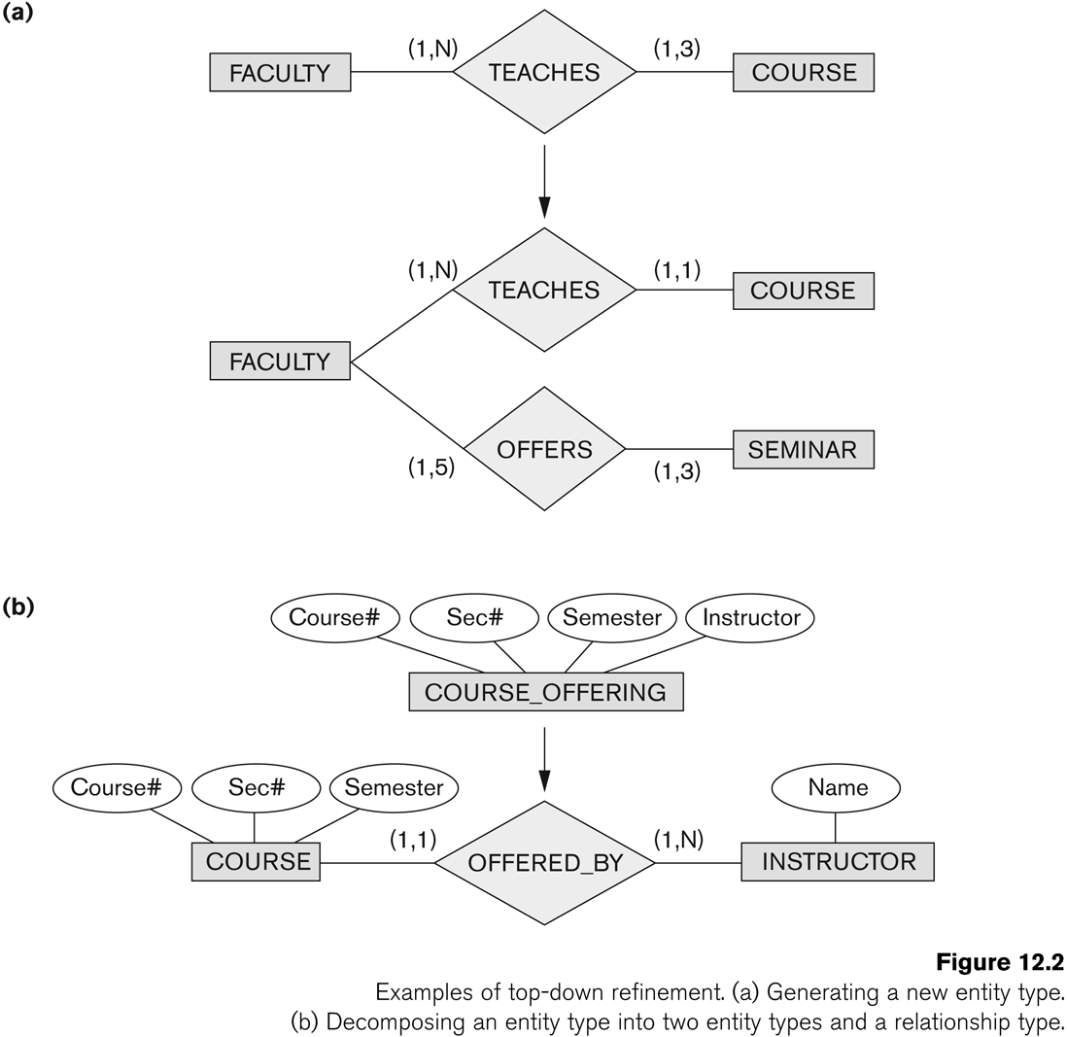
Strategies for Schema Design
Top Down Strategy
  Start with a schema containing high-level abstractions and then apply successive top-down refinements

Slide 17
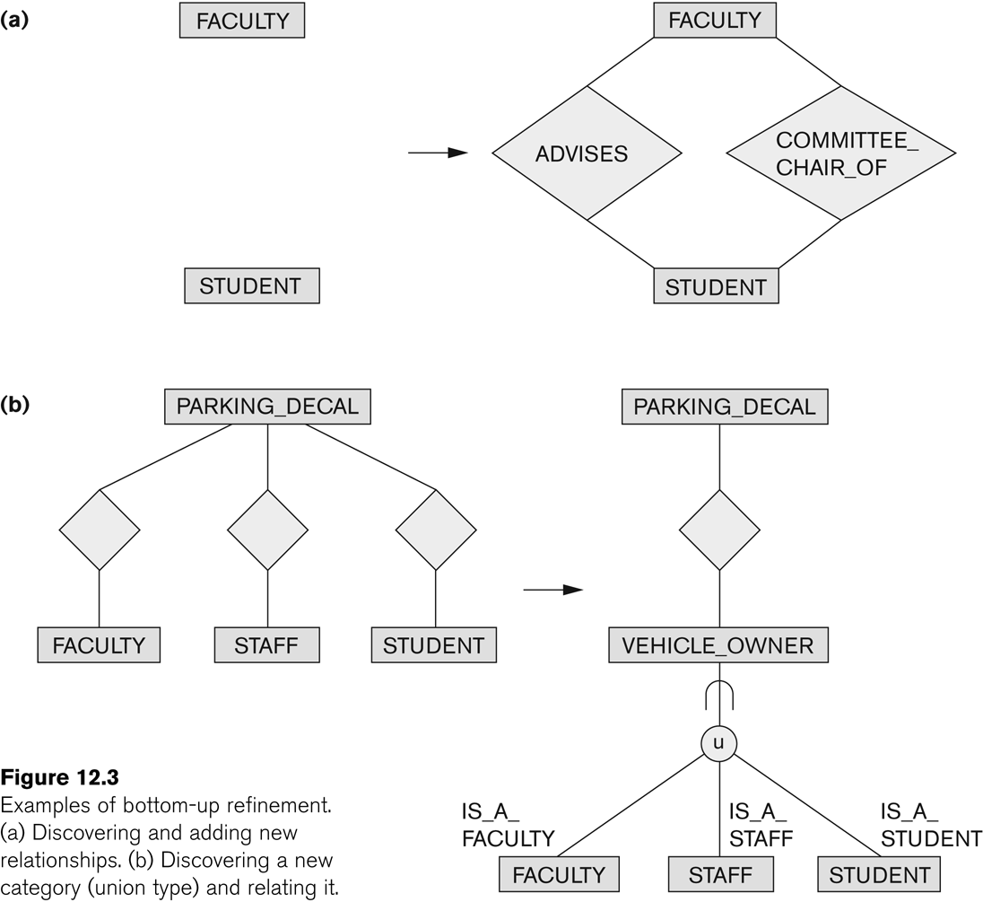
Strategies for Schema Design (contd.)
Bottom-Up Strategy
  Start with a schema containing basics abstractions and then combine or add to these abstractions

Slide 18
Strategies for Schema Design (contd.)
Inside-out Strategy
  Start with central set of concepts and then spread outward by considering new concepts in the vicinity of existing ones
Mixed Strategy
  Use a combination of top-down and bottom-up strategies

Slide 19
Schema Integration
Identifying correspondence and conflict among different schemas
  Naming conflicts
    Synonyms: The same concept but different names
      e.g. entity types CUSTOMER and CLIENT
    Homonyms: Different concepts but same name
      e.g. entity type PART as computer parts and furniture parts
  Type Conflicts: Representing the same concept by different modeling constructs
    e.g. DEPARTMENT may be an entity type and an attribute
  Domain Conflicts: Attribute has different domains
    Also known as value set conflicts
    e.g. SSN as an integer and as a character string
  Conflict among constraints: Two schemas impose different constraints
    e.g. different key of an entity type in different schemas

Slide 20
Schema Integration (contd.)
Modifying views to conform to one another
  Modifying schemas to conform to one another
Merging of views
  Merging Schemas to create a global schema
  Specifying mappings between views and global schema
    Time consuming and difficult
Restructuring
  Simplifying and restructuring to remove any redundancies

Slide 21
View Integration Strategies
Binary Ladder Integration
  Two similar schemas are integrated first and the resulting schema is then integrated with another schema
  The process is repeated until all schemas are integrated
N-ary Integration
  All views are integrated in one procedure after analysis and specification of their correspondences
    Requires computerized tools for large designs

Slide 22
View Integration Strategies (contd.)
Binary Balanced Strategy
  Pairs of schemas are integrated first and the resulting schemas are then paired for further integration.
  This process is repeated until a final global schema
Mixed Strategy
  Schemas are partitioned into groups based on their similarity and each group is integrated separately.
  This process is repeated until a final global schema

Slide 23
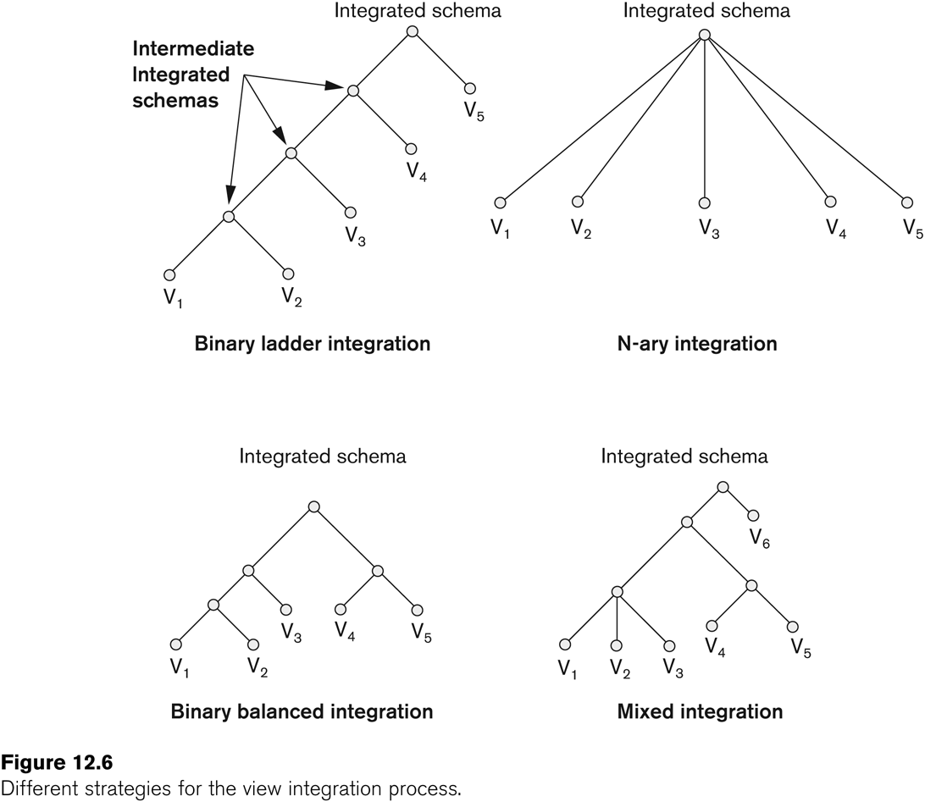
View Integration Strategies (contd.)

Slide 24
Transaction Design
Design characteristics of known database transactions in a DBMS
Types of Transactions
  Retrieval Transactions
    Used to retrieve data
  Update Transactions
    Update data
  Mixed Transactions
    Combination of update and retrieval
Techniques for Specifying Transactions
  Input/output
  Functional Behavior

Slide 25
Choice of DBMS
Many factors to consider
  Technical Factors
    Type of DBMS: Relational, object-relational, object etc.
    Storage Structures
    Architectural options
  Economic Factors
    Acquisition, maintenance, training and operating costs
    Database creation and conversion cost
  Organizational Factors
    Organizational philosophy
      Relational or Object Oriented
      Vendor Preference
    Familiarity of staff with the system
    Availability of vendor services

Slide 26
Logical Database Design
Transform the Schema from high-level data model into the data model of the selected DBMS.
Design of external schemas for specific applications
Two stages
  System-independent mapping
    DBMS independent mapping
  Tailoring the schemas to a specific DBMS
    Adjusting the schemas obtained in step 1 to conform to the specific implementation features of the data model used in the selected DBMS
Result
  DDL statements in the language of the chosen DBMS

Slide 27
Physical Database Design
Design the specifications for the stored database in terms of physical storage structures, record placements and indexes.
Design Criteria
  Response Time
    Elapsed Time between submitting a database transaction for execution and receiving a response
  Space Utilization
    Storage space used by database files and their access path structures
  Transaction throughput
    Average number of transactions/minute
    Must be measured under peak conditions
Result
  Initial determination of storage structures and access paths for database files

Slide 28
Database System Implementation and Tuning
During this phase database and application programs are implemented, tested and deployed
Database Tuning
  System and Performance Monitoring
  Data indexing
  Reorganization
Tuning is a continuous process

Slide 29
UML Diagrams
Class Diagrams
  Capture the static structure of the system
  Represent classes, Interfaces, dependencies, generalizations and other relationships
Object Diagrams
  Show a set of objects and their relationships
Component Diagrams
  Show the organizations and dependencies among software components
Deployment Diagrams
  Represent the distribution of components across the hardware topology

Slide 30
UML Diagrams (contd.)
Use Case Diagrams
  Model the functional interactions between users and system
  Describe scenarios of use
  Serve as a communication tool between users and developers

Slide 31
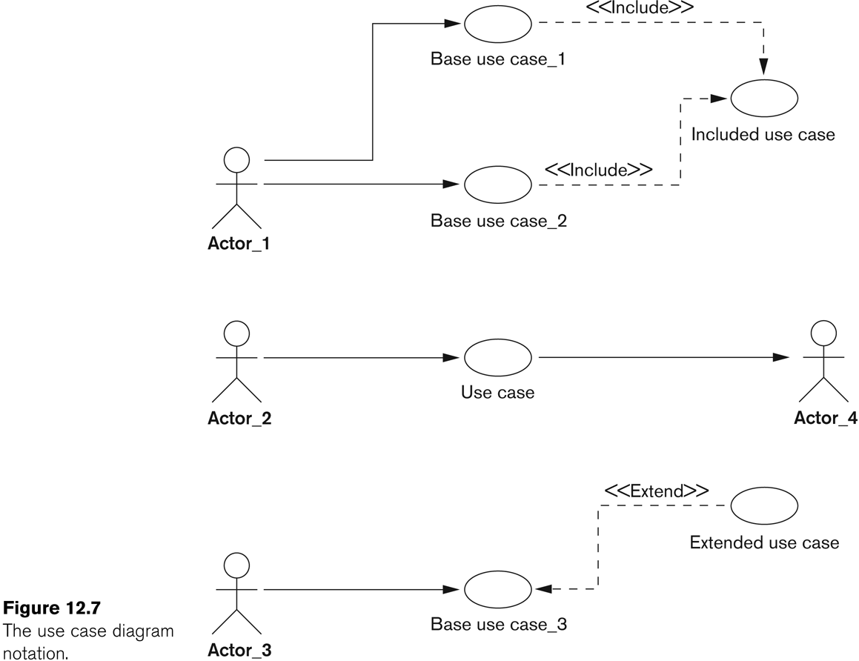
UML Diagrams (contd.)

Slide 32
UML Diagrams (contd.)
Sequence Diagrams
  Represent interactions between various objects over time
  Relate uses cases and class diagrams

Slide 33
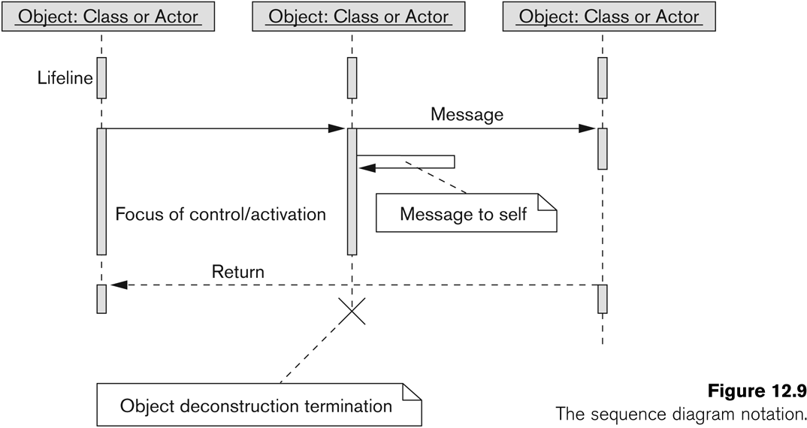
UML Diagrams (contd.)

Slide 34
UML Diagrams (contd.)
Collaboration Diagrams
  Represent interactions between objects as a series of sequenced messages
Statechart Diagram
  Describe how an object’s state changes in response to external events
  Consist of states, transitions, actions, activities and events

Slide 35
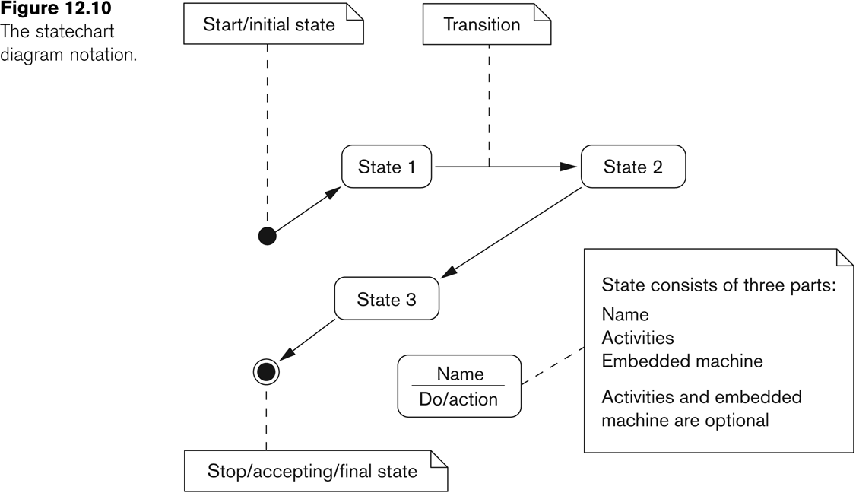
UML Diagrams (contd.)

Slide 36
UML Diagrams (contd.)
Activity Diagrams
  Model the flow of control from activity to activity
  Flowcharts with states

Slide 37
Salient Features of Rational Rose Data Modeler
UML based modeling tool for designing databases
Reverse Engineering
  Generate a conceptual data model from an existing DBMS database or DDL
Forward Engineering
  Create application/data model
  Generate DDL from data model

Slide 38
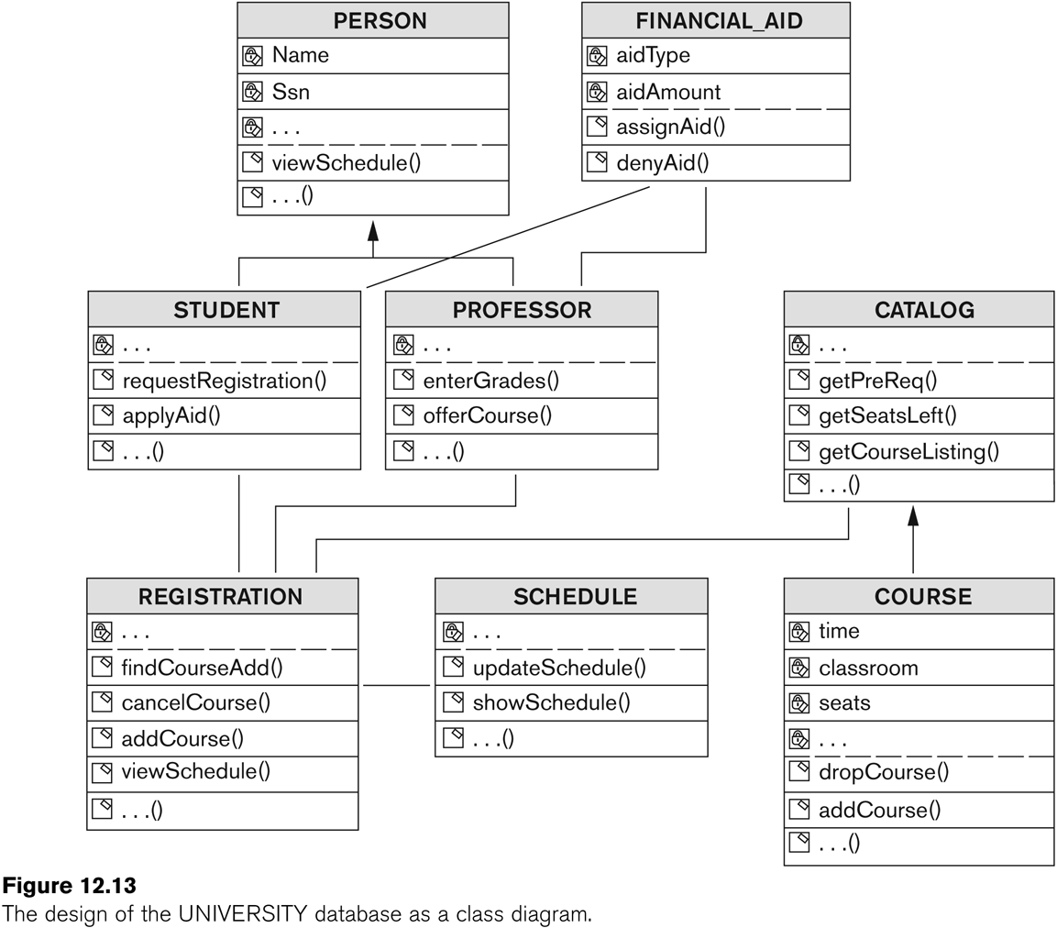
Salient Features of Rational Rose Data Modeler (contd.)

Slide 39
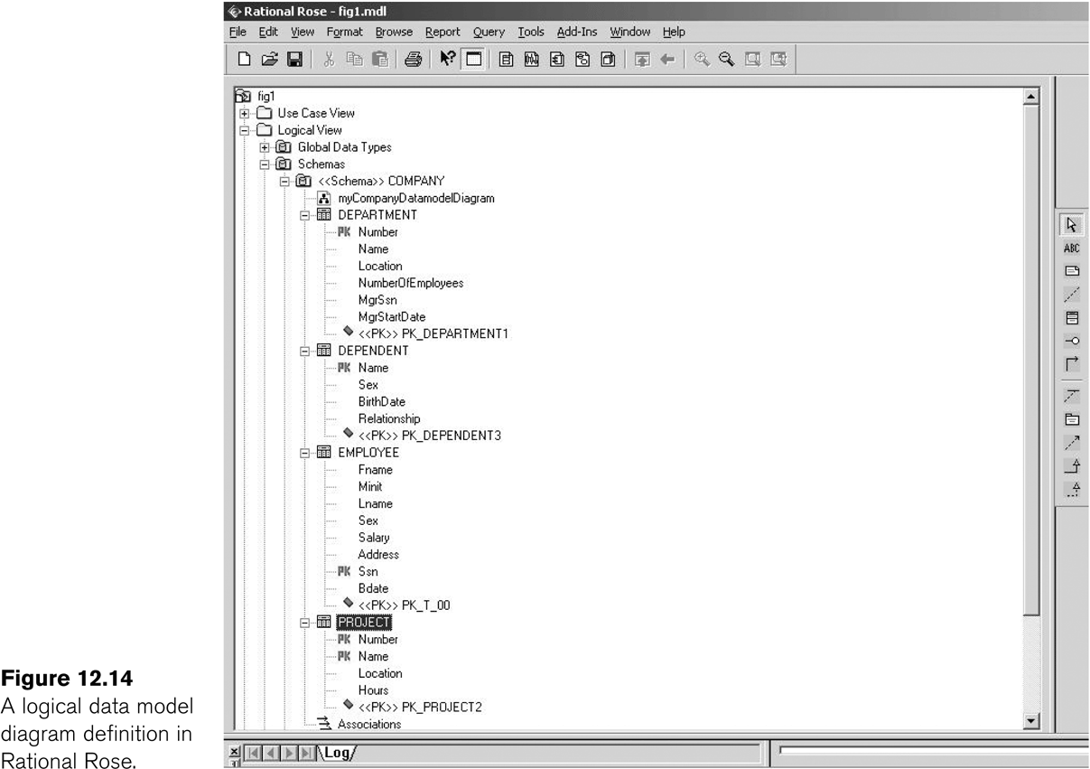
Salient Features of Rational Rose Data Modeler (contd.)
Modeling ER diagrams in UML
  ER schema from the company example in chapter 3 can be drawn in Rational Rose using UML notation

Slide 40
Salient Features of Rational Rose Data Modeler (contd.)
Keeps the data model and database synchronized
  Gives the option of updating the model or changing the database
Provides Extensive Domain Support
  Allows database designers to create a standard set of user-defined types
Allows Converting between logical and object model design
Allows easy communication between various developing and design teams
  Provides a common tool and platform to designers and developers
  Rational Rose Web Publisher

Slide 41
Database Design Tools
Common Features
  Allow the designer to draw conceptual schema diagram in some tool-specific notation
  Allow model mapping
  Allow some level of design normalization
Problems
  Most tools do nothing more than representing relationships among tables
  Most tools lack built-in methodology support
  Most tools have poor design verification system

Slide 42
Characteristics of a Good Design Tool
Easy-to-use interface
  Easy to use
  Customizable
Analytical components
  For difficult tasks
    such as evaluating physical design alternatives or detecting conflicting constraints among views
Heuristic components
  Automating design process using heuristic rules

Slide 43
Characteristics of a Good Design Tool (contd.)
Trade-off analysis
  Comparative analysis in case of multiple alternatives
  At least at the conceptual design level
Display of design results
  Displaying results in simple and easy to understand form
Design Verification
  Verifying that the resulting design satisfies the initial requirements

