Slide 1
Chapter 9: Application Design and Development

Slide 2
Chapter 8: Application Design and Development
User Interfaces and Tools
Web Interfaces to Databases
Web Fundamentals
Servlets and JSP
Building Large Web Applications
Triggers
Authorization in SQL
Application Security

Slide 3
User Interfaces and Tools
Most database users do not use a query language like SQL.
  Forms
  Graphical user interfaces
  Report generators
  Data analysis tools (see Chapter 18)
Many interfaces are Web-based
Back-end (Web server) uses such technologies as
  Java servlets
  Java Server Pages (JSP)
  Active Server Pages (ASP)

Slide 4
The World Wide Web
The Web is a distributed information system based on hypertext.
Most Web documents are hypertext documents formatted via the HyperText Markup Language (HTML)
HTML documents contain
  text along with font specifications, and other formatting instructions
  hypertext links to other documents, which can be associated with regions of the text.
  forms, enabling users to enter data which can then be sent back to the Web server

Slide 5
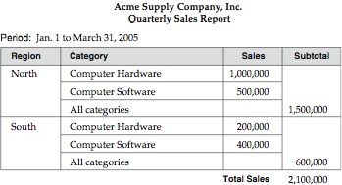
A formatted report

Slide 6
Web Interfaces to Databases
Why interface databases to the Web?
Web browsers have become the de-facto standard user interface to databases
  Enable large numbers of users to access databases from anywhere
  Avoid the need for downloading/installing specialized code, while providing a good graphical user interface
  Examples: banks, airline and rental car reservations, university course registration and grading, an so on.

Slide 7
Web Interfaces to Database (Cont.)
Dynamic generation of documents
  Limitations of static HTML documents
    Cannot customize fixed Web documents for individual users.
    Problematic to update Web documents, especially if multiple Web documents replicate data.
  Solution: Generate Web documents dynamically from data stored in a database.
    Can tailor the display based on user information stored in the database.
      E.g. tailored ads, tailored weather and local news, …
    Displayed information is up-to-date, unlike the static Web pages
      E.g. stock market information, ..

Slide 8
Uniform Resources Locators
In the Web, functionality of pointers is provided by Uniform Resource Locators (URLs).
URL example:
http://www.bell-labs.com/topics/book/db-book
  The first part indicates how the document is to be accessed
    “http” indicates that the document is to be accessed using the Hyper Text Transfer Protocol.
  The second part gives the unique name of a machine on the Internet.
  The rest of the URL identifies the document within the machine.
The local identification can be:
    The path name of a file on the machine, or
    An identifier (path name) of a program, plus arguments to be passed to the program
      E.g. http://www.google.com/search?q=silberschatz

Slide 9
HTML and HTTP
HTML provides formatting, hypertext link, and image display features.
HTML also provides input features
    Select from a set of options
      Pop-up menus, radio buttons, check lists
    Enter values
      Text boxes
  Filled in input sent back to the server, to be acted upon by an executable at the server
HyperText Transfer Protocol (HTTP) used for communication with the Web server

Slide 10
Sample HTML Source Text
<html> <body>
<table border cols = 3>
<tr> <td> A-101 </td> <td> Downtown </td> <td> 500 </td> </tr>
…
</table>
<center> The <i>account</i> relation </center>
<form action=“BankQuery” method=get>
Select account/loan and enter number <br>
<select name=“type”>
<option value=“account” selected> Account
<option> value=“Loan”> Loan
</select>
<input type=text size=5 name=“number”>
<input type=submit value=“submit”>
</form>
</body> </html>

Slide 11
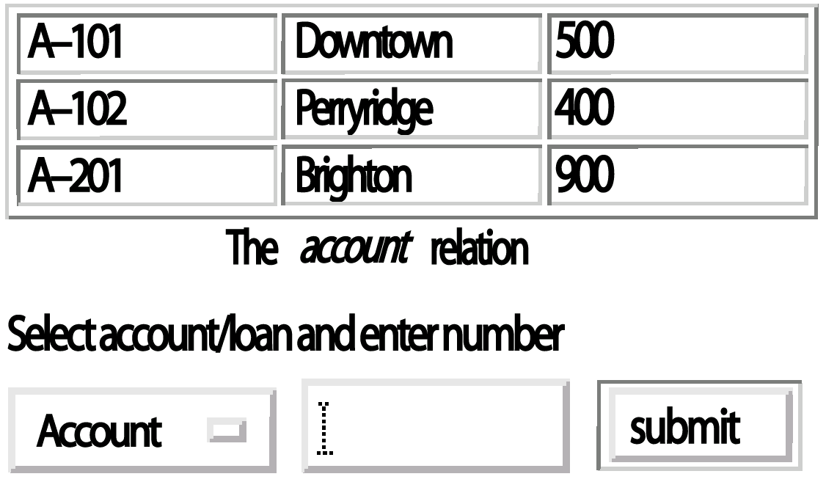
Display of Sample HTML Source

Slide 12
Client Side Scripting and Applets
Browsers can fetch certain scripts (client-side scripts) or programs along with documents, and execute them in “safe mode” at the client site
  Javascript
  Macromedia Flash and Shockwave for animation/games
  VRML (virtual reality modeling language)
  Applets
Client-side scripts/programs allow documents to be active
  E.g., animation by executing programs at the local site
  E.g. ensure that values entered by users satisfy some correctness checks
  Permit flexible interaction with the user.
    Executing programs at the client site speeds up interaction by avoiding many round trips to server

Slide 13
Client Side Scripting and Security
Security mechanisms needed to ensure that malicious scripts do not cause damage to the client machine
  Easy for limited capability scripting languages, harder for general purpose programming languages like Java
E.g. Java’s security system ensures that the Java applet code does not make any system calls directly
  Disallows dangerous actions such as file writes
  Notifies the user about potentially dangerous actions, and allows the option to abort the program or to continue execution.

Slide 14
Web Servers
A Web server can easily serve as a front end to a variety of information services.
The document name in a URL may identify an executable program, that, when run, generates a HTML document.
  When a HTTP server receives a request for such a document, it executes the program, and sends back the HTML document that is generated.
  The Web client can pass extra arguments with the name of the document.
To install a new service on the Web, one simply needs to create and install an executable that provides that service.
  The Web browser provides a graphical user interface to the information service.
Common Gateway Interface (CGI): a standard interface between web and application server

Slide 15
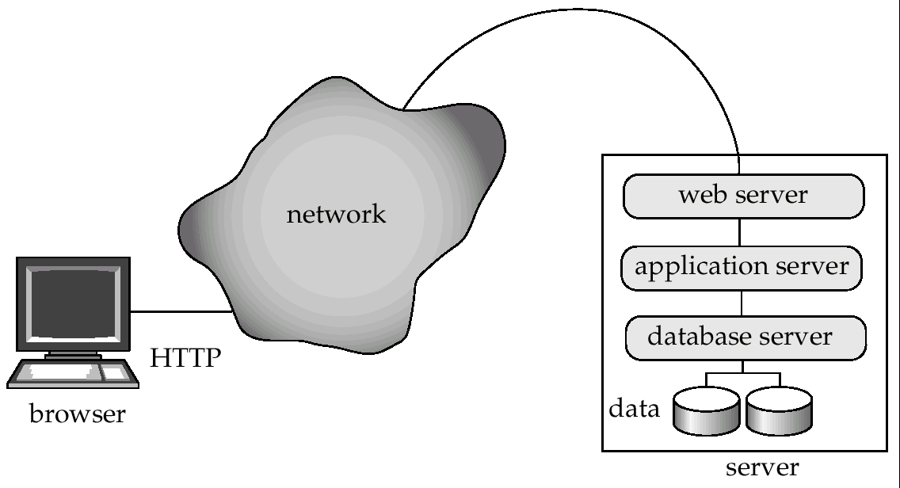
Three-Tier Web Architecture

Slide 16
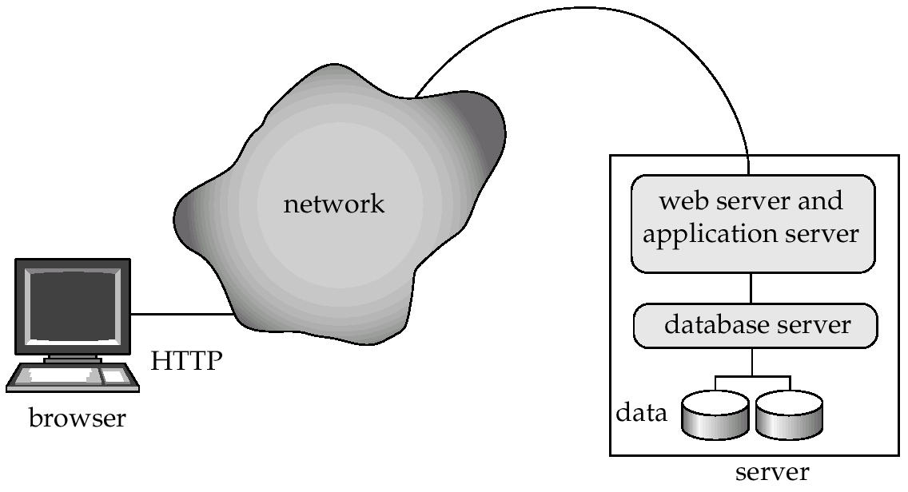
Two-Tier Web Architecture
Multiple levels of indirection have overheads
  Alternative: two-tier architecture

Slide 17
HTTP and Sessions
The HTTP protocol is connectionless
  That is, once the server replies to a request, the server closes the connection with the client, and forgets all about the request
  In contrast, Unix logins, and JDBC/ODBC connections stay connected until the client disconnects
    retaining user authentication and other information
  Motivation: reduces load on server
    operating systems have tight limits on number of open connections on a machine
Information services need session information
  E.g. user authentication should be done only once per session
Solution: use a cookie

Slide 18
Sessions and Cookies
A cookie is a small piece of text containing identifying information
  Sent by server to browser on first interaction
  Sent by browser to the server that created the cookie on further interactions
    part of the HTTP protocol
  Server saves information about cookies it issued, and can use it when serving a request
    E.g., authentication information, and user preferences
Cookies can be stored permanently or for a limited time

Slide 19
Servlets
Java Servlet specification defines an API for communication between the Web server and application program
  E.g. methods to get parameter values and to send HTML text back to client
Application program (also called a servlet) is loaded into the Web server
  Two-tier model
  Each request spawns a new thread in the Web server
    thread is closed once the request is serviced
Servlet API provides a getSession() method
  Sets a cookie on first interaction with browser, and uses it to identify session on further interactions
  Provides methods to store and look-up per-session information
    E.g. user name, preferences, ..

Slide 20
Example Servlet Code
Public class BankQuery(Servlet extends HttpServlet {
public void doGet(HttpServletRequest request, HttpServletResponse result)
throws ServletException, IOException {
String type = request.getParameter(“type”);
String number = request.getParameter(“number”);
…code to find the loan amount/account balance …
…using JDBC to communicate with the database..
…we assume the value is stored in the variable balance
result.setContentType(“text/html”);
PrintWriter out = result.getWriter( );
out.println(“<HEAD><TITLE>Query Result</TITLE></HEAD>”);
out.println(“<BODY>”);
out.println(“Balance on “ + type + number + “=“ + balance);
out.println(“</BODY>”);
out.close ( );
}
}

Slide 21
Server-Side Scripting
Server-side scripting simplifies the task of connecting a database to the Web
  Define a HTML document with embedded executable code/SQL queries.
  Input values from HTML forms can be used directly in the embedded code/SQL queries.
  When the document is requested, the Web server executes the embedded code/SQL queries to generate the actual HTML document.
Numerous server-side scripting languages
  JSP, Server-side Javascript, ColdFusion Markup Language (cfml), PHP, Jscript
  General purpose scripting languages: VBScript, Perl, Python

Slide 22
Improving Web Server Performance
Performance is an issue for popular Web sites
  May be accessed by millions of users every day, thousands of requests per second at peak time
Caching techniques used to reduce cost of serving pages by exploiting commonalities between requests
  At the server site:
    Caching of JDBC connections between servlet requests
    Caching results of database queries
      Cached results must be updated if underlying database changes
    Caching of generated HTML
  At the client’s network
    Caching of pages by Web proxy

Slide 23
Triggers
A trigger is a statement that is executed automatically by the system as a side effect of a modification to the database.
To design a trigger mechanism, we must:
  Specify the conditions under which the trigger is to be executed.
  Specify the actions to be taken when the trigger executes.
Triggers introduced to SQL standard in SQL:1999, but supported even earlier using non-standard syntax by most databases.

Slide 24
Trigger Example
Suppose that instead of allowing negative account balances, the bank deals with overdrafts by
  setting the account balance to zero
  creating a loan in the amount of the overdraft
  giving this loan a loan number identical to the account number of the overdrawn account
The condition for executing the trigger is an update to the account relation that results in a negative balance value.

Slide 25
Trigger Example in SQL:1999
create trigger overdraft-trigger after update on account
referencing new row as nrow for each row
when nrow.balance < 0
begin atomic
insert into borrower
(select customer-name, account-number
from depositor
where nrow.account-number =
depositor.account-number);
insert into loan values
(n.row.account-number, nrow.branch-name,
– nrow.balance);
update account set balance = 0
where account.account-number = nrow.account-number
end

Slide 26
Triggering Events and Actions in SQL
Triggering event can be insert, delete or update
Triggers on update can be restricted to specific attributes
  E.g. create trigger overdraft-trigger after update of balance on account
Values of attributes before and after an update can be referenced
  referencing old row as : for deletes and updates
  referencing new row as : for inserts and updates
Triggers can be activated before an event, which can serve as extra constraints. E.g. convert blanks to null.
create trigger setnull-trigger before update on r
referencing new row as nrow
for each row
when nrow.phone-number = ‘ ‘
set nrow.phone-number = null

Slide 27
Statement Level Triggers
Instead of executing a separate action for each affected row, a single action can be executed for all rows affected by a transaction
  Use for each statement instead of for each row
  Use referencing old table or referencing new table to refer to temporary tables (called transition tables) containing the affected rows
  Can be more efficient when dealing with SQL statements that update a large number of rows

Slide 28
External World Actions
We sometimes require external world actions to be triggered on a database update
  E.g. re-ordering an item whose quantity in a warehouse has become small, or turning on an alarm light,
Triggers cannot be used to directly implement external-world actions, BUT
  Triggers can be used to record actions-to-be-taken in a separate table
  Have an external process that repeatedly scans the table, carries out external-world actions and deletes action from table
E.g. Suppose a warehouse has the following tables
  inventory (item, level ): How much of each item is in the warehouse
  minlevel (item, level ) : What is the minimum desired level of each item
  reorder (item, amount ): What quantity should we re-order at a time
  orders (item, amount ) : Orders to be placed (read by external process)

Slide 29
External World Actions (Cont.)
create trigger reorder-trigger after update of amount on inventory
referencing old row as orow, new row as nrow
for each row
when nrow.level < = (select level
from minlevel
where minlevel.item = orow.item)
and orow.level > (select level
from minlevel
where minlevel.item = orow.item)
begin
insert into orders
(select item, amount
from reorder
where reorder.item = orow.item)
end

Slide 30
Triggers in MS-SQLServer Syntax
create trigger overdraft-trigger on account
for update
as
if inserted.balance < 0
begin
insert into borrower
(select customer-name,account-number
from depositor, inserted
where inserted.account-number =
depositor.account-number)
insert into loan values
(inserted.account-number, inserted.branch-name,
– inserted.balance)
update account set balance = 0
from account, inserted
where account.account-number = inserted.account-number
end

Slide 31
When Not To Use Triggers
Triggers were used earlier for tasks such as
  maintaining summary data (e.g. total salary of each department)
  Replicating databases by recording changes to special relations (called change or delta relations) and having a separate process that applies the changes over to a replica
There are better ways of doing these now:
  Databases today provide built in materialized view facilities to maintain summary data
  Databases provide built-in support for replication
Encapsulation facilities can be used instead of triggers in many cases
  Define methods to update fields
  Carry out actions as part of the update methods instead of
  through a trigger

Slide 32
Authorization in SQL (see also Section 4.3)
Forms of authorization on parts of the database:
Read authorization - allows reading, but not modification of data.
Insert authorization - allows insertion of new data, but not modification of existing data.
Update authorization - allows modification, but not deletion of data.
Delete authorization - allows deletion of data

Slide 33
Authorization (Cont.)
Forms of authorization to modify the database schema:
Index authorization - allows creation and deletion of indices.
Resources authorization - allows creation of new relations.
Alteration authorization - allows addition or deletion of attributes in a relation.
Drop authorization - allows deletion of relations.

Slide 34
Authorization and Views
Users can be given authorization on views, without being given any authorization on the relations used in the view definition
Ability of views to hide data serves both to simplify usage of the system and to enhance security by allowing users access only to data they need for their job
A combination or relational-level security and view-level security can be used to limit a user’s access to precisely the data that user needs.

Slide 35
View Example
Suppose a bank clerk needs to know the names of the customers of each branch, but is not authorized to see specific loan information.
  Approach: Deny direct access to the loan relation, but grant access to the view cust-loan, which consists only of the names of customers and the branches at which they have a loan.
  The cust-loan view is defined in SQL as follows:
create view cust-loan as
select branchname, customer-name
from borrower, loan
where borrower.loan-number = loan.loan-number

Slide 36
View Example (Cont.)
The clerk is authorized to see the result of the query:
        select *
        from cust-loan
When the query processor translates the result into a query on the actual relations in the database, we obtain a query on borrower and loan.
Authorization must be checked on the clerk’s query before query processing replaces a view by the definition of the view.

Slide 37
Authorization on Views
Creation of view does not require resources authorization since no real relation is being created
The creator of a view gets only those privileges that provide no additional authorization beyond that he already had.
E.g. if creator of view cust-loan had only read authorization on borrower and loan, he gets only read authorization on cust-loan

Slide 38
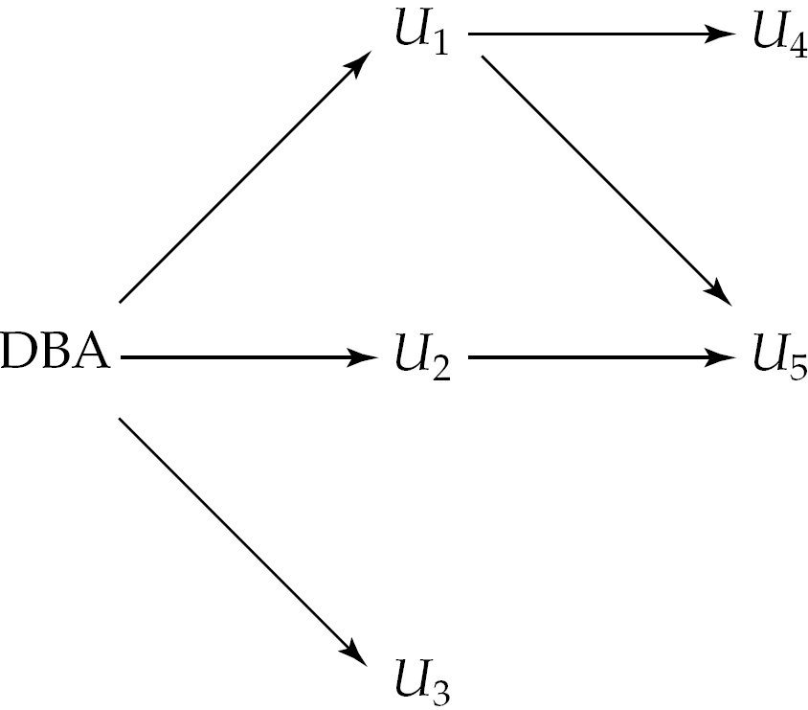
Granting of Privileges
The passage of authorization from one user to another may be represented by an authorization graph.
The nodes of this graph are the users.
The root of the graph is the database administrator.
Consider graph for update authorization on loan.
An edge U_{i} → U_{j} indicates that user U_{i} has granted update authorization on loan to U_{j.}

Slide 39
Authorization Grant Graph
Requirement: All edges in an authorization graph must be part of some path originating with the database administrator
If DBA revokes grant from U₁:
  Grant must be revoked from U₄ since U₁ no longer has authorization
  Grant must not be revoked from U₅ since U₅ has another authorization path from DBA through U₂
Must prevent cycles of grants with no path from the root:
  DBA grants authorization to U₇
  U₇ grants authorization to U₈
  U₈ grants authorization to U₇
  DBA revokes authorization from U₇
Must revoke grant U₇ to U₈ and from U₈ to U₇ since there is no path from DBA to U₇ or to U₈ anymore.

Slide 40
Security Specification in SQL
The grant statement is used to confer authorization
grant <privilege list>
on <relation name or view name> to <user list>
<user list> is:
  a user-id
  public, which allows all valid users the privilege granted
  A role (more on this later)
Granting a privilege on a view does not imply granting any privileges on the underlying relations.
The grantor of the privilege must already hold the privilege on the specified item (or be the database administrator).

Slide 41
Privileges in SQL
select: allows read access to relation,or the ability to query using the view
  Example: grant users U₁, U₂, and U₃ select authorization on the branch relation:
grant select on branch to U₁, U₂, U₃
insert: the ability to insert tuples
update: the ability to update using the SQL update statement
delete: the ability to delete tuples.
references: ability to declare foreign keys when creating relations.
usage: In SQL-92; authorizes a user to use a specified domain
all privileges: used as a short form for all the allowable privileges

Slide 42
Privilege To Grant Privileges
with grant option: allows a user who is granted a privilege to pass the privilege on to other users.
  Example:
      grant select on branch to U₁ with grant option
    gives U₁ the select privileges on branch and allows U₁ to grant this
    privilege to others

Slide 43
Roles
Roles permit common privileges for a class of users can be specified just once by creating a corresponding “role”
Privileges can be granted to or revoked from roles, just like user
Roles can be assigned to users, and even to other roles
SQL:1999 supports roles
      create role teller
      create role manager
      grant select on branch to teller
      grant update (balance) on account to teller
      grant all privileges on account to manager
      grant teller to manager
      grant teller to alice, bob
      grant manager to avi

Slide 44
Revoking Authorization in SQL
The revoke statement is used to revoke authorization.
  revoke<privilege list>
  on <relation name or view name> from <user list> [restrict|cascade]
Example:
  revoke select on branch from U₁, U₂, U₃ cascade
Revocation of a privilege from a user may cause other users also to lose that privilege; referred to as cascading of the revoke.
We can prevent cascading by specifying restrict:
  revoke select on branch from U₁, U₂, U₃ restrict
With restrict, the revoke command fails if cascading revokes are required.

Slide 45
Revoking Authorization in SQL (Cont.)
<privilege-list> may be all to revoke all privileges the revokee may hold.
If <revokee-list> includes public all users lose the privilege except those granted it explicitly.
If the same privilege was granted twice to the same user by different grantees, the user may retain the privilege after the revocation.
All privileges that depend on the privilege being revoked are also revoked.

Slide 46
Limitations of SQL Authorization
SQL does not support authorization at a tuple level
  E.g. we cannot restrict students to see only (the tuples storing) their own grades
With the growth in Web access to databases, database accesses come primarily from application servers.
  End users don't have database user ids, they are all mapped to the same database user id
All end-users of an application (such as a web application) may be mapped to a single database user
The task of authorization in above cases falls on the application program, with no support from SQL
  Benefit: fine grained authorizations, such as to individual tuples, can be implemented by the application.
  Drawback: Authorization must be done in application code, and may be dispersed all over an application
  Checking for absence of authorization loopholes becomes very difficult since it requires reading large amounts of application code

Slide 47
Audit Trails
An audit trail is a log of all changes (inserts/deletes/updates) to the database along with information such as which user performed the change, and when the change was performed.
Used to track erroneous/fraudulent updates.
Can be implemented using triggers, but many database systems provide direct support.

Slide 48
Application Security
Data may be encrypted when database authorization provisions do not offer sufficient protection.
Properties of good encryption technique:
  Relatively simple for authorized users to encrypt and decrypt data.
  Encryption scheme depends not on the secrecy of the algorithm but on the secrecy of a parameter of the algorithm called the encryption key.
  Extremely difficult for an intruder to determine the encryption key.

Slide 49
Encryption (Cont.)
Data Encryption Standard (DES) substitutes characters and rearranges their order on the basis of an encryption key which is provided to authorized users via a secure mechanism. Scheme is no more secure than the key transmission mechanism since the key has to be shared.
Advanced Encryption Standard (AES) is a new standard replacing DES, and is based on the Rijndael algorithm, but is also dependent on shared secret keys
Public-key encryption is based on each user having two keys:
  public key – publicly published key used to encrypt data, but cannot be used to decrypt data
  private key -- key known only to individual user, and used to decrypt data.
  Need not be transmitted to the site doing encryption.
Encryption scheme is such that it is impossible or extremely hard to decrypt data given only the public key.
The RSA public-key encryption scheme is based on the hardness of factoring a very large number (100's of digits) into its prime components.

Slide 50
Authentication
Password based authentication is widely used, but is susceptible to sniffing on a network
Challenge-response systems avoid transmission of passwords
  DB sends a (randomly generated) challenge string to user
  User encrypts string and returns result.
  DB verifies identity by decrypting result
  Can use public-key encryption system by DB sending a message encrypted using user’s public key, and user decrypting and sending the message back
Digital signatures are used to verify authenticity of data
  E.g. use private key (in reverse) to encrypt data, and anyone can verify authenticity by using public key (in reverse) to decrypt data. Only holder of private key could have created the encrypted data.
  Digital signatures also help ensure nonrepudiation: sender
  cannot later claim to have not created the data

Slide 51
Digital Certificates
Digital certificates are used to verify authenticity of public keys.
Problem: when you communicate with a web site, how do you know if you are talking with the genuine web site or an imposter?
  Solution: use the public key of the web site
  Problem: how to verify if the public key itself is genuine?
Solution:
  Every client (e.g. browser) has public keys of a few root-level certification authorities
  A site can get its name/URL and public key signed by a certification authority: signed document is called a certificate
  Client can use public key of certification authority to verify certificate
  Multiple levels of certification authorities can exist. Each certification authority
    presents its own public-key certificate signed by a
    higher level authority, and
    Uses its private key to sign the certificate of other web sites/authorities

Slide 52
End of Chapter

