Slide 1
FIXING THE GAPS
A Stakeholder-Driven Power BI Dashboard for Resource Allocation and School Performance in Pakistan
Business Intelligence & Advanced Data Analytics — Capstone Project
Prepared for KP-IT Board Course Evaluation
Shoaib Yousaf
Prepared By:
Fixing the Gaps • BI Capstone Project
1

Slide 2
1. Business Problem
Why this BI solution is needed
2013–2016
Education data is fragmented across performance, infrastructure, geography and contextual indicators.
Decision makers need to identify where resource gaps are most severe, not only view national averages.
Traditional tables report numbers but do not clearly prioritize districts for intervention.
The solution converts available data into an interactive decision support dashboard.
Primary analysis period
Province → City
Geographic analysis
Evidence → Action
Decision-support focus
Fixing the Gaps • BI Capstone Project
2

Slide 3
2. Project Objectives
Measure education, learning and retention performance across regions.
Identify infrastructure deficits involving electricity, drinking water, toilets, classrooms and teachers.
Highlight gender enrollment disparities and high-risk regions.
Connect findings to specific, actionable government interventions.
Provide executives with a consistent, interactive BI reporting experience.
Fixing the Gaps • BI Capstone Project
3

Slide 4
3. Dataset & Data Sources
Core educational and contextual indicators
Education
Infrastructure
Geography
Context
Enrollment, completion & performance
Facilities, classrooms & teachers
Province, city/district & population
Budget, economic & security indicators
• Main dataset: Consolidated Educational / Pakistan Education Performance Dataset.
• Analysis period: 2013–2016.
• Key fields include boys' and girls' enrollment, facility availability, single-teacher and single-classroom indicators.
• Context fields include Global Terrorism Index drone attacks, bomb blasts, economic growth and educational budget spend of GDP.
Fixing the Gaps • BI Capstone Project
4

Slide 5
4. Data Preparation & Quality
Reviewed column names, data types, blanks/nulls and duplicate records.
Converted percentage and numeric fields to appropriate data types.
Standardized geographic and categorical values.
Created separate Time, Geography and Context dimensions.
Validated key measures using direct aggregation, filtered visual checks and cross-visual comparison.
Reviewed Year and Province filter behavior and corrected relevant model relationships.
Applied consistent formatting and conditional formatting for risk indicators.
Fixing the Gaps • BI Capstone Project
5

Slide 6
5. Data Model
Star-schema approach
Dim_Time
Dim_Geography
Year / YearKey
Province / City
One to many
One to many
Fact_Education_Metrics
Education + infrastructure measures
One to many
Dim_Context
Measures
Policy / security / economy
DAX KPI calculations
Dimension tables filter the central fact table; measures respond to report filter context.
Fixing the Gaps • BI Capstone Project
6

Slide 7
6. KPI Framework
Gender Enrollment Gap
Utility Deficit Rate
Teacher Strain
Classroom Strain
Boys enrollment − girls enrollment
No-facility schools / total schools
Single-teacher schools / primary schools
Single-classroom schools / primary schools
Education Score
Learning Score
Retention Score
Overall Risk Score
Overall education performance
Learning performance indicator
Retention performance indicator
Combined risk indicator
Fixing the Gaps • BI Capstone Project
7

Slide 8
7. Dashboard Architecture
Executive Governance Panel
High-level KPIs, education performance and governance view
Executive Risk & Intervention
Critical regions, risk scoring and priority interventions
District Infrastructure Audit
Province/city infrastructure gaps and drill-through analysis
Policy Impact & Socio-Economic
Education outcomes in relation to policy and socio-economic context
Fixing the Gaps • BI Capstone Project
8

Slide 9
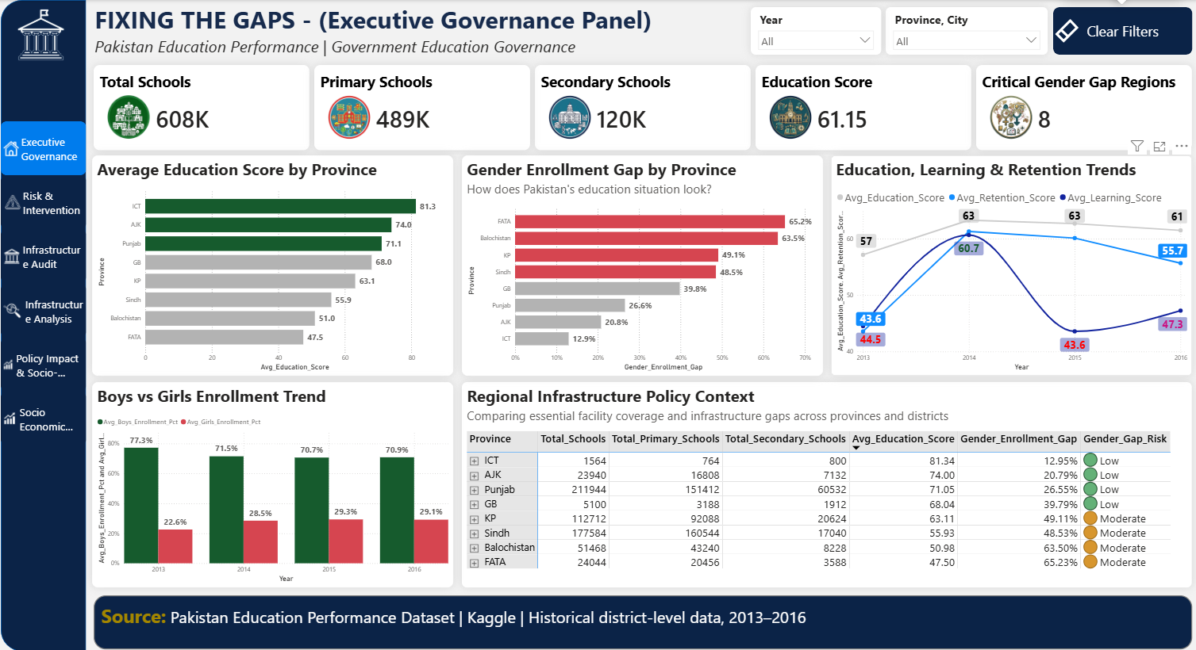
Dashboard 1 — Executive Governance Panel
Pakistan Education Performance | Government Education Governance
Fixing the Gaps • BI Capstone Project

Slide 10
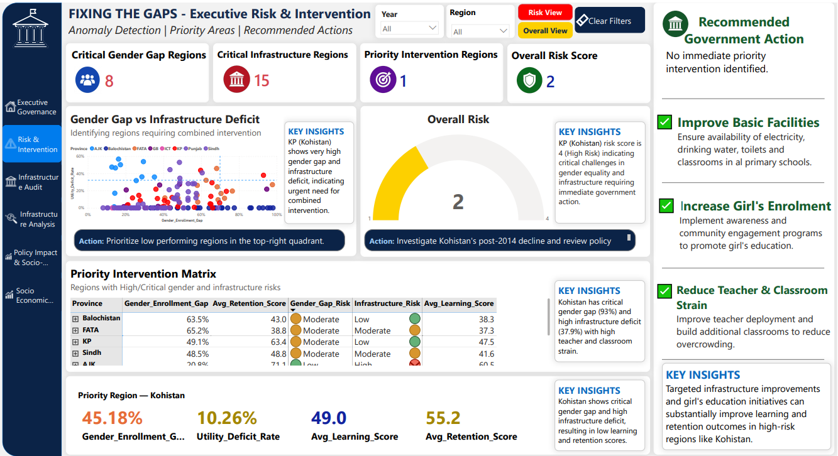
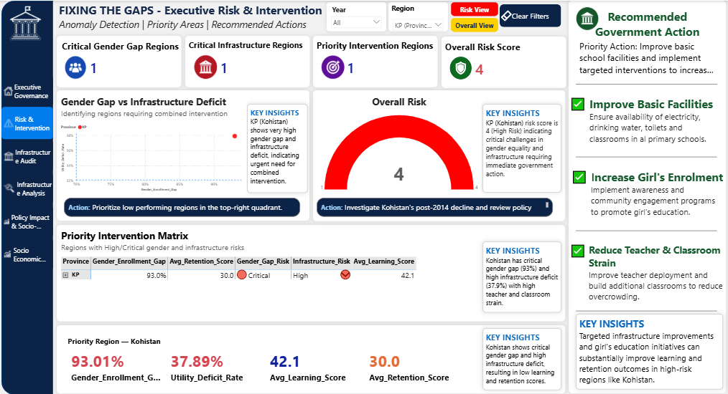
Dashboard 1 — Executive Risk & Intervention
Risk prioritization, critical regions and recommended government action
Overall View | Risk View
Fixing the Gaps • BI Capstone Project

Slide 11
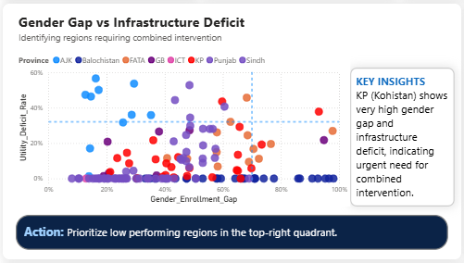
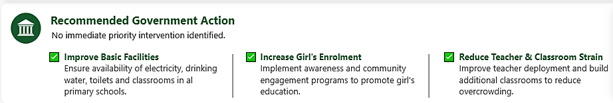
10. Priority Intervention: Kohistan
93.0%
37.89%
28.6%
Gender Enrollment Gap
Utility Deficit
Single-Teacher Strain
20.5%
42.1
30.0
Single-Classroom Strain
Learning Score
Retention Score
Why it matters
Kohistan is supported by multiple risk indicators simultaneously, making it a strong priority case rather than one based on a single KPI.
Fixing the Gaps • BI Capstone Project
11

Slide 12
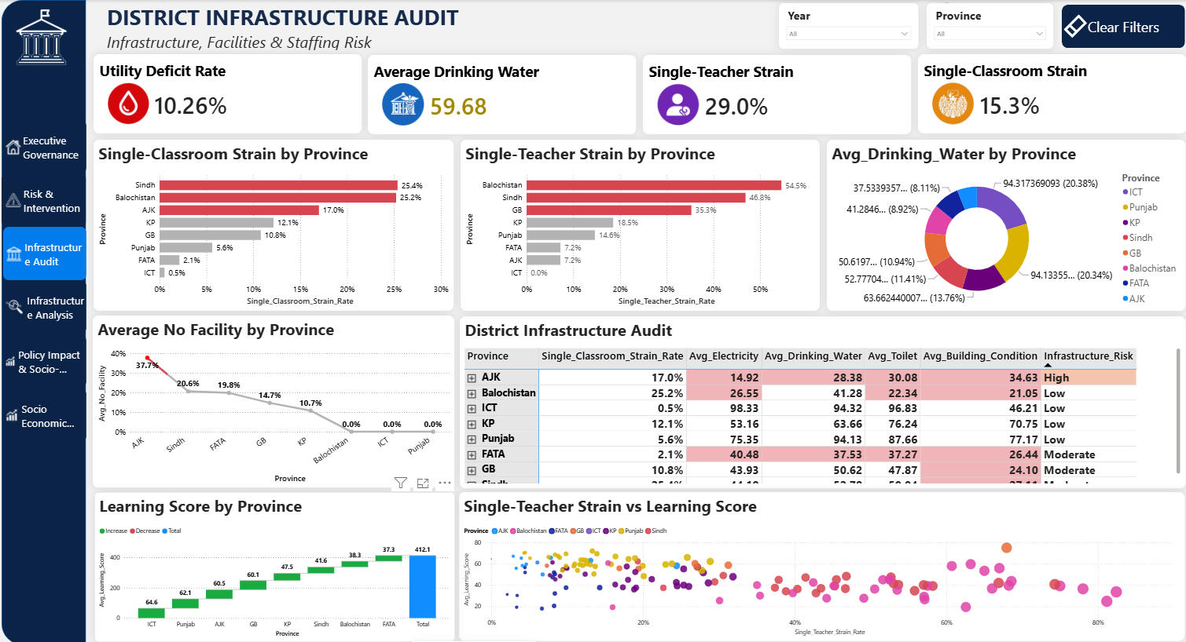
Dashboard 2 — District Infrastructure Audit
Infrastructure, Facilities & Staffing Risk
Fixing the Gaps • BI Capstone Project

Slide 13
Dashboard 2 — District Infrastructure Audit
Infrastructure, Facilities & Staffing Risk
ICT
98.33 Electricity • 94.32 Drinking Water • 96.83 Toilets
Punjab
75.35 Electricity • 94.13 Drinking Water • 87.66 Toilets
Sindh
44.19 Electricity • 52.78 Drinking Water • 59.04 Toilets
Balochistan
26.55 Electricity • 41.28 Drinking Water • 22.34 Toilets
Fixing the Gaps • BI Capstone Project

Slide 14
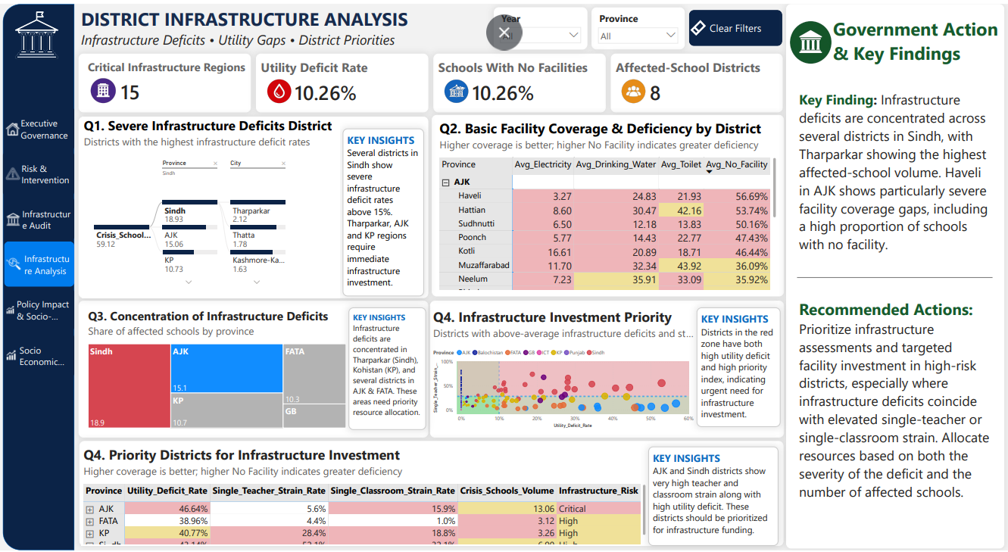
Dashboard 2 — District Infrastructure Analysis
Infrastructure deficits, utility gaps and district investment priorities
Fixing the Gaps • BI Capstone Project

Slide 15
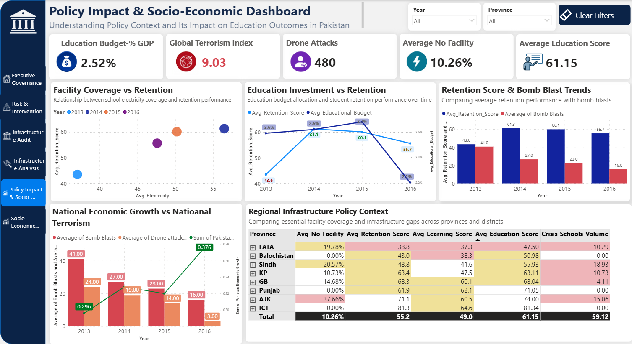
Dashboard 3 — Policy Impact & Socio-Economic
Education outcomes viewed alongside policy and socio-economic context
Fixing the Gaps • BI Capstone Project

Slide 16
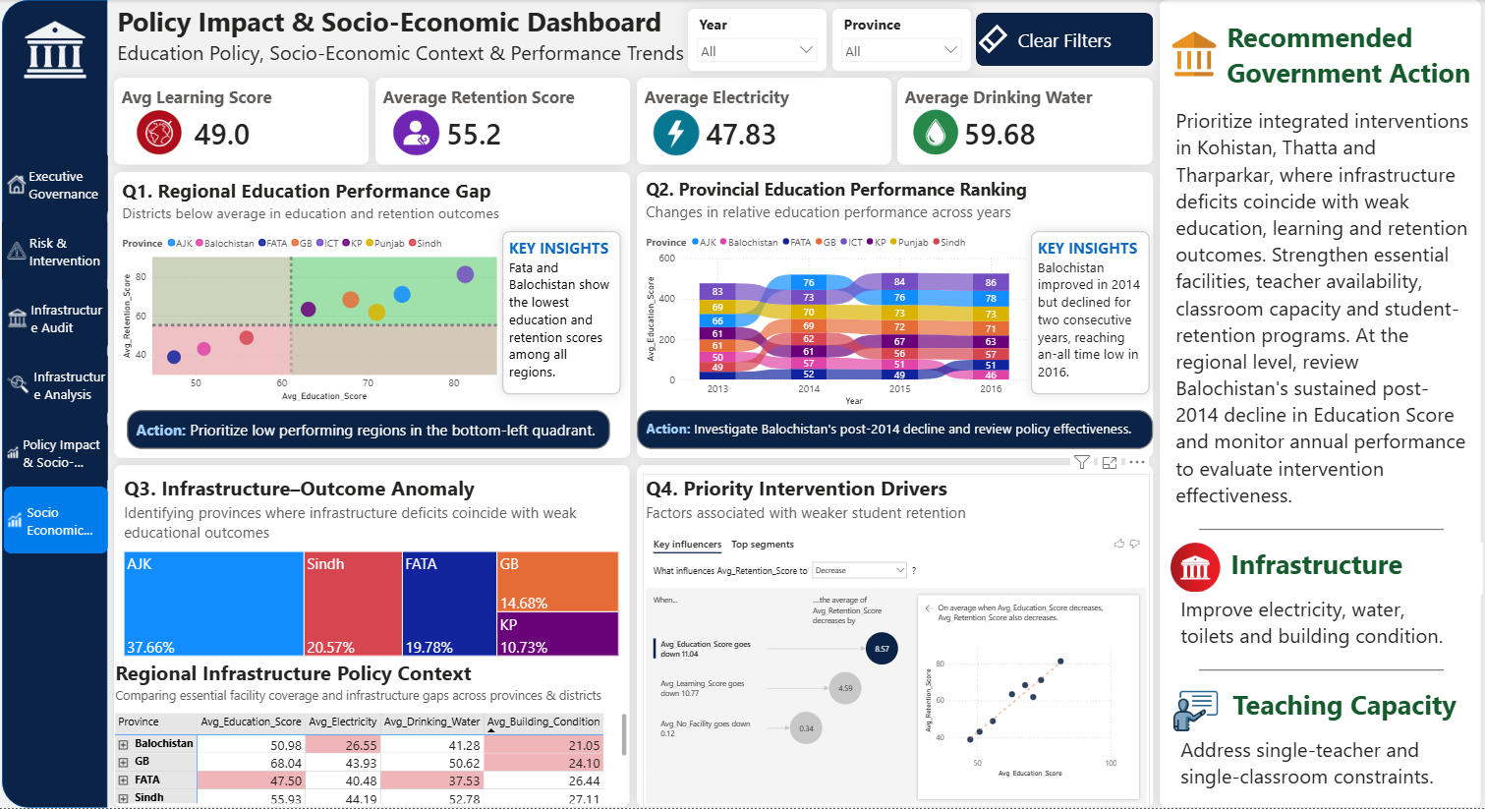
Dashboard 4 — Policy Impact & Socio-Economic Analysis
Interactive analysis view with anomaly and intervention-oriented visuals
Fixing the Gaps • BI Capstone Project

Slide 17
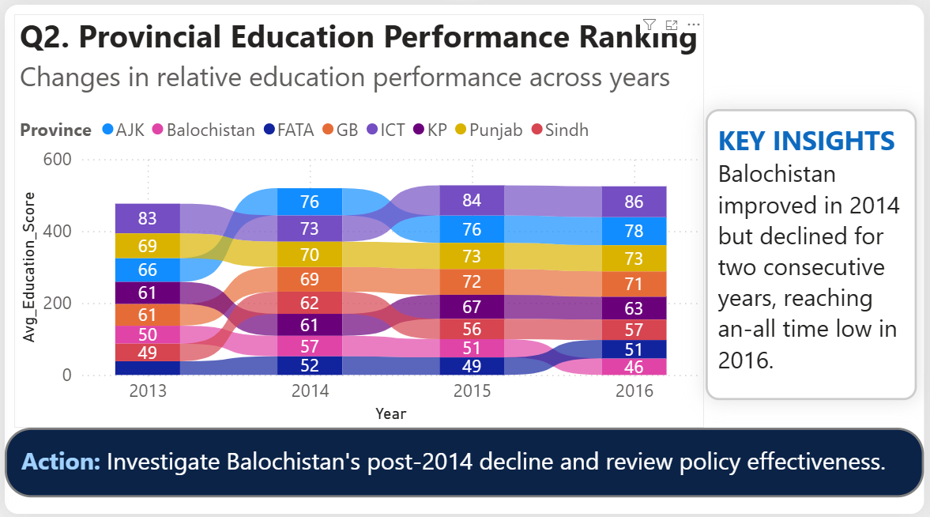
9. Trends & Anomalies
AJK: 66.2 → 78.1
Sindh: 48.9 → 61.7 → 56.2 → 56.9
Balochistan: 49.8 → 57.2 → 50.8 → 46.1
Education score, 2013 to 2016
2013–2016; 2014 gain not sustained
Improvement reversed after 2014
• AJK shows sustained improvement across the analysis period.
• Sindh shows a sharp 2014 improvement followed by a decline and slight recovery.
• Balochistan's post-2014 decline is a key anomaly requiring investigation.
• Sudhnoti shows that high infrastructure deficit does not automatically imply low retention, so local context matters.
Fixing the Gaps • BI Capstone Project
10

Slide 18
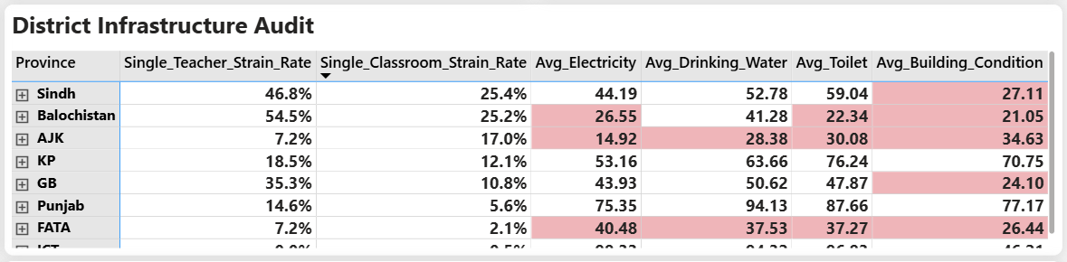
11. District Infrastructure Evidence
Tharparkar
Thatta
Haveli
52.89% No Facility
44.42% No Facility
56.69% No Facility
33.1 Retention
24.3 Retention
55.6 Retention
Hattian
Sudhnoti
Tor Ghar
53.74% No Facility
50.16% No Facility
43.64% No Facility
55.6 Retention
85.4 Retention
51.0 Retention
KEY INSIGHTS
Similar infrastructure deficits can coexist with very different outcomes, so interventions should be district-specific.
Fixing the Gaps • BI Capstone Project
12

Slide 19
12. Policy Impact & Socio-Economic Analysis
Compares education outcomes with contextual indicators such as educational budget, economic growth and security-related measures.
Educational budget is treated as a national-level indicator; therefore it responds to Year but is not expected to change with a Province slicer.
The analysis reveals associations and patterns; it does not claim that one contextual variable directly causes an education outcome.
Province and district comparisons show where national policy context is associated with different local outcomes.
National Budget
Year-sensitive context
Regional Outcomes
Province/city comparison
Decision Lens
Policy → evidence → action
Fixing the Gaps • BI Capstone Project
13

Slide 20
13. Recommended Government Actions
HIGH
Prioritize integrated interventions in Kohistan and other critical regions: facilities + teachers + classrooms + gender participation.
HIGH
Target Sindh and Balochistan districts where high no-facility rates coincide with weak learning and retention.
MEDIUM
Study high-performing/improving regions such as ICT and AJK to identify practices that can be adapted elsewhere.
MEDIUM
Investigate reversals such as Balochistan after 2014 rather than evaluating policy only from a single year's result.
Fixing the Gaps • BI Capstone Project
14

Slide 21
15. Performance Optimization
225.40 → 183.92 ms
3,381 → 2,391 ms
214.78 → 202.28 ms
District page average processing time
District page total processing time
Executive Governance average
• Reduced unnecessary visual processing and consolidated report elements.
• Used Performance Analyzer to identify expensive visuals/queries.
• Kept analytical visuals required for decision-making while improving responsiveness.
• Before/after performance evidence was documented in the project workbook.
Fixing the Gaps • BI Capstone Project
16

Slide 22
16. Expected Business & Policy Impact
Faster
Clearer
Targeted
Repeatable
Identify priority regions
Translate KPIs into insights
Allocate resources by need
Monitor trends over time
• Reduce the time required to locate high-risk districts across multiple indicators.
• Support evidence-based resource allocation instead of relying only on aggregate provincial averages.
• Create a repeatable reporting structure for monitoring education performance.
• Improve communication between analytical evidence and policy recommendations.
Fixing the Gaps • BI Capstone Project
17

Slide 23
17. Conclusion
Data → Gaps → Evidence → Priority Regions → Government Action
The solution combines education, infrastructure, geography and contextual indicators into one decision-support environment.
The analysis demonstrates significant regional variation and identifies specific high-priority districts.
Kohistan is a clear multi-indicator intervention case; Sindh and Balochistan contain districts requiring targeted support.
The dashboard helps stakeholders move from observing performance to deciding where action is needed.
THANK YOU
Fixing the Gaps • BI Capstone Project
18

