Slide 1
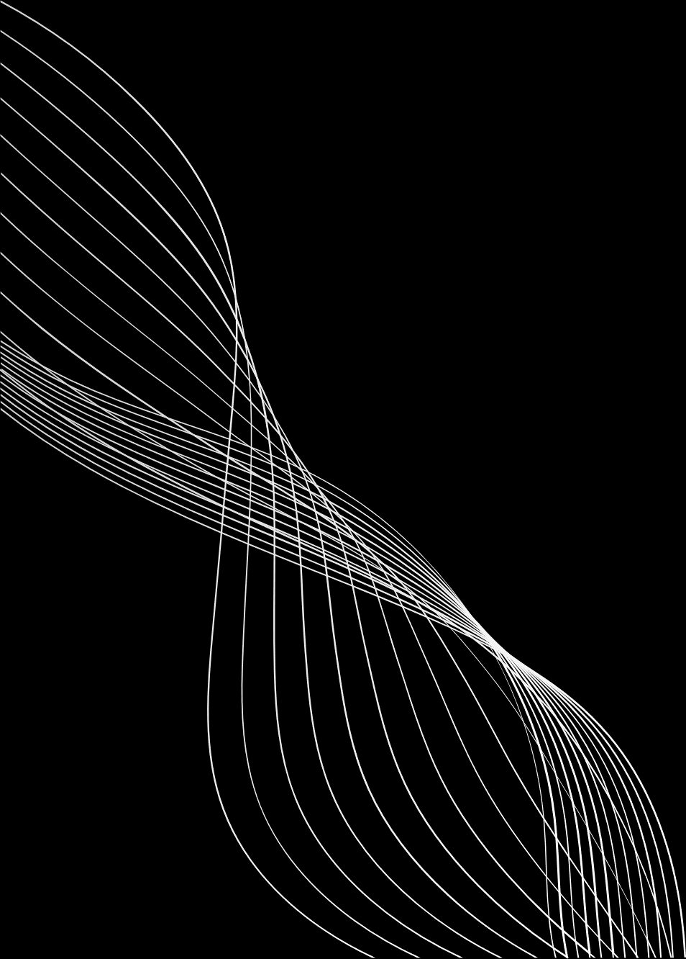
22BCE0669
SHOBHIT SHOURYA
DEEPGUARD
AI
GUIDE: DR. SANTHI K
PyTorch • Flask • ResNet18 • Computer Vision

Slide 2


Deepfakes are synthetic media generated using Artificial Intelligence where a person’s face or identity is replaced with another.
DEEPFAKES
01
INTRODUCTION
Prevent misinformation
Protect digital identity
Stop financial & social scams
Support media authenticity verification
IMPORTANCE OF DEEPFAKE DETECTION

Slide 3


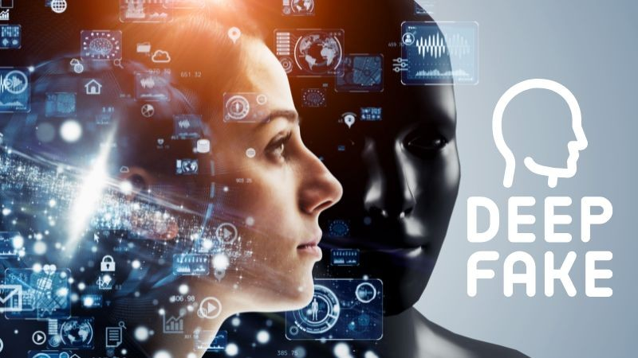
02
INTRODUCTION
ROLE OF AI
PROJECT IDEA
AI models can detect:
Pixel-level inconsistencies
Abnormal facial textures
Blending artifacts
Lighting & shadow mismatches
I developed a Deep Learning-based web system that classifies images into:
→ Real Face
→ Deepfake Face
Using Transfer Learning with ResNet18

Slide 4
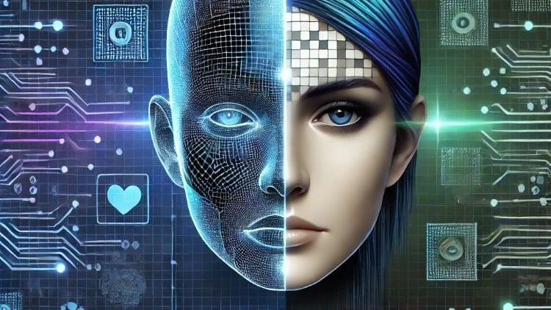
03
PROBLEM STATEMENT
DEEPFAKE CONTENT IS GROWING RAPIDLY AND:
CANNOT BE RELIABLY DETECTED BY HUMANS
CAUSES IDENTITY THEFT AND FAKE EVIDENCE
SPREADS MISINFORMATION ONLINE
THE CHALLENGE:
TO DESIGN AN AUTOMATED SYSTEM THAT:
ACCEPTS AN INPUT FACIAL IMAGE
DETECTS WHETHER IT IS REAL OR DEEPFAKE
WORKS IN REAL-TIME
PROVIDES RELIABLE PREDICTION CONFIDENCE

Slide 5
04
Objectives of the Project
Build a deep learning model for deepfake image detection
Use transfer learning to improve accuracy
Develop a Flask-based web interface
Provide real-time predictions
Show confidence scores for predictions
Add Grad-CAM visualization for model interpretability
RESEARCH OBJECTIVES

Slide 6
Proposed System
A web-based deepfake detection platform consisting of:
Frontend for image upload
Backend for processing
Deep learning model for classification
05
PROPOSED SYSTEM OVERVIEW
Workflow
User Image → Preprocessing → ResNet18 Model → Prediction → Display Result

Slide 7
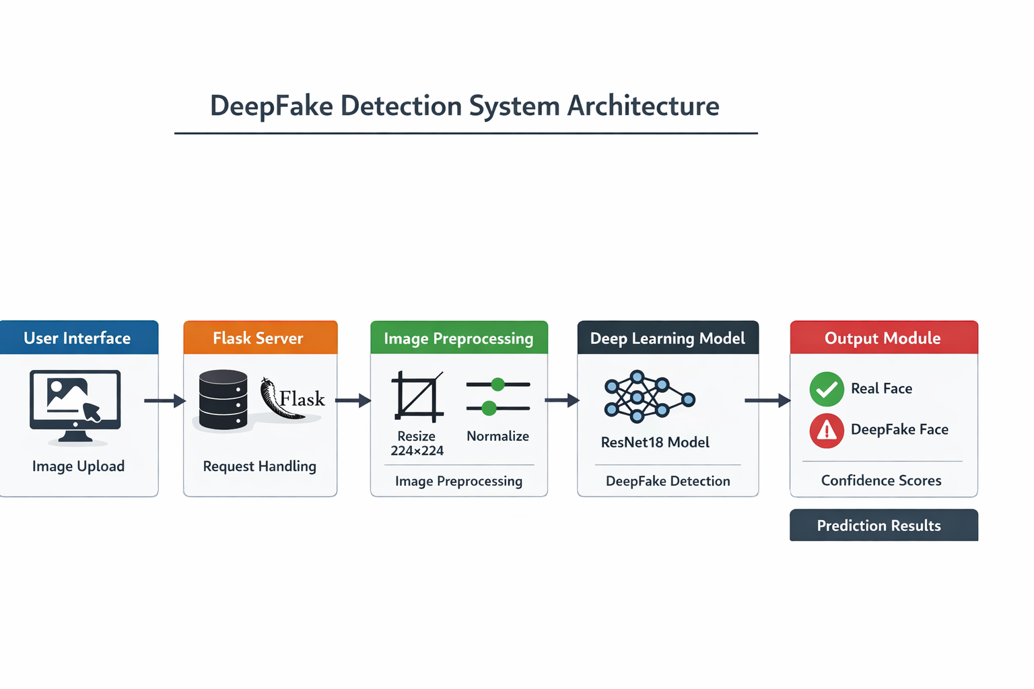
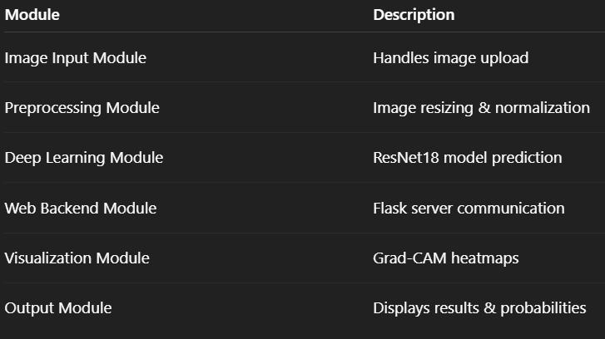
06
COMPONENTS:
USER INTERFACE
UPLOAD IMAGE
FLASK SERVER
HANDLES REQUEST
IMAGE PREPROCESSING
RESIZE (224×224)
NORMALIZE
DEEP LEARNING MODEL
RESNET18 (FINE-TUNED)
OUTPUT MODULE
FAKE/REAL LABEL
CONFIDENCE SCORES
SYSTEM DIAGRAM

Slide 8
07
MODULES LIST

Slide 9
IMAGE INPUT & PREPROCESSING MODULE
ACCEPTS IMAGES FROM USERS
CONVERTS IMAGE TO RGB
RESIZES TO 224×224
NORMALIZES USING IMAGENET MEAN & STD
DEEP LEARNING MODULE
RESNET18 PRE-TRAINED ON IMAGENET
FINAL LAYER MODIFIED FOR 2 CLASSES
ONLY CLASSIFICATION LAYER TRAINED
08
MODULE EXPLANATION

Slide 10

09
MODULE EXPLANATION
Backend Module (Flask)
Receives uploaded image
Sends image to model
Returns JSON response
Visualization Module
Uses Grad-CAM
Generates heatmap on facial regions
Explains model decisions
Output Module
Displays:
✔ Prediction (Fake/Real)
✔ Confidence percentages

Slide 11
12
IMPLEMENTATION RESULTS (40–50%)
MODEL PERFORMANCE
ACHIEVED HIGH ACCURACY ON TEST DATASET
GOOD DETECTION OF TEXTURE AND BLENDING ARTIFACTS
EVALUATION METRICS USED
ACCURACY
CONFUSION MATRIX
PRECISION & RECALL
CLASSIFICATION REPORT
SYSTEM PERFORMANCE
REAL-TIME PREDICTION VIA WEB
FAST INFERENCE
USER-FRIENDLY INTERFACE
OBSERVATIONS
WORKS BEST ON FRONTAL FACES
STRUGGLES WITH EXTREMELY REALISTIC DEEPFAKES

Slide 12
22BCE0669
SHOBHIT SHOURYA
THANK
You!
GUIDE: DR. SANTHI K
PyTorch • Flask • ResNet18 • Computer Vision

