Slide 1
KEYLOGGER AND SECURITY
CAPSTONE PROJECT
Presented By:
R.JANANI - Priyadarshini Engineering College

Slide 2
OUTLINE
Problem Statement (Should not include solution)
Proposed System/Solution
System Development Approach (Technology Used)
Algorithm & Deployment
Result (Output Image)
Conclusion
Future Scope
References

Slide 3
Problem Statement
It's challenging to covertly install a hardware keylogger on another person's device. To tackle this issue, We are therefore using a software keylogger that can be remotely installed on a person's PC to resolve this problem.

Slide 4
Proposed Solution
In this program I have reduced the work of accessing the target machine after installing the program to get the keystrokes stored in the target machine because I have enabled an option for the user to get the keystrokes from the target machine using mail.
The program automatically stores the keystrokes and mail to the user from the target machine which makes the work for the user to avoid going to the target machine again and retrieve the data
The solution to the above existing problem is that we can create software keyloggers instead of hardware keyloggers.
The proposed model provides a solution that reduces trouble installing the keylogger to the target System. Because keylogger software can be installed remotely and does not need any physical access of the target system.
The designed software is powerful enough to be installed targeted system itself when a user clicks, for example malicious link sent to him through mail or any social network media and finally captures all the user's keystrokes when logged into the system, it saves the logs to a folder or sends the log directly to a third party's email address celebration.

Slide 5
System Approach
A keylogger capturing is a form of malware or hardware that keeps track of and records your keystrokes as you type.
It takes the information and sends it to a hacker using a command-and-control (C&C) server.
Keyloggers are a particularly insidious type of spyware that can record and steal consecutive keystrokes (and much more) that the user enters on a device. The term keylogger, or “keystroke logger,” is self-explanatory: Software that logs what you type on your keyboard.

Slide 6
Algorithm & Deployment
A keylogger is a type of surveillance technology used to monitor and record each keystroke typed on a specific computer's keyboard. In this tutorial, you will learn how to write a keylogger in Python.
1: Install the Required Library
2: Importing the Necessary Libraries
3: Define the Log File
4: Create the Key Press Event Function
5: Register the Key Press Event
6: Wait for Key Presses
7: Run the Code

Slide 7
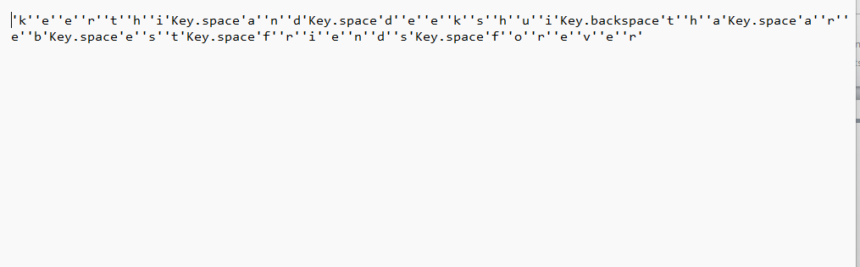
Result

Slide 8
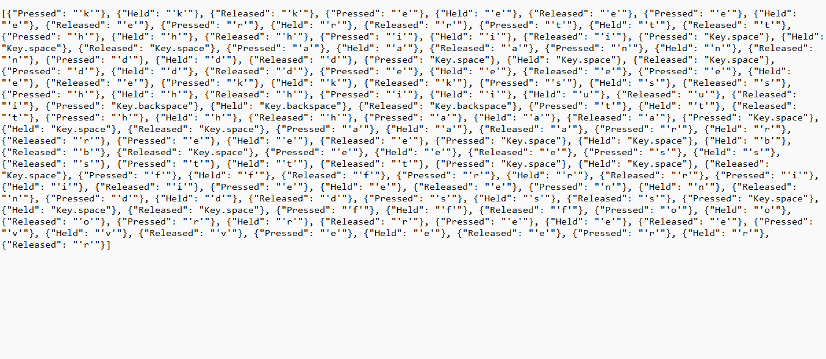
RESULT

Slide 9
Conclusion
Now you can extend this to send the log files across the network, or you can use Google Drive API to upload them to your drive, or you can even upload them to your FTP server.
Also, since no one will execute a .py file, you can build this code into an executable using open-source libraries such as Pyinstaller.
Finally, we have an EBook that is for ethical hackers like you, where we build 35+ hacking tools with Python from scratch! Make sure to check it out here.

Slide 10
Future scope
The scope of the project as follows:
Implementation of a variation of LSB technique for hiding information
i.e. text in image files.

Slide 11
References
Dzmitry Bahdanau, Kyunghyun Cho, and Yoshua Bengio. 2014. Neural machine translation by jointly learning to align and translate. CoRR abs/1409.0473. http://arxiv.org/abs/1409.0473.
Lushan Han, Abhay L. Kashyap, Tim Finin, James Mayfield, and Jonathan Weese. 2013. Umbc ebiquitycore: Semantic textual similarity systems. In Second Joint Conference on Lexical and Computational Semantics (*SEM), Volume 1: Proceedings of the Main Conference and the Shared Task: Semantic Textual Similarity. Association for Computational Linguistics, Atlanta, Georgia, USA, pages 44–52. http://www.aclweb.org/anthology/S13-1005.
Po-Sen Huang, Xiaodong He, Jianfeng Gao, Li Deng, Alex Acero, and Larry Heck. 2013. Learning deep structured semantic models for web search using clickthrough data. In Proceedings of the 22Nd ACM International Conference on Information & Knowledge Management. ACM, New York, NY, USA, CIKM ’13, pages 2333–2338. https://doi.org/10.1145/2505515.2505665

Slide 12
THANK YOU

