Slide 1

INTERNSHIP VIVA PRESENTATION
Vulnerability Assessment and Penetration Testing Tools
Web-based VAPT Dashboard
Name:
Shobanadevi S
Class:
III B.Sc. Computer Science (Cyber Security)
Guide:
Dr. G. Jothi, M.C.A., M.Phil., Ph.D., NET, Assistant Professor
Internship Company:
Optimus Technocrates India Private Limited
Periyar University | Sona College of Arts and Science, Salem

Slide 2


Introduction
Why security matters
Web applications handle sensitive data, so security weaknesses create real risk.
What VAPT is
Vulnerability Assessment finds weaknesses; Penetration Testing shows how they could be exploited.
This project
A web-based VAPT Dashboard built with Python, Flask, HTML, CSS, JavaScript and SQLite.

Slide 3


Problem Statement
Web applications hold sensitive data, but security misconfigurations and missing HTTP security headers leave them exposed to cyber attacks.
Detect weaknesses
Classify risk
Record and report
Scan website URLs and analyse their HTTP security headers.
Rate each finding as SAFE, MEDIUM or HIGH risk.
Keep scan history and generate downloadable PDF reports.

Slide 4
System Architecture
Flask Web Application (Python)
User (Browser)
HTML, CSS, JavaScript
Secure Login
Scan and Header Analysis
SQLite Database
Scan history
Risk Classification
PDF Report Generator
Target Website
URL entered for scanning

Slide 5
Scan Analysis and Risk Classification
Header Checks
Risk Level
Dashboard Output
CSP
SAFE
Scan history table
HSTS
MEDIUM
Risk distribution chart
X-Content-Type-Options
HIGH
Downloadable PDF report
Server info exposed

Slide 6
System Flowchart
No
Start
User login
Valid login?
Enter website URL
Scan and analyse security headers
Yes
End
Download PDF report
Show dashboard and risk chart
Save to scan history (SQLite)
Classify risk: SAFE / MEDIUM / HIGH

Slide 7

Technologies and Features
Technologies
Implemented Features
Python
Flask
Secure login
Vulnerability scanning
HTML5
CSS3
Security header analysis
Risk classification: SAFE / MEDIUM / HIGH
JavaScript
SQLite
Scan history
VS Code
Interactive dashboard with risk chart
Downloadable PDF reports

Slide 8
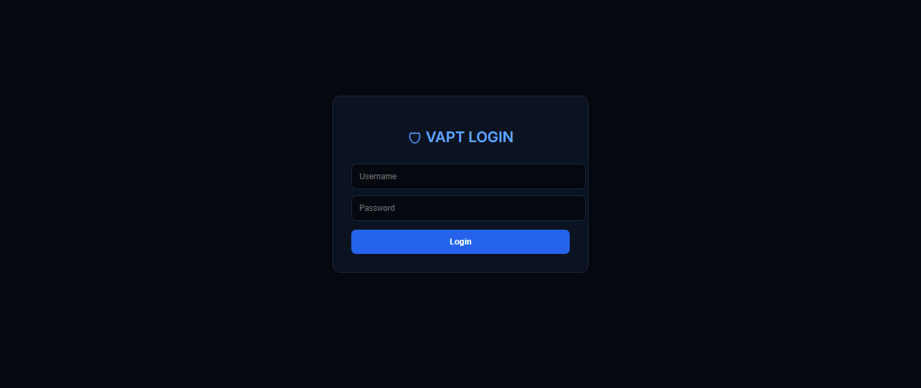
Output 1: Login Page
1. Login Page: The login page provides secure access to the VAPT application through username and password authentication. It ensures that only authorized users can access the system.

Slide 9
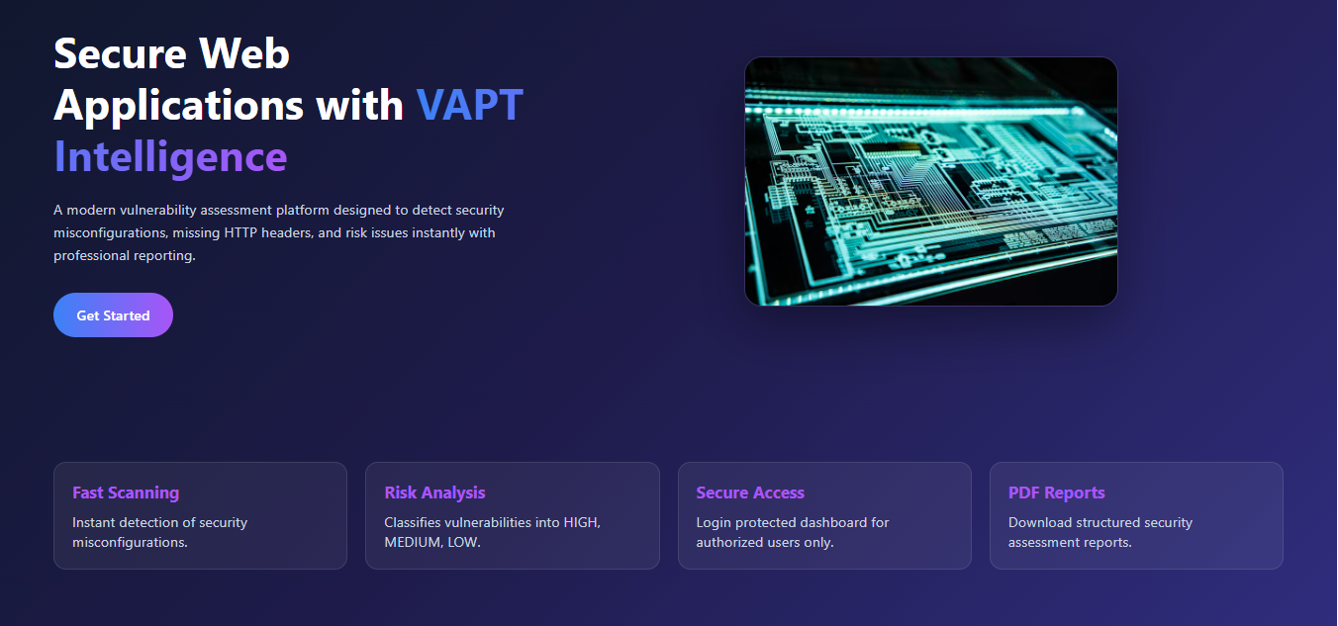
Output 2: Dashboard
2. Dashboard: The dashboard provides a centralized interface to access the VAPT tools and security analysis features. It displays vulnerability assessment results and helps users identify potential security risks.

Slide 10
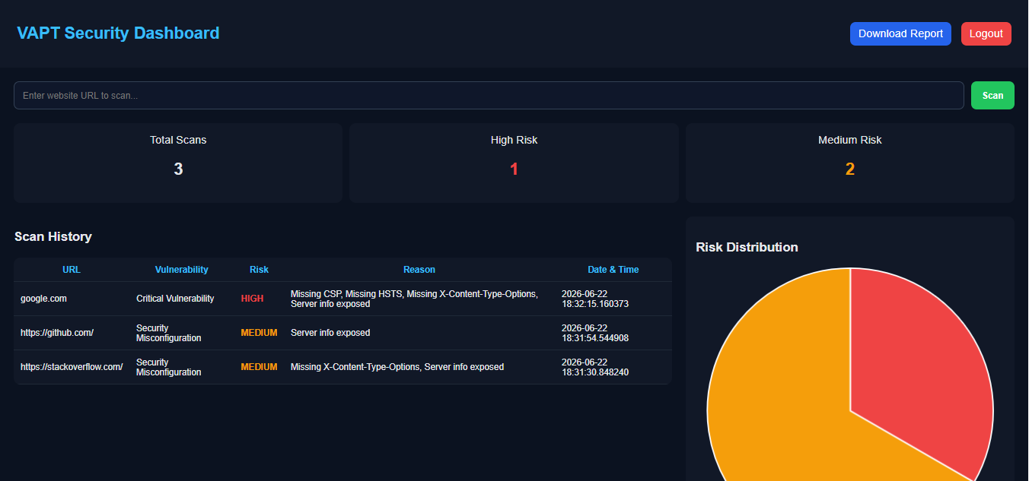
Output 3: Vulnerability Analysis Page
3. Vulnerability Analysis Page: This page analyzes web application inputs and identifies potential vulnerabilities such as SQL injection and Cross-Site Scripting (XSS). It displays the results with risk levels such as SAFE, MEDIUM, and HIGH to help users understand the security status.

