Slide 1
HaCT Managed Containers V2
Suresh babu / Vamshi

Slide 2
Agenda
Liveness & Readiness checks
Namespace access
Application Logs
Policy Compliance

Slide 3
Liveness Probe
A liveness probe indicates if the container is operating:
If it succeeds, no action is taken, and no events are logged
If it fails, the kubelet kills the container, and it is restarted in line with the pod restartPolicy
A liveness probe is not necessary if the application running on a container is configured to automatically crash the container when a problem or error occurs. In this case, the kubelet will take the appropriate action—it will restart the container based on the pod’s restartPolicy.
When Should You Use a Liveness Probe?

Slide 4
Liveness Probe
A liveness probe indicates if the container is operating:
If it succeeds, no action is taken, and no events are logged
If it fails, the kubelet kills the container, and it is restarted in line with the pod restartPolicy
A liveness probe is not necessary if the application running on a container is configured to automatically crash the container when a problem or error occurs. In this case, the kubelet will take the appropriate action—it will restart the container based on the pod’s restartPolicy.
When Should You Use a Liveness Probe?

Slide 5
Liveness Probe
You should use a liveness probe if you are not confident that the container will crash on any significant failure. In this case, a liveness probe can give the kubelet more granular information about the application on the container, and whether it can be considered operational.
If you use a liveness probe, make sure to set the restartPolicy to Always or OnFailure
Applications running for long periods of time eventually transition to broken states, and cannot recover except by being restarted. Kubernetes provides liveness probes to detect and remedy such situations.
Define a liveness command

Slide 6
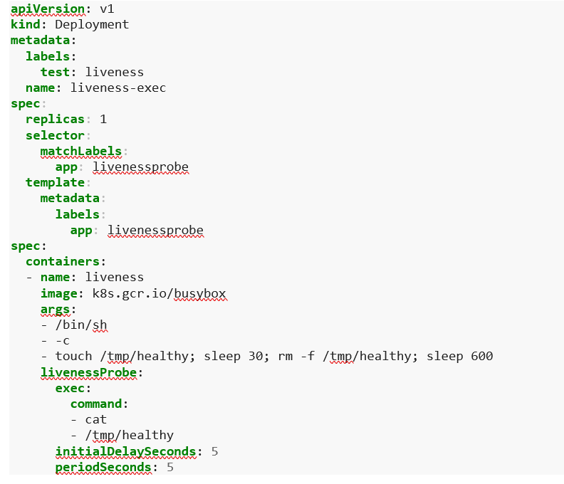
Define a liveness command

Slide 7
Liveness Probe Best Practices
The following best practices can help you make effective use of liveness probes. These best practices apply to Kubernetes clusters :
Prefer to use probes on applications that have unpredictable or fluctuating startup times
If you use a liveness probe on the same endpoint as a startup probe, set the failure Threshold of the startup probe higher, to support long startup times
You can use liveness and readiness probes on the same endpoint, but in this case, use the readiness probe to check startup behavior and the liveness probe to determine container health (in other words, downtime)
Defining probes carefully can improve pod resilience and availability. Before defining a probe, observe the system behavior and average startup times of the pod and its containers
Be sure to update probe options as an application evolves, or if you make infrastructure changes, such as giving the pod more or less system resources.

Slide 8
Readiness Probe
A readiness probe indicates whether the application running on the container is ready to accept requests from clients:
If it succeeds, services matching the pod continue sending traffic to the pod
If it fails, the endpoints controller removes the pod from all Kubernetes Services matching the pod
By default, the state of a Readiness probe is Failure.
Applications are temporarily unable to serve traffic. For example, an application might need to load large data or configuration files during startup, or depend on external services after startup. In such cases, you don't want to kill the application, but you don't want to send it requests either. Kubernetes provides readiness probes to detect and mitigate these situations. A pod with containers reporting that they are not ready does not receive traffic through Kubernetes Services.
Note:- Readiness probes runs on the container during its whole lifecycle.
Define readiness probes

Slide 9
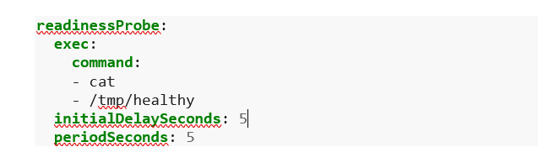
Readiness Probe
Readiness probes are configured similarly to liveness probes. The only difference is that you use the readinessProbe field instead of the livenessProbe field

Slide 10
Readiness Probe Best Practices
The following best practices can help you make effective use of probes. Readiness These best practices apply to Kubernetes clusters :
Prefer to use probes on applications that have unpredictable or fluctuating startup times
If you use a readiness probe on the same endpoint as a startup probe, set the failure Threshold of the startup probe higher, to support long startup times
You can use liveness and readiness probes on the same endpoint, but in this case, use the readiness probe to check startup behavior and the liveness probe to determine container health (in other words, downtime)
Defining probes carefully can improve pod resilience and availability. Before defining a probe, observe the system behavior and average startup times of the pod and its containers
Be sure to update probe options as an application evolves, or if you make infrastructure changes, such as giving the pod more or less system resources.

Slide 11
Startup Probe
A startup probe indicates whether the application running in the container has fully started:
If it succeeds, other probes start their diagnostics. When a startup probe is defined, other probes do not operate until it succeeds
If it fails, the kubelet kills the container, and is restarted in line with the pod restartPolicy

Slide 12
Startup Probe Best Practices
The following best practices can help you make effective use of startup probes. These best practices apply to Kubernetes clusters :
Prefer to use probes on applications that have unpredictable or fluctuating startup times
If you use a Startup probe on the same endpoint as a startup probe, set the failure Threshold of the startup probe higher, to support long startup times
Defining probes carefully can improve pod resilience and availability. Before defining a probe, observe the system behavior and average startup times of the pod and its containers
Be sure to update probe options as an application evolves, or if you make infrastructure changes, such as giving the pod more or less system resources.

Slide 13
Kubernetes Namespaces
Namespaces can be ordered via the CloudWorks Services.
If you have used namespaces already the main differences during migration are:
Define resource quota for your namespace When submitting a request for a namespace you will be asked for the CPU and memory quota to reserve for the namespace. Information on how to determine these values can be found here: Resource quotas. Adjust network policy for your namespace if necessary The default network policy provided with your namespace will allow incoming communication via the default ingress controller and via internal load balancers but would block communication to other application namespaces within the cluster. If this is required you should adjust the network policy accordingly, see Network policies.

Slide 14
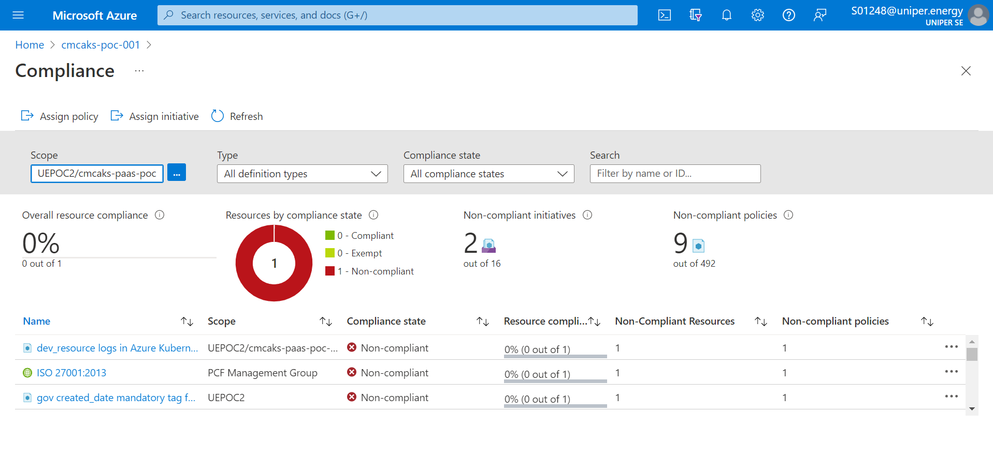
Assign a built-in policy definition or initiative
To apply a policy definition or initiative, use the Azure portal or Azure cli etc..
Custom policies allow you to define rules for using Azure. For example, you can enforce:
Security practices
Cost management
Organization-specific rules (like naming or locations)

Slide 15
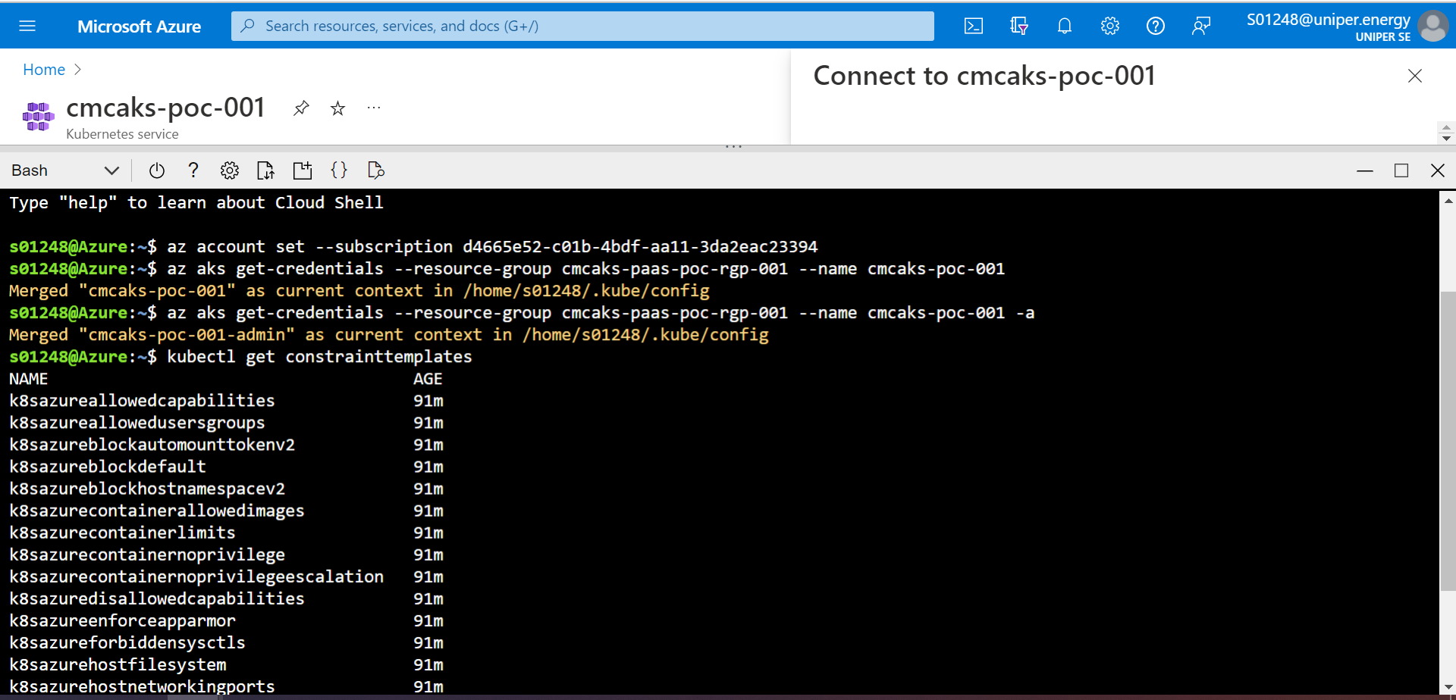
Validate a Azure Policy is running
Confirm the policy assignments are applied to your cluster by running the following:
$ kubectl get constrainttemplates

Slide 16
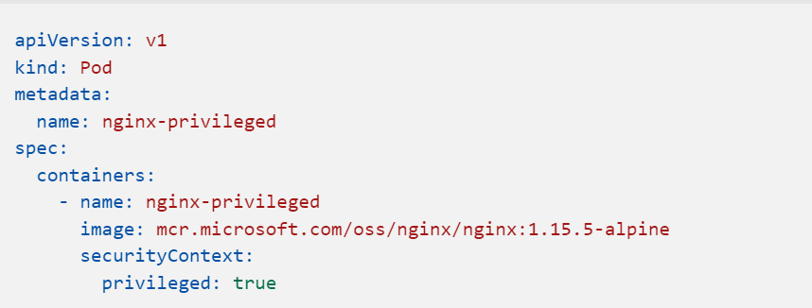
Validate rejection of a privileged pod
The initiative disallows privileged pods, so the request will be denied resulting in the deployment being rejected.
Create a file named nginx-privileged.yaml and paste the following YAML manifest:
Create the pod with kubectl apply command and specify the name of your YAML manifest:

Slide 17
Feature works from POD side
Kubernetes clusters should disable automounting API credentials.
Kubernetes cluster containers should only use allowed images.
Kubernetes cluster containers should run with a read only root file system.
AKS clusters should have defender profile enabled
Kubernetes clusters should not use the default namespace
Kubernetes clusters should not allow container privilege escalation
Resource logs in Azure Kubernetes Service should be enabled

