Slide 1


ONLINE FOOD ORDERING SYSTEM
K.RAMAKRISHNAN COLLEGE OF TECHNOLOGY
SHOBANA M (2403811720522051)
SIVARANJANI S (2403811720522052)
SWETHA M (2403811720522055)
TAMILAZHAKI A (2403811720522056)
GUIDED BY
A.MALARMANNAN M.E

Slide 2
Problem Definition
Manual ordering is time
consuming and error-prone
No centralized system to manage orders and restaurants
Lack of real-time tracking and payment integration
Difficulty in managing large volumes of customer data

Slide 3
Objectives of the Project
To design and implement a relational database for food ordering
To manage customers, restaurants, menus, orders, and payments
To apply normalization for efficient data storage
To implement SQL queries for data retrieval and manipulation

Slide 4
System Requirements
Hardware-Processor, RAM, Storage-
Software-MySQL / Oracle, SQL Developer / Workbench-
OS-Windows / Linux-
Frontend (if any)- HTML, PHP or Python

Slide 5
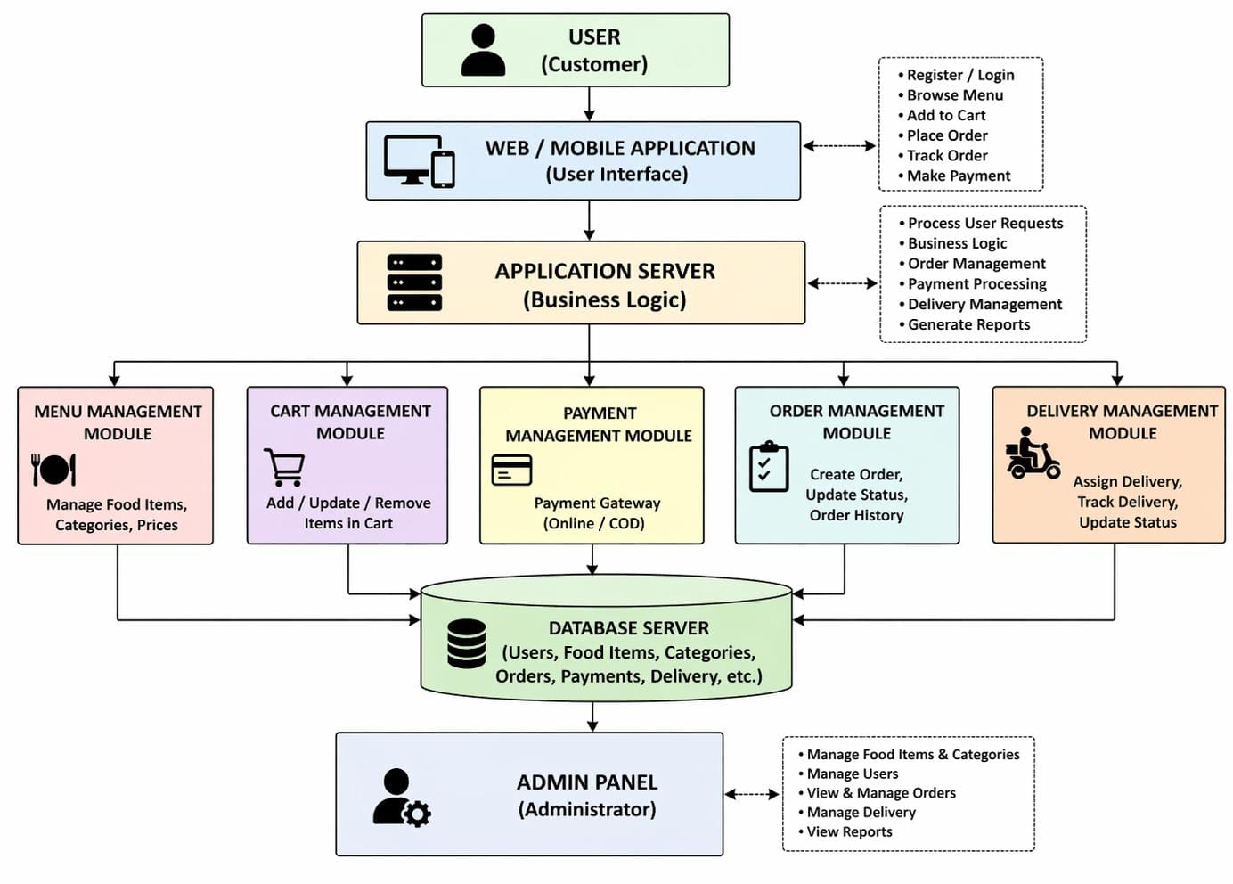

Slide 6
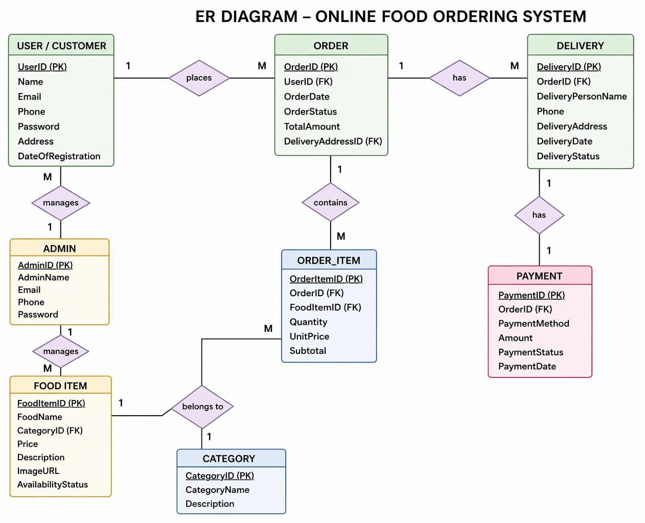
ER Diagram

Slide 7
Relational Schema
Customer (CustID, Name, Email, Phone, Address)
Restaurant (RestID, Name, Location, Cuisine)
Menu (ItemID, RestID, ItemName, Price, Category)
Orders (OrderID, CustID, RestID, Date, Status, Total)
OrderItems (OrderID, ItemID, Quantity, Price)
Payment (PayID, OrderID, Method, Amount, Status)
Delivery (DelID, OrderID, PartnerID, Status, Time)

Slide 9
Database and Table Creation
Sql
CREATE TABLE Customer ( CustID INT PRIMARY KEY,
Name VARCHAR(50), Email VARCHAR(50),
Phone VARCHAR(15))
Show CREATE TABLE for all major tables
Define PRIMARY KEY, FOREIGN KEY, constraints

Slide 10
Modules 1
User Management
Customer Registration & Login
Profile Update- Address Management
Tables: Customer, Login

Slide 11
Modules 2
Restaurant & Menu Management-
Add / Update Restaurant details-
Manage Menu Items and Prices
Category-wise item listing
Tables: Restaurant, Menu

Slide 12
Modules 3
Order Management
Place Order, View Cart-
Order Status Update (Pending → Confirmed → Delivered)
Order History- Tables: Orders, OrderItems

Slide 13
Modules 4
Payment & Delivery
Payment processing (Cash / Online)-
Delivery partner assignment-
Delivery status tracking- Tables: Payment, Delivery

Slide 14
Challenges Faced
Maintaining referential integrity across tables
Handling concurrent orders efficiently
Normalizing without losing query performance
Designing scalable schema for real-world use

Slide 15
Conclusion
Successfully designed a normalized relational database
Implemented all CRUD operations using SQL
System supports real-world food ordering scenarios
Future scope: Triggers, Stored Procedures, Web Integration

