Slide 1


ONLINE FOOD ORDERING SYSTEM
K.RAMAKRISHNAN COLLEGE OF TECHNOLOGY
SHOBANA M (2403811720522051)
SIVARANJANI S (2403811720522052)
SWETHA M (2403811720522055)
TAMILAZHAKI A (2403811720522056)
GUIDED BY
A.MALARMANNAN M.E

Slide 2
Problem Definition
Manual ordering is time
consuming and error-prone
No centralized system to manage orders and restaurants
Lack of real-time tracking and payment integration
Difficulty in managing large volumes of customer data

Slide 3
Objectives of the Project
To design and implement a relational database for food ordering
To manage customers, restaurants, menus, orders, and payments
To apply normalization for efficient data storage
To implement SQL queries for data retrieval and manipulation

Slide 4
System Requirements
Hardware-Processor, RAM, Storage-
Software-MySQL / Oracle, SQL Developer / Workbench-
OS-Windows / Linux-
Frontend (if any)- HTML, PHP or Python

Slide 5
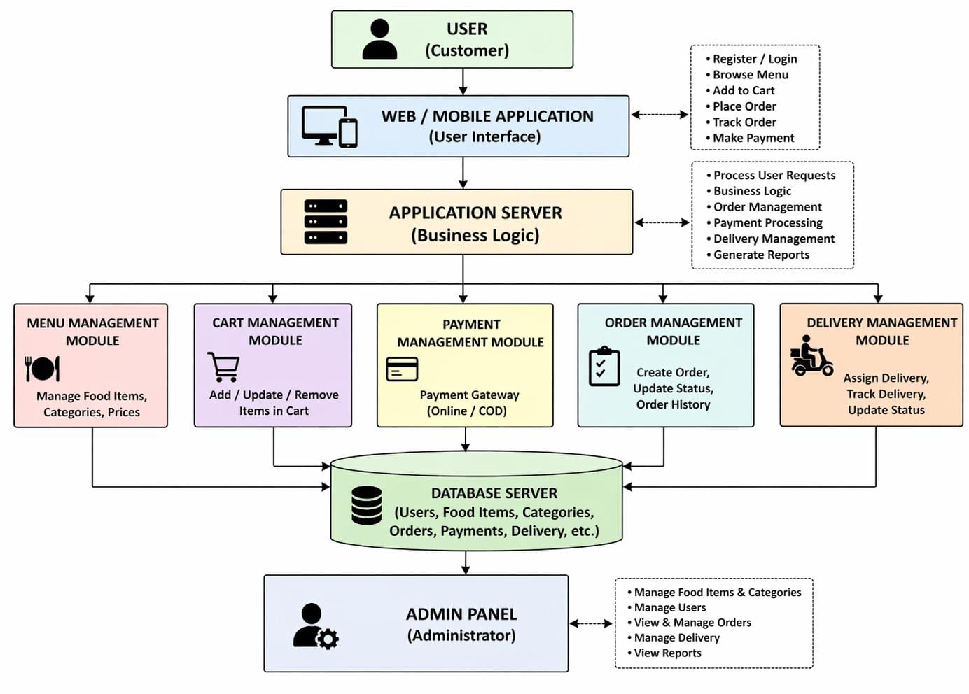
System Architecture

Slide 6
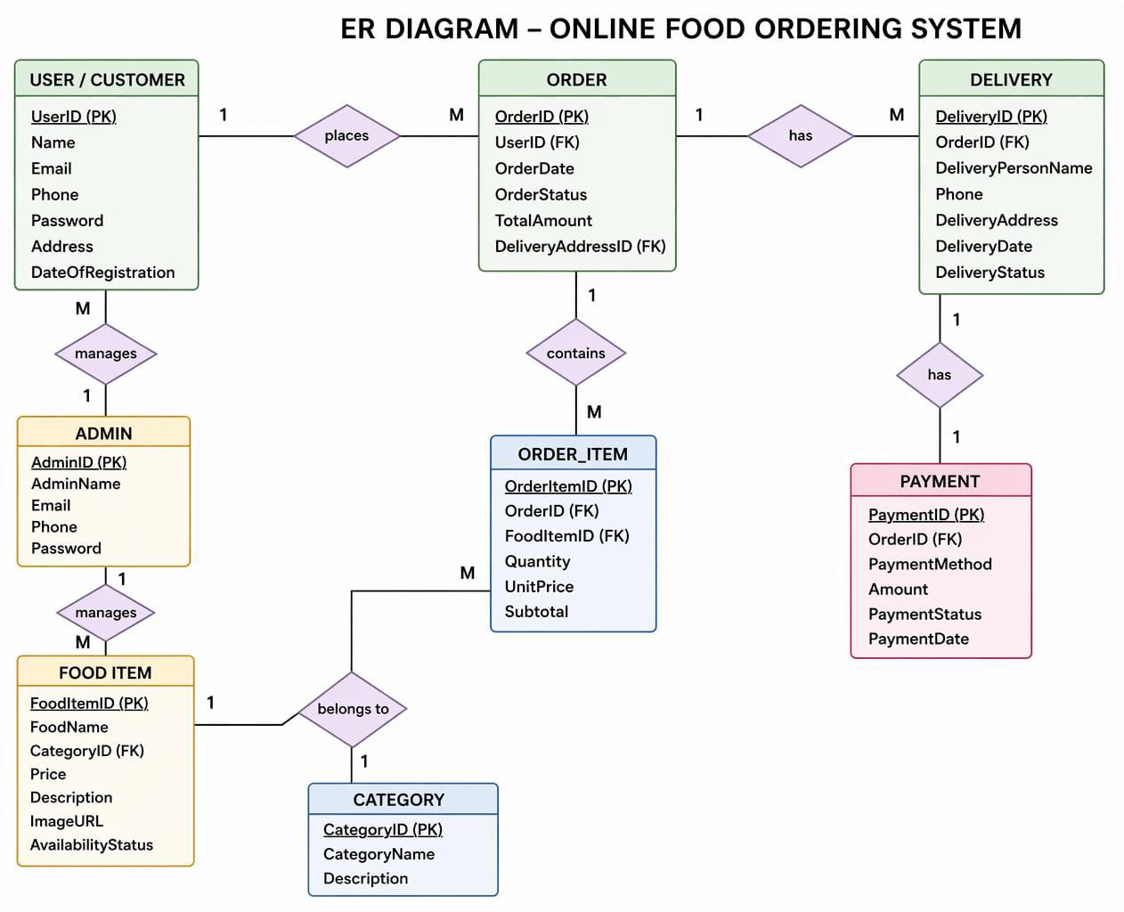
ER Diagram

Slide 7
Relational Schema
Customer (CustID, Name, Email, Phone, Address)
Restaurant (RestID, Name, Location, Cuisine)
Menu (ItemID, RestID, ItemName, Price, Category)
Orders (OrderID, CustID, RestID, Date, Status, Total)
OrderItems (OrderID, ItemID, Quantity, Price)
Payment (PayID, OrderID, Method, Amount, Status)
Delivery (DelID, OrderID, PartnerID, Status, Time)

Slide 8
Normalisation
UNF: Data stored in one table with repeating items (multiple food items repeated for each order).
• 1NF: Remove repeating groups → each food item stored in separate rows.
• 2NF: Remove partial dependency → split into tables like Customer, Order, Food_Item, Order_Item.
• 3NF: Remove transitive dependency → separate Category, Payment, Delivery, etc.
Result
No data duplication
Better data consistency
Efficient database structure

Slide 9
Database and Table Creation
Sql
CREATE TABLE Customer ( CustID INT PRIMARY KEY,
Name VARCHAR(50), Email VARCHAR(50),
Phone VARCHAR(15))
Show CREATE TABLE for all major tables
Define PRIMARY KEY, FOREIGN KEY, constraints

Slide 10
SQL Implementation and Queries
Create
CREATE TABLE Customer (
CustID INT PRIMARY KEY,
Name VARCHAR(50),
Phone VARCHAR(15),
Email VARCHAR(50)
);
Insert
INSERT INTO Menu VALUES
(1, 'Chicken Biryani', 120, 'Main Course');

Slide 11
SQL Implementation and Queries
Select
SELECT * FROM Menu;
Update
UPDATE Menu
SET Price = 150
WHERE Name = 'Chicken Biryani';
Delete
DELETE FROM Menu
WHERE Name = 'Chicken Biryani';

Slide 12
Modules 1
User Management
Customer Registration & Login
Profile Update- Address Management
Tables: Customer, Login

Slide 13
Modules 2
Restaurant & Menu Management-
Add / Update Restaurant details-
Manage Menu Items and Prices
Category-wise item listing
Tables: Restaurant, Menu

Slide 14
Modules 3
Order Management
Place Order, View Cart-
Order Status Update (Pending → Confirmed → Delivered)
Order History- Tables: Orders, OrderItems

Slide 15
Modules 4
Payment & Delivery
Payment processing (Cash / Online)-
Delivery partner assignment-
Delivery status tracking- Tables: Payment, Delivery

Slide 16
Challenges Faced
Maintaining referential integrity across tables
Handling concurrent orders efficiently
Normalizing without losing query performance
Designing scalable schema for real-world use

Slide 17
Conclusion
Successfully designed a normalized relational database
Implemented all CRUD operations using SQL
System supports real-world food ordering scenarios
Future scope: Triggers, Stored Procedures, Web Integration

