Slide 1
Spring Framework

Slide 2
What is Spring Framework
Spring is an open source, lightweight framework that allows developers to build simple, reliable and scalable enterprise applications.
Spring framework is an open source Java platform and it was initially written by Rod Johnson and was first released under the Apache 2.0 license in June 2003.

Slide 3
Why Spring?
EJB extends java components and provides services that help in enterprise application development.
Developing an Enterprise application was not easy, java developer has to perform tasks such as creating Home and remote interfaces and implementing lifecycle call back methods which led to complexity.

Slide 4
What is Spring Framework
Spring is lightweight when it comes to size and transparency. The basic version of spring framework is around 2MB.
Spring framework targets to make J2EE development easier to use and promote good programming practice by enabling a POJO-based programming model.

Slide 5
Benefits of Using Spring Framework
Spring enables developers to develop enterprise-class applications using POJOs.
you do not need an EJB container product such as an application server but you have the option of using only a robust servlet container such as Tomcat or some commercial product.

Slide 6
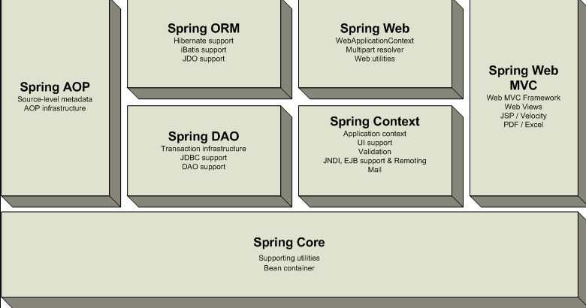
Some Important Spring Modules

Slide 7
Benefits of Using Spring Framework
Spring is organized in a modular fashion.
Even though the number of packages and classes are substantial, you have to worry only about ones you need and ignore the rest.

Slide 8
Benefits of Using Spring Framework
Spring does not reinvent the wheel instead, it truly makes use of some of the existing technologies like several ORM frameworks, logging frameworks, JEE other view technologies.

Slide 9
Benefits of Using Spring Framework
Spring's web framework is a well-designed web MVC framework, which provides a great alternative to web frameworks such as Struts or other over engineered or less popular web frameworks.

Slide 10
Benefits of Using Spring Framework
Spring provides a convenient API to translate technology-specific exceptions (thrown by JDBC for example) into consistent, unchecked exceptions.
Spring provides a consistent transaction management interface that can scale down to a local transaction (using a single database, for example) and scale up to global transactions (using JTA, for example).

Slide 11
Benefits of Using Spring Framework
The primary benefits of the Spring framework are
loose-coupling with dependency injection
POJO-oriented model for simpler development.

Slide 12
Container
The Spring container is at the core of the Spring Framework.
The container will create the objects, wire them together, configure them, and manage their complete life cycle from creation till destruction.

Slide 13
Container
The Spring container uses dependency injection (DI) to manage the components that make up an application.
The container gets its instructions on what objects to instantiate, configure, and assemble by reading configuration metadata provided.

Slide 14
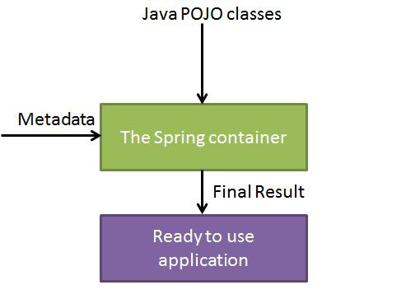
Container
The configuration metadata can be represented either by XML, Java annotations.

Slide 15
Hand over
Bean Factory
Objects
Spring XML

Slide 16
IoC
Inversion of Control is a principle of software construction where the developers do not have the need to create objects from classes.
Instead application gets the objects from outside sources.
The concept of IoC is to reduce coupling in an application.

Slide 17
Dependency Injection
It is a design pattern
It allows developers to inject an object directly in a class which means that they no longer need to depend on a class to create on object.
Objects define their dependencies using constructors or properties using factory method.

Slide 18
Spring Versions
The first milestone release, 1.0, was released in March 2004, with further milestone releases in September 2004 and March 2005.
The Spring 1.2.6 framework won a Jolt productivity award and a JAX Innovation Award in 2006.
Spring 2.0 was released in October 2006, Spring 2.5 in November 2007.

Slide 19
Spring 3.0 in December 2009, and Spring 3.1 in December 2011 and later 3.2. The current version is 5.0

Slide 20
Dependency Injection
It is classified in to
  Constructor Dependency Injection
  Setter Dependency Injection
  Autowiring

Slide 21
xmlBeanFactory class
The most commonly used BeanFactory implementation is the xmlBeanFactory class.
This container class reads the configuration metadata from an XML file and uses it to create a fully configured system or application.

Slide 22
XmlBeanFactory vs ApplicationContext
BeanFactory is a subset of ApplicationContext and provides lesser functionalities.
When we need full capabilities with respect to configuration handling then we go for ApplicationContext.
Syntactically BeanFactory and ApplicationContext both are are Java interfaces and ApplicationContext extends BeanFactory

Slide 23
Built-in resources for XmlBeanFactory Class
BeanFactory mybean = new XmlBeanFactory(new FileSystemResource(“c:\message.xml”));
getBean() method is used to retrieve bean from Bean Factory.

Slide 24
Bean Configuration File
Properties | Description
class | This attribute is mandatory and specify the bean class to be used to create the bean.
name | This attribute specifies the bean identifier uniquely. In XML-based configuration metadata, you use the id and/or name attributes to specify the bean identifier(s).
scope | This attribute specifies the scope of the objects created from a particular bean definition
constructor-arg | This is used to inject the dependencies

Slide 25
Spring Bean Scopes
Scope | Description
singleton | This scopes the bean definition to a single instance per Spring IoC container (default).
prototype | This scopes a single bean definition to have any number of object instances.
request | This scopes a bean definition to an HTTP request. Only valid in the context of a web-aware Spring ApplicationContext.
session | This scopes a bean definition to an HTTP session. Only valid in the context of a web-aware Spring ApplicationContext.
global-session | This scopes a bean definition to a global HTTP session. Only valid in the context of a web-aware Spring ApplicationContext.

Slide 26
In Spring, “Autowiring by Name” means, if the name of a bean is same as the name of other bean property, auto wire it.
For example, if a “customer” bean exposes an “address” property, Spring will find the “address” bean in current container and wire it automatically. And if no matching found, just do nothing.

Slide 27
In Spring framework, bean autowiring by type allows a property to be autowired –
if there is exactly one bean of the property type in the container.
If there is more than one, a fatal exception is thrown, and this indicates that you may not use byType autowiring for that bean.
If there are no matching beans, nothing happens; the property is not set.

Slide 28
In Spring framework, bean autowiring by constructor is similar to byType, but applies to constructor arguments. In autowire enabled bean, it look for class type of constructor arguments, and then do a autowire by type on all constructor arguments.
If there is not exactly one bean of the constructor argument type in the container, a fatal error is raised.

Slide 29
Eager and Lazy Instantiation
By default, Spring “application context” eagerly creates and initializes all ‘singleton scoped‘ beans during application startup itself.
It helps in detecting the bean configuration issues at early stage, in most of the cases.
But sometimes, you may need to mark some or all beans to be lazy initialized due to different project requirements.

Slide 30
Eager and Lazy Instantiation
( Lazy Loading for a single bean )
<beans>
<bean id="employeeManager" class="com.pack.Employee“ lazy-init="true"/>
<beans>
( Lazy Loading for all beans )
<beans default-lazy-init="true">
<beans>

Slide 31
The lifecycle of any object means when & how it is born, how it behaves throughout its life, and when & how it dies.
Similarly, the bean life cycle refers to when & how the bean is instantiated, what action it performs until it lives, and when & how it is destroyed.
Bean life cycle is managed by the spring container.

Slide 32
When we run the program then, first of all, the spring container gets started.
After that, the container creates the instance of a bean as per the request and then dependencies are injected.
And finally, the bean is destroyed when the spring container is closed.
Therefore, if we want to execute some code on the bean instantiation and just after closing the spring container, then we can write that code inside the custom init() method and the destroy() method.
We can choose custom method name instead of init() and destroy().

Slide 33
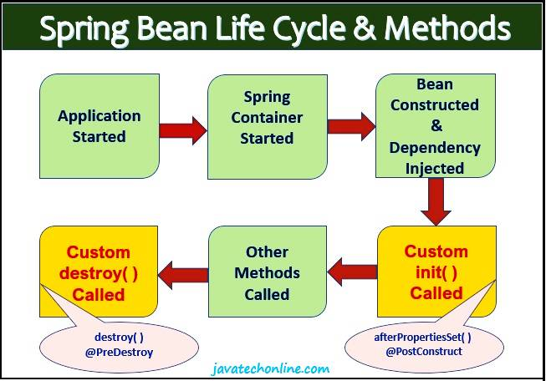

Slide 34
Each SpringApplication will register a shutdown hook with the JVM to ensure that the ApplicationContext is closed on exit.
The <context:annotation-config> annotation is mainly used to activate the dependency injection annotations.

Slide 35
Spring JDBC classes
The Spring Framework's JDBC abstraction framework consists of four different packages, namely core, dataSource, object, and support.
The org.springframework.jdbc.core package contains the JdbcTemplate class and its various callback interfaces, plus a variety of related classes.

Slide 36
Spring JDBC classes
The org.springframework.jdbc.datasource package contains a utility class for easy DataSource access, and various simple DataSource implementations .

Slide 37
Spring JDBC classes
The org.springframework.jdbc.object package contains classes that represent RDBMS queries, updates, and stored procedures as thread safe, reusable objects.
Finally the org.springframework.jdbc.support package is where you find the SQLException translation functionality and some utility classes.

Slide 38
The JdbcTemplate
The JdbcTemplate class is the central class in the JDBC core package. It simplifies the use of JDBC since it handles the creation and release of resources.

Slide 39
BeanPropertyRowMapper is a RowMapper implementation that converts a table row into a new instance of the specified mapped target class.

Slide 40
Transactions
Transaction management is critical in any form of applications that will interact with the database.
The application has to ensure that the data is consistent and the integrity of the data is maintained.
There are many popular data frameworks like JDBC, JPA, Hibernate etc.. and Spring Framework provides a seamless way of integrating with these frameworks.

Slide 41
Types of Transactions
J2EE developers have had two choices for transaction management: global or local transactions.
Global transactions are executed in various JVMs and managed using the Java Transaction API (JTA).
Local transactions are resource-specific: that is executed in single JVM and works on single data source.

Slide 42
Issues with transactions
Global transaction require JTA (complex code) to lookup data sources to handle transactions.
Local transactions are easier to write but will not work with multiple data sources.

Slide 43
Handling Transactions in Spring
public interface PlatformTransactionManager {
TransactionStatus getTransaction(TransactionDefinition definition) throws TransactionException;
void commit(TransactionStatus status) throws TransactionException;
void rollback(TransactionStatus status) throws TransactionException;
}

Slide 44
Handling Transactions in Spring
The getTransaction(..) method returns a TransactionStatus object, depending on a TransactionDefinition parameter.

Slide 45
Default transaction Definition in Spring
Default implementation of the TransactionDefinition interface
PROPAGATION_REQUIRED,
ISOLATION_DEFAULT,
TIMEOUT_DEFAULT,
readOnly=false

Slide 46
The TransactionDefinition interface
Isolation: the degree of isolation this transaction has from the work of other transactions.
Transaction isolation levels specify what data is visible to statements within a transaction.

Slide 47
Dirty read: read the uncommitted change of a concurrent transaction
A "non-repeatable read" in the context of transaction isolation levels occurs when a transaction reads the same data multiple times within its scope, but gets different values each time because another transaction modified the data in between those reads;

Slide 48
The TransactionDefinition interface
Propagation: normally all code executed within a transaction scope will run in that transaction.
However, there are several options specifying behavior if a transactional method is executed when a transaction context already exists: for example, simply continue running in the existing transaction (the common case); or suspending the existing transaction and creating a new transaction. Spring offers all of the transaction propagation options familiar from EJB CMT.

Slide 49
The TransactionDefinition interface
Timeout: how long this transaction may run before timing out (and automatically being rolled back by the underlying transaction infrastructure).
Read-only status: a read-only transaction does not modify any data, indicating that the operation will only read data from the database and not modify it .

Slide 50
Propagation
REQUIRED - Default propagation, if no transaction exists, create a new one.
SUPPORTS - Will participate in the existing transaction if one exists, otherwise, it won’t start a new one.
MANDATORY - Will throw an exception if no transaction is present
REQUIRES_NEW - Always starts a new transaction
NEVER: Will execute only if there is no existing transaction; if one exists, it will throw an exception.

