Slide 1
What is a Web Service
Web service is a technology used for one application to communicate with an other application.
For example, an application running on java can interact with PHP or .Net application by using web services.
In other words, web service provides a way to achieve interoperability.

Slide 2
What is a Web Service
A Web Service can be defined by the following ways:
is a client server application or application component for communication.
method of communication between two devices over network.
is a software system for interoperable machine to machine communication.
is a collection of standards or protocols for exchanging information between two devices or application.

Slide 3
Service Oriented Architecture
Service Oriented Architecture or SOA is a design pattern.
It is designed to provide services to other applications through protocol.
It is a concept only and not tied to any programming language or platform.
Web services is a technology of SOA .

Slide 4
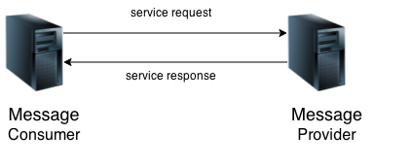
Service Oriented Architecture

Slide 5
Service Oriented Architecture
Service consumer sends service request to the service provider and service provider sends the service response to the service consumer.
The service connection is understandable to both service consumer and service provider.

Slide 6
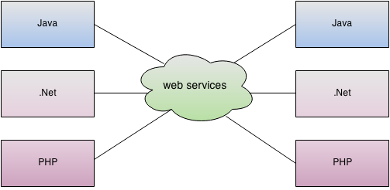
Notes:
Why we need web services
Eg of 2 ATM application having the need to communicate with each other.

Slide 7
There are mainly two types of web services.
SOAP web services.
RESTful web services.

Slide 8
SOAP Web Service
SOAP (Simple Object Access Protocol ) is a XML-based protocol for accessing web services.
SOAP is a W3C recommendation for communication between applications.
SOAP is XML based, so it is platform independent and language independent. In other words, it can be used with Java, .Net or PHP language on any platform.

Slide 9
Disadvantages of SOAP Web Services
It defines many standards that must be followed while developing the SOAP applications.
So it is slow and consumes more bandwidth and resource.

Slide 10
Restful Web Services
REST stands for REpresentational State Transfer.
REST is an architectural style not a protocol.
Representing and transferring the state of an object in XML or JSON.

Slide 11
SOAP stands for Simple Object Access Protocol whereas REST stands for Representational State Transfer.
SOAP is a protocol whereas REST is an architectural style.

Slide 12
Advantages of RESTFUL WebServices
Fast: RESTful Web Services are fast because there is no strict specification like SOAP. It consumes less bandwidth and resource.
Language and Platform independent: RESTful web services can be written in any programming language and executed in any platform.
Permits different data format: RESTful web service permits different data format such as Plain Text, HTML, XML and JSON.

Slide 13
JSON (JavaScript Object Notation)
JSON (JavaScript Object Notation) is a lightweight data-interchange format.
It is easy for humans to read and write.
It is easy for machines to parse and generate.

Slide 14
XML
· XML stands for eXtensible Markup Language
XML is a markup language much like
HTML XML was designed to store and transport data

Slide 15
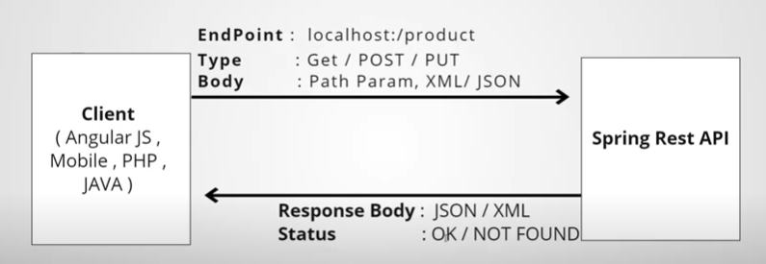
All CRUD operations Supported .
CRUD - Post,Get,Put,Delete

Slide 16
REST API
In a client-server communication, REST suggests to create an object of the data requested by the client and send the values of the object in response to the user.
The state of an object is sent.Hence REST is known as Representational State Transfer.

Slide 17
REST API
So, the client requests the server for the required information, via an API, and then, the server sends a response to the client.
You would prefer the data to be returned in the form of a structured format, rather than the complete Web page.
So, for such reasons, the data returned by the server, in response to the request of the client is either in the format of JSON or XML. Both JSON and XML formats have a proper hierarchical structure of data.

Slide 18
@RestController
@RestController is a convenient annotation for creating Restful controllers.
It is a specialization of @Component and is autodetected through classpath scanning.
It adds the @Controller and @ResponseBody annotations. It converts the response to JSON or XML.

Slide 19
The @ResponseBody annotation tells a controller that the object returned is automatically serialized into JSON and passed back into the HttpResponse object

Slide 20
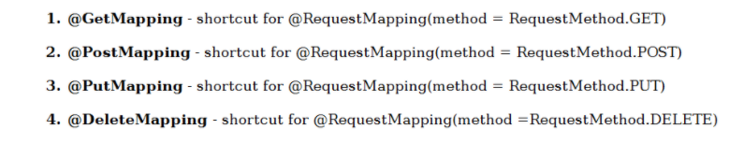

Slide 21
ResponseEntity is meant to represent the entire HTTP response.
You can control anything that goes into it: status code, headers, and body.

Slide 22
We can use @ResponseStatus to mark a method with a status code and reason that should be returned.
On invoking the marked handler method , the HTTP status will be set to the one defined using @ResponseStatus annotation

Slide 23
The HTTP 201 Created success status response code indicates that the request has succeeded and has led to the creation of a resource.
The common use case of this status code is as the result of a POST request.

Slide 24
@RequestBody
This is used to convert the body of the HTTP request to the java class object .
This annotation will be used in the method parameter and the body of the http request will be mapped to that method parameter.

Slide 25
Postman is an app for interacting with HTTP APIs.
It presents you with a friendly GUI for constructing requests and reading responses.
It works on the backend, and makes sure that each API is working as intended.

