Slide 1
What is Spring Boot
Spring Boot is a project that is built on the top of the Spring Framework.
It provides an easier and faster way to set up, configure, and run both simple and web-based applications.
It is a Spring module that provides the RAD (Rapid Application Development) feature to the Spring Framework.
It is used to create a stand-alone Spring-based application that you can just run because it needs minimal Spring configuration.

Slide 2
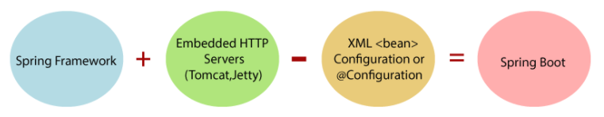

Slide 3
Features
In Spring Boot, there is no requirement for XML configuration (deployment descriptor).
It uses convention over configuration software design paradigm that means it decreases the effort of the developer.
We can use Spring STS IDE to develop Spring Boot Java applications.

Slide 4
Spring Tool Suite (STS) is a set of tools for creating Spring applications.
It can be either installed as a plugin to an existing installation of Eclipse JEE or can be installed standalone.

Slide 5
Why should we use Spring Boot Framework?
The dependency injection approach is used in Spring Boot.
It contains powerful database transaction management capabilities.
It simplifies integration with other Java frameworks like JPA/Hibernate ORM, Struts, etc.
It reduces the cost and development time of the application.

Slide 6
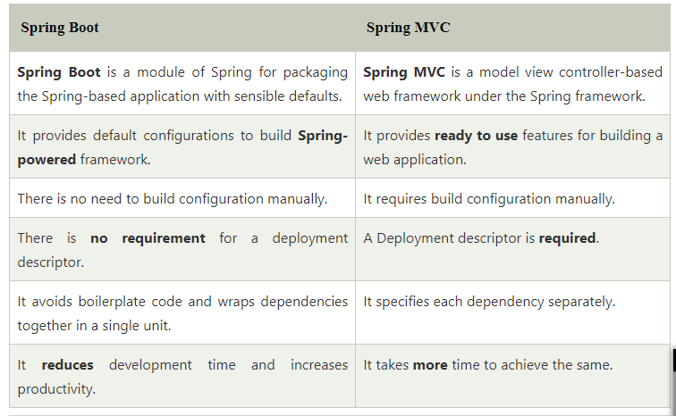

Slide 7
SpringApplication.run bootstraps a spring application as a stand-alone application from the main method.
It creates an appropriate ApplicationContext instance and load beans.
It also runs embedded Tomcat server in Spring web application.
Spring Boot automatically configures your application based on the dependencies you have added to the project by using @EnableAutoConfiguration annotation.

Slide 8
The spring-boot-starter-parent project is a special starter project – that provides default configurations for our application .
The single spring-boot-starter-web dependency transitively pulls in all dependencies related to web development.

Slide 9
The Spring Boot Maven Plugin provides Spring Boot support in Apache Maven.
It allows you to package executable jar or war archives, run Spring Boot applications, generate build information and start your Spring Boot application prior to running integration tests.
tomcat-embed-jasper: provides support for . jsp file rendering.

Slide 10
stereotype annotations
@Component is a generic stereotype for any Spring-managed component.
@Service annotates classes at the service layer.
@Repository annotates classes at the persistence layer, which will act as a database repository.
@Service and @Repository are special cases of @Component
@Repository’s job is to catch persistence-specific exceptions and re-throw them as one of Spring’s unchecked exceptions.

Slide 11
Way to create spring application with zero or minimum configurations
Follows opinionated default configuration approach.
Spring Boot uses sensible defaults, “opinions”, mostly based on the classpath contents.
For example
Creates a default Spring MVC setup, if Spring MVC is on the classpath.

Slide 12
Spring Boot Spring Application class is used to bootstrap and launch a Spring application from a Java main method.
This class automatically creates the ApplicationContext from the classpath, scan the configuration classes and launch the application.
Thus spring container gets started once SpringApplication.run() method is called.

Slide 13
Spring Data JPA
When you implement a new application, you should focus on the business logic instead of technical complexity and boilerplate code.
That’s why the Java Persistence API (JPA) specification and Spring Data JPA Module are extremely popular.
JPA handles most of the complexity of JDBC-based database access and object-relational mappings.
On top of that, Spring Data JPA reduces the amount of boilerplate code required by JPA. That makes the implementation of your persistence layer easier and faster.

Slide 14
Spring Data JPA
Spring Data JPA, part of the larger Spring Data family, makes it easy to easily implement JPA based repositories.
Implementing a data access layer of an application has been cumbersome for quite a while.
Too much boilerplate code has to be written to execute simple queries .

Slide 15
Spring Data JPA aims to significantly improve the implementation of data access layers by reducing the effort to the amount that’s actually needed.
As a developer you write your repository interfaces, including custom finder methods, and Spring will provide the implementation automatically.

Slide 16
Using Spring Data JPA with Spring Boot
You only need to add the spring-boot-starter-data-jpa artifact, and your JDBC driver to your maven build.
The Spring Boot Starter includes all required dependencies and activates the default configuration.

Slide 17
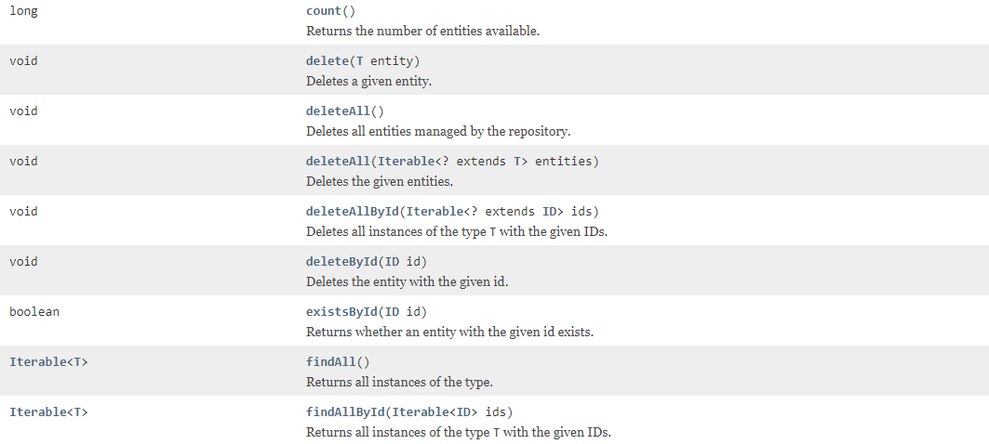
Methods of JPA Repository

Slide 18
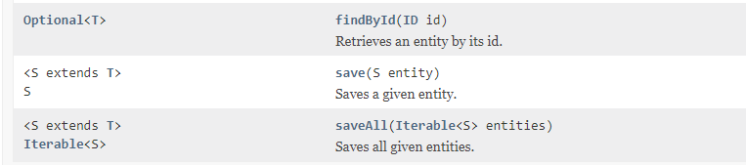
Methods of JPA Repository

Slide 19
Spring Data JPA takes this simplification one step further and makes it possible to remove the DAO implementations entirely.
In order to start leveraging the Spring Data programming model with JPA, a DAO interface needs to extend the JPA specific Repository interface, JpaRepository.
This will enable Spring Data to find this interface and automatically create an implementation for it.
JpaRepository provides some JPA-related methods such as flushing the persistence context and deleting records in a batch.
choose CrudRepository for simplicity when basic CRUD operations are sufficient. Use JpaRepository when you need additional JPA features, pagination, or sorting capabilities.

