Slide 1
Modeling Fire Safety Deficiencies in Nursing Homes
Shobair Abidi

Slide 2


Purpose
Defining Clusters of Categorized data
Determining Fault/Negligence
Location
Time of Occurrence
Type of Deficiency

Slide 3
Dataset
Selecting a Dataset
Split Data
Location
Modeling Data
LINK

Slide 4
Data Skew
Notes:
MENTION OVERSAMPLING

Slide 5
Data Skew
Deficiency Tag Number | Normalized Frequency
931 | 0.000006
257 | 0.000006
16 | 0.000006
19 | 0.000006
109 | 0.000006
Deficiency Category
Deficiency Tag Number
Scope Severity Code
Deficiency Corrected
Scope Severity Code | Normalized Frequency
I | 0.000006
H | 0.000006
G | 0.000025
J | 0.000049
K | 0.000074

Slide 6
Model Building
Notes:
MENTION OVERSAMPLING

Slide 7
Model Building
Preliminary Analysis
Dimensionality Reduction?
Modeling Method?

Slide 8
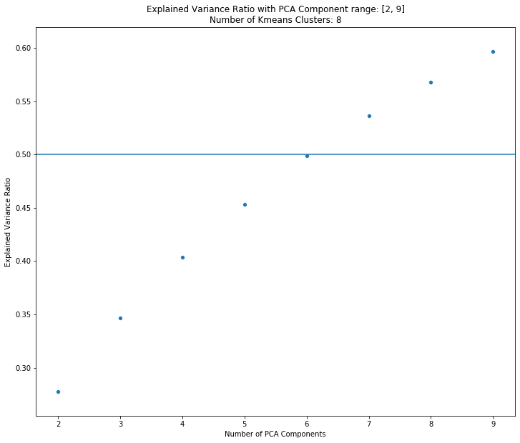
PCA - KMeans
Low Burden
Usefulness?
Modeling Method?

Slide 9
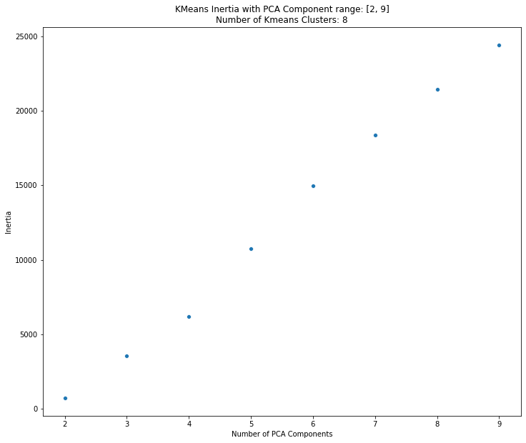
PCA - KMeans
Low Burden
Usefulness?
Modeling Method?

Slide 10
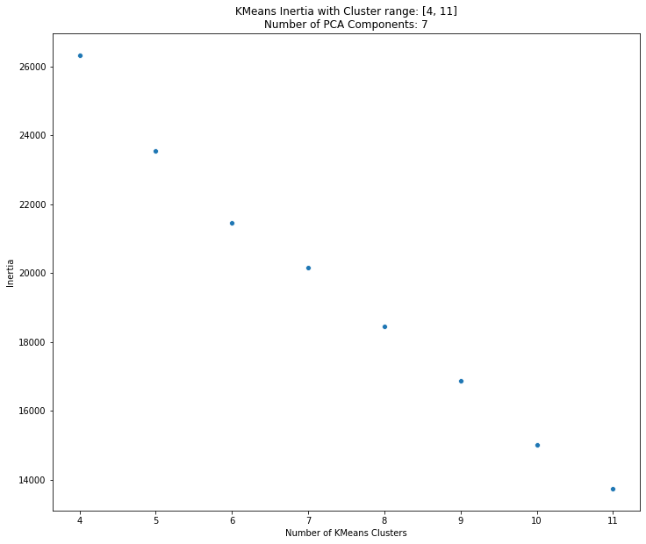
PCA - KMeans
Low Burden
Usefulness?
Modeling Method?

Slide 11
PCA - KMeans
Conclusions
Intrinsically High-dimensional data
PCA not a useful method for dimensionality reduction
KMeans clustering poorly

Slide 12
MCA – Hierarchical
Cluster | Cluster Size
1 | 4790
0 | 4637
2 | 3854
6 | 2453
7 | 1414
5 | 1334
3 | 874
4 | 644
Better for Categorical data
Modeling Method

Slide 13
MCA – Hierarchical
label | Survey Year
 | 2015 | 2016 | 2017 | 2018 | 2019 | 2020
0 | 25 | 168 | 4444 | 0 | 0 | 0
1 | 0 | 0 | 505 | 4285 | 0 | 0
2 | 0 | 0 | 0 | 12 | 3842 | 0
3 | 0 | 0 | 0 | 0 | 20 | 854
4 | 5 | 639 | 0 | 0 | 0 | 0
5 | 0 | 0 | 0 | 0 | 1334 | 0
6 | 0 | 0 | 2 | 2451 | 0 | 0
7 | 0 | 0 | 0 | 0 | 1414 | 0
Hyperparameters:
Components
Clusters

Slide 14
Results
Notes:
MENTION OVERSAMPLING

Slide 16
Conclusion
Notes:
MENTION OVERSAMPLING

Slide 17
Conclusion
Clean Clustering
Modeling Method
Skew Cutoff
Census Data
Weather Data

Slide 18
Questions?
Notes:
MENTION OVERSAMPLING

