Slide 1
AIR POLLUTION

Slide 2
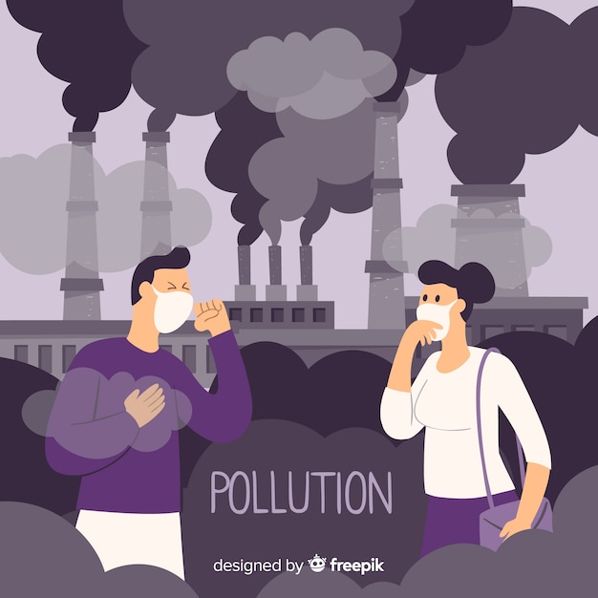
Introduction
Air pollution is contamination of the indoor or outdoor environment by any chemical, physical or biological agent that modifies the natural characteristics of the atmosphere. Household combustion devices, motor vehicles, industrial facilities and forest fires are common sources of air pollution.

Slide 3
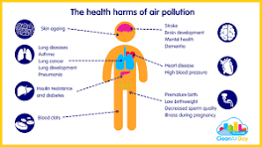
Effect
Autism.
Autoimmune Diseases.
Breast Cancer.
Inflammation.
Asthma.
Kidney Disease.
Lung Diseases.
Obesity.

Slide 4

solution Using public transports. ... Turn off the lights when not in use. ... Recycle and Reuse. ... No to plastic bags. ... Reduction of forest fires and smoking. ... Use of fans instead of Air Conditioner. ... Use filters for chimneys. ... Avoid usage of crackers

Slide 5
causes
The Burning of Fossil Fuels. ...
Industrial Emission. ...
Indoor Air Pollution. ...
Wildfires. ...
Microbial Decaying Process. ...
Transportation. ...
Open Burning of Garbage Waste

Slide 6

types
Particulate matter.
Ground-level ozone.
Carbon monoxide.
Sulfur oxides.
Nitrogen oxides.
Lead

Slide 7
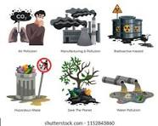
fact
$8.1 trillion in annual global health costs. ...
6.1% reduction in global GDP. ...
1.2 billion work days lost globally each year, which could reach 3.8 billion days by 2060. ...
In the USA, every $1 spent on air pollution control yields an estimated $30 in economic benefits. ...
Global crop yield losses of

Slide 8

Control
d-powered lawn equipment. ...
Drive your car less. ...
Turn off your engine. ... Keep your car in good repair. ...
Don't burn your garbage. ...
Limit backyard fires in the city. ...
Plant and care for trees. ...
Switch to electric or hanUse less energy.

Slide 9
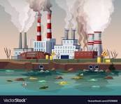
Thank you

