Slide 1

Project Title – Seasonal Agriculture Performance Analysis
Student Name : Shobhakiran B T
College Name : Bahubali College Of Engineering
AICTE STU ID :STU699abfa8903f31771749288

Slide 2

PROBLEM STATEMENT
Agricultural activities are influenced by seasonal variations in environmental conditions, farming practices, resource availability and market conditions. As a result, agricultural performance may differ from one season to another. However, raw agricultural data does not clearly explain how agricultural performance changes across seasons or what patterns can be observed in different seasonal conditions. The problem is to analyze the given agricultural dataset and investigate seasonal differences in agricultural performance by identifying meaningful patterns, trends, relationships and variations within the available data.

Slide 3
Project Description :
Seasonal Agriculture Performance Analysis is a data analytics project that analyzes agricultural data across different seasons, regions, environmental conditions, resource usage, and economic factors. The project uses Python-based data analysis and visualization techniques to identify seasonal patterns, compare agricultural performance, detect unusual values, and study relationships between production, resources, environmental conditions, and economic factors. Statistical analysis is also used to determine whether differences between seasons are significant.

Slide 4

Technology Used:
Programming Language Python
Data Analysis Pandas, Numpy
Data visualization Matplotlib Seaborn
Statistical Analysis Scipy
Development platform Google Colab/Jupyter Notebook
Dataset CSV/ Excel

Slide 5

Who are the Endusers ?
Farmers – to understand which seasons provide better agricultural performance.
Agricultural Officers – to analyze seasonal and regional agricultural conditions.
Agricultural Researchers – to study relationships between environmental factors and crop production
.
Government Departments – to support agricultural planning and resource allocation.
Agribusiness Organizations – to understand production and economic trends.
Students and Data Analysts – for agricultural data analysis and resea

Slide 6
RESULTS
The project provides a clear comparison of agricultural performance across different seasons. It identifies:
The highest and lowest performing seasons.
Seasonal differences in production/output.
Variation in resource usage.
Relationships between environmental conditions and agricultural performance.
Relationships between production and economic factors.
Regional/category-wise performance, when such data is available.
Missing values, duplicates, outliers, and unusual patterns.
Whether seasonal differences are statistically significant.

Slide 7
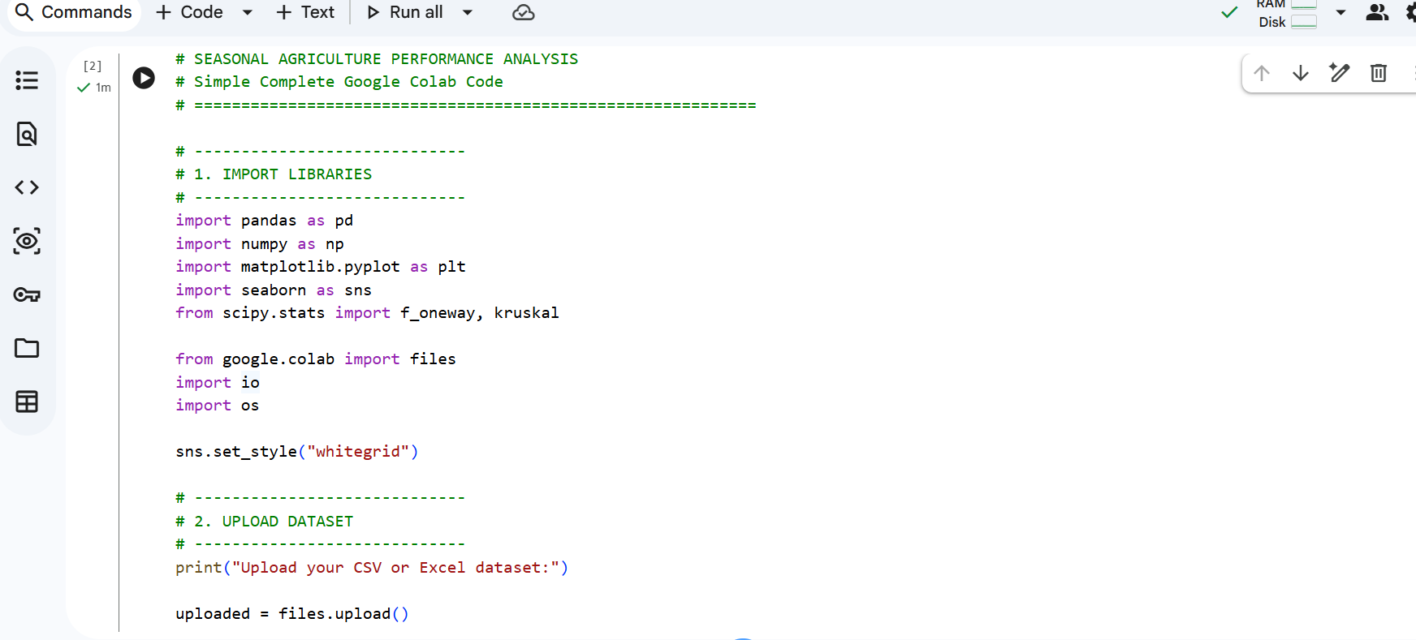
RESULTS

Slide 8
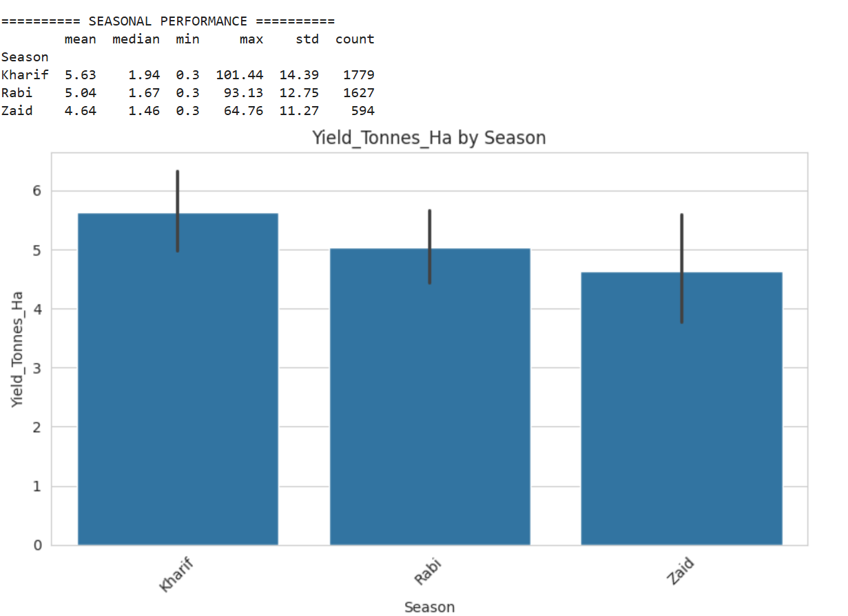
RESULTS

Slide 9
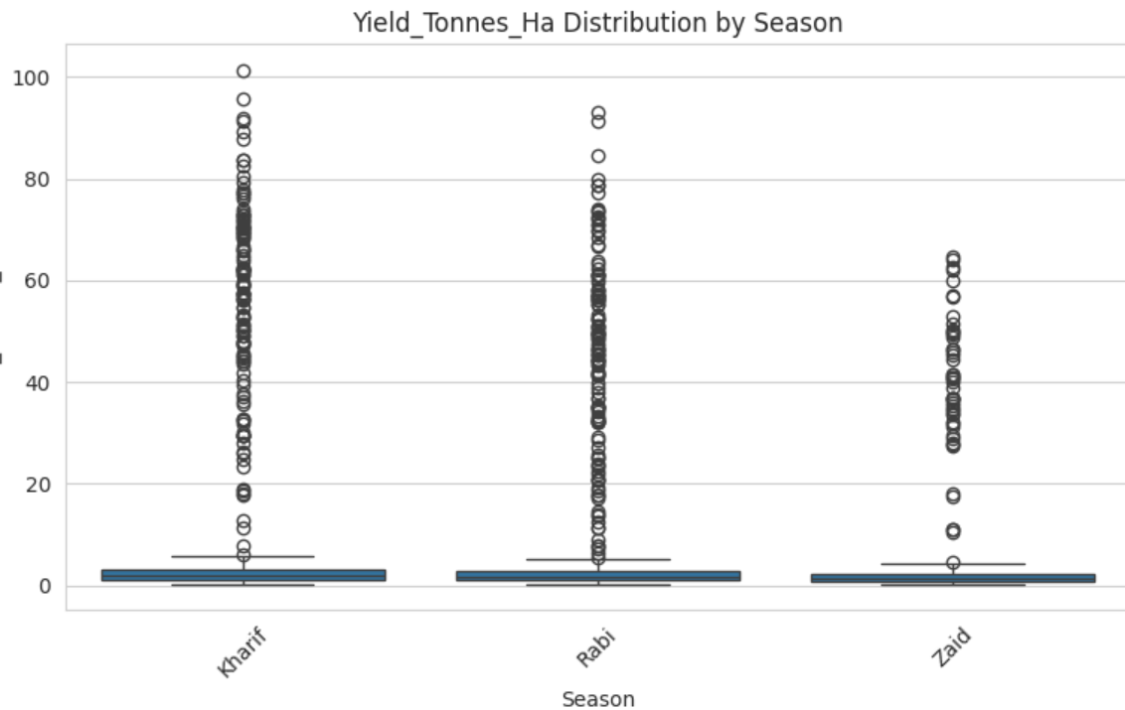
RESULTS

Slide 10
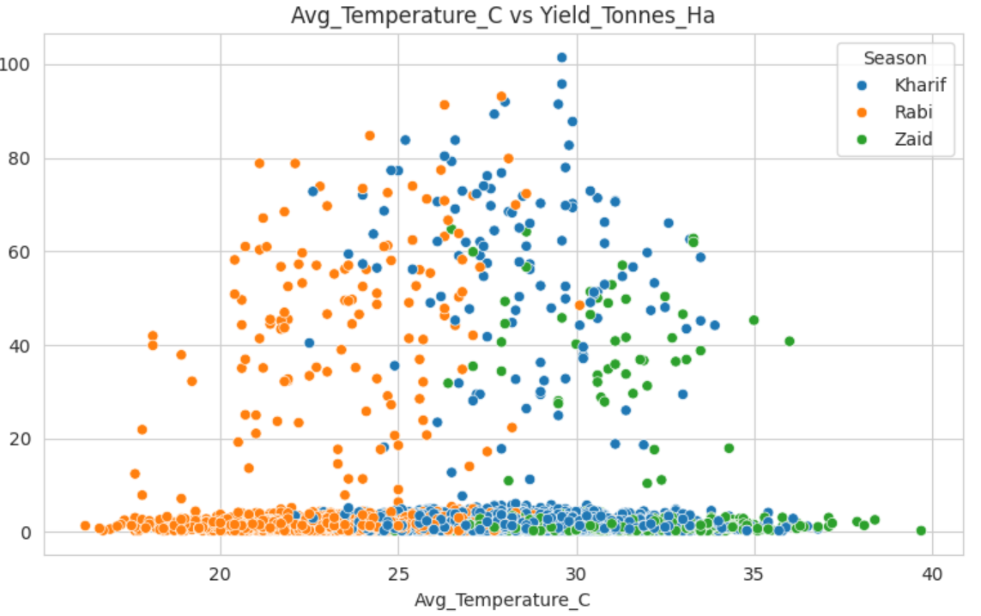
RESULTS

Slide 11
Future scope
1.Crop Production Prediction – Use machine learning to prediction crop production for future seasons.
2.Real-Time Weather Integration – Include real-time rainfall, temperature, humidity, and other weather data.
3.Smart Crop Recommendations – Recommend suitable crops based on season, soil, and environmental conditions.
4.Interactive Dashboard – Develop a Power BI or web-based dashboard for real-time agricultural analysis.
5.Market & Profit Prediction – Analyze market prices and predict crop profitability to support better farming decisions.

Slide 12
GitHub Link
https://github.com/shobhakiranbt18/Seasonal-Agriculture-Performance-Analysis

Slide 13
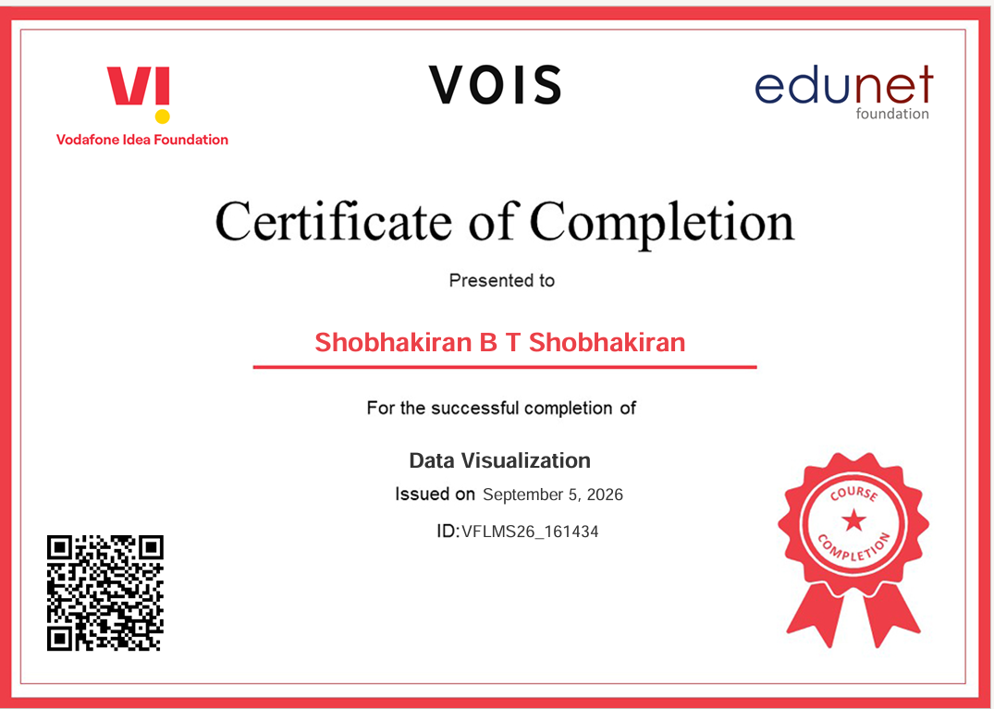
VOIS Course completion certificate - Course name- Data Visualization

Slide 14
Thank you
.
.

