Slide 1
MINI PROJECT PRESENTATION
SMART EVENT MANAGEMENT SYSTEM
A simple web application to create, view and manage college events.
HTML • CSS • JavaScript • Node.js • Express.js
Student: Shobhana | Roll No.: 24KT1A0516

Slide 2
1. Introduction & Problem Statement
Why a simple event management application is useful
Problem
Proposed Solution
Managing college events manually can take time. Event details may be scattered, registrations can be difficult to track, and updates may not reach students clearly.
A web application where event details are displayed in one place. Users can add events, view the event list and register through a simple interface.
Project Overview
• Central place to display college event information.
• Simple form to add an event with its name, date and venue.
• Students can view available events and register.
• REST APIs connect the webpage with the Node.js server.
2

Slide 3
2. Aim, Objectives & Requirements
Main goals and tools used in the project
Aim
Objectives
Software Requirements
To develop a simple web application that makes college event information and basic event management easier.
• Add new events • Display all events • Update event details through an API • Delete events • Register students for events
• HTML • CSS • JavaScript • Node.js • Express.js • VS Code • Web browser
Storage in this demonstration: an in-memory JavaScript array. Data resets when the server restarts.
3

Slide 4
3. System Architecture & Workflow
A lightweight client–server design
Frontend
Backend
Event Data
index.html style.css script.js
Node.js Express.js server.js
JavaScript array Temporary storage
Workflow
1. User opens the webpage.
2. JavaScript sends a request using fetch().
3. Express receives the REST API request.
4. Server reads or changes the event array and sends a JSON response.
5. The webpage updates the event list dynamically.
4

Slide 5
4. REST API Methods
Endpoints used to manage events
METHOD
ENDPOINT
PURPOSE
POST
/api/events
Add a new event
GET
/api/events
Retrieve all events
PUT
/api/events/:id
Update an existing event
DELETE
/api/events/:id
Delete an event
The frontend uses fetch() to send requests and receives JSON responses from Express.
5

Slide 6
5. Implementation, Testing & Conclusion
How the application is used and verified
Implementation
Testing
• Express handles API routes. • CORS and express.json() are enabled. • Events are stored in a server-side array. • Static frontend files are served from public.
• Start server using node server.js. • Open http://localhost:3000. • Add an event and confirm it appears. • Delete an event and confirm it disappears.
Advantages
• Simple interface and beginner-friendly code.
• No database installation is required.
• REST API structure makes frontend–backend communication clear.
Conclusion: The project demonstrates basic event management using a client–server web application. In-memory data is temporary and can be replaced with persistent storage in a future version.
6

Slide 7
SERVER.JS
SCRIPT.JS
const express = require('express');
const cors = require('cors');
const app = express();
const PORT = 3000;
app.use(cors());
app.use(express.json());
app.use(express.static('public'));
et events = [];
let id = 1;
// Add event
app.post('/api/events', (req, res) => {
const { name, date, venue } = req.body;
const event = { id: id++, name, date, venue };
events.push(event);
res.status(201).json(event);
});
// Display events
app.get('/api/events', (req, res) => {
res.json(events);
});
// Update event
app.put('/api/events/:id', (req, res) => {
const event = events.find(e => e.id == req.params.id);
if (!event) {
return res.status(404).json({ message: 'Event not found' });
}
Object.assign(event, req.body);
res.json(event);
});
// Delete event
app.delete('/api/events/:id', (req, res) => {
events = events.filter(e => e.id != req.params.id);
res.json({ message: 'Event deleted successfully' });
});
app.listen(PORT, () => {
console.log(`Server running at http://localhost:${PORT}`);
});
INDEX.HTML
<!DOCTYPE html>
<html>
<head>
<title>Smart Event Management</title>
<link rel="stylesheet" href="style.css">
</head>
<body>
<h1>Smart Event Management</h1>
<input type="text" id="name" placeholder="Event Name">
<input type="date" id="date">
<input type="text" id="venue" placeholder="Event Venue">
<button onclick="addEvent()">Add Event</button>
<h2>Event List</h2>
<table border="1">
<thead>
<tr>
<th>ID</th>
<th>Name</th>
<th>Date</th>
<th>Venue</th>
<th>Action</th>
</tr>
</thead>
<tbody id="eventTable"></tbody>
</table>
<script src="script.js"></script>
</body>
</html>
const API = '/api/events';
// Display events
async function loadEvents() {
const response = await fetch(API);
const events = await response.json();
const table = document.getElementById('eventTable');
table.innerHTML = '';
events.forEach(event => {
table.innerHTML += `
<tr>
<td>${event.id}</td>
<td>${event.name}</td>
<td>${event.date}</td>
<td>${event.venue}</td>
<td>
<button onclick="deleteEvent(${event.id})">
Delete
</button>
</td>
</tr>
`;
});
}
// Add event
async function addEvent() {
const name =
document.getElementById('name').value;
const date = document.getElementById('date').value;
const venue = document.getElementById('venue').value;
if (!name || !date || !venue) {
alert('Please fill all fields');
return;
}
await fetch(API, {
method: 'POST',
headers: { 'Content-Type': 'application/json' },
body: JSON.stringify({ name, date, venue })
});
document.getElementById('name').value = '';
document.getElementById('date').value = '';
document.getElementById('venue').value = '';
loadEvents();
}
// Delete event
async function deleteEvent(id) {
await fetch(`${API}/${id}`, {
method: 'DELETE'
});
loadEvents();
}
loadEvents();
6

Slide 8
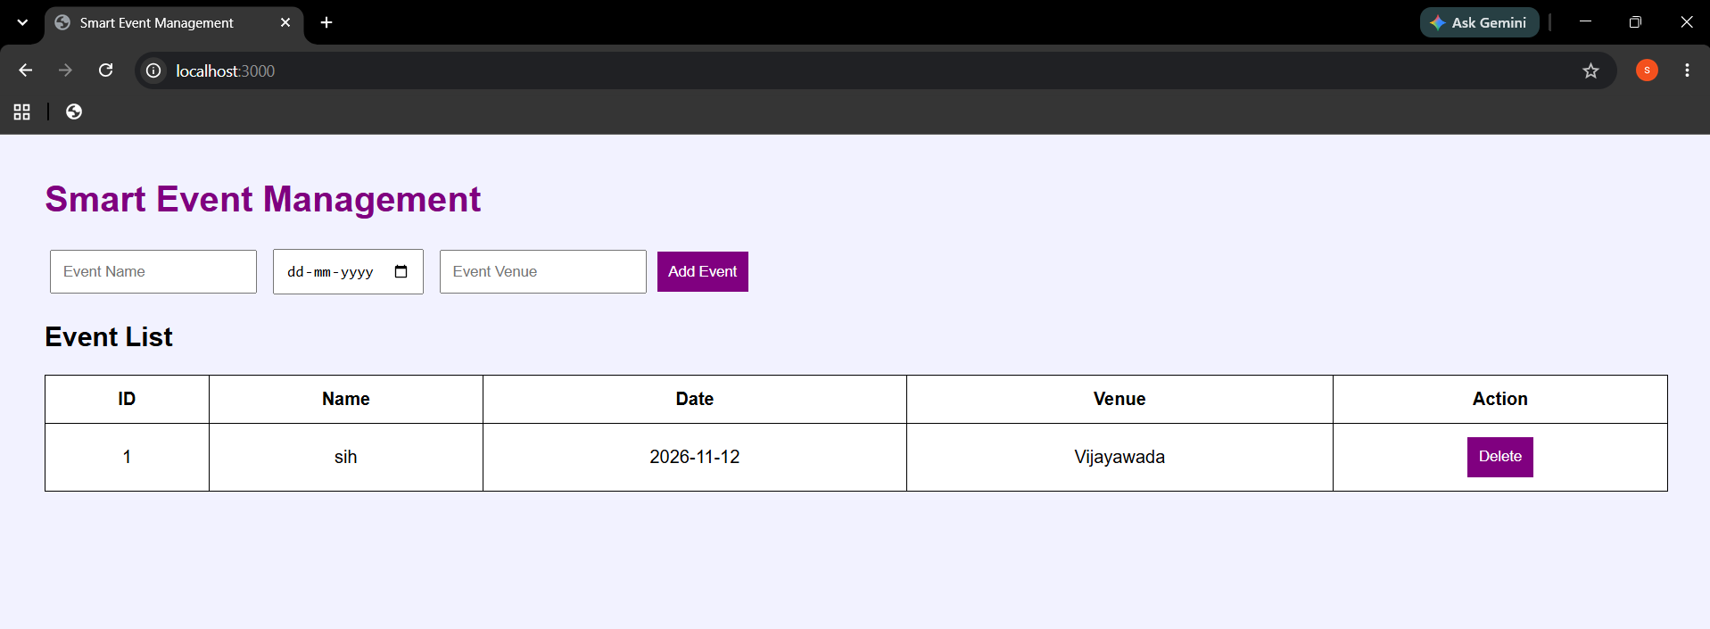
OUTPUT:
6

Slide 9
PROJECT REPOSITORY & THANK YOU
Smart Event Management System
GitHub Repository
https://github.com/shobhanabathina/Smart-Event-Management
Student: Shobhana
Roll Number: 24KT1A0516
THANK YOU

