Slide 1

Git-Github

Slide 2
Git
It is a distributed version-control system for tracking changes in source code during software development.
Github /Git repository
A Git repository is a virtual storage of your project. It allows you to save versions of your code, which you can access when needed.

Slide 3
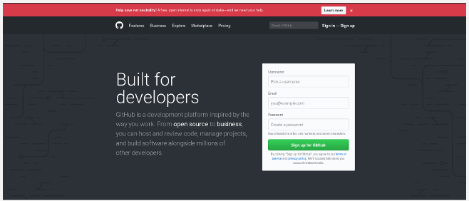
Step 1: Create a GitHub account

Slide 4
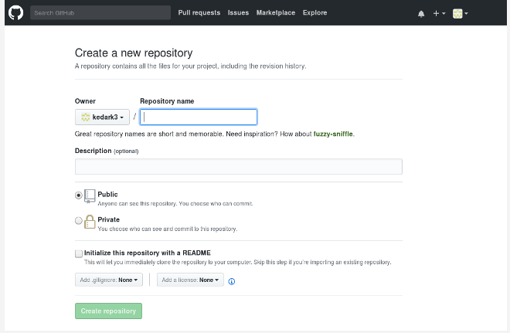
Step 2: Create a new repository
Enter a name for your repository (e.g, "Demo") and click Create Repository. Don't worry about changing any other options on this page

Slide 5
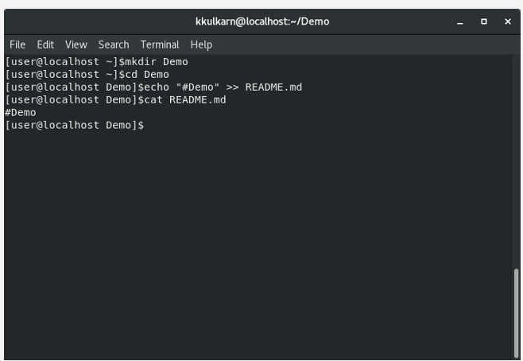

Slide 6
Step 3: Create a file

Slide 7
Create a file
Intialization:
git init
add a file to the folder
git add newfile.file

Slide 8
Step 4: Make a commit
So far you've created a file and told Git about it, and now it's time to create a commit. Every time you accomplish some work, you can write a Git commit to store that version of your file, so you can go back later and see what it looked like at that point in time. Whenever you make a change to your file, you create a new version of that file, different from the previous one.
git commit -m "first commit“ a.txt

Slide 9
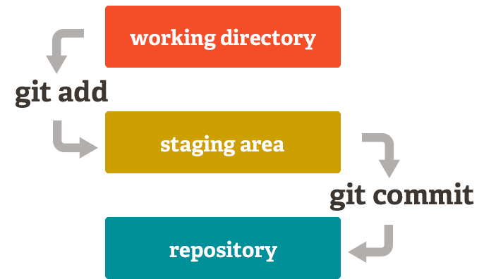

Slide 10
Step 5: Connect your GitHub repo with your computer
git remote add origin https://github.com/<your_username>/Demo.git

Slide 11
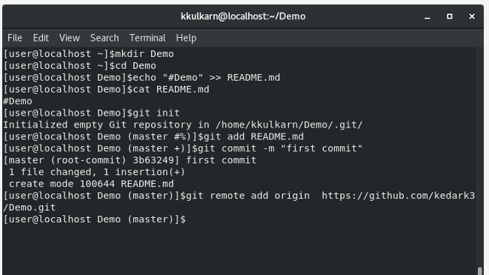

Slide 12
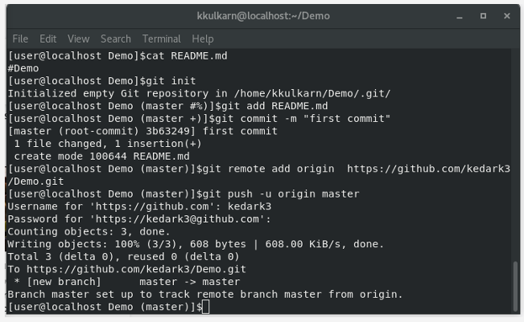
Step 6: Push the file to GIT

Slide 13
Git Branch

Slide 14

Creating a Branch

Slide 15
View Branches
To view the branches in a Git repository.
Command: git branch
To view both remote-tracking branches and local branches.
Command: git branch –a

Slide 16
Checkout/Change Branch
To checkout an existing branch, run the command:
git checkout BRANCH-NAME

Slide 17
Rename a Branch
git branch -m OLD-BRANCH-NAME NEW-BRANCH-NAME

Slide 18
Delete a Branch
Git won’t let you delete a branch that you’re currently on.
You first need to checkout a different branch, then run the command:
git branch -d BRANCH-TO-DELETE
You can delete the remote branch with the -D option.
git branch -D BRANCH-TO-DELETE

Slide 19
Adding local branch to Remote
git push -u origin <branch-name>

Slide 20
GIT PULL OR GIT FETCH
When downloading content from a remote repo, git pull and git fetch commands are available to accomplish the task. You can consider git fetch the 'safe' version of the two commands. It will download the remote content but not update your local repo's working state, leaving your current work intact. git pull is the more aggressive alternative, it will download the remote content for the active local branch and immediately execute git merge to create a merge commit for the new remote content. If you have pending changes in progress this will cause conflicts and kickoff the merge conflict resolution flow.

Slide 21


Slide 22



