Slide 1
WEEK 02 / BUILD & DEMONSTRATE
Agentic AI
Debugging & Test
Automation
From a command-line repair loop to a live Streamlit demonstration
CORE AGENT
PYTEST
STREAMLIT UI
https://github.com/shobhis330/agentic-ai-debugging-test-automation

Slide 2
01 / PURPOSE
Less manual debugging. More verified iteration.
The prototype automates part of the test–diagnose–repair–retest cycle.
THE PROBLEM
OUR APPROACH
A test fails. A developer must inspect the error, locate the defect, edit the code, and run tests again.
Python runs tests; Gemini suggests a structured repair; pytest checks the updated solution again.
→
Passing tests is evidence only for the behaviors covered by the tests.
WEEK 02 • 02

Slide 3
02 / WORKFLOW
The repair loop
A bounded loop with clear stop conditions.
01
02
03
04
05
RUN TESTS
→
READ FAILURE
→
ASK GEMINI
→
VALIDATE
→
RETEST
pytest
capture feedback
structured JSON
syntax + save
pytest again
PASS → FINISH
FAIL → repair again if retries remain
Retry limit: 3 • stops endless attempts
WEEK 02 • 03

Slide 4
03 / ARCHITECTURE
How the components connect
The UI invokes the existing agent; it does not duplicate the repair logic.
USER
STREAMLIT
PYTHON AGENT
GEMINI API
RESULT
→
→
→
→
select case
app.py
pytest + retries
repair JSON
logs + status
STRUCTURED REPAIR
VALIDATION
bug_type • explanation • fixed_code • confidence
response fields • syntax check • test rerun
API credentials remain in Colab Secrets/environment variables.
WEEK 02 • 04

Slide 5
04 / IMPLEMENTATION
Structured JSON makes the repair usable
Predictable fields can be checked by the program.
REPAIR RESPONSE
1. PARSE
Read structured fields from Gemini.
"bug_type":
"logical_error"
"explanation":
"Incorrect denominator"
2. VALIDATE
"fixed_code":
"return total / len(numbers)"
Check required fields, types, confidence and syntax.
"confidence":
0.94
3. RETEST
Save candidate and run pytest again.
WEEK 02 • 05

Slide 6
05 / EVALUATION
Three intentional bugs
Cases cover a logic error, a boundary condition, and an undefined variable.
TC01
TC02
TC03
AVERAGE LOGIC
AGE BOUNDARY
UNDEFINED NAME
BEFORE
BEFORE
BEFORE
len(numbers) - 1
age > 18
return tota
EXPECTED FIX
EXPECTED FIX
EXPECTED FIX
len(numbers)
age >= 18
return total
WEEK 02 • 06

Slide 7
06 / EVIDENCE
What the captured run shows
Separate confirmed results from cases still needing verification.
TC01 • CAPTURED PASS
TC02 + TC03
4 tests passed
Final verification pending
Repair attempt: 1 of 3
First run failed; the next run passed.
Buggy versions are restored and ready for separate runs. Capture their logs before claiming success.
3 controlled cases • MAX_RETRIES = 3 • Not a broad benchmark
WEEK 02 • 07

Slide 8
07 / STREAMLIT UI
A browser-based control panel
UI was added early based on mentor direction and connected to the existing agent.
SELECT
Agentic AI Debugging System
Choose TC01–TC03.
Select evaluation case
TC01 ▾
Run AI Debugging Agent
RUN
Start agent and tests.
Execution result
PASS • 4 tests passed • 1 repair attempt
REVIEW
Logs, code, status, diff.
Illustrative layout, not a screenshot of the actual app.
WEEK 02 • 08

Slide 9
08 / ARTIFACTS
Project structure and repository
The files needed for the Week 2 demonstration are organized together.
agentic-ai-debugging-test-automation/
GITHUB REPOSITORY
↳ debugging_agent.py
agentic-ai-debugging-test-automation
↳ agent_cli.py
↳ app.py
https://github.com/shobhis330/agentic-ai-debugging-test-automation
↳ README.md
↳ week2_evaluation_results.csv
↳ evaluation_cases/ TC01 • TC02 • TC03
SECRET HANDLING
Keep GEMINI_API_KEY out of GitHub.
WEEK 02 • 09

Slide 10
09 / STATUS
Week 2 milestone: working MVP demo
The complete multi-week project is still in progress.
IMPLEMENTED / DEMONSTRATED
NEXT TO COMPLETE
• Core agent loop + retry limit
• Structured repair response
• pytest execution
• Three prepared cases
• Connected Streamlit UI
• Verify TC02 and TC03
• Record final results in CSV
• Expand toward 15 cases
• Week 3 knowledge/memory
• Strengthen execution safety
UI was added early following mentor direction; the guideline places UI delivery later.
WEEK 02 • 10

Slide 11
WEEK 02 / WRAP-UP
From a repair loop
to a live demo.
NEXT
Verify.
Evaluate.
Extend.
Core agent • Gemini • pytest • 3 bug cases • Streamlit UI
https://github.com/shobhis330/agentic-ai-debugging-test-automation
Thank you

Slide 12
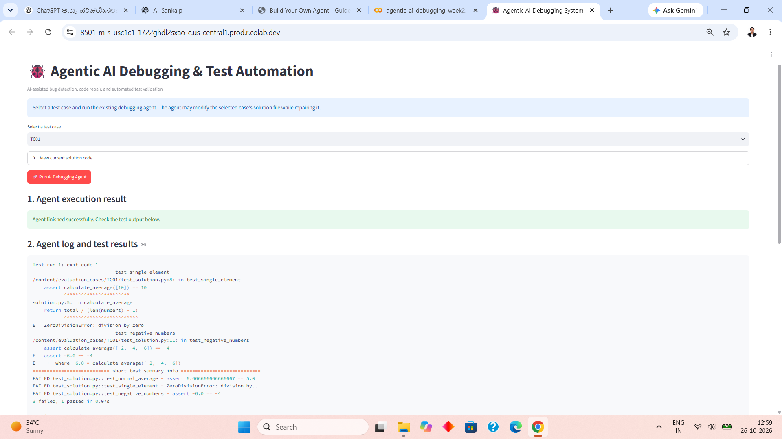
Live Streamlit Interface — Initial Test Failure
Actual application screenshot: TC01 begins with failing tests, showing the division-by-zero and incorrect-average defects.

Slide 13
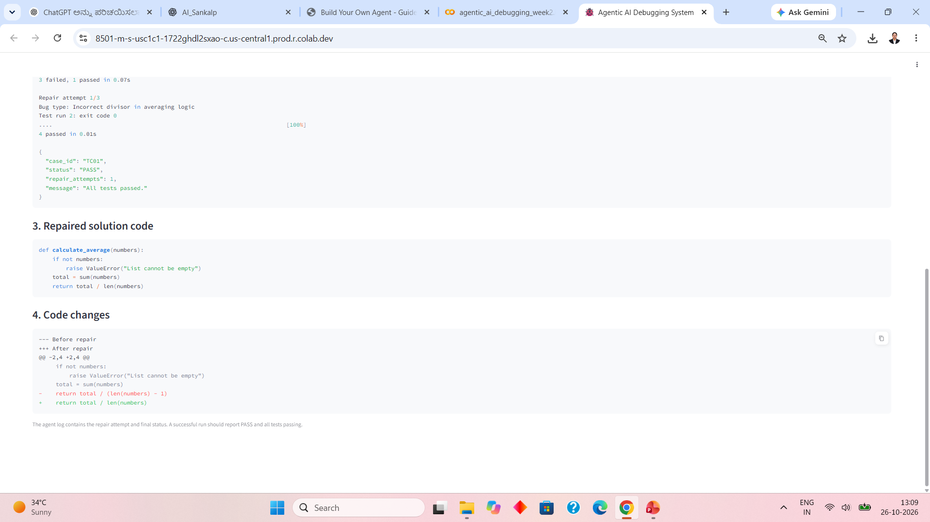
Live Agent Run — Repair and Validation
Actual application screenshot: the agent identifies the averaging-logic bug, applies one repair attempt, and reports all four tests passing.

