Slide 1
Data Analysis
Linkfire data

Slide 2

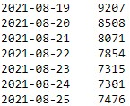
Data details:
We have user data of our customers from all over the world for these 7 dates:
Let’s see how many clicks did we have for each day:
which amounts to almost 8000 clicks per day!

Slide 3
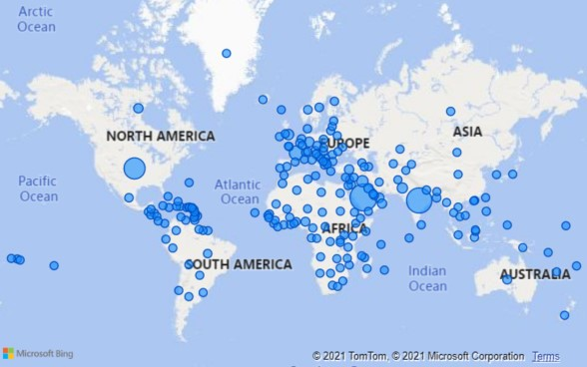
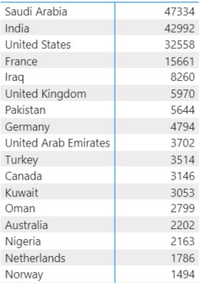
Countries
Which countries do most of our users come from?

Slide 4
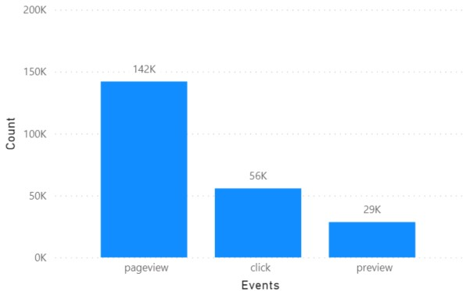
How do we perform for our events worldwide?
We have 3 events: Previews, Pageviews and Clicks

Slide 5
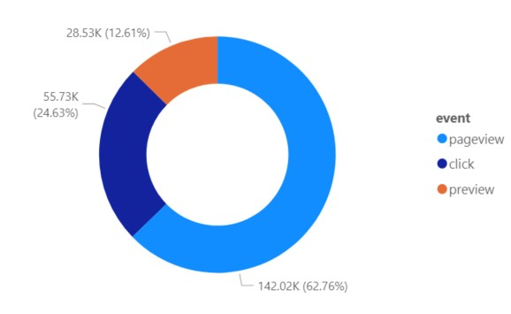
What’s the distribution of our events?

Slide 6
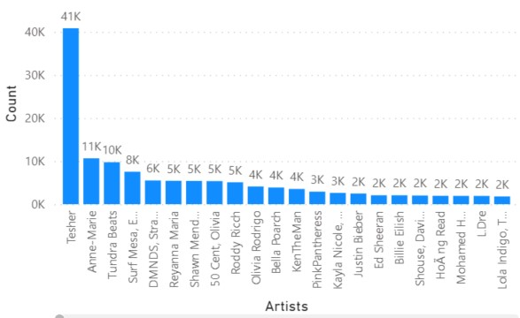
Who are our biggest artists?

Slide 7
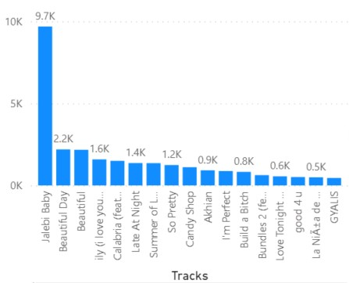
Which tracks have the most clicks?

Slide 8
Thank you!

