Slide 1

Learn To Code
Arrays and Functions

Slide 2

Content
01. Arrays in Java
02. Functions
03. Polymorphism

Slide 3
Java Arrays

Slide 4
Java Arrays – 1 Dimensional
Array is an object which contains fixed number of elements of a similar data type under same name
arrayRefVar = new dataType[arraySize];
myArray
=
new int[5]
myArray[0]
=
10
myArray[0]
myArray[1]
myArray[2]
myArray[3]
myArray[4]

Slide 5
Java Arrays – 1 Dimensional
Array is an object which contains fixed number of elements of a similar data type under same name
arrayRefVar = new dataType[arraySize];
myArray
=
new int[5]
myArray[1]
=
20
myArray[2]
=
30
10
myArray[3]
=
40
myArray[0]
myArray[1]
myArray[2]
myArray[3]
myArray[4]
myArray[4]
=
50

Slide 6
Java Arrays – 1 Dimensional
Array is an object which contains fixed number of elements of a similar data type under same name
arrayRefVar = new dataType[arraySize];
myArray
=
new int[5]
10
20
30
40
50
myArray[0]
myArray[1]
myArray[2]
myArray[3]
myArray[4]

Slide 7
Java Arrays – 2 Dimensional
Like a 1D array, a 2D array is also a collection of data cells, all of the same type, which can be given a single name
datatype[][] arrayRefVar = new dataType[row][col];
int[][] myArray
=
new int[2][2]
myArray[0][0]
myArray[0][1]
myArray[0][0]
=
100
myArray[1][0]
myArray[1][1]

Slide 8
Java Arrays – 2 Dimensional
Like a 1D array, a 2D array is also a collection of data cells, all of the same type, which can be given a single name
datatype[][] arrayRefVar = new dataType[row][col];
int[][] myArray
=
new int[2][2]
myArray[0][1]
=
200
myArray[0][0]
myArray[0][1]
myArray[1][0]
=
300
100
myArray[1][1]
=
400
myArray[1][0]
myArray[1][1]

Slide 9
Java Arrays – 2 Dimensional
Like a 1D array, a 2D array is also a collection of data cells, all of the same type, which can be given a single name
datatype[][] arrayRefVar = new dataType[row][col];
int[][] myArray
=
new int[2][2]
myArray[0][0]
myArray[0][1]
100
200
300
400
myArray[1][0]
myArray[1][1]

Slide 10
Java Classes
Fields
A class may contain
Methods
class <class_name>{
field;
method;
}
Constructors
Blocks
Nested Class & Interface

Slide 11
Java Methods

Slide 12
Java Methods
A method is a set of code that is grouped together to perform a specific operation
A method must be written inside a class
Each method has its own signature
Java provides two types of methods
Pre Defined or Standard Library Methods
User Defined Methods

Slide 13
Java User Defined Methods
To use a method, you need to perform two steps:
Method Initialization
Method Invocation

Slide 14
Java Methods
Method Initialization
modifier returnType nameOfMethod (Parameter List) {
// method body
}
A method can be parameterized or non-parameterized
Method definition consists of a method header and a method body
You can Overload Method i.e. Provide same name to more than one method but their data type or parameter list must be different

Slide 15
Java Methods
Method Invocation
methodName()
methodName(parameter1, parameter2...)
To use a method it needs to be invoked or called
When a program invokes a method, the program control gets transferred to the called method
A method can be called in two ways:
Call by Value
Call by Reference

Slide 16
Static Vs Non-Static

Slide 17
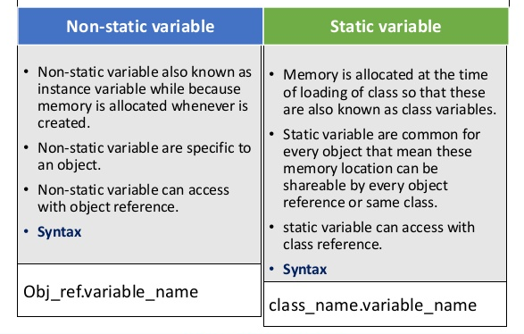
Static vs Non Static

Slide 18
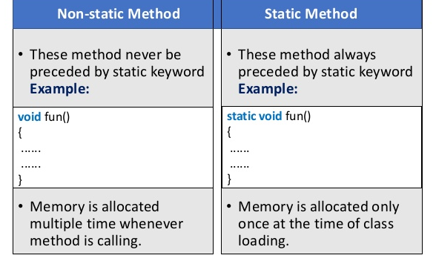
Static vs Non Static

Slide 19
Polymorphism

Slide 20
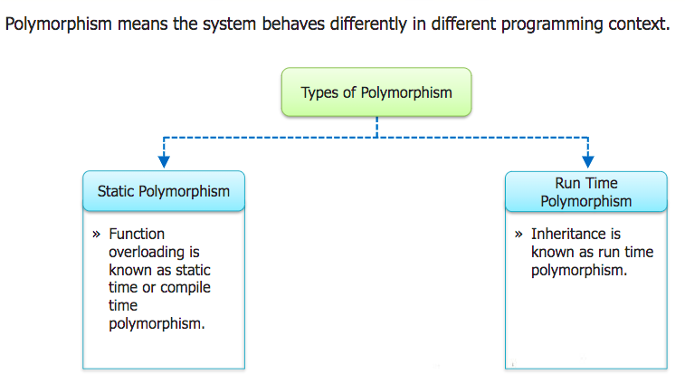
Polymorphism

Slide 21
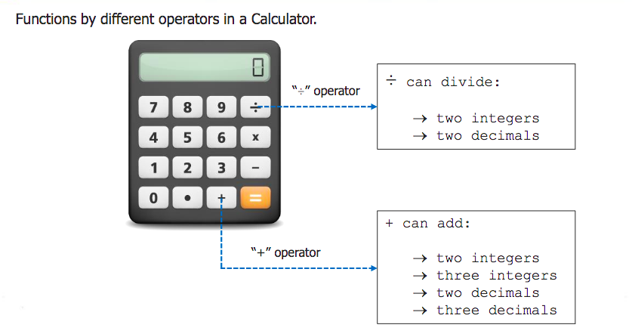
Polymorphism

Slide 22
Thank You

