Slide 1

PACKAGES,
EXCEPTIONS AND THREADS

Slide 2

Content
01. Packages
02. Access Modifiers
03. Exception Handling
04. Threads
05. Multi Threading
06. Synchronization

Slide 3
PACKAGES

Slide 4
Why Packages?
Programmers can easily determine that these classes are related.
Programmers know where to find files of similar types.
The names won’t conflict.
You can have define access of the types within the packages.

Slide 5
What is a Package?
A Java Package is a mechanism for organizing.
Java classes into namespaces.
Programmers use package to organize classes belonging to the same category.
Classes in the same package can access each other’s package –access members.

Slide 6
Naming Convention of a Package.
Packages names are written in all lower case. (It is not mandatory. However, it is standard convention that is followed)
Companies use their reversed internet domain name to begin their package names.
For example: com.example.mypackage for a named mypackage created by a programmer at example.com

Slide 7
Naming Convention of a Package
If the domain name contains :
a hypen or a special character.
If the package name begins with a digit, illegal character reserved Java keyword such as “int”.
In this event, the suggested convention is to add an underscore as follows:
Legalizing Package Names
Domain Name | Package Name Prefix
hyphenated-name.example.org | Org.example.hyphenated_name
Example.int | int_.example
123name.example.com | com.example_123name

Slide 8
Packages
Myclass.java
Myproject
com
src
Project
classes
com
Myproject
Myclass.java

Slide 9
Program on Package
Company URL-> auribises.com
Package name-> com.auribises.db

Slide 10
Package and Import
A package can have many classes and each class can have many methods.
These methods can be used by another class in another package by using the keyword “keyword”.
Syntax is: import <package name>.<class name>
or import <package name>.*; ->This loads all the classes in the given package.
We can also import static members .For eg:PI,cos etc.
import static java.lang.Math.PI;
import static java.lang.Math.*;

Slide 11
Access Modifiers
Access modifiers helps to restrict the scope of a class, constructor , variable , method or data member
Default
Public
Private
Protected

Slide 12
Access Modifier
Access Modifier specifies the scope/accessibility of a variable or a method or a class from the same class or from a different class or from a different package.
Use of Access Modifier:
Data abstraction/hiding is one of the concept of object Oriented Programming.
This means, client will not know the implementation details.
This can be achieved through Access Modifier.
For Example: If an attribute is made private then it can be accessed only in the class which defined it.

Slide 13
Access Modifier – Public
Public: When an attribute of method is declared as public then it can be accessed anywhere . Any package, any class accessibility is available.
com.auribises.pack2
com.auribises.pack1
Class 1
Public
Members
Class 5
Class 2
class 4
Extends
Class 1
Class 3

Slide 14
Access Modifier-Protected
Protected- When an attribute of a method is declared as protected then it is visible to all the classes in the same package and all subclasses in different package.
com.auribises.pack2
com.auribises.pack1
Class1
Protected
Members
Class 5
Class 2
Class 4
Extends
Class 1
Class 3

Slide 15
Access Modifier- Private
Private: If a method , variable or constructor is defined as private then it can only be accessed within the declared class itself. Access is not available outside the class.
com.auribises.pack2
com.auribises.pack1
Class 1
Private
Members
Class 5
Class 2
Class 4
Extends
Class 1
Class 3

Slide 16
Access Modifier- Default
Default : When no access modifier is defined then it is to have default access modifier. This attribute/method is used only in the given package . It is not accessible outside the package.
com.auribises.pack2
com.auribises.pack1
Class1
Default
Members
Class 5
Class 2
Class 4
Extends
Class 1
Class 3

Slide 17
Access Modifiers
Default
Public
Private
Protected
Same class
Yes
Yes
Yes
Yes
Same Package subclass
Yes
No
Yes
Yes
Same Package non-subclass
Yes
No
Yes
Yes
Different package subclass
No
No
Yes
Yes
Different package non-subclass
No
No
No
Yes

Slide 18
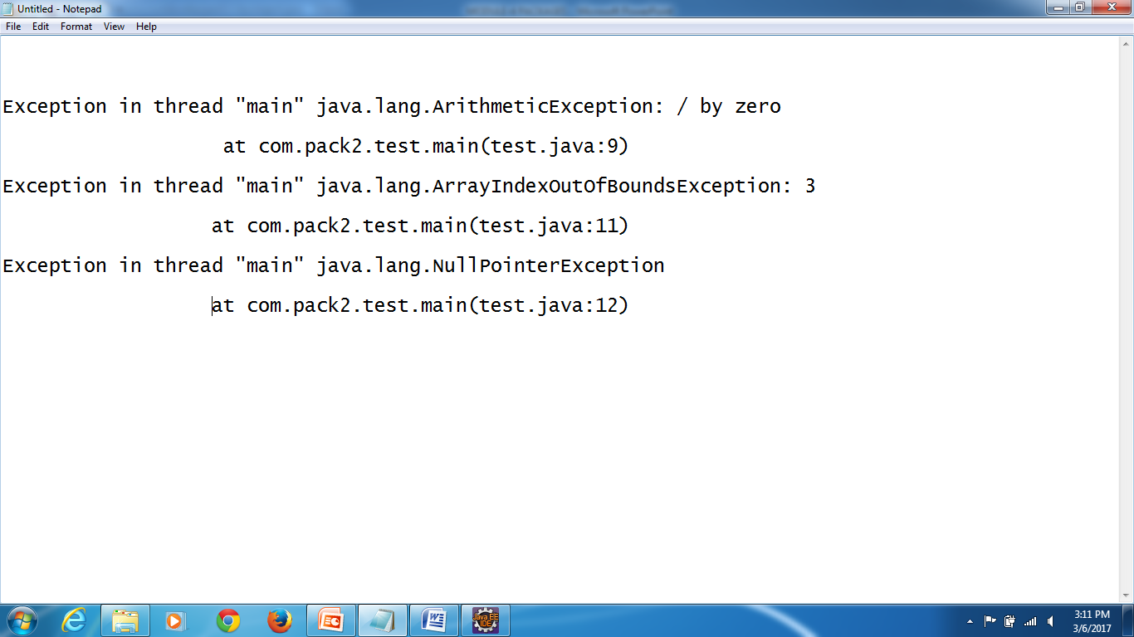
Exception
An exception is an event, which occurs during the execution of a program, that disrupts the normal flow of the program’s instructions—oracle.
It is often referred to as run-time error.
Below are few of them :

Slide 19
Types of Exception
Exception
Checked exceptions are checked at compile-time.
It means if a method is throwing a checked
exception then it should handle the exception
using try-catch block or it should declare the
exception using throws keywords, otherwise the
program will give a compilation error.
Checked Exceptions
Runtime
Exceptions
Error

Slide 20
Types of Exception
Exception
Unchecked exceptions are not checked at compile time . It means
if your program is throwing an unchecked exception and even if
you didn’t handle/declare that exception, the program won’t give
a compilation error. It is up to the programmer to judge the
conditions in advance, that can cause such exceptions and handle
them appropriately. All unchecked exceptions are direct sub classes of
RuntimeException class.
Checked Exception
Runtime
Exception
Error

Slide 21
Types of Exception
Exception
These are exceptional conditions that are external to
the application, and that the application usually cannot
anticipate or recover from. For example, if a stack
overflow occurs, an error will arise. They are also
ignored at the time of compilation.
Checked
Exception
Runtime
Exceptions
Error

Slide 22
Exception Class
Arithmetic Exception
Throwable
ArrayStore Exception
classCast Exception
Error
IllegalArgument
Exception
Exception
IllegalMonitor Exception
IndexOutOfBoundsException
IO Exception
Runtime
Exception
Negative Array Exception
SQL Exception
NullPointer Exception
Other checked Exception
Security Exception
Other unchecked Exception

Slide 23
Why Exceptional Handling?
// Divide by Zero Problem
int x= 5 / 0 ;
System.out.println(x); output error
program will halt
Exception in thread “main” java.lang.ArithmeticException : /by zero
at com.pack2.test.main(test.java:9)

Slide 24
Array Index Out of Bound
int arr[] = {1, 2, 3} ;
System.out.println(arr[3]) ; output error!
program will halt
Exception in thread“main”java.lang.ArrayIndexOutOfBoundsException: 3 at com.pack2.test.main(test.java:11)

Slide 25
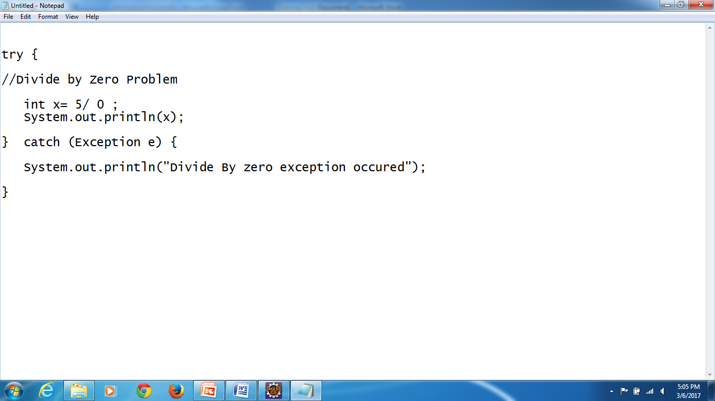
Solution
Output
Divide By Zero exception occurred.

Slide 26
Exception Handling
If there is a run time error then program is crashed and control out of the program.
This issue can be solved by exception handling.
Mainly, try, catch and finally are keywords for exception handling.

Slide 27
Exception Handling (contd.)
try: All the statements to be executed should be placed in the try block.
catch: If there are any issues or runtime errors, control comes in catch block.
finally: Whether successful or unsuccessful execution , statements in the finally block gets executed.

Slide 28
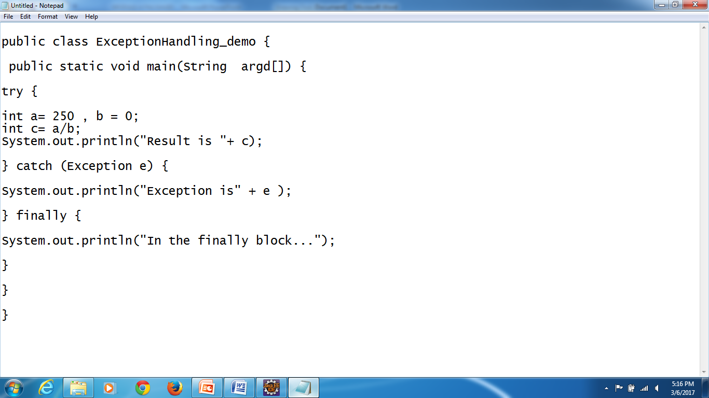
Program on Exception Handling

Slide 29
Exception Handling
One try can have multiple catch blocks. In this scenarios, depends on the type of exception thrown corresponding catch blocks is invoked.
Since all the exceptions are derived from Exception, catch (Exception e) should be placed at last. It can catch all the exceptions.

Slide 30
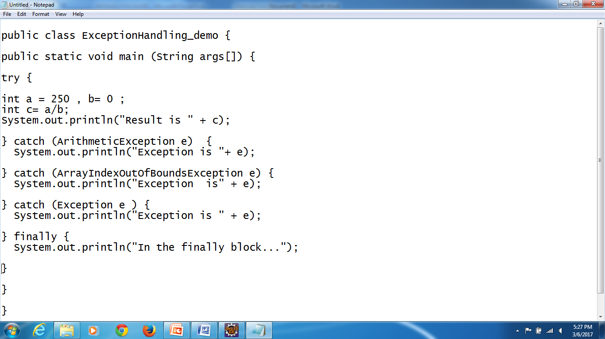
Program on Multiple Catch Blocks

Slide 31
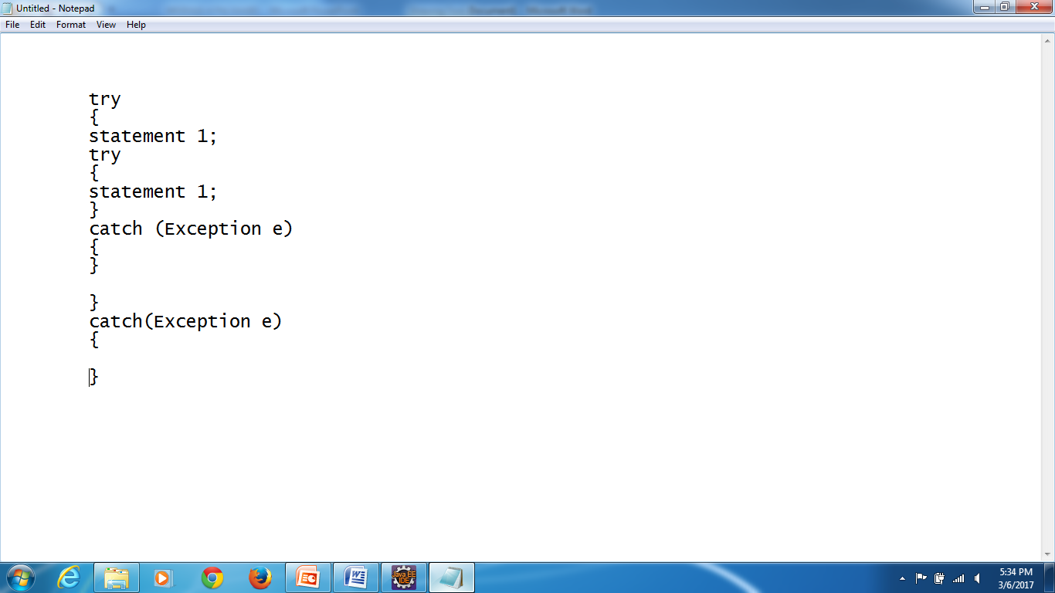
Nested try catch
Why use nested try block?
Sometimes a situation may arise where a part of a block may
cause one error and the entire block itself ma cause another error.
In such cases, exception handlers have to be nested.
Syntax:

Slide 32
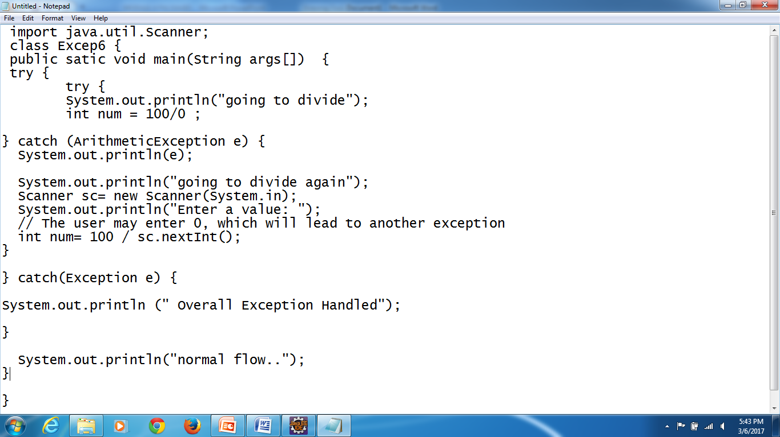
Program on Nested try catch

Slide 33
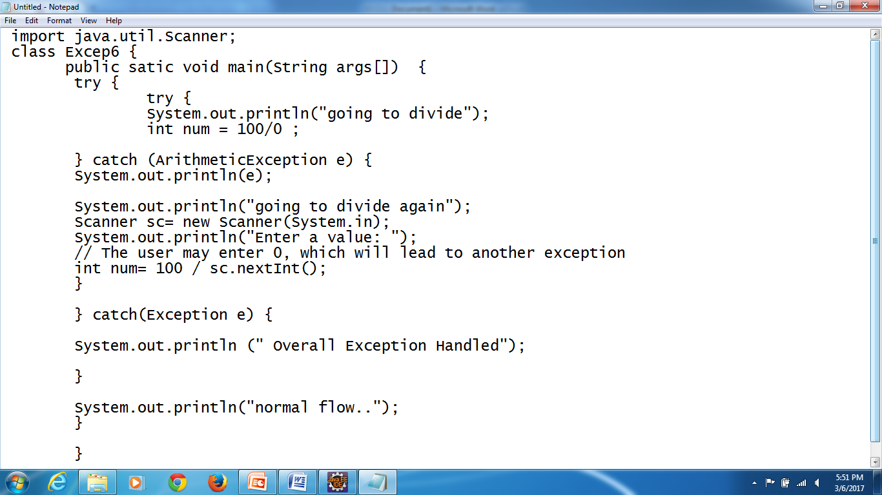
Program on Nested try catch

Slide 34
Why throw?
Example1 : If there is a chance of a serious logic error or operational error then developer can also throw an exception .For example , if we are developing software for elections. For voting, minimum age required is 18. If the voter’s age is below 18 then we can not continue any further, as the basic requirement itself is not met, hence developer can throw an exception.
Example 2 : In banking application, one user account is blocked or closed and if the bank gets the cheque to clear the amount from this account then it is not possible to continue any further hence developer can throw an exception. All the possible scenarios, developer has to use the throw keyword to throw an exception.

Slide 35
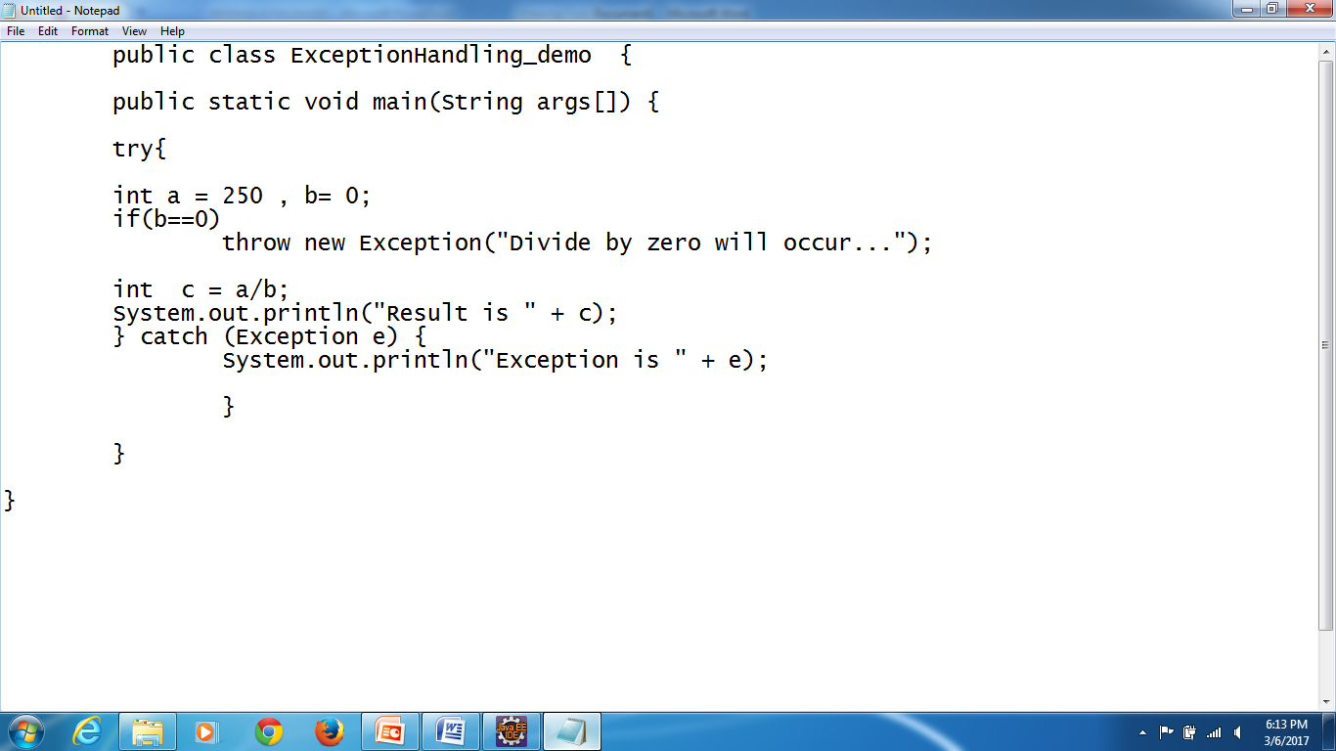
Throw

Slide 36
Why throws?
Design requirement: In an organization, employees provide the service. If there are any issues , in some scenarios , it is not possible for the employees to handle and it has to be escalated to the management to handle it . For example, contract signatures, handling legal issues etc.
Similarly in Java, method which provides the service may not be required to handle certain exceptions and those exceptions should be handled by the calling function.

Slide 37
Throws
Throws will be used next to a function declaration statement as given below:
This statement states that the function test() will not handle IO exception and
the calling function will handle these IOException. Calling function is
responsible for IOExceptions. Many exceptions can be added by adding
comma operator as given below:
Public void test()throws IOException
Public void function() throws IOException, ArrayIndexOutOfBoundsException

Slide 38
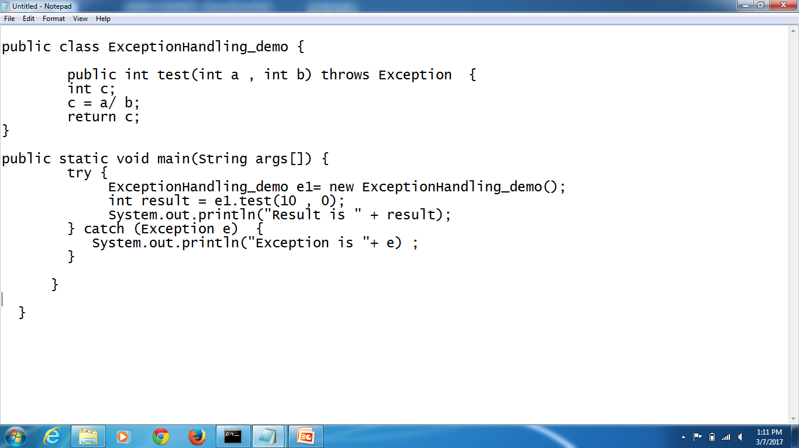
Program on Throws

Slide 39
What is a Java Thread?

Slide 40
Program Vs Process Vs Thread
Program: A program is a set of instructions stored in the secondary storage device that are intended to carry out a specific job. It is read into the primary memory and executed by the kernel.
Process : An executing instance of a program is called a process. It is also referred as a task.
Thread : A thread is called a ‘lightweight process’. It is similar to a real process but executes within the context of a process and shares the same resources allotted to the process by the kernel.

Slide 41
Program
Process 3
Within a Process
Process 1
Process 2
Process 3
Thread 1
Thread 2
Thread 3
Process 4
Process 5
Thread 4
Thread 5
Process 6
Process 7
Thread 6
Thread 7

Slide 42
Multi Threading
Every computer has multiple processes running at a time.
Playing Video
Music
Player
Notepad
My Super Computer
Browse
Internet
Other Tasks
Playing Game

Slide 43
Multi Threading (contd.)
Every application has multiple sub-process running at a time.
Playing songs
Managing playlists
Music Player
Downloading Updates
Accessing Internet

Slide 44
Multi Threading (contd.)
Thread is a task to be performed. Multi threading is multiple tasks getting executed at the same time in the same program/process.
Multi threading takes the same memory space for any number of threads.

Slide 45

What is a Java Thread?
Thread is a lightweight sub process
It is the smallest independent unit of a program
Contains a separate path of execution
Every Java program contains at least one thread
A thread is created & controlled by the java.lang.Thread class

Slide 46
Creating a Thread

Slide 47
Creating A Thread
A thread in Java can be created using two ways
Thread Class
Runnable Interface
public class Thread
extends Object
implements Runnable
public interface Runnable

Slide 48
Thread Class
Runnable Interface
Create a Thread class
Override run() method
Create object of the class
Invoke start() method to execute the custom threads run()
public class MyThread extends Thread {
public void run(){
System.out.println(“My Thread…");
}
public static void main(String[] args) {
MyThread obj = new MyThread();
obj.start();
}

Slide 49
Thread Class
Runnable Interface
Create a Thread class implementing Runnable interface
Override run() method
Create object of the class
Invoke start() method using the object
public class MyThread implements Runnable {
public void run(){
System.out.println(“My Thread…");
}
public static void main(String[] args) {
Thread t = new Thread(new MyThread());
t.start();
}

Slide 50
Java Main Thread

Slide 51

Java Main Thread
Subtitle for arrow graphic
Main thread is the most important thread of a Java Program
It is executed whenever a Java program starts
Every program must contain this thread for its execution to take place
Java main Thread is needed because of the following reasons
From this other “child” threads are spawned
It must be the last thread to finish execution i.e when the main thread stops program terminates

Slide 52
Java Main Thread
JVM
start()
start()
Main Thread
Other Demon Threads
start()
start()
Child Thread A
Child Thread B
start()
Child Thread C

Slide 53
Java Thread Life-Cycle

Slide 54
Thread Lifecycle
New
Runnable
A Java thread can lie only in one of the shown states at any point of time
Waiting
Running
Terminated

Slide 55
Thread Lifecycle
New
A new thread begins its life cycle in this state & remains here until the program starts the thread. It is also known as a born thread.
New
Once a newly born thread starts, the thread comes under runnable state. A thread stays in this state is until it is executing its task.
Runnable
Runnable
In this state a thread starts executing by entering run() method and the yield() method can send them to go back to the Runnable state.
Running
Waiting
Running
A thread enters this state when it is temporarily in an inactive state i.e it is still alive but is not eligible to run. It is can be in waiting, sleeping or blocked state.
Waiting
Terminated
A runnable thread enters the terminated state when it completes its task or otherwise terminates.
Terminated

Slide 56
Multi Threading In Java

Slide 57
Multi – Threading
Multi threading is the ability of a program to run two or more threads concurrently, where each thread can handle a different task at the same time making optimal use of the available resources
Main Thread
start()
start()
start()
Main Thread
switching
Main Thread
switching
Main Thread

Slide 58
Thread Methods
Creating Multiple Threads
Joining Threads
Thread.sleep()
Inter Thread Communication
Daemon Thread

Slide 59
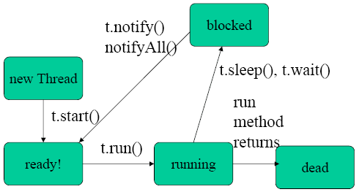
Thread -Methods
Start() method should be called to start a thread.
Start () will call the run () method.
Run() will have the actual task to be performed by the thread.

Slide 60
Thread Pool

Slide 61
Thread Pool
Java thread pool manages the pool of worker threads and contains a queue that keep the tasks waiting to get executed
Queue
Thread
Task
Task
Task
Task
Task
New Task
Thread
Assignment
Thread
Application
Task Finished
Thread

Slide 62

Synchronization
Synchronization is the coordination of events to operate a system
in unison. Synchronization is achieved by the use of locks in Java.
Synchronous
Asynchronous
Test
System
Test
System

Slide 63
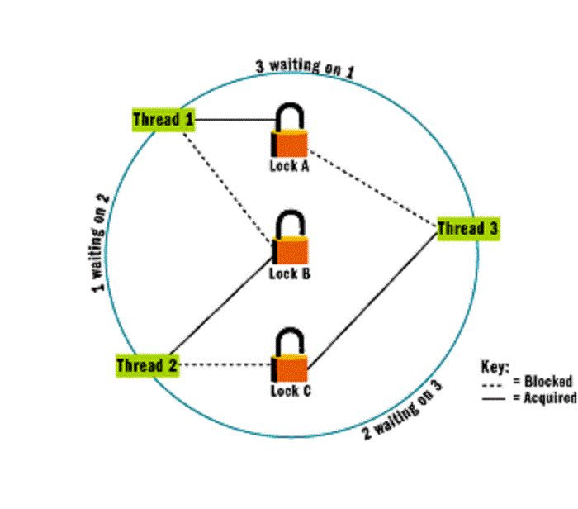
Locks in Java

Slide 64
A lock is a tool for controlling access to a shared resource by multiple
threads.
There are four different kinds of locks:
Fat locks: A fat lock is a lock with a history of contention (several threads trying to
take the lock simultaneously) , or a lock that has been waited on (for notification).
Thin locks : A thin lock is a lock that does not have any Contention.
Recursive locks : A recursive lock is a lock that has been taken by a thread several
times without having been released.
lazy locks: A lazy lock is a lock that is not released when a critical section is exited.
Once a lazy lock is acquired by a thread, other threads that try to acquire the lock have
to ensure that the lock is , or can be , released.

Slide 65
Deadlock
Deadlock describes a situation where two or more threads are blocked forever, waiting for each other.
or
A deadlock is a situation in which two or more competing actions
are each waiting for the other to finish, and thus neither ever does.

Slide 66
Deadlock
R1
P1
P2
R2

Slide 67
Thank You

