Slide 1
Collections (util)

Slide 2

Objectives
Explore a wide variety of utilities provided by utility and text packages of the J2SDK
Learn the architecture of the Java collections framework
Select appropriate collection classes and interfaces for specific behavioral requirements
Create, build, and traverse collections using the provided collection classes
Define your own collections that conform to the collections framework
Generate random numbers

Slide 3
The Utility Packages
In the first version of Java, the java.util package contained general purpose utility classes and interfaces
Utility packages are in the java.util package and the packages inside it
The java.util package contains the collections framework and a number of utility types not related to collections

Slide 4
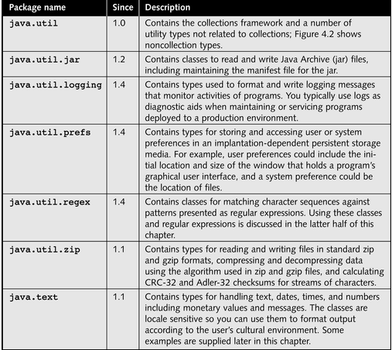
The Utility Packages

Slide 5
The Collections Framework
The collections framework consists of:
Interfaces that define the behavior of collections
Concrete classes that provide general-purpose implementations of the interfaces that you can use directly
Abstract classes that implement the interfaces of the collections framework that you can extend to create collections for specialized data structures

Slide 6
The Collections Framework
The goals of the Collections framework are to:
Reduce the programming effort of developers by providing the most common data structures
Provide a set of types that are easy to use, extend, and understand
Increase flexibility by defining a standard set of interfaces for collections to implement
Improve program quality through the reuse of tested software components

Slide 7
The Collections Framework
Bag: a group of elements
Iterator: a cursor, a helper object that clients of the collections use to access elements one at a time
List: a group of elements that are accessed in order
Set: a group of unique elements
Tree: a group of elements with a hierarchical structure

Slide 8
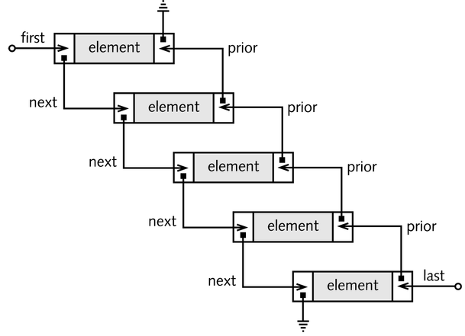
A Doubly Linked List

Slide 9
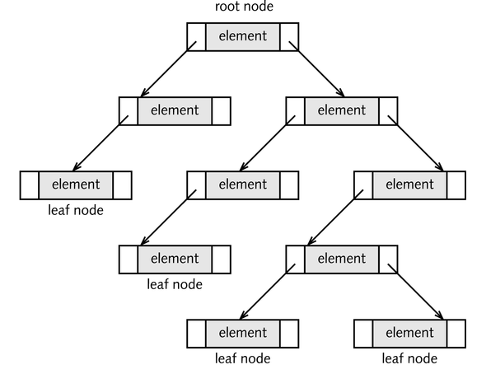
A Binary Tree

Slide 10
Example Tree class
class tree{
String val;
tree left=null;
tree right=null;
tree (String s){ val=s;}// constructor
static tree ins(tree t,String s){
if (t==null) return new tree(s);
if( t.val.compareTo(s)<0)
t.right=ins(t.right,s);
if(t.val.compareTo(s)>=0)
t.left=ins(t.left,s);
return t;
}

Slide 11
More of tree class
void ins(String s){ ins(this,s);}
void visit(Visitor v){
v.act(val);
if(left!=null) left.visit(v);
if(right!=null) right.visit(v);
}
class printer implements visitor{
void act(Object o){System.out.println(o.toString());}
}
void printTree() { visit(new Printer());}
}
interface visitor{ void act(Object o) ;}

Slide 12
The Collections Framework
The root interface of the framework is Collection
The Set interface:
Extends the Collection interface
Defines standard behavior for a collection that does not allow duplicate elements
The List interface:
Extends the Collection interface
Defines the standard behavior for ordered collections (sequences)

Slide 13
The Collection Interface
Methods:
boolean add( Object element )
boolean addAll( Collection c )
void clear()
boolean contains( Object element )
boolean containsAll( Collection c )
boolean equals( Object o )
int hashCode()
boolean isEmpty()

Slide 14
The Collection Interface (Cont.)
Methods:
Iterator iterator()
boolean remove( Object element )
boolean removeAll( Collection c )
boolean retainAll( Collection c )
int size()
Object[] toArray()
Object[] toArray( Object[] a )

Slide 15
The Set Interface
Methods:
The boolean add( Object element ) method:
Ensures collection contains the specified element
Returns false if element is already part of the set
The boolean addAll( Collection c ) method:
Adds all the elements in the specified collection to this collection
Returns false if all the elements in the specified collection are already part of the set

Slide 16
The List Interface
Methods:
boolean add( Object element )
void add( int index, Object element )
boolean addAll( Collection c )
boolean addAll( int index, Collection c )
Object get( int index )
int indexOf( Object element )
int lastIndexOf( Object element )
Note that the elements of the list have numbered positions – their indices

Slide 17
The List Interface (Cont.)
Methods:
ListIterator listIterator()
ListIterator listIterator( int index )
boolean remove( Object element )
Object remove( int index )
Object set( int index, Object element )
List subList( int beginIndex, int endIndex )

Slide 18
Traversing Collections with Iterators
Iterator interface methods:
boolean hasNext()
Object next()
void remove()
Iterator i = s.iterator();
while (i.hasNext()){
Object n = i.next();
… do something with n
}

Slide 19
Traversing Collections with Iterators
ListIterator interface methods:
void add( Object element )
The element is inserted immediately before the next element that would be returned by next,
boolean hasPrevious()
int nextIndex()
Object previous()
int previousIndex()
void set( Object element )

Slide 20
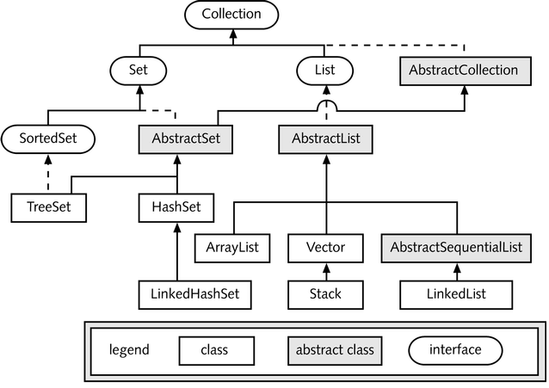
General Purpose Implementations

Slide 21
General Purpose Sets
Three framework classes implement the Set interface:
HashSet
TreeSet
LinkedHashSet
Note that it is possible to add elements of different classes to the same set as the following example illustrates.

Slide 22
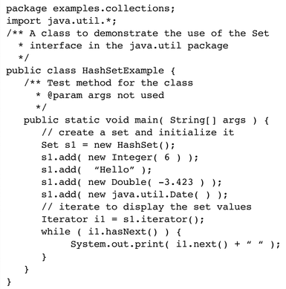

Slide 23
General Purpose Lists
Four concrete classes in the framework are implementations of the List interface:
ArrayList
LinkedList
Vector
Stack

Slide 24
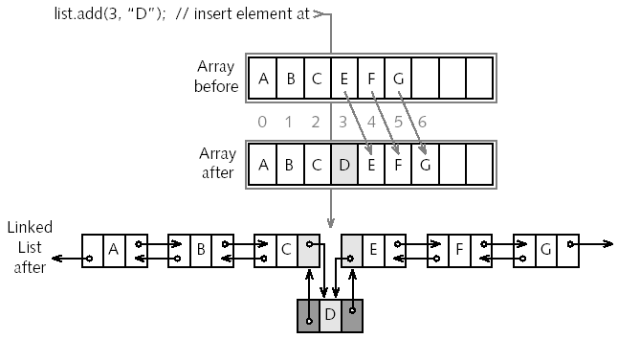

Slide 25
Array lists versus linked lists
Array lists are more compact and thus use less memory and may impose less of a garbage collection overhead
Linked lists are more efficient however, when insertions and deletions are common, as they do not require shifting of existing elements

Slide 26
Arrays as Collections
toArray: converts a Collection object into an array
java.util.Arrays: provides static methods that operate on array objects
Arrays class: useful when integrating your programs with APIs that
Require array arguments
Return arrays

Slide 27
Sorted Collections
SortedSet adds methods to the Set interface:
Comparator comparator()
Object first()
SortedSet headSet( Object element )
Object last()
SortedSet subSet( int beginElement, int endElement )
SortedSet tailSet( Object element )

Slide 28
Maps
A map is an abstraction for an aggregation of key-value, or name-value, pairs
Two interfaces in the collections framework define the behavior of maps: Map and SortedMap
A third interface, Map.Entry, defines the behavior of elements extracted from Map

Slide 29
Maps (Contd.)
Seven concrete framework classes implement the Map interface:
HashMap
IdentityHashMap
LinkedHashMap
TreeMap
WeakHashMap
Hashtable
Properties

Slide 30
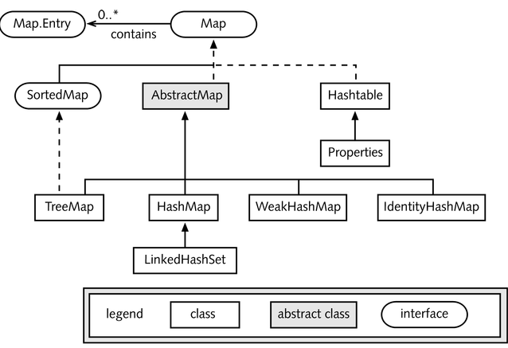
The Map Types

Slide 31
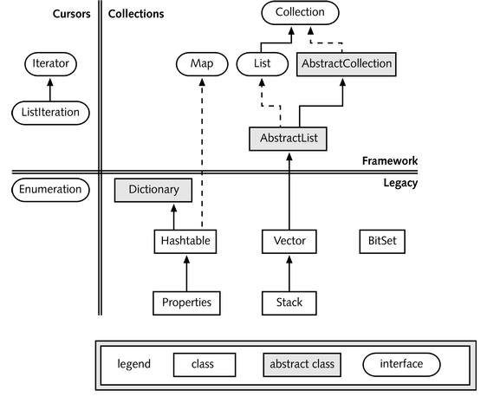
Legacy Classes and Collections

Slide 32
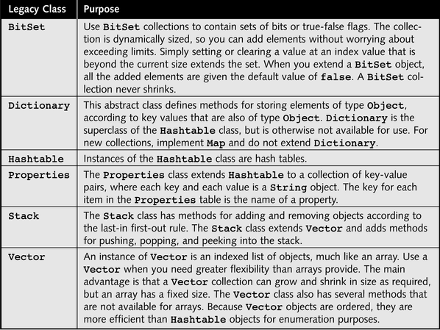
Legacy Collection Classes

Slide 33
java.util.Enumeration
The java.util.Enumeration interface defines the methods you can use to traverse the objects in a collection of type Vector, Stack, Hashtable, or Properties
Methods:
boolean hasMoreElements()
Object nextElement()

Slide 34
A BitSet object contains a number of bits, each of which represents a true or false value
You can use a Hashtable collection for key-value pairs
The Properties class extends Hashtable and suitable for writing to or reading from I/O streams
The Vector class supports a dynamically resizable list of object references
The Stack class provides a collection with first-in last-out or last-in first-out behavior

Slide 35
WeakHashMap
This is a hashtable-based Map implementation with weak keys.
An entry in a WeakHashMap will automatically be removed when its key is no longer in ordinary use. More precisely, the presence of a mapping for a given key will not prevent the key from being discarded by the garbage collector, so that if the garbage collector gets rid of it for other reasons, then the key can be deleted from the table.
This prevents objects remaining on the heap just because they are in the hash table.

Slide 36
Generating Random Numbers
A pseudo-random number generator produces a sequence of values, one at a time, so that resulting data can pass statistical tests of randomness
The java.util.Random class generates pseudo-random numbers or data of a variety of types
The random method in the java.lang.Math class generates uniformly distributed pseudo-random double values in the range 0.0 to 1.0
A random number is one for which the shortest generating program is longer than the number itself. If the program is shorter then the number is pseudo random

Slide 37
Class Random
Random r = new Random(109876L); // seed
int i = r.nextInt();
int j = r.nextInt();
long l = r.nextLong();
float f = r.nextFloat();
double d = r.nextDouble();
double k = r.nextGaussian();
The nextGaussian() method returns a pseudo-random, Gaussian distributed, double value with mean 0.0 and standard deviation 1.0.

Slide 38
A locale stores settings about a language or country—including what alphabet is used, how dates and numbers are written, and other culture-specific aspects of information processing
Dates, numbers, and monetary values are formatted by default according to the default locale for the implementation of Java

Slide 39
A resource is a single entity, such as a text message, that your program can access and use
Use the ResourceBundle class to collect resources into one manageable object
The resources can reside in a separate file called a properties file or in a class definition created for the purpose of holding resources

Slide 40
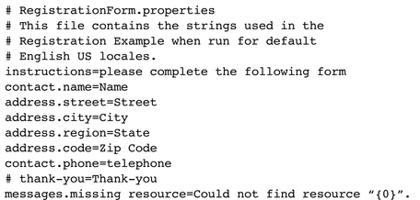
A Sample Properties File

Slide 41
Using Resource Bundles
The java.util.ResourceBundle abstract class encapsulates resources that are loaded from a property file or a class that extends ListResourceBundle
The getBundle method
Locates a .class file or a .properties file
Parses the file
Creates a ResourceBundle object containing the resource information
myResourceBundle.getString(“address.street")

Slide 42
Summary
The collections framework defines interfaces that define the behavior of a variety of data structures: Collection, List, Set, SortedSet, Map, and SortedMap
Each collection class has an iterator method that provides an Iterator object to traverse the collection one element at a time
Legacy collection classes Hashtable, Properties, Vector, and Stack (except Bitset) have been retrofitted into the collections framework; they retain old methods and cursor objects of type Enumeration

Slide 43
Summary (Cont.)
Classes that implement the interface Observer are notified when an object of a class that extends the Observable class changes
The Random class generates pseudo-random numbers
Locales are data structures that encapsulate cultural environments
The StringTokenizer class gives you limited ability to parse strings
The classes Pattern and Matcher in java.util.regex provide flexible pattern recognition in character sequences using regular expressions

