Slide 1

Introduction to JAVA

Slide 2

Content
01. Introduction To Java
02. JVM vs JRE vs JDK
03. Java Fundamentals
04. Conditional Constructs
05. Iterative Statements
06. Java 8 Features

Slide 3
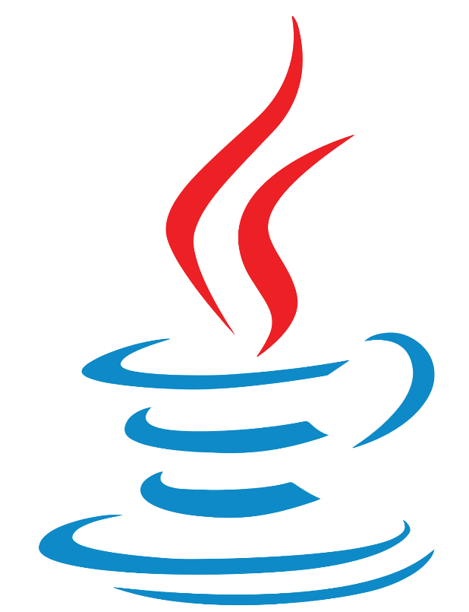
Introduction to Java
Write Once Run Anywhere (WORA)
High Level Programming Language
Originally
called OAK
Father of Java is James Gosling
Free and Open Source Software
Released by Sun Microsystems in 1996

Slide 4




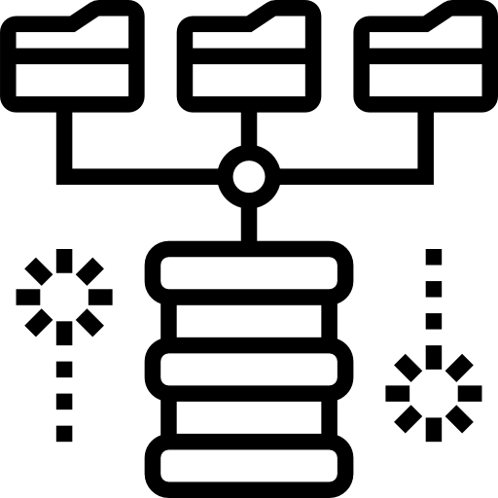
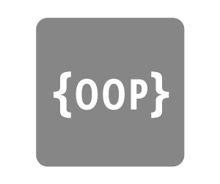
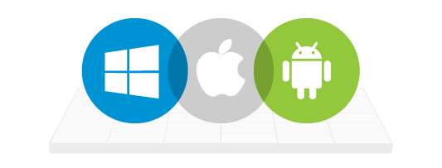



Features of Java
Robust
Portable
Easy
Object Oriented
Platform Independent
Distributed
Secure
Interpreted
Multithreaded

Slide 5
JVM vs JRE vs JDK

Slide 6
JVM vs JRE vs JDK
Java Virtual Machine
JVM is an abstract machine that doesn’t exist physically
Provides runtime environment to drive the Java Code or applications
It compiles the Java code into bytecode
It is platform dependent
JVM

Slide 7
JVM vs JRE vs JDK
Java Runtime Environment
JRE is the environment within which the JVM runs
It contains a set of libraries + other files that JVM uses at runtime
Also called Java RTE
JRE
JVM

Slide 8
JVM vs JRE vs JDK
Java Development Kit
JDK is a software development environment which is used to develop Java applications and applets
It contains Development Tools and JRE
JDK
JRE
JVM

Slide 9
Java Compilation and Execution

Slide 10
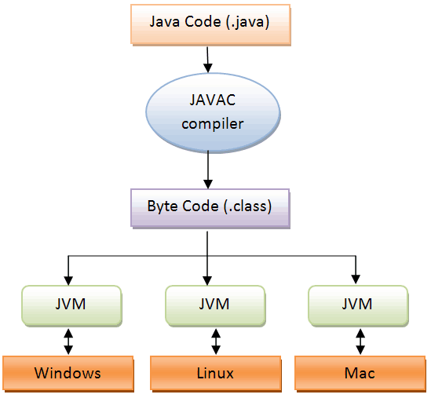

Slide 11
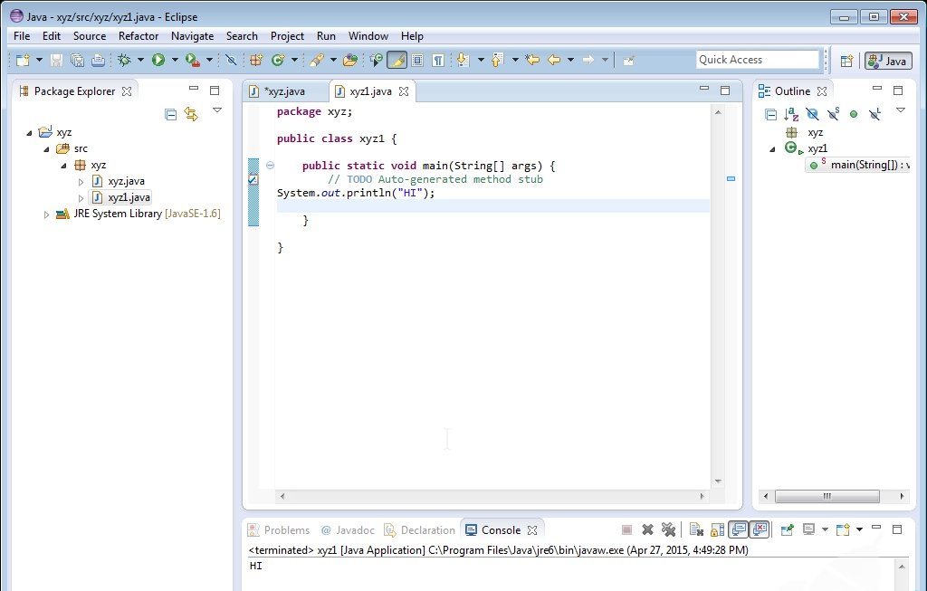
Eclipse IDE

Slide 12
My First Java Program

Slide 13
My First Java Program
class Demo{
public static void main(String args[]){
System.out.println("Hello World!!!");
}
}
public static void main(String args[])

Slide 14
My First Java Program
public static void main(String args[])
public
void
String args[]
static
main

Slide 15
My First Java Program
public static void main(String args[])
public
It is the access modifier of the main method
static
It is a keyword which identifies the class related thing
public
void
static
main
void
It is used to define the Return Type of the Method
main
It is the name of the method that is searched by JVM as a starting point for an application with a particular signature only
String args[]
It is the parameter to the main Method where the argument name could be anything
NOTE: main() in Java is the most important method as it is the entry point of any java program

Slide 16
Java Fundamentals

Slide 17
Java Fundamentals - Variables
Variable refers to the name of reserved memory area
1
2
3
Local Variables
Instance Variables
Static Variables

Slide 18
Java Fundamentals – Data Types
Data Types
Primitive
Non-Primitive
Boolean
Numeric
Array
String
Character
Integral
Integer
Floating Point
boolean
char
byte
short
int
long
float
double

Slide 19
Java Fundamentals - Operators
++X --X X++ X-- +X –X ! ~
+ - * ? %
&& ||
? :
= += -= *= /= %= &= ^= |= <<= >>= >>>=
^ & |
< > <= >=
== !=
<< >> >>>
1
2
3
4
5
6
7
8
Arithmetic Operators
Bitwise Operators
Logical Operators
Relational Operators
Ternary Operators
Assignment Operators
Unary Operators
Shift Operators

Slide 20
Conditional Statements

Slide 21
Conditional Statements - If
It is the simplest selection statement in the Java language that checks the condition and executes the loop if condition is true
If
Nested If

Slide 22
Conditional Statements - If
If is the most simple decision making statement that decides whether a certain statement or block of statements will be executed or not
Test Expression
START
If
True
False
Nested If
Body of If
END
Statement below If

Slide 23
Conditional Statements - If
Syntax
If
if(condition)
{
//Statements to execute if condition is true
}
Nested If

Slide 24
Conditional Statements - If
It is an if statement or an if-else statement within an if statement
Test Expression
Nested Test Expression
START
If
True
True
False
Nested If
Body of If
Body of If
Body of Nested If
END
Statement below If

Slide 25
Conditional Statements - If
if (condition1)
{
// Executes when condition1 is true
if (condition2)
{
// Executes when condition2 is true
}
}
Syntax
If
Nested If

Slide 26
Conditional Statements - If Else
It is an upgraded if statement that tests the condition and if the condition is false then ‘else’ statement is executed
If-Else
If-Else-If Ladder

Slide 27
Conditional Statements - If Else
It tests the condition and if the condition is false then ‘else’ statement is executed
Test Expression
START
If-Else
True
False
If-Else-If Ladder
Body of If
Body of Else
END
Statement below If

Slide 28
Conditional Statements - If Else
Syntax
if (condition)
{
//Executes this block if condition is true
}
else
{
//Executes this block if condition is false
}
If-Else
If-Else-If Ladder

Slide 29
Conditional Statements - If Else
If-else-if ladder allows the user to use many if else statement within a loop and in case one of the condition holds true the rest of the loops is bypassed
Test Expression
True
START
Statement 1
False
If-Else
Test Expression
True
Statement 2
If-Else-If Ladder
False
Test Expression
True
Statement 3
Body of Else
Statement below If-else-if

Slide 30
Conditional Statements - If Else
Syntax
if (condition)
{
statement;
}
else if (condition)
{
statement;
}
.
.
else
statement;
If-Else
If-Else-If Ladder

Slide 31
Conditional Statements - Switch
The switch statement provides an easy way to execute conditions to different parts of the code
START
Switch
Condition 1
True
Statement 1 break;
False
Condition 2
True
Statement 2 break;
False
Condition n
True
Statement n break;
False
Default
True
Default Statement
Statement just below Switch Case

Slide 32
Conditional Statements - Switch
Syntax
switch (expression)
{
case value1:
statement1;
break;
case value2:
statement2;
break;
.
.
case valueN:
statementN;
break;
default:
statementDefault;
}

Slide 33
Iterative Statements

Slide 34
Iterative Statements – For Loop
It is a control structure that allows us to repeat certain operations by incrementing and evaluating a loop counter
Initialization
START
False
Increment /Decrement
END
Condition
True
Statement

Slide 35
Iterative Statements – For Loop
Syntax
for(initialization; condition; incr/dcr)
{
code block;
}
START
Initialization
END
False
Condition
Increment /Decrement
True
Statement

Slide 36
Iterative Statements – While Loop
It is a control structure that allows us to specify that a certain statement is to be executed repetitively until the loop condition is false
START
False
END
Condition
True
Statement

Slide 37
Iterative Statements – While Loop
Syntax
while (boolean condition)
{
loop statements...
}
START
END
False
Condition
True
Statement

Slide 38
Iterative Statements – Do While Loop
It is a control structure that allows code to be executed repeatedly based on a given Boolean condition and tests the condition before executing the loop body
Statement
START
True
False
END
Condition

Slide 39
Iterative Statements – Do While Loop
Syntax
START
Statement
do{
//code to be executed
}
while(condition);
True
False
Condition
END

Slide 40
Jump Statements

Slide 41
Jump Statements - break
The break construct is used to break out of the middle of loops
After a break, all the remaining statements in the loop are skipped and the execution continues with the immediate next statement outside the loop
It is used in loops (while, for, do-while) and in a switch case

Slide 42
Jump Statements - break
Test Expression
Syntax
True
Yes
if(condition)
{
break;
}
Break?
Statement below loop
No
Remaining body of loop

Slide 43
Jump Statements – continue
Continue statement is used to skip execution of statements within a loop
It doesn’t terminate the loop but just skips some part of it to start the next iteration

Slide 44
Jump Statements – continue
Test Expression
Syntax
True
if(condition)
{
continue;
}
Yes
Continue?
Statement below loop
No
Remaining body of loop

Slide 45
Jump Statements – return
The return statement is used to end the execution of a specific method and then return a value
It sends the program control back to the method caller
The data type of the returned value should always be equal to the data type of the method's declared return value
Syntax
if(condition)
{
return;
}

Slide 46
Java 8 Features

Slide 47
Java 8 Features
Lambda Expressions
Pipelines and Streams
Date and Time API
Default Methods
Type Annotations
Nashorn JavaScript Engine
Concurrent Accumulators
Parallel operations
PermGen Space Removed
TLS SNI

Slide 48
Thank You

