Slide 1

Learn To Use
Strings in Java

Slide 2

Content
01. Strings and Methods
02. StringBuffer Vs StringBuilder
03. StringTokenizer

Slide 3
Java Strings

Slide 4
Java Strings
Java String
String Pool
Creating a String
String Methods
Hands On

Slide 5
Java String
Object
String is a Java object
Characters
Represents a sequence of characters
Class
java.lang.String class is used to create and manipulate strings
Immutable
A string is immutable in nature

Slide 6
Java Strings
With Strings in Java you can perform various operations, some of which are:
Search
The quick brown fox jumps over the lazy dog
Create Substring
The quick brown fox jumps over the lazy dog
The quick brown fox
jumps over the lazy dog
Create new strings
The quick brown fox jumps over the lazy dog
The quick fox jumps
The quick lazy dog

Slide 7
Java Strings
Serializable
Comparable
CharSequence
java.lang.String
public final class String
extends Object
implements Serializable, Comparable<String>, CharSequence

Slide 8
Java Strings
Serializable is a marker interface that contains no data member or method. It is used to “mark” the java classes so that objects of these classes may get a specific capability
Serializable
Comparable interface is used for ordering the objects of any user-defined class. This interface is found in java.lang.package and contains only one method named compareTo(Object)
Comparable
A CharSequence interface is a readable sequence of characters. This interface provides uniform, read-only access to various kind of character sequences
CharSequence

Slide 9
Java Strings – Immutable and Mutable
CharSequence
String
StringBuffer
StringBuilder
java.lang.String class is used
to create string objects
and provides a list of methods
to create and manipulate
Strings
java,lang.StringBuffer is a
peer class of String that represents growable and writable charactersequences
java.lang.StringBuilder is identical to StringBuffer except for one important difference
that it is not synchronized,
which means it is not thread
safe

Slide 10
String Pool

Slide 11
String Pool
Heap Memory
Java String pool refers to collection of Strings which are stored in heap memory
String Pool
As String objects are immutable in nature the concept of String Pool came into the picture
String Pool helps in saving space for Java Runtime

Slide 12
Creating a String

Slide 13
Creating a String – Using Literal
Java String literal is created by using double quotes
String str = “Ishant”;
Before creating a String literal first looks for String with same value in the String pool, if found it returns the reference else it creates a new String in the pool & returns the reference
Heap Memory
String Pool
str
Ishant
Welcome
str1
String str1 = “Ishant”;
str2
String str2 = “Welcome”;

Slide 14
Creating a String – Using new Keyword
String object created using “new” keyword it always create a new object in heap memory
String str = new String (“Ishant”);
Heap Memory
str
String Pool
Ishant
str1
Welcome
str2
Ishant
str3

Slide 15
String Methods

Slide 16
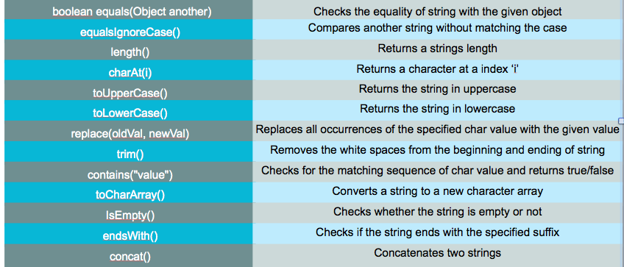
String Methods

Slide 17
StringBuilder and StringBuffer

Slide 18
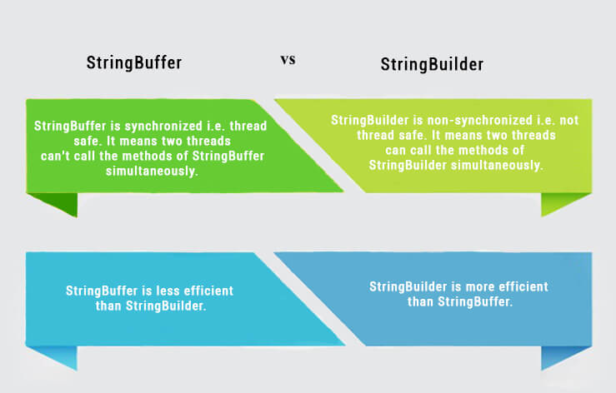

Slide 19
StringTokenizer

Slide 20
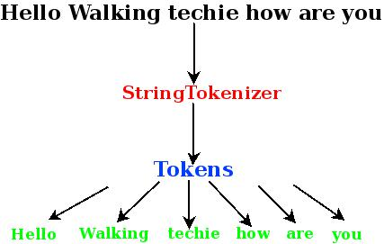

Slide 21
Thank You

