Slide 1
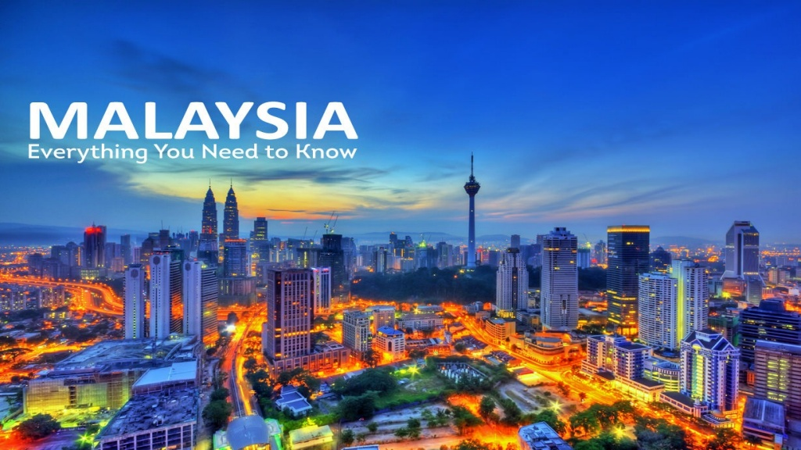
SELAMAT DETANG
To

Slide 2
Selamat Petang
The Malaysian Language
As per government policy, It is Bahasa Malaysia
It is also known as Malay language and belongs to the Austronesian Languages
But, English is widely spoken, especially in business

Slide 3
People
The multi-cultural and multi-racial population consists of Malays, Chinese, Indians and numerous natives.
Ethnic Groups: 59% Malay and other indigenous, 32% Chinese and 9% Indian.
Religion: Muslim (primarily Malays), Buddhism (Chinese), Hindu (Indian), Christianity.
Official religion is Islam but it is common to see temples and churches located in close proximity.

Slide 4
Art & Culture
Many traditional arts, culture and handicrafts are there, which are performed during religious festivals.
Communities get together to celebrate public events like the Chingay in Penang and Merdeka Day.
The harvest season is celebrated with the giant kites, top spinning and traditional puppet shows.

Slide 5
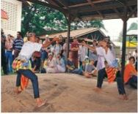
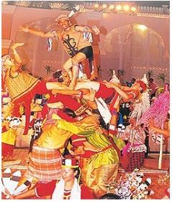
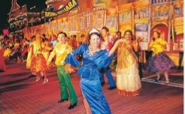
Art & Culture
•Joget – Traditional barn- dance
• Wayang Kulit – Puppet Show
• Giant Kite – The Wau
• Top Spinning – Gasing
• Rattan Football – Sepak Tekraw
• Martial Art – Silat

Slide 6
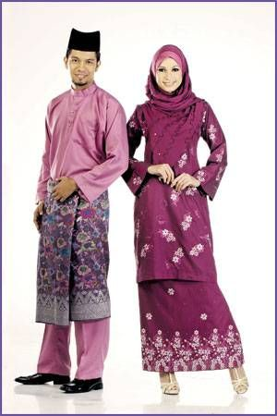
Traditional Dress
•For men is the Baju Melayu, a loose tunic ,worn over trousers and usually accompanied with a sampin which is wrapped around the hips.
•Malay women wear the Baju Kurung. The blouse is long-sleeved and collarless, while the skirt, called a kain, has pleats on one side.

Slide 7
Festivals
Many Malaysian festivals are celebrated based on the religious calendar of the multi- cultural and multi-racial society.
It also means house decoration, new clothes, visiting friends, relatives and enjoying the public holiday.
Some common festivals:
Hari Raya – End of Ramadan
Chinese New Year – Lunar Calendar (Feb)
Deepavali – Indian festival
Wesak Day – Buddha’s birthday
Christmas Day (Dec)
Merdeka Day – Independence

Slide 8
Local Cuisine
The unique cooking styles and flavors of the Malays, Chinese and Indians cuisine are enjoyed.
Some common dishes:
Satays - Skewers of marinated beef or chicken grilled over a slow charcoal fire. The dipping sauce is made from a spicy mix and crushed peanut.
Nasi Lemak - Rice steamed with coconut milk and served with curry chicken or beef, fried anchovies and sambal.
Wantan Mee - Egg noodle and soya sauce served with barbeque pork, prawns and dumplings
Nasi Briyani - Rice steamed with goat butter, spices and nuts. The cooked rice is served with meat or vegetable curries.
Mee Siam - Rice noodle with fresh tamarind juice and soya sauce. Sliced chicken, prawns and fried eggs are normally served with the noodles.

Slide 9
Local Customs & Greetings
Greeting of "salam" resembles a handshake whereby the man offers both hands, lightly touches the visitor’s outstretched hands, and then brings his hands to his chest to mean, “I greet you from my heart".
Muslim ladies greet with a nod of her head and smile.
Greeting, by hugging and kissing, is not generally practiced in Malaysia.
Shoes must be removed when entering a Mosque or an Indian temple and Malaysian homes.
Pointing is normally done using the thumb as using the forefinger is considered rude.

Slide 10
Respect And Modesty
As members of such a multicultural society, Malaysians are generally very attentive towards how they respectfully interact with people of all backgrounds.
The Malay concept of ‘budi’ by which politeness and respect are considered essential to human interaction.
They are often modest in their attire, body language and demeanor and tend to approach daily life with a great deal of patience.

Slide 11
Gift Etiquettes
Never give alcohol.
Do not give toy dogs or pigs to children.
Do not give anything made of pigskin.
Avoid white wrapping paper as it symbolizes death and mourning.
If you give food, it must be “halal” (meaning permissible for Muslims).
Offer gifts with the right hand only or both hands if the item is large.
Gifts are generally not opened when received.

Slide 12
Family Culture
Extended families are seen as the basic unit of society
The act of an individual can impact the perception of the entire family by others and the interests of the family supersede those of the individual.
Elders handle the important family matters. The oldest members of the family are consulted before any major decision and demand the most respect.

Slide 13
Do’s And Don’ts
Do’s:
Smile when meeting people. Malaysians are renowned for their sunny personalities. Reciprocating their warmth will be appreciated.
Wear modest clothing. It is best to cover your shoulders, and wear shorts and skirts that pass the knee.
Give a Malaysian of the opposite gender a considerable amount of respect and distance.
Don’ts
Do not publicly humiliate anyone. This action directly conflicts with cultural principles of respect and is likely to make a Malaysian think less of you.
Avoid publicly displaying signs of anger, raising your voice or shouting in front of those older or superior to you.

Slide 14
Terima kasih (Thank You)

