Slide 1

Cache Coherence for GPU Architectures
^{- Shobhit 19CS06008}
Under the Guidance of
DR. Manoranjan Satpathy
Image source: www.forces.gc.ca

Slide 2
Content:
Cache Coherence
GPU
GPU Architecture
GPU Coherence Challenges
Temporal Coherence
Design Issues and solution
TC-Weak
Interconnect Traffic
Performance
Complexity
Summary
2

Slide 3
What is Cache Coherence?
Client
Cache
Memory
Resource
Coherency
Client
Cache
3

Slide 4
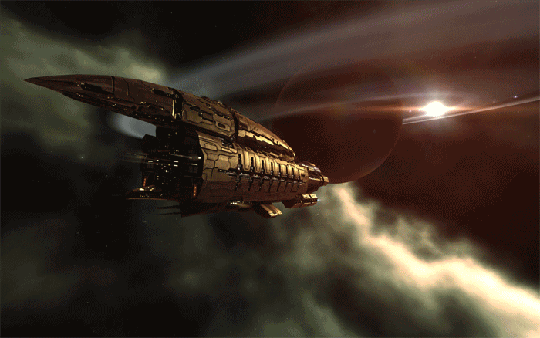
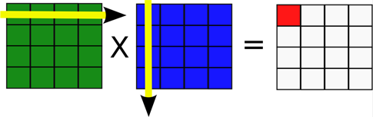
Evolution of GPUs
Graphics pipeline
Compute (OpenCL, CUDA)
e.g. Matrix Multiplication
OpenGL/
DirectX
Vertex
Shader
Pixel
Shader

Slide 5
What is a GPU?
Workgroups
CPU
Wavefronts
spawn
GPU Core
GPU Core
GPU
▪▪▪
done
CPU
Memory
CPU
spawn
GPU
time

Slide 6
GPU Architecture
Multiprocessor 1
Multiprocessor 2
Multiprocessor n
......
L1 Cache
L1 Cache
L1 Cache
L2 Cache
Global Memory
Constant Memory

Slide 7
GPU Coherence Challenges
Challenge 1: Coherence traffic
Load C
Load D
Load E
Load F
…
Load G
Load H
Load I
Load J
…
Load K
Load L
Load M
Load N
…
Load O
Load P
Load Q
Load R
…
No coherence
MESI
GPU-VI
Load C
C1
C2
C3
C4
1.5
Recalls
L1
L1
L1
L1
A
B
A
B
A
B
A
B
Interconnect traffic
rcl A
rcl A
rcl A
1.0
ack
ack
rcl A
ack
ack
gets C
L2/Directory
0.5
A
B

Slide 8
GPU Coherence Challenges
Challenge 2: Tracking in-flight requests
Significant % of L2
S Shared
Transient States
M Modified
L2 / Directory
MSHR

Slide 9
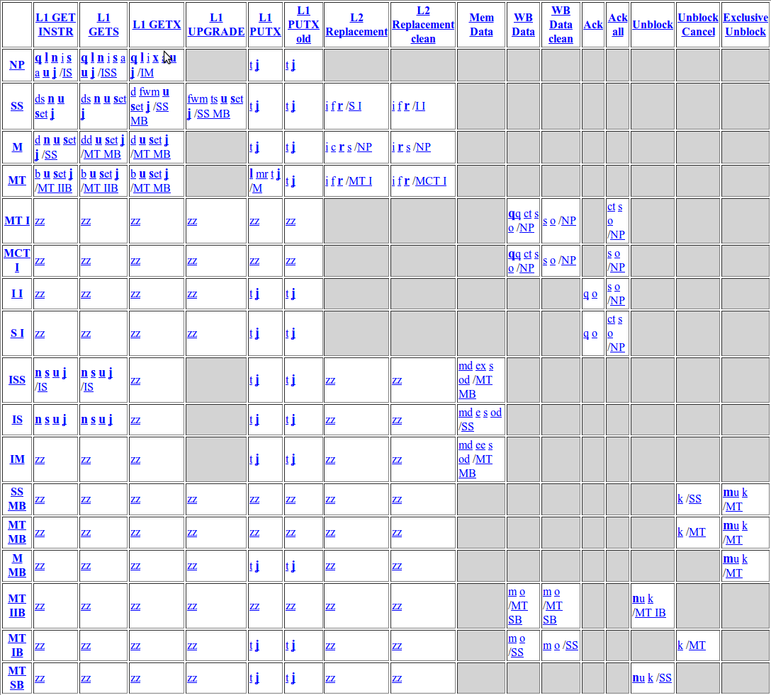
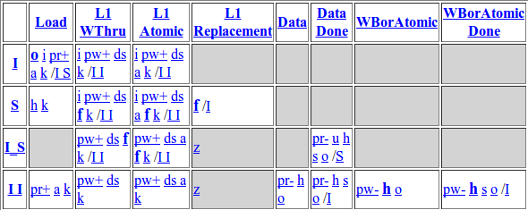
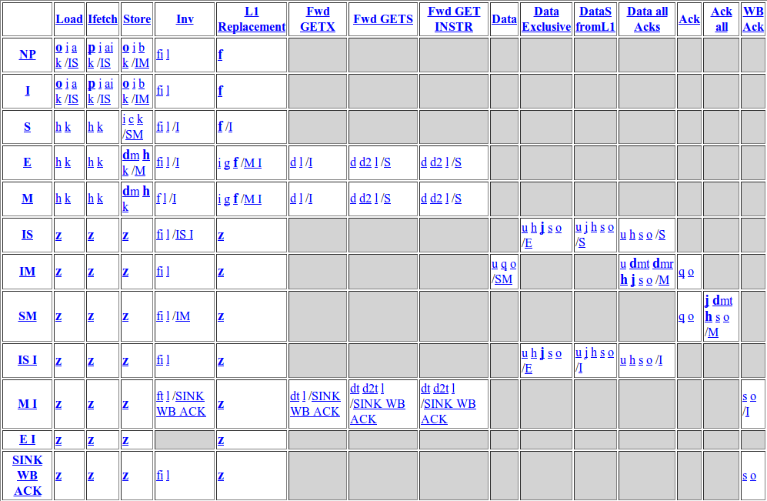
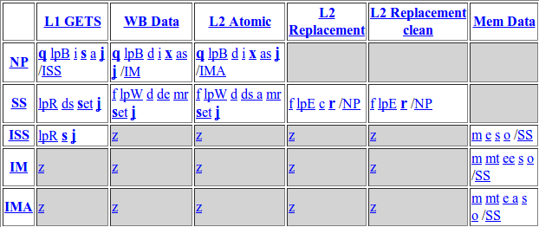
GPU Coherence Challenges
Challenge 3: Complexity
MESI L2 States
Non-coherent L1
MESI L1 States
Events
States
Non-coherent L2

Slide 10
Solution
GPU cache coherence without coherence messages?
YES – using global time
Which coherence technique use timer?
Temporal coherence

Slide 11
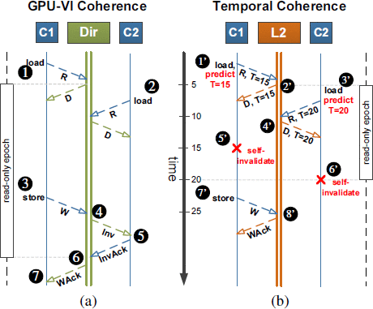
GPU-VI vs Temporal Coherence

Slide 12
Design Issues of Temporal Coherence (TC)
Use a predictor to predict lifetime values
Synchronize counter
Stalling
Solution: TC Weak

Slide 13
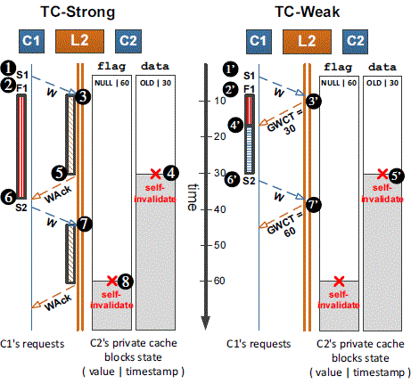

Slide 14
Interconnect Traffic
NO-COH
MESI
GPU-VI
TC-Weak
1.50
1.25
TC Weak Reduces traffic by 53% over MESI and 23% over GPU-VI for intra-workgroup applications
1.00
0.75
Interconnect Traffic
0.50
0.25
0.00
Do not require coherence

Slide 15
Performance
NO-L1
MESI
GPU-VI
TC-Weak
2.0
TC-Weak with simple predictor performs 85% better than disabling L1 caches
Performs 28% better than TC with stalling
1.5
Speedup
1.0
0.5
0.0
Require coherence

Slide 16
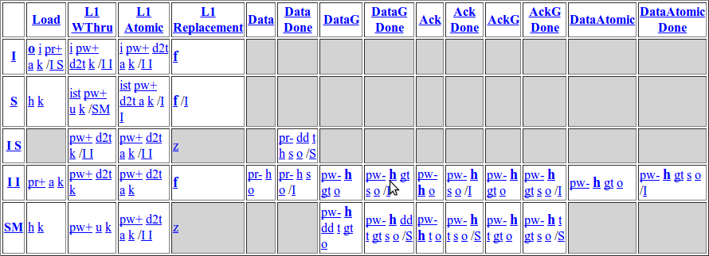
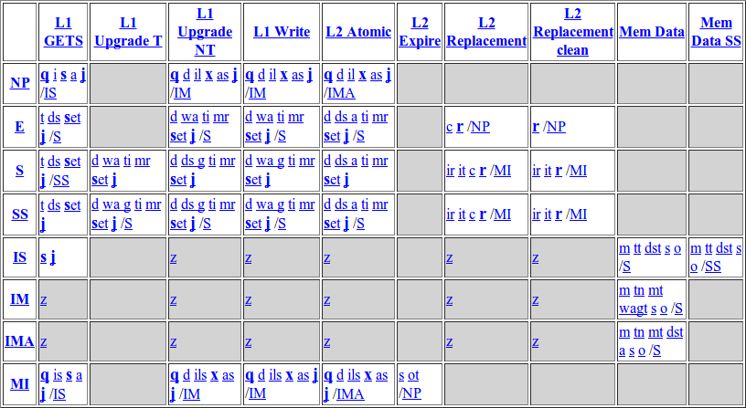
Complexity
MESI L1 States
MESI L2 States
TC-Weak L1
TC-Weak L2

Slide 17
Summary
Issues in traditional coherence technique when used in GPU lead to a new technique
Save traffic and energy by using global time
Reduce protocol complexity
85% performance improvement over no coherence

Slide 18
References:
I. Singh, A. Shriraman, W. W. L. Fung, M. O'Connor and T. M. Aamodt, "Cache coherence for GPU architectures," 2013 IEEE 19th International Symposium on High Performance Computer Architecture (HPCA), Shenzhen, 2013, pp. 578-590.
X. Ren and M. Lis, "Efficient Sequential Consistency in GPUs via Relativistic Cache Coherence," 2017 IEEE International Symposium on High Performance Computer Architecture (HPCA), Austin, TX, 2017, pp. 625-636.
A. Tabbakh, X. Qian and M. Annavaram, "G-TSC: Timestamp Based Coherence for GPUs," 2018 IEEE International Symposium on High Performance Computer Architecture (HPCA), Vienna, 2018, pp. 403-415

Slide 19
Any Questions?

Slide 20
Thank You

Slide 21
Backup slides

Slide 22
Lifetime Predictor
Store A
Events Prediction
Expired load: ↑
Unexpired store: ↓
Unexpired eviction: ↓
Load A
L2 Bank
T = 20
T = 0
prediction--
Prediction Value
prediction++
30
A
10
A

